Slide 1
Gen93 LWCTG L4 Introduction
WCS/SE3/PS8 Hong
2017/05/15

Slide 2
Outline
Overview
ATP
L4B
Debugging

Slide 3
Overview
6M Protocol Stack Software Architecture

Slide 4
Current Gen91/Gen92 Architecture
AP
RIL Proxy
MD1
MD3
L4 Task
CVAL
L4C
CVAL
LWTG NAS
C2K NAS

Slide 5
MT6293 Architecture
MS dial-up program
AP
MD1
Middleman
D2AT
DDM
ATP (AT Proxy)
ATP_IO
IMSM
IMC
ATP
SIMMNGR
IMCSMS
ATP_2
IWLAN
SDM
PPP dial up channel
ILM
AT in ILM
WO
VDM
SSDS
LTECSR
L4 Task
CVAL Task
L4B Group
Thin-IOP
L4B
AT in ILM
L4B Group
L4BPWR
L4BNW
L4BCC
AT in ILM
ILM
L4BXXX
L4BNW_2
L4BCC_2
ILM
L4BYYY
CVAL
ATCI/L4C
LWTG NAS
C2K NAS

Slide 6
MT6293 L4 Integration Task Force
Goal: Merge MD1 and MD3 protocol stacks into one image
Keep legacy LWTG and C2K NAS/AS/L1 transparent as possible
Optimize modem procedures which are limited due to previous two modem architecture
Move modem AT command entry point from legacy ATCI to new task ATP
To revise AT command flow in modem and improve AT in ILM performance
Re-pack ATP customer release package
Add new L4B group modules
To bridge/bind LWTG and C2K L4, and integrate information from/to AP

Slide 7
ATP (AT Proxy)
Introduction
AT Command Flow

Slide 8
ATP – Introduction
A new task to replace whole IMSP and partial of ATCI
Functionality
Handle AT command UART open/read/write
Intercept AT command data for middlemen
Forward AT command data to protocol stack
Related Terminology
Middleman
Module who will
intercept AT commands from AP by ATP
send AT commands to protocol stack, including 3GPP and 3GPP2
Intercept AT URC from protocol stack
send AT URC to AP
IMS Group
IMS related middlemen
E.g. IMC/IMCSMS/SDM/VDM/LTECSR

Slide 9
ATP – Module and Interface
Module
Module ATP_IO
Read/Write AT command from/to UART
Handle AT command UART/CMUX related operations
Module ATP ~ MOD_ATP_4
Duplicate modules in multi SIM project
Handle interface with middlemen and L4B
Interface
AT in ILM interface with L4B (replace IMSP <-> ATCI)
Replace legacy IMSP interfaces with middlemen

Slide 10
ATP Library Components
ATP contains two build components
atp → source release to L4 package customer
atp_protected → library release for all customers
ATP libraries are built in all projects except L1S and BASIC projects
Refer to complist_def.mak

Slide 11
ATP File Architecture
mcu/pcore/modem/atp/
protected/
include/
Header files used by mcu/pcore/modem/atp/protected/src/
src/
Source files not released to customer
E.g., IMC/IMCSMS/VDM/SDM/LTECSR related source codes
include/
Header files used by mcu/pcore/modem/atp/src/ and mcu/pcore/modem/atp/protected/src/
src/
ATP source files, including ATP_IO and ATP framework
These files are “L4 package” release policy

Slide 12
ATP Interface
Inter Task
ATP_IO
UART driver (UART、CMUX)
MSG_ID_UART_READY_TO_READ_IND
MSG_ID_UART_READY_TO_WRITE_IND
MSG_ID_CMUX_DLC_CONNECT_IND
MSG_ID_CMUX_CLOSE_DOWN_IND
ATP
AT in ILM with L4B
MSG_ID_ATP_L4B_AT_CMD_REQ
MSG_ID_ATP_L4B_AT_CMD_CNF
MSG_ID_ATP_L4B_AT_URC_IND
ILM with middleman
Inner Task
ATP_IO → ATP
MSG_ID_ATP_AT_CMD_REQ
ATP → ATP_IO
MSG_ID_ATP_AT_CMD_CNF
MSG_ID_ATP_IO_URC_IND

Slide 13
AT Command from AP
1. AP writes to UART port → 2. ATP_IO read from UART port to buffer → 3. ATP_IO parses data in the buffer → 4. ATP_IO process AT commands and forwards to ATP via AT in ILM →
5a. ATP translates the AT commands to ILM for middleman or
5b. ATP forwards the AT in ILM to protocol stack(L4B)
AP
1
ATP_IO
2
3
4
AT in ILM
ATP
middleman
ATP_2
5a
5b
ILM
AT in ILM
Protocol Stack

Slide 14
AT Command from Middleman
1. Middleman sends request ILM to ATP → 2. ATP translates the request ILM to AT command → 3. ATP sends the AT in ILM to protocol stack(L4B)
AP
ATP_IO
ATP
2
middleman
ATP_2
3
ILM
AT in ILM
1
Protocol Stack

Slide 15
AT Response from Protocol Stack
1. Protocol stack sends AT response in ILM to ATP →
2a. ATP forwards the AT response in ILM to ATP_IO → 3. ATP_IO writes to AP or
2b. ATP translates the AT response to ILM for middleman
AP
3
ATP_IO
2a
AT in ILM
ATP
middleman
ATP_2
2b
ILM
AT in ILM
1
Protocol Stack

Slide 16
AT Response from Middleman
1. Middleman sends the response ILM to ATP → 2. ATP translates the ILM to AT response and sends to ATP_IO → 3. ATP_IO writes to AP
AP
3
ATP_IO
2
AT in ILM
ATP
middleman
ATP_2
1
ILM
Protocol Stack

Slide 17
AT URC from Protocol Stack
1. Protocol stack sends AT URC in ILM to ATP →
2a. ATP forwards the AT URC in ILM to ATP_IO → 3. ATP_IO writes to AP
2b. ATP translates the AT URC to ILM for middleman
2a and 2b are not exclusive
AP
3
ATP_IO
2a
AT in ILM
ATP
middleman
ATP_2
2b
ILM
AT in ILM
1
Protocol Stack

Slide 18
AT URC from Middleman
1. Middleman sends the URC ILM to ATP → 2. ATP translates the ILM to AT URC and sends to ATP_IO → 3. ATP_IO writes to AP
AP
3
ATP_IO
2
AT in ILM
ATP
middleman
ATP_2
1
ILM
Protocol Stack

Slide 19
L4B
Introduction
L4B Framework
L4B Sub-modules

Slide 20
L4B – Introduction
A new sub-layer in L4 task
L4B framework: module L4B
Handle AT in ILM
L4B sub-modules: module L4BXXX
Handle specific functionalities
E.g. L4BNW handles network attach/detach related procedures
Functionality
Bridge LWTG and C2K protocol stacks
Dispatch requests to 3GPP(ATCI) or 3GPP2(CVAL) protocol stacks
Handle indication/confirmation from 3GPP or 3GPP2 protocol stacks

Slide 21
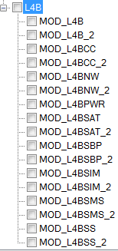
L4B Modules and Framework Interface
When GEMINI=2
AT in ILM with ATP
MSG_ID_ATP_L4B_URC_IND
L4B reports URC to AP via ATP
MSG_ID_ATP_L4B_CMD_REQ
L4B receives AT command from ATP
MSG_ID_ATP_L4B_CMD_CNF
L4B sends AT response to ATP
AT in ILM with ATCI(legacy LWTG protocol stack)
MSG_ID_L4B_ATCI_AT_URC_IND
L4B receives URC reported from ATCI
MSG_ID_L4B_ATCI_AT_CMD_REQ
L4B sends AT command to ATCI
MSG_ID_L4B_ATCI_AT_CMD_CNF
L4B receives AT response from ATCI
AT in ILM with CVAL(legacy C2K protocol stack)
MSG_ID_L4B_CVAL_AT_URC_IND
L4B receives URC reported from CVAL
MSG_ID_L4B_CVAL_AT_CMD_REQ
L4B sends AT command to CVAL
MSG_ID_L4B_CVAL_AT_CMD_CNF
L4B receives AT response from CVAL

Slide 22
L4B File Architecture
mcu/pcore/modem/l4/l4b
include: L4B common header files
l4b_trc.h
l4b_context.h
…etc
interface: L4B sub-modules interface files
src: MOD_L4B source files
l4b_main.c
…etc
l4bcc
include
…etc
src
l4b_cc_main.c
l4b_cc_handler.c
…etc
l4bnw
include
…etc
src
…etc
…etc
All L4B files are built in l4 library, i.e. align to L4 package release policy

Slide 23
AT Command Flow in L4B
ATP_IO
ATP_2
ATP
Two kinds of AT command transaction in L4B
AT commands from ATP
AT requests from L4B sub-modules
L4B
L4B sub-modules
ATCI
CVAL
AT in ILM
Normal ILM

Slide 24
AT Command from ATP – Case1
L4B/L4B_2 redirects the AT in ILM to legacy LWTG(ATCI/ATCI_2) or C2K(CVAL) directly
ATP
L4B
ATCI
L4B sub-modules
CVAL
AT in ILM
Normal ILM

Slide 25
AT Command from ATP – Case2
L4B/L4B_2 redirects the AT in ILM to L4B sub-modules
ATP
L4B
ATCI
L4B sub-modules
CVAL
AT in ILM
Normal ILM

Slide 26
AT Command from L4B sub-modules
L4B sub-modules request AT command to LWTG
ATP
L4B
ATCI
L4B sub-modules
CVAL
AT in ILM
Normal ILM

Slide 27
AT Command from L4B sub-modules
L4B sub-modules request AT command to C2K
ATP
L4B
ATCI
L4B sub-modules
CVAL
AT in ILM
Normal ILM

Slide 28
AT URC Flow in L4B
ATP_IO
ATP_2
ATP
Two kinds of AT URC in L4B
AT URC from LWTG or C2K protocol stack
redirect to L4B sub-modules
don’t redirect to L4B sub-modules
AT URC from L4B Group
L4B
L4B sub-modules
ATCI
CVAL
AT in ILM
Normal ILM

Slide 29
L4BCC
An adaptation module between VDM and ATCI/CVAL
To interpret Call Control related requests from VDM, and send AT commands to ATCI or CVAL.
Interface
VDM – normal ILM
Note: VDM’s ILM peer is L4B instead of L4BCC module ID. L4B will dispatch to L4BCC by invoking its main() function
ATCI/CVAL – AT in ILM
Utilizing L4B framework AT in ILM service
Call domain selection is handled by VDM instead of L4BCC
E.g. when AP sends a MO call request to MD, VDM will judge whether to make this call over 3GPP or 3GPP2 CS domain, and then requests to L4BCC

Slide 30
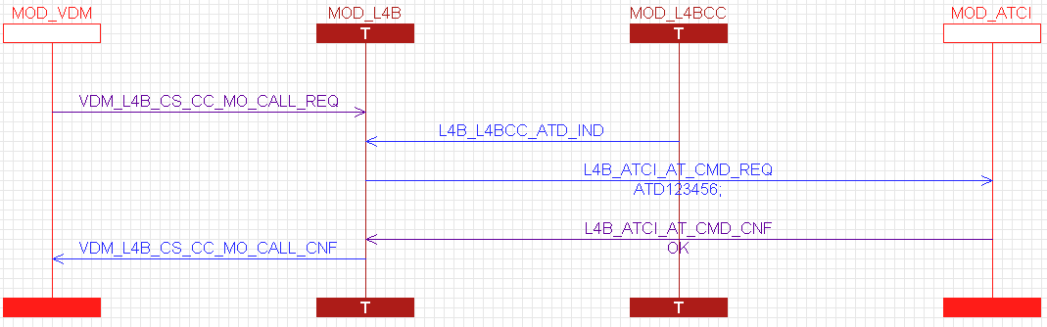
L4BCC Example
Here is an example of make a MO call
1ST step: VDM send CS MO CALL REQ (call domain is already decided by VDM)
2nd step: L4BCC interpret it as ATD123456 and then send to ATCI
3rd step: once L4BCC receive OK, interpret is as CS MO CALL CNF to VDM

Slide 31
L4BSMS
Handle SMS related AT commands and dispatch to ATCI or CVAL
Broadcast SMS related AT commands from AP to both ATCI and CVAL
Collect SMS URC from both ATCI and CVAL, and then notify AP
SMS domain selection is handled by SDM instead of L4BSMS
E.g. when AP sends a MO SMS request to MD, SDM will judge whether to send this SMS over 3GPP or 3GPP2 protocol stack by different AT commands

Slide 32
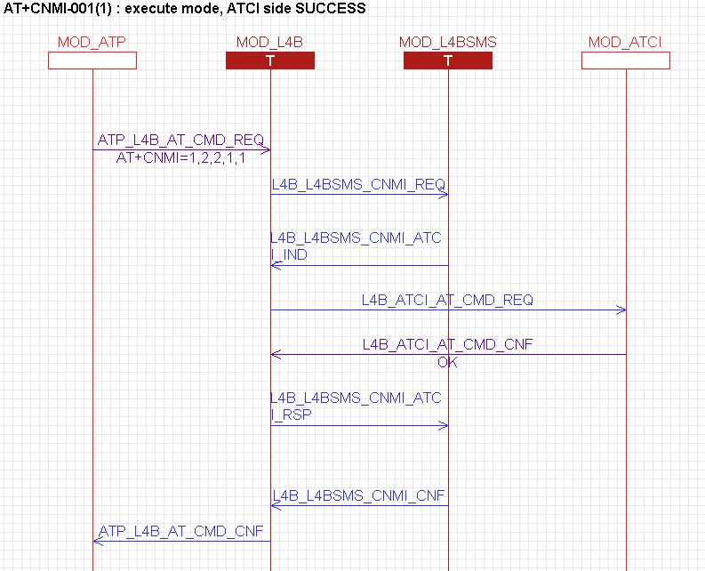
Example – AT+CNMI to ATCI only (5M)

Slide 33
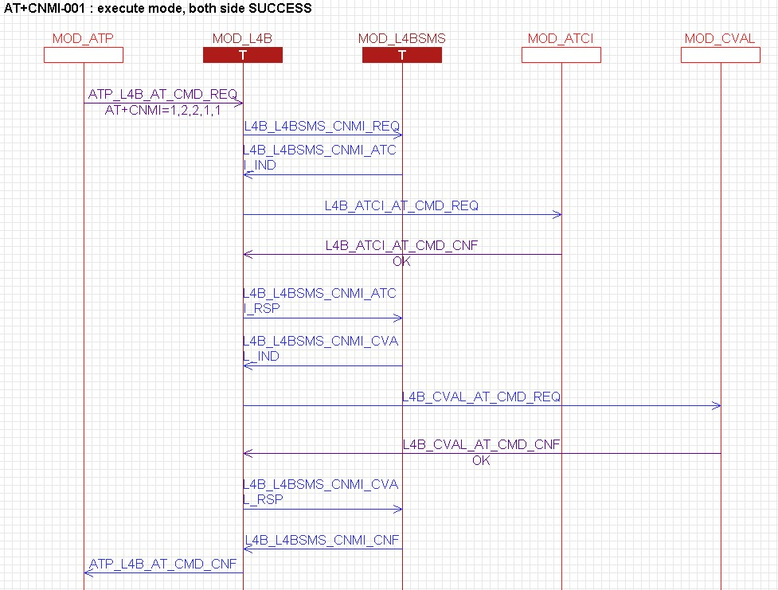
Example – AT+CNMI to both ATCI and CVAL (in 6M global RAT mode)

Slide 34
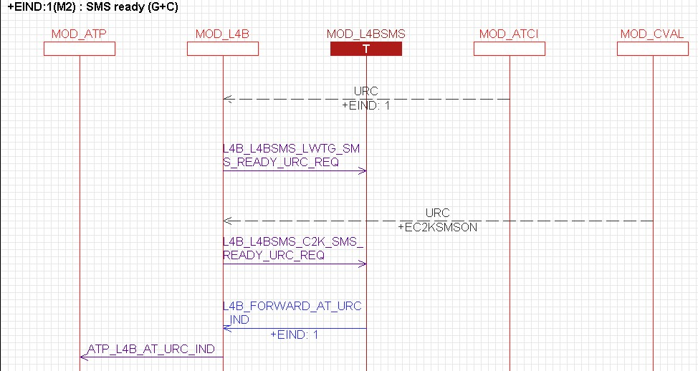
Example – Collect SMS ready URC from ATCI and CVAL (6M)

Slide 35
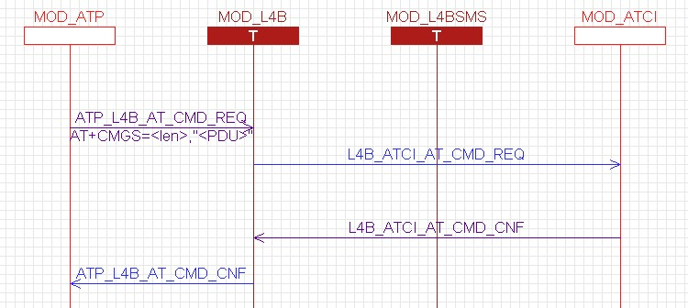
Example – SMS command to ATCI directly (MO 3GPP SMS over CS)

Slide 36
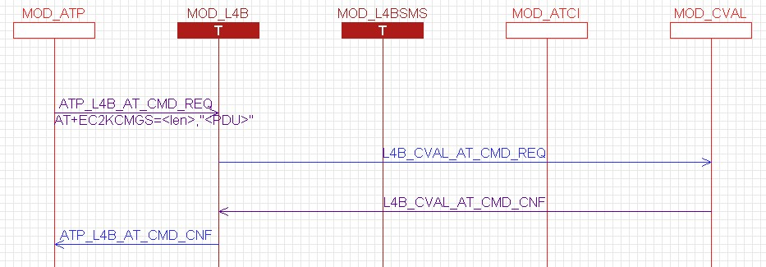
Example – SMS command to CVAL directly (MO 3GPP2 SMS over CS)

Slide 37
L4BSIM
Handle SIM related AT commands from AP and dispatch/re-direct/request to ATCI or CVAL
Collect SIM related information by intercepting URC from ATCI and CVAL, and then stored in contexts

Slide 38
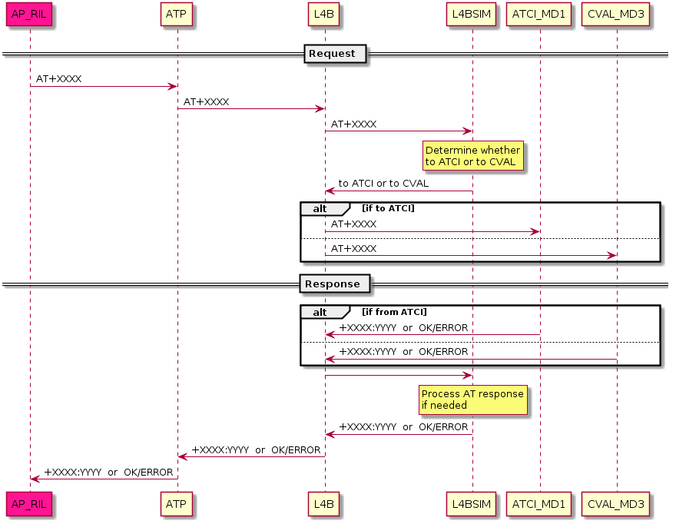
Dispatch SIM AT commands to ATCI or CVAL

Slide 39
Example – dispatch SIM AT commands to ATCI or CVAL
3GPP and 3GPP2 both support AT+CNUM, but different command modes
Active mode
AT+CNUM -> ATCI
Test mode
AT+CNUM=? -> ATCI
Read mode
AT+CNUM? -> CVAL
Set or execute mode
AT+CNUM=<…> -> CVAL

Slide 40
Example – extend proprietary AT commands for 6M
Define new proprietary command or extend parameters to carry 6M information
AT+ECRLA=<application_id>,<…>
If application_id is:
0 (ISIM) -> ATCI
1 (USIM) -> ATCI
2 (CSIM) -> CVAL
3 (SIM) -> ATCI
4 (RUIM) -> CVAL

Slide 41
Example – dispatch AT commands to according to context
L4BSIM stores SIM information in advance
When card initializes or card status changes
E.g. AT+CRSM=<…>
If the SIM card currently has capability of:
GSM + C2K -> ATCI
GSM -> ATCI
C2K -> CVAL
None of GSM or C2K -> ATCI

Slide 42
Example – interpret AT commands from AP
Interpret AP’s request to legacy 3GPP/3GPP2 AT commands
Repack commands into a different form or commands
Reduce modem’s effort for new commands
AP sends AT+ECRLA=<application_id>,<…>
Repack into AT+CRLA=<…> (-> ATCI/CVAL)
ATCI/CVAL returns +CRLA: <…>
Repack into +ECRLA: <…> (-> AP)

Slide 43
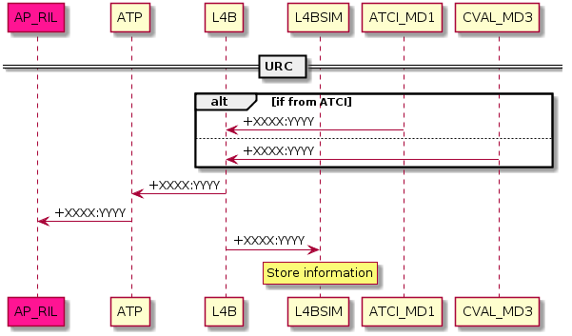
Retrieve SIM information by listening URC

Slide 44
Example – retrieve SIM insert status from URC
L4BSIM captures URC from modem
+EUSIM: <usim_type>,<csim_type>,<has_isim>
usim_type: Has SIM? USIM? None?
Has GSM capability?
csim_type: Has RUIM? CSIM? None?
Has C2K capability?
has_isim: Has ISIM?
Information is then kept in L4BSIM

Slide 45
L4BPWR & L4BNW
Control LWTG and C2K protocol stacks on/off according to the RAT mode setting and the SIM on/off state from AP
AP is responsible to tell MD whether C2K RAT mode is set and in which SIM
AP has to guarantee C2K RAT mode is set in one SIM at a time
Coordinate LWTG and C2K protocol stacks as what AP RIL Proxy did in Gen90/91/92

Slide 46
L4BPWR & L4BNW – RF operation principle
Controls the RF of LWTG and C2K protocol stacks by AT+EFUN and AT+CPON/CPOF respectively
Below is the calculation rule
The RF off procedure obeys the Active RAT first rule
 | 3GPP RAT | Global RAT | C2K only
RF ON | AT+EFUN=1 AT+CPOF | AT+EFUN=1 AT+CPON | AT+EFUN=0 AT+CPON
RF OFF | AT+EFUN=0 AT+CPOF | AT+EFUN=0 AT+CPOF | AT+EFUN=0 AT+CPOF

Slide 47
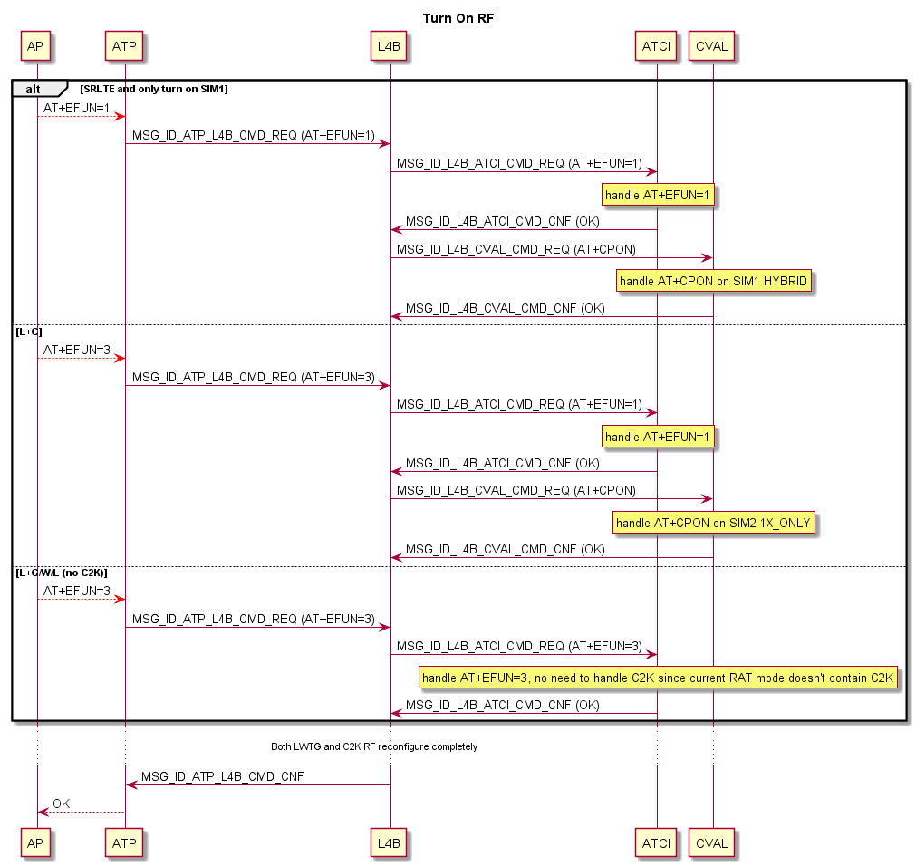
Example – AT+EFUN flow
C2K EVDO only supports SIM1
Gen90/91/92: AP uses AT+EVDOMODE to config MD3
Gen93: C2K protocol stack controls EVDO according to received AT+ERAT information

Slide 48
Replace AT+EIRATMODE by AT+ERAT
+EIRATMODE | RAC handling | GMSS handling | EMM handling
0 (AP IRAT) | [Original] When AP IRAT and working in SRLTE, RAC will change UE mode to PS mode 2 [Gen93] Phase out AP IRAT | [Original] AP will handle C2K and LTE IR, GMSS will do nothing [Gen93] Phase out AP IRAT | [Original] N/A [Gen93] Phase out AP IRAT
1 (MD IRAT 5M (LTE FDD/TDD+WCDMA+GSM+CDMA2000)) | [Original] RAC do nothing [Gen93] N/A | [Original] GMSS will handle 4G IR (LWCG or LC) [Gen93] GMSS will handle 4G IR when AT+ERAT setting is global mode, both 3GPP and 3GPP2 RAT mode is enabled. | [Original] Expect RAT mode is set to LWCG by upper layer. EMM specially set report RAT to LC/LWG [Gen93] Upper layer will set RAT mode to LWCG, and report RAT = LC/LWCG
2 (MD IRAT 4M (LTE FDD/TDD+GSM+CDMA2000)) | [Original] RAC do nothing [by ERAT] N/A | [Original] GMSS will handle 4G IR, but remove UMTS in reported RAT. [Gen93] AP will set RAT mode to LCG, and GMSS will handle 4G IR. | [Original] Expect RAT mode is set to LWCG by upper layer. EMM specially set report RAT to LC/LG [Gen93] Upper layer will set RAT mode to LCG, and report RAT is the subset of LCG
3 (CDMA only mode (No effect on LWG modem. It is used in CDMA modem)) | [Original] RAC do nothing [by ERAT] N/A | [Original] GMSS will be inactive [Gen93] GMSS will be inactive | [Original] AP will send AT+EFUN=0, and MD1 will turn off RF [Gen93] AP will use AT+ERAT to set C2K only, EMM will still detach and enter flight mode. EMM could handle C2K only RAT mode.

Slide 49
Replace AT+ECTMODE by AT+ERAT
+ECTMODE | RAC handling | GMSS handling | EMM handling
0 (SVLTE) | [Original] Just forward to GMSS [Gen93] Just forward RAT mode setting=GSM/C2K or GSM/UMTS/LTE/C2K to low layers | [Original] AP indicates to turn off ECTMODE=2. Meanwhile GMSS will decide whether to detach C2K PS to prevent both LTE and C2K are active [Gen93] Both 3G/4G IR are all handled by GMSS, so this requirement is not applicable | [Original] AP will set RAT mode to LWCG, and EMM will notify ERRC leaving flight mode [Gen93] EMM can handle RAT mode setting is LC/LWCG
1 (TDD data only) | [Original] Set UE mode to PS mode 2 [Gen93] Phase out in Gen93 | [Original] GMSS didn’t handle ECTMODE=1 [Gen93] Phase out in Gen93 | [Original] N/A [Gen93] Phase out in Gen93
2 (4G switch-off) | [Original] Just forward to GMSS [Gen93] Just forward RAT mode setting=C2K to low layers | [Original] AP indicates 3G IR is activated, and requests modem to attach C2K. Meanwhile GMSS will attach C2K CS/PS service. AP will turn off 3GPP modem to prevent dual active RAT. [Gen93] AP will set RAT mode to WCG, and then GMSS is responsible to handle WCG 3G IR | [Original] AP will send AT+EFUN=0, LTWG RF will be turned OFF [Gen93] AP will send AT+ERAT to set non-LTE RAT mode. EMM will still DETACH and notify ERRC to enter flight mode. EMMcan handle RAT mode=WCG/C

Slide 50
Replace AT+EVDOMODE by AT+ERAT
+EVDOMODE is to notify MD3 whether LTE is enabled or disabled in Gen90/91/92, but Gen93 replaces this by AT+ERAT
Card Type | Network Type in Android | MD1 +ERAT | MD3 +EVDOMODE | MD1 On/Off | MD3 On/Off
CDMA Card | NETWORK_MODE_CDMA | 7 | 0 | OFF | ON
 | NETWORK_MODE_CDMA_NO_EVDO | 7,32 | 0 | OFF | ON
 | NETWORK_MODE_EVDO_NO_CDMA | 7,64 | 0 | OFF | ON
 | NETWORK_MODE_GLOBAL | 2 | 0 | ON | ON
 | NETWORK_MODE_LTE_CDMA_EVDO | 14 | 1 | ON | ON
 | NETWORK_MODE_LTE_CDMA_EVDO_GSM_WCDMA | 14 | 1 | ON | ON
 | NETWORK_MODE_LTE_TDD_ONLY | 3 | 0 | ON | OFF
 | NETWORK_MODE_WCDMA_PREF | 2 | X | ON | OFF
 | NETWORK_MODE_GSM_ONLY | 0 | X | ON | OFF
 | NETWORK_MODE_WCDMA_ONLY | 2 | X | ON | OFF
 | NETWORK_MODE_GSM_UMTS | 2 | X | ON | OFF
 | NETWORK_MODE_LTE_GSM_WCDMA | 14 | X | ON | ON
 | NETWORK_MODE_LTE_ONLY | 14 | X | ON | ON
 | NETWORK_MODE_LTE_WCDMA | 14 | X | ON | ON

Slide 51
RAT mode setting
Extend <Rat mode> parameter for +ERAT
0: GSM only
1: UMTS only
2: GSM + UMTS
3: LTE only
4: GSM + LTE
5: UMTS + LTE
6: GSM + UMTS + LTE
7: C2K only
8: GSM + C2K
9: UMTS + C2K
10: GSM + UMTS + C2K
11: LTE + C2K
12: GSM + LTE + C2K
14: GSM + UMTS + LTE + C2K
Notify modem default RAT mode to C2K protocol stack
After Gen93 RAC has to notify C2K protocol stack the default RAT mode setting, the same as notifying LWTG during power-on
AP will set RAT mode to modem according to below three factors:
user setting、inserted SIM card type、PS capability
MD then performs under the RATs set by AP
When RAT mode is set to global mode (both 3GPP and 3GPP2 RAT are included), MD will handle 3GPP and 3GPP2 inter RAT

Slide 52
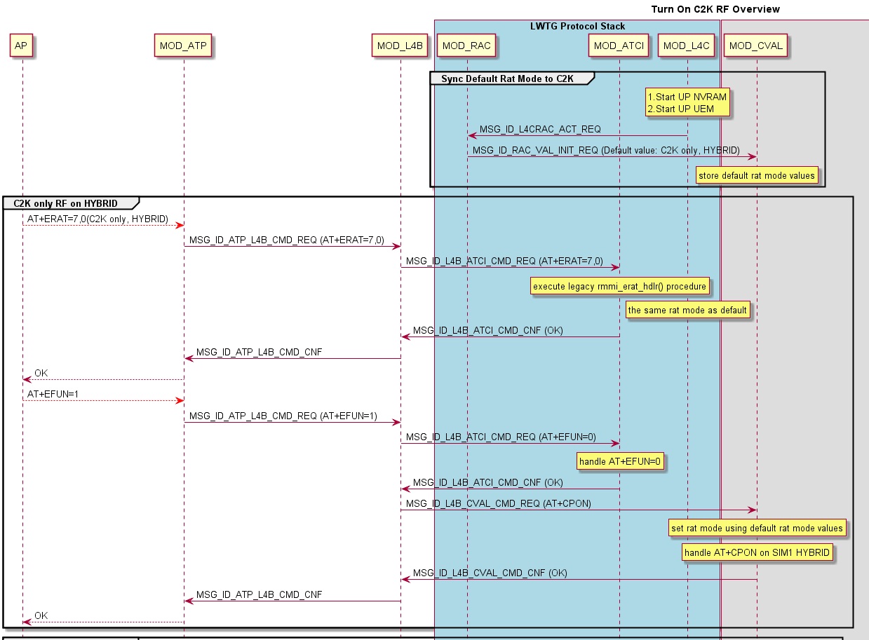
Example – RAT mode init flow
Add RAT mode init flow here

Slide 53
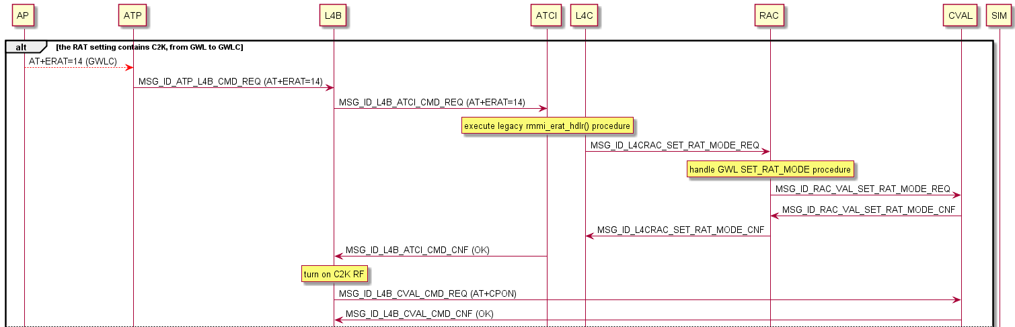
Example – RAT mode init flow
AP sets RAT to global mode

Slide 54
Android AOSP Network Mode and ERAT
Mapping between AP’s network mode and MD’s +ERAT, 3GPP and 3GPP2 RF status
AOSP Defined Network Mode | Value | Comments (RAT Capability) | ERAT | 3GPP RF | C2K RF
NETWORK_MODE_WCDMA_PREF | 0 | GSM/WCDMA (WCDMA preferred) | AT+ERAT=2,2 | On | Off
NETWORK_MODE_GSM_ONLY | 1 | GSM only | AT+ERAT=0 | On | Off
NETWORK_MODE_WCDMA_ONLY | 2 | WCDMA | AT+ERAT=1 | On | Off
NETWORK_MODE_GSM_UMTS | 3 | GSM/WCDMA (auto mode, according to PRL | AT+ERAT=2,0 | On | Off
NETWORK_MODE_CDMA | 4 | CDMA and EvDo (auto mode, according to PRL) | AT+ERAT=7 | Off | On
NETWORK_MODE_CDMA_NO_EVDO | 5 | CDMA only | AT+ERAT=7,32 | Off | On
NETWORK_MODE_EVDO_NO_CDMA | 6 | EvDo only | AT+ERAT=7,64 | Off | On
NETWORK_MODE_GLOBAL | 7 | GSM/WCDMA, CDMA, and EvDo (3G Global) | AT+ERAT=10 | On | On
NETWORK_MODE_LTE_CDMA_EVDO | 8 | LTE, CDMA and EvDo | AT+ERAT=11 | On | On
NETWORK_MODE_LTE_GSM_WCDMA | 9 | LTE, GSM/WCDMA | AT+ERAT=6,4 | On | Off
NETWORK_MODE_LTE_CDMA_EVDO_GSM_WCDMA | 10 | LTE, CDMA, EvDo, GSM/WCDMA (4G Global) | AT+ERAT=14 | On | On
NETWORK_MODE_LTE_ONLY | 11 | LTE only | AT+ERAT=3 | On | Off
NETWORK_MODE_LTE_WCDMA | 12 | LTE/WCDMA | AT+ERAT=5 | On | Off
NETWORK_MODE_LTE_GSM | MTK+1 | LTE/GSM | AT+ERAT=4 | On | Off
NETWORK_MODE_LTE_TDD_ONLY (90 only) | MTK+2 | LTE TDD Only
NETWORK_MODE_CDMA_GSM | MTK+3 | CDMA, GSM (2G Global) | AT+ERAT=8,32 | On | On
NETWORK_MODE_LTE_CDMA_EVDO_GSM | MTK+4 | LTE, CDMA, EvDo, GSM (4G Global, 4M) | AT+ERAT=12 | On | On
NETWORK_MODE_CDMA_EVDO_GSM | MTK+5 | CDMA, EVDO, GSM | AT+ERAT=8 | On | On
Notes:
<prefer_rat>:
typedef enum{
RAT_NONE = 0,
RAT_GSM = 1,
RAT_UMTS = 2,
RAT_GSM_UMTS = RAT_GSM | RAT_UMTS,
RAT_LTE = 4,
RAT_GSM_LTE = RAT_GSM | RAT_LTE,
RAT_UMTS_LTE = RAT_UMTS | RAT_LTE,
RAT_GSM_UMTS_LTE = RAT_GSM | RAT_UMTS | RAT_LTE,
RAT_COM_GSM = 8,
RAT_C2K = 16,
RAT_GSM_C2K = RAT_GSM | RAT_C2K,
RAT_UMTS_C2K = RAT_UMTS | RAT_C2K,
RAT_LTE_C2K = RAT_LTE | RAT_C2K,
RAT_GSM_UMTS_C2K = RAT_GSM | RAT_UMTS | RAT_C2K,
RAT_GSM_LTE_C2K = RAT_GSM | RAT_LTE | RAT_C2K,
RAT_UMTS_LTE_C2K = RAT_UMTS | RAT_LTE | RAT_C2K,
RAT_GSM_UMTS_LTE_C2K = RAT_GSM | RAT_UMTS | RAT_LTE | RAT_C2K,
RAT_1xRTT = 32,
RAT_HRPD = 64,
RAT_1xRTT_HRPD = RAT_1xRTT | RAT_HRPD
}rat_enum;

Slide 55
Replace AT+EMDSTATUS by AT+ERAT (1/2)
Set command format
AT+EMDSTATUS=<modem_status>,<remote_sim_protocol>[,<flow_revision>]
Used by AP to notify MD1 whether MD3 is active or not and how MD3 access SIM card
<md_status>: Integer
0 only MD1 active
1 MD1s' RF off + MD3 active (remote access)
2 MD1 and MD3 active
<remote_sim_protocol>: integer
0 MD3 access local card
1 MD3 access MD1's SIM task1
2 MD3 access MD1's SIM task2
<flow_revision>: Integer (only exist when previous two parameters are 0)
0 MD3 is notified by AP via this AT command (default)
1 MD3 is notified by MD1
In Gen93, all above information can be carried by AT+ERAT
C2K protocol stack is active or not
Which SIM C2K shall access

Slide 56
Replace AT+EMDSTATUS by AT+ERAT (2/2)
 | 91, 92EMDSTATUS solution | 93 solution | Note
L+W | AT+EUTK=0 AT+EFUN=3 AT+ERAT=6 (LWG) AT+EMDSTATUS=0,1 | PS1: AT+ERAT=6 (LWG) PS2: AT+ERAT=2 (WG) | CPON/CPOF will be controlled by L4
L+G | AT+EUTK=0 AT+EFUN=3 AT+ERAT=6 (LWG) AT+EMDSTATUS=0,1 | PS1: AT+ERAT=6 (LWG) PS2: AT+ERAT=0 (G) | CPON/CPOF will be controlled by L4
SRLTE+G | AT+EUTK=1 AT+EFUN=3 AT+ERAT=14 (LWCG) AT+EMDSTATUS=2,1 or AT+EMDSTATUS=1,1 | PS1: AT+ERAT=14 (LWCG) PS2: AT+ERAT=0 (G) | CPON/CPOF will be controlled by L4
L+C | AT+EUTK=0 AT+EFUN=1 AT+ERAT=6 (LWG) AT+EMDSTATUS=1,2 | PS1: AT+ERAT=6 (LWG) PS2: AT+ERAT=7, 0 (C) | CPON/CPOF will be controlled by L4
L+L |  | PS1: AT+ERAT=6 (LWG) PS2: AT+ERAT=6 (LWG) | CPON/CPOF will be controlled by L4
L+SRLTE |  | PS1: AT+ERAT=6 (LWG) PS2: AT+ERAT=14 (LWCG) | CPON/CPOF will be controlled by L4

Slide 57
L4BPDN – SAP
L4BPDN
Between L4B and original L4 PS signaling modules (L4C/TCM/CVAL)
No interface with L4B anymore
i.e. L4BPDN doesn’t use AT command utilities provided by L4B framework
All PS related AT commands are parsed/composed in ATP
AP
New ILM MSG
DDM
ATP Task
L4 Task
L4BNW
New ILM MSG
L4BPDN
UPCM_SAP
UPCM
VAL
ATCI/L4C
TCM

Slide 58
L4BPDN – Interface
atcmd_struct.h at_xxx_req_struct
at_xxx_ind_struct
at_cmd_cnf_struct
at_cgev_ind_struct
AP
New ILM MSG
DDM
ATP Task
L4 Task
l4bpdn_struct.h l4bpdn_l4bnw_attached_rat_ind_struct
L4BNW
New ILM MSG
L4bpdn_upcm_struct.h l4bpdn_upcm_xxx_req_struct
l4bpdn_upcm_xxx_cnf_struct
L4BPDN
UPCM_SAP
ddm_l4bpdn_struct.h ddm_l4bpdn_xxx_req_struct
ddm_l4bpdn_xxx_ind_struct
ddm_l4bpdn_cmd_cnf_struct
ddm_l4bpdn_cgev_ind_struct
UPCM
VAL
ATCI/L4C
l4bpdn_tcm_struct.h l4bpdn_tcm_bearer_act_ind_struct
l4bpdn_tcm_bearer_deact_ind_struct
l4bpdn_tcm_pf_update_ind_struct
l4bpdn_cval_struct.h l4bpdn_cval_xxx_req_struct
l4bpdn_cval_cmd_cnf_struct
l4bpdn_cval_cgev_ind_struct
TCM
tcm_cval_struct.h tcm_cval_pdp_define_req_struct
tcm_cval_vzw_apn_define_req_struct
L4bpdn_l4c_struct.h l4bpdn_l4c_xxx_req_struct
l4bpdn_l4c_xxx_ind_struct
l4bpdn_l4c_cmd_cnf_struct
l4bpdn_l4c_cgev_ind_struct
L4bpdn_cval_struct.h l4bpdn_cval_bearer_act_ind_struct
l4bpdn_cval_bearer_deact_ind_struct

Slide 59
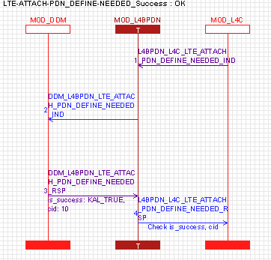
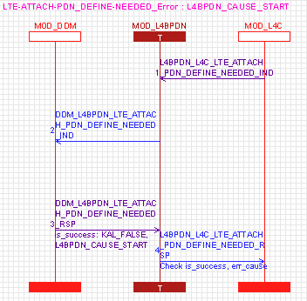
L4BPDN Flow – Attach in LTE/WG/C2K
In WG or C2K
L4BPDN expects to be told the “currently attached rat” from L4BNW directly
Attach procedure (AT+CGATT=1) goes between DDM, L4BNW and RAC …
In LTE
L4BPDN involves a bit (the PDN part) in the LTE attach procedure
DDM defines iA related context
Specify a cid
for LTE attach
Notes:
L4BPDN_CAUSE, new defined proprietary cause in ps_cause_enum
/* ============================== L4BPDN cause ============================== */
L4BPDN_CAUSE_START = 0X01500,
L4BPDN_AT_OK = 0x01 + L4BPDN_CAUSE_START,
L4BPDN_AT_ERROR_CMD_MODE_NOT_SUPPORT = 0x02 + L4BPDN_CAUSE_START,
L4BPDN_AT_ERROR_CURRENT_RAT_UNKNOWN = 0x03 + L4BPDN_CAUSE_START,
L4BPDN_AT_ERROR_CID_IS_NOT_ACTIVE_FOR_CGCONTRDP = 0x04 + L4BPDN_CAUSE_START,
L4BPDN_AT_ERROR_CID_IS_NOT_VALID = 0x05 + L4BPDN_CAUSE_START,
L4BPDN_AT_ERROR_IE_PARSE_RESULT_IS_NOT_OK = 0x06 + L4BPDN_CAUSE_START,
L4BPDN_AT_ERROR_PCO_ID_IS_NOT_VALID = 0x07 + L4BPDN_CAUSE_START,
L4BPDN_AT_ERROR_PCO_ID_IS_NOT_SUPPORTED = 0x08 + L4BPDN_CAUSE_START,
L4BPDN_AT_ERROR_PCO_ID_SUPPORTED_IS_NOT_PRESENT = 0x09 + L4BPDN_CAUSE_START,
L4BPDN_AT_ERROR_CID_IS_NOT_ACTIVE_FOR_BINDING = 0x0A + L4BPDN_CAUSE_START,
L4BPDN_AT_ERROR_CID_IS_NOT_ACTIVE_FOR_UNBINDING = 0x0B + L4BPDN_CAUSE_START,
L4BPDN_AT_ERROR_CMD_NOT_SUPPORT_IN_CURRENT_DOMAIN = 0X0C + L4BPDN_CAUSE_START,
L4BPDN_AT_ERROR_CID_IS_ALREADY_BINDED = 0x0D + L4BPDN_CAUSE_START,
L4BPDN_AT_ERROR_CID_IS_ALREADY_UNBINDED = 0x0E + L4BPDN_CAUSE_START,
L4BPDN_AT_ERROR_CMD_NOT_SUPPORT = 0x0F + L4BPDN_CAUSE_START,
L4BPDN_AT_ERROR_CGCMOD_NOT_SUPPORT_IN_C2K = 0x10 + L4BPDN_CAUSE_START,
L4BPDN_AT_ERROR_EGACT_NOT_SUPPORT_IN_C2K = 0x11 + L4BPDN_CAUSE_START,
L4BPDN_AT_ERROR_CID_IS_ACTIVE_BUT_NOT_PRIMARY_PDP = 0x12 + L4BPDN_CAUSE_START,
L4BPDN_AT_ERROR_CID_IS_NOT_ACTIVE_FOR_SENDING_DATA = 0x13 + L4BPDN_CAUSE_START,
L4BPDN_CGEV_IND_FROM_CVAL_WITHOUT_CAUSE = 0x14 + L4BPDN_CAUSE_START,
L4BPDN_CGEV_IND_NO_CAUSE = 0x15 + L4BPDN_CAUSE_START,
L4BPDN_LEISIM_CAUSE_START = 0X01580,
L4BPDN_LEISIM_AT_ERROR_CID_IS_ALREADY_BINDED = 0x01 + L4BPDN_LEISIM_CAUSE_START,
L4BPDN_LEISIM_AT_ERROR_CID_PDN_TRANSFER_ONGOING = 0x02 + L4BPDN_LEISIM_CAUSE_START,
L4BPDN_LEISIM_OTHER_DIRECTION_IRAT_STARTED_ABORT_REVIVE = 0x03 + L4BPDN_LEISIM_CAUSE_START,
L4BPDN_LEISIM_EHRPD_ALL_3_ROUNDS_REVIVE_FAIL = 0x04 + L4BPDN_LEISIM_CAUSE_START,
L4BPDN_LEISIM_DEACT_ABORT_REVIVE = 0x05 + L4BPDN_LEISIM_CAUSE_START,
L4BPDN_LEISIM_EHRPD_ONE_PDN_REVIVE_SUCCESS_NO_NEED_REVIVE_OTHER = 0x06 + L4BPDN_LEISIM_CAUSE_START,
L4BPDN_LEISIM_OTHER_DIRECTION_IRAT_STARTED_ABORT_EHRPD_2ND_REVIVE = 0x07 + L4BPDN_LEISIM_CAUSE_START,
L4BPDN_LEISIM_OTHER_DIRECTION_IRAT_STARTED_ABORT_EHRPD_3ND_REVIVE = 0x08 + L4BPDN_LEISIM_CAUSE_START,
L4BPDN_LEISIM_CAUSE_END,
L4BPDN_CAUSE_END = 0xFF + L4BPDN_CAUSE_START,
/* ============================== L4BPDN cause ============================== */

Slide 60
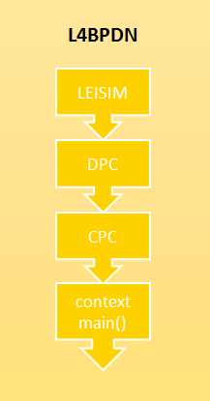
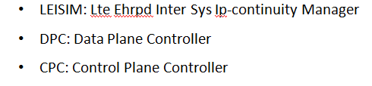
L4BPDN Flow – Establish PDN
Assumption:
CPC knows current PDN domain from L4BNW
CGACT_REQ
Is CID controlled by LIESIM ?
Yes
LEISIM decides
No
What is current
PDN domain?
l4bpdn_cpc_get_current_pdn_domain()
L4BPDN_CPC_
PDN_DOMAIN_UNKNOWN
L4BPDN_CPC_
PDN_DOMAIN_3GPP
L4BPDN_CPC_
PDN_DOMAIN_3GPP2
Error
Send to L4C
Send to CVAL

Slide 61
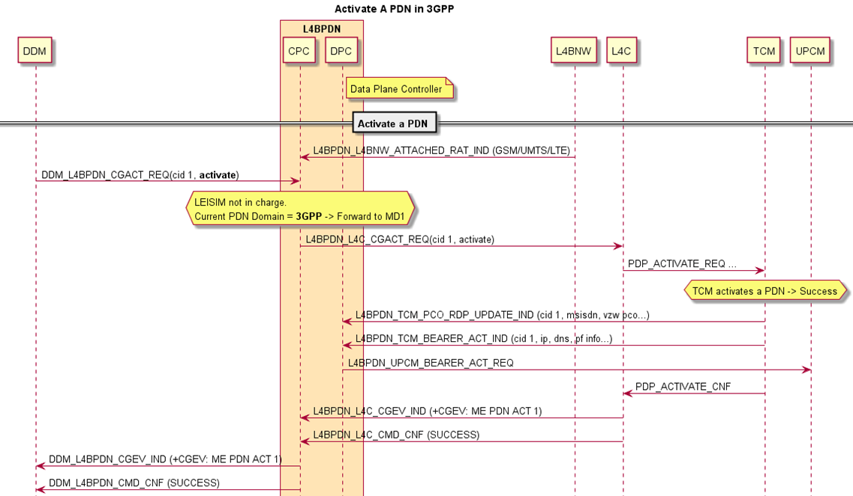
L4BPDN – Establish PDN in 3GPP

Slide 62
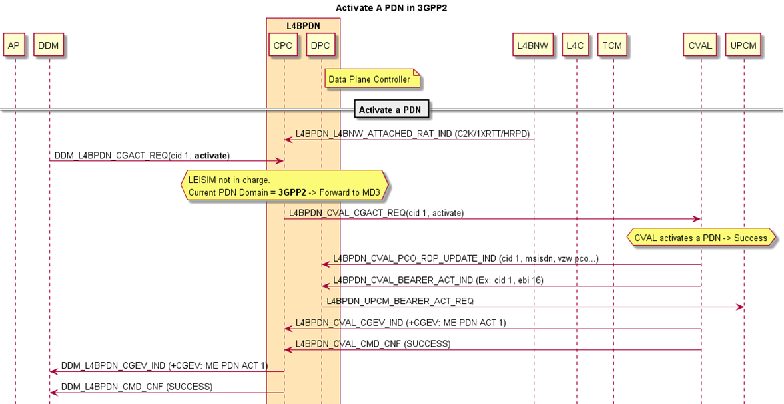
L4BPDN – Establish PDN in 3GPP2

Slide 63

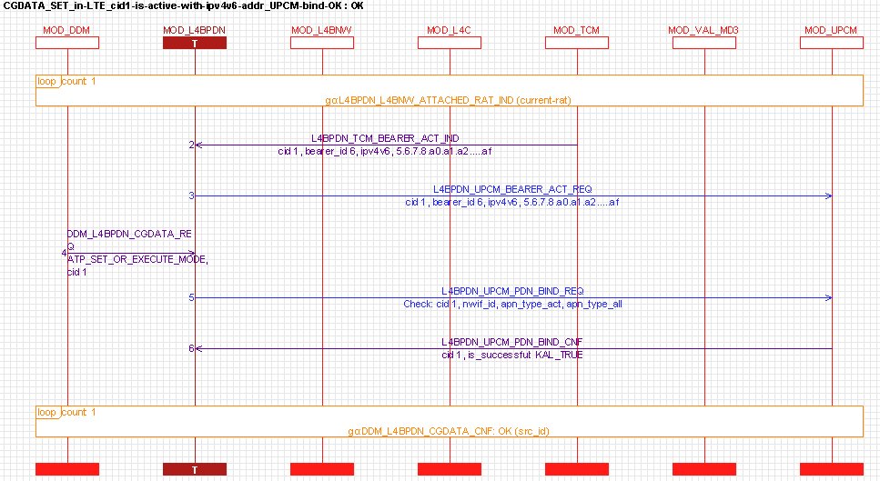
L4BPDN – Bind Network Interface
AT+CGDATA
AT-Like ILM
AT-Like ILM
Note: If CID is not yet activated, L4BPDN directly replies L4BPDN_AT_ERROR_CID_IS_NOT_ACTIVE_FOR_BINDING

Slide 64
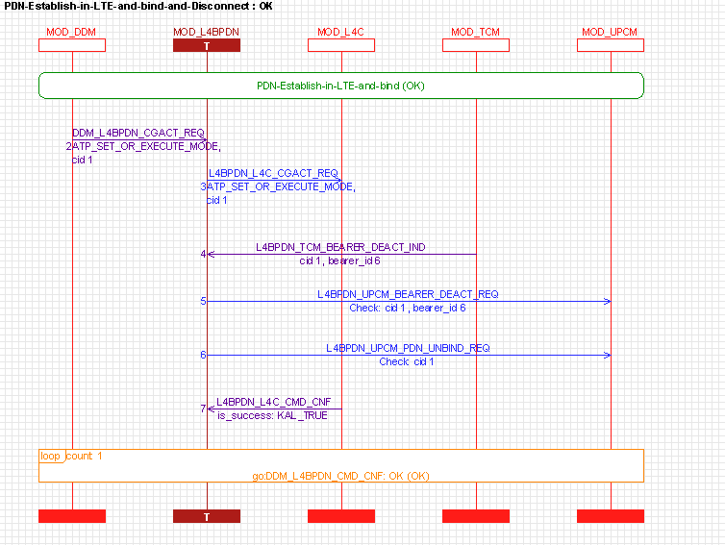
L4BPDN – Disconnect (a Binded) PDN
Two separated ILMs. One is for bearer DEACT; the other is for PDN unbinded

Slide 65
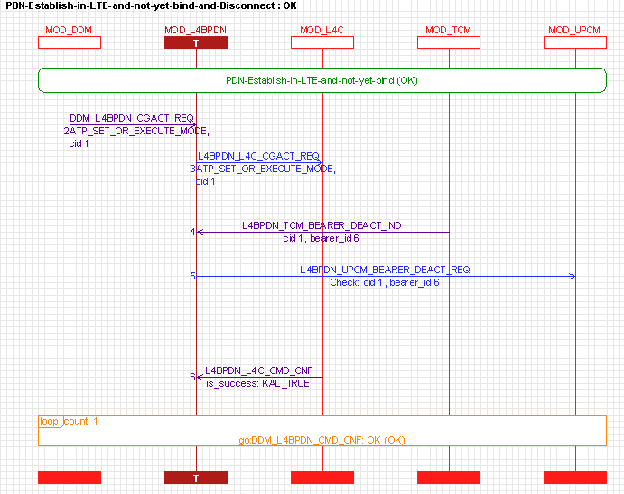
L4BPDN – Disconnect (a NOT-yet-Binded) PDN
Only one ILM. One is for bearer DEACT; the other is for PDN unbinded

Slide 66
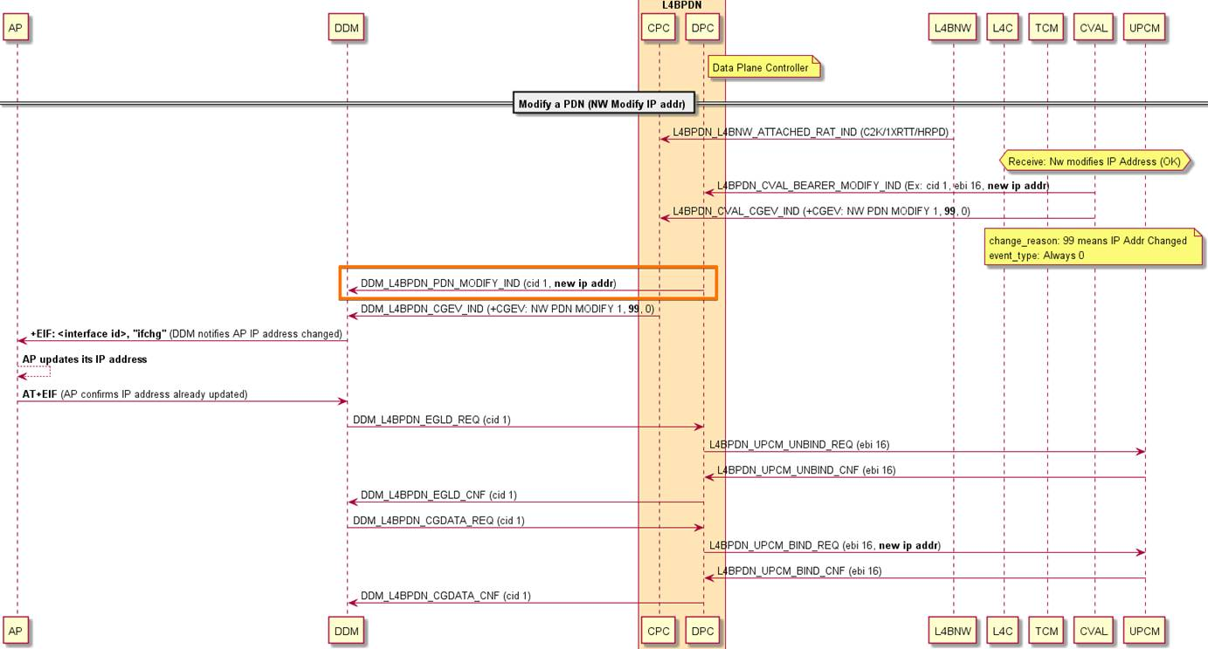
L4BPDN – IP Address Modify in 3GPP2

Slide 67
Debugging
ELT Log Analysis

Slide 68
AT Command Flow in System Trace
ATP
[AT_RX p%d,ch%d]
AT command received from UART by ATP_IO
[AT_TX p%d,ch%d]
AT command response print to UART by ATP_IO
[AT_URC p%d,ch%d]
AT URC print to UART by ATP_IO
p means port and ch means channel
ATCI
[ATCI_AT_I_%d s%d]
AT command received (Input) from L4B by ATCI
[ATCI_AT_R_%d s%d]
AT command response (Response) sent to L4B by ATCI
[ATCI_AT_U_%d s%d]
AT URC sent to L4B by ATCI
The first %d is SIM index, and the second %d means source ID in L4C

Slide 69
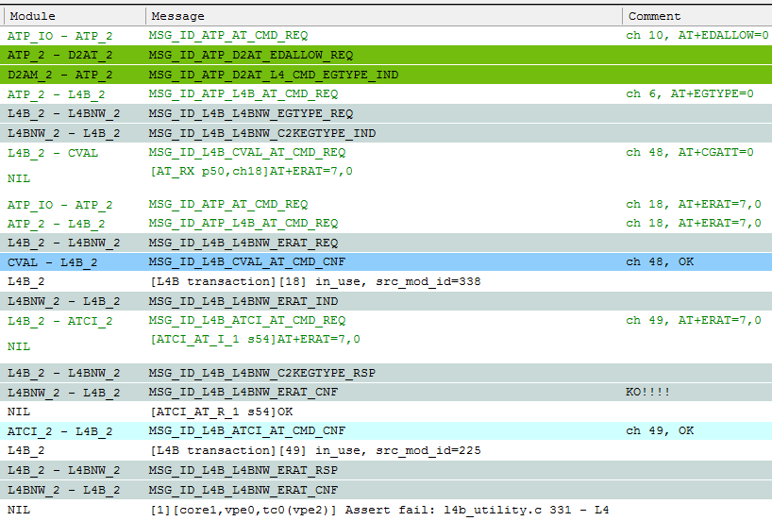
Log Example
[1][core1,vpe0,tc0(vpe2)] Assert fail: l4b_utility.c 331 - L4
L4B received unexpected response

