Slide 1
Gen93 SQC Workshop Modem RAC
Morning Lee

Slide 2
Outline
C2K/L4 Integration
  Extend Active RAT
  Re-design SET RAT Flow
  Default RAT Mode to C2K
  CT3G Implementation
IMS relative procedure
      Use AT+EIMSCFG replace AT+EIMS

Slide 3
C2K/L4 Integration – Extend Active RAT
Why to change:
- Based on AS request, UE should deactivate active PS RAT first during RF off procedure. So we need extend active RAT as C2K due to C2K integration.
Corresponding changes:
- L4B reuse l4c_get_active_rat() to query current active RAT and decide RF off C2K first or 3GPP.
- For global mode case, active RAT should be decided by GMSS. GMSS will send one new primitive MSG_ID_RAC_GMSS_ACTIVE_RAT_IND to L4C, and then update to L4C context.
- For non-global mode case, reuse MSG_ID_L4CRAC_PLMN_STATUS_IND to update active RAT in L4C context.
- If current active RAT was RAT_C2K, RAC will report PS reg status and state as GPRS_NULL and REG_STATE_UNKNOWN respectively.

Slide 4
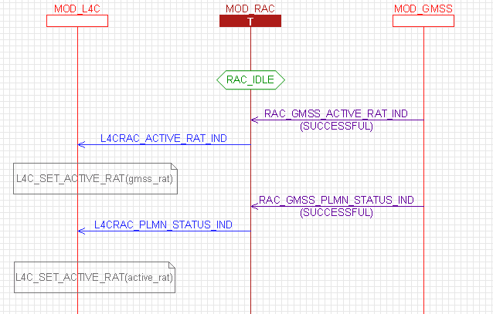
Design Flow Chart
Update by GMSS
Update by NWSEL

Slide 5
C2K/L4 Integration – Re-design SET RAT Flow
Why to change :
- In current architecture, C2K will be treated as one of module controlled by L4. L4 should forward RAT information to C2K. RAC reuse the SET RAT flow to control C2K rat mode also. For original design, C2K RAT info will be forwarded by GMSS.
Corresponding changes:
- Align with original design about active RAT, RAC will decide SET RAT order based on active RAT. (Active rat is first target)
- For 93 ERAT design, RAT mode was be treated as UE capability. Thus, rat mode will be broadcasted to EMM/MM/CVAL every time. Except for the following condition.
If MD1 was RF off, then SET RAT will only be delivered to GMSS and CVAL.
RAT mode setting was the same as last.

Slide 6
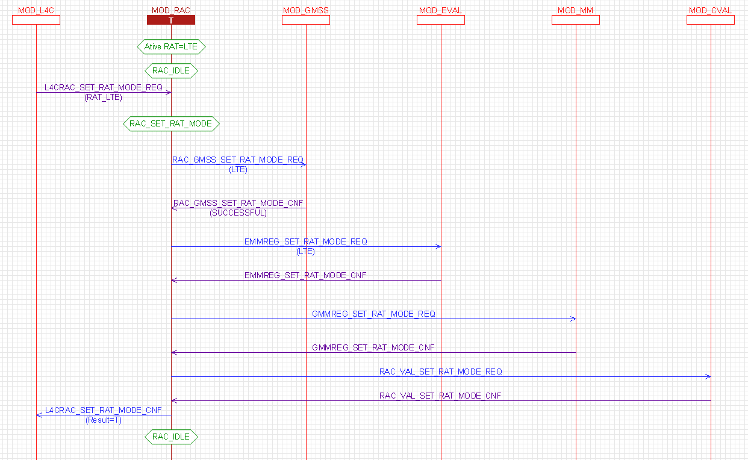
Active RAT: LTE
MSG_ID_RAC_VAL_SET_RAT_MODE_REQ:
rat_enum rat_mode;
rat_enum reported_rat;
irat_system_type_enum c2k_mode;
kal_uint8 protocol_id;

Slide 7
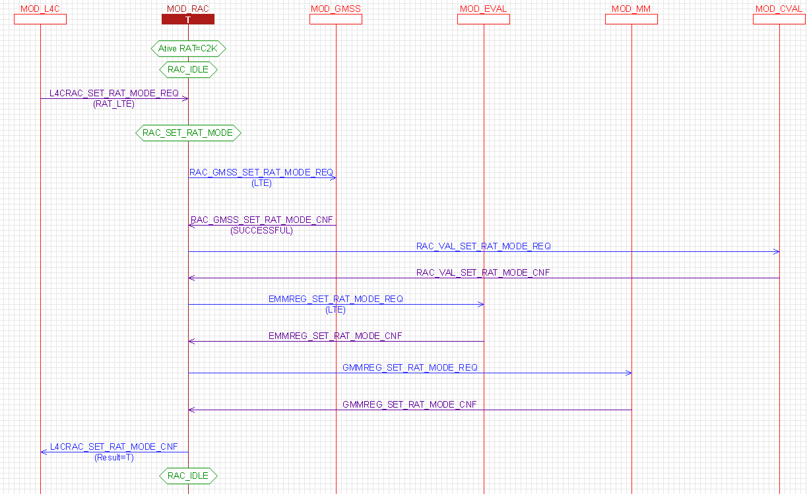
Active RAT: C2K
MSG_ID_RAC_VAL_SET_RAT_MODE_REQ:
rat_enum rat_mode;
rat_enum reported_rat;
irat_system_type_enum c2k_mode;
kal_uint8 protocol_id;

Slide 8
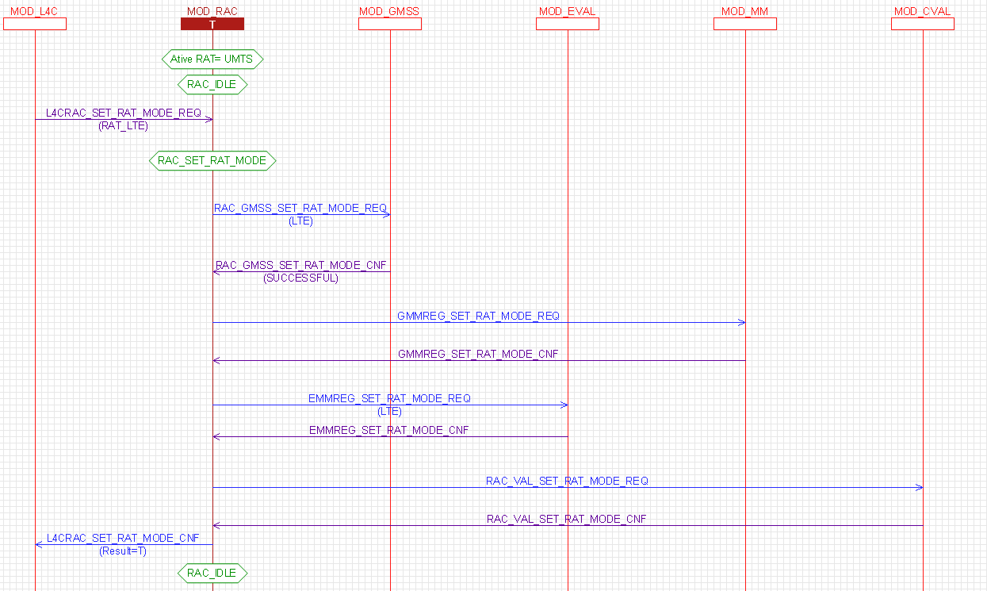
Active RAT: UMTS
MSG_ID_RAC_VAL_SET_RAT_MODE_REQ:
rat_enum rat_mode;
rat_enum reported_rat;
irat_system_type_enum c2k_mode;
kal_uint8 protocol_id;

Slide 9
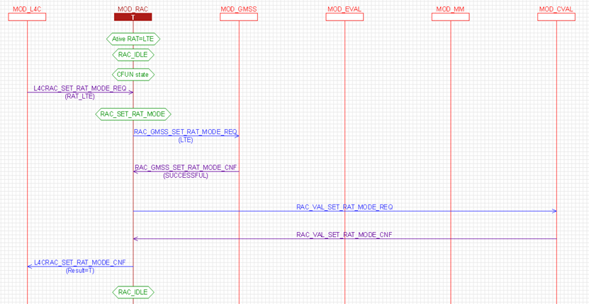
RF OFF

Slide 10
C2K/L4 Integration – Default RAT Mode to C2K
Why to change:
- When booting up, if ERAT send from AP was the same as default RAT mode. ATCI will discard this ERAT as duplicate setting. It will cause CVAL can not operate normally due to NO RAT mode info.
Corresponding changes:
- When booting up, RAC will read NVRAM_EF_RAC_PREFERENCE_LID and get corresponding RAT mode setting. RAC will send MSG_ID_RAC_VAL_INIT_REQ to CVAL before EIND:128 send to AP.
- It is not necessary to wait for CNF for init message.

Slide 11
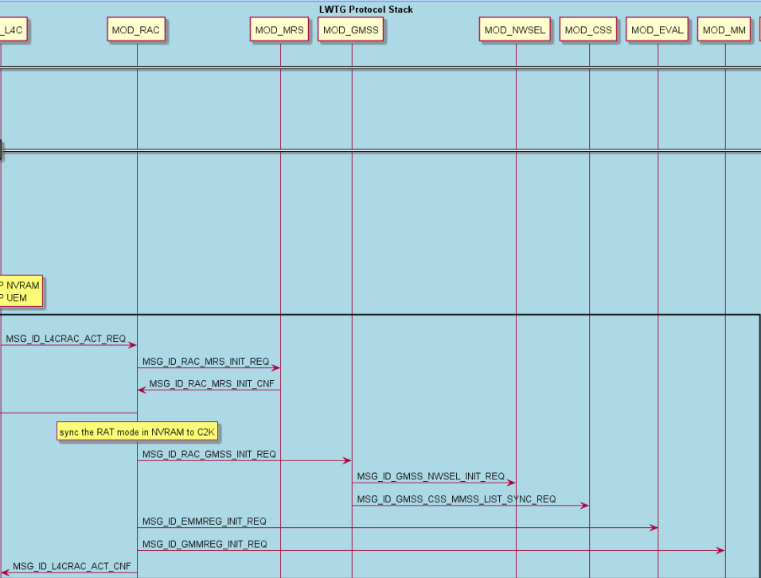
Design Flow Chart
MSG_ID_RAC_VAL_INIT_REQ:
rat_enum rat_mode;
rat_enum reported_rat;
irat_system_type_enum c2k_mode;
kal_uint8 protocol_id;

Slide 12
RAC/L4/GMSS CT3G Implementation
Why to change :
- Based on GMSS request, UE can do PS search even search type is search any when inserted CT3G card.
Corresponding changes :
- When CT3G card inserted, L4C_SIM will inform RAC by MSG_ID_L4CRAC_CT3G_INSERTED_IND. And then CT3G specific flag in RAC context will be set as TRUE.
- When reg_req with came from L4C before SIM ready, RAC will check rat mode if involved RAT_C2K and CT3G specific flag was set as TRUE. Once condition was satisfied, UE will change attach type from CS to CS+PS when PS was allowed.
- Once receiving sim_ready_ind or sim_error_ind, RAC will clear CT3G specific flag as FALSE.

Slide 13
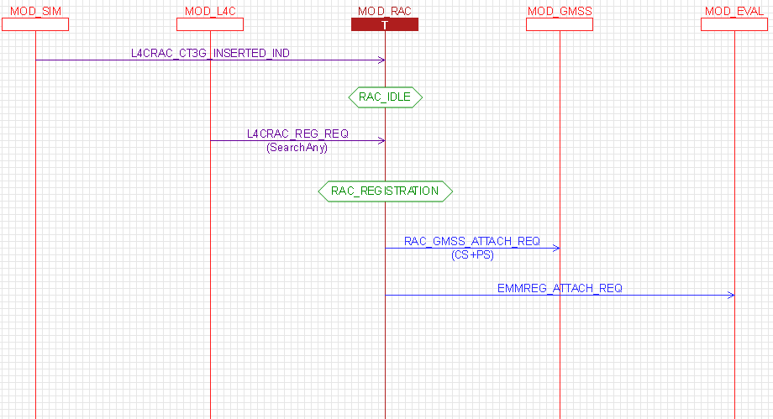
Design Flow Chart

Slide 14
AT+EIMSCFG Replace AT+EIMS
AP integrate IMS and VoLTE relative info into AT+EIMSCFG from AT+EIMS
Format: +EIMSCFG = <volte_cfg>, <vilte_cfg>, <vowifi_cfg>, <viwifi_cfg>, <ims_sms_cfg>, <eims_cfg>
If volte_cfg and eims_cfg enabled, it means modem support IMS.
L4C will forward MSG_ID_L4CRAC_IMS_CONFIG_REQ message to RAC with ims_support parameter.

Slide 15
Remove Dependency between AT+EIMSCFG and EFUN
Background: In original design, AP will send AT+EIMS=0/1 before EFUN=1. After SIM ready, AP will calculate IMS capability according to SIM card and resent AT+EIMS with correct IMS support value.
Purpose: Before SIM ready, IMS support value may not be correct. To make sure correction of IMS support, AP will only send AT+EIMSCFG when
<1>. SIM ready
<2>. User configuration change (IMS support or not)
Change: RAC need to record current configuration in NVRAM. After booting up, RAC will use last record to info NWSEL/EMM.

Slide 16



Design Flow
L4C
cmnRAC
eRAC
GMSS
eNAS
L4CRAC_IMS_CONFIG_REQ
Support =>
Not Support
Save to NVRAM
rac_e_ims_config_req()
rac_e_set_ims_voice_availability_req(FALSE)
IMS_REG_STATUS_UNREGISTERED
Save to NVRAM
Not support => Support
L4CRAC_IMS_CONFIG_REQ
rac_e_ims_config_req()
IMS_REG_STATUS_UNSPECIFIED
Rebooting
Read from NVRAM_EF_LTE_PREFERENCE_LID and update to NWSEL when UE mode updating
Notes:
RAC_IMS_REG_GUARD_TIMER_PERIOD 64 seconds
Start when starting IMS registration
Stop when IMS registration complete

Slide 17
Thank You!

