Slide 1
SBP Framework in Gen93
WCS/SE8/PSD9
Danny Kuo

Slide 2
Agenda
SBP Introduction
Dynamic SBP
SBP FW Change in Gen93
Case Study

Slide 3

SBP Introduction
SBP: Single Binary Platform
  One modem image to serve different operators’ requirements, e.g. Vodafone, T-Mobile, AT&T…etc.
  Modem doesn’t need to have many projects and doesn’t need to maintain many compiler options.
For T-Mobile
For AT&T
No need to re-build modem

Slide 4
SBP Introduction
AP
MODEM
Power on
SBP ID delivery via CCCI
Set related features according to the ID
Protocol stack initialization
Modem operates according to the configuration.
Note:
(1) SBP IDs map to different operators.
(2) SBP ID is pre-configured in AP

Slide 5
SBP - Customization
Modem provides a custom function to configure SBP features according to SBP ID.
This function is called when AP sets SBP ID to modem.
This is an example to turn on the feature “SBP_UMTS_CB_OFF” when SBP ID = 1 (CMCC).
This feature is to disable cell broadcast in 3G network.
    kal_bool nvram_custom_config_sbp(sbp_reconfig_custom_param_struct *param_ptr)
    {
    sbp_id = param_ptr->sbp_id;
    nvram_ef_sbp_modem_config_struct sbp_config;
    /* Update NVRAM content according to SBP_ID. For example: NVRAM_EF_SBP_MODEM_CONFIG_LID */
    nvram_external_read_data(NVRAM_EF_SBP_MODEM_CONFIG_LID, 1, &sbp_config, NVRAM_EF_SBP_MODEM_CONFIG_SIZE);
    if (sbp_id == 1)
    {
    sbp_set_md_feature(SBP_UMTS_CB_OFF, KAL_TRUE, &sbp_config);
    }
    nvram_external_write_data(NVRAM_EF_SBP_MODEM_CONFIG_LID, 1, &sbp_config, NVRAM_EF_SBP_MODEM_CONFIG_SIZE);
    }
    }

Slide 6
Dynamic SBP
There are two SBP IDs
  Static SBP ID: get from AP through CCCI, we initial our SBP configuration using this one
  SIM SBP ID: computed from MCC/MNC or ICCID, we use it to do D-SBP.
We introduce L4B-SBP in Gen93 to control D-SBP flow when SIM SBP ID is changed.
AP will notify MD if D-SBP is enabled or not by AT CMD
MD will report a URC to inform AP about the current SIM SBP ID
Please notice that we only support D-SBP for IMS/VOLTE modules currently. We don’t support DSBP for protocol.

Slide 7
Dynamic SBP
SIM SBP ID may be changed at runtime because:
  SIM switch
  SIM hot plug
  SIM refresh with IMSI change
  Power on
Current D-SBP procedure will be triggered without RF-off and SIM-off.
  Note, RF-OFF may be applied if we want to support D-SBP for protocol in the future

Slide 8
Dynamic SBP
MCC/MNC mapping table
ATP/L4B
L4BSBP
SIM
If DSBP is enabled and MCC/MNC/ICCID is changed
ATCI/L4C
SIM_L4BSBP_READY_IND(MCC, MNC, ICCID)
MD D-SBP procedure
L4B_FORWARD_AT_URC_IND
(+ESBPID:<sbp_id>,<sim_sbp_id>)
+ESBPID:<sbp_id>,<sim_sbp_id>
ESBP_IND (is_from_user=F, sim_spb_id)
L4B_ATCI_AT_CMD_REQ (AT+ESBP=0,<sim_sbp_id>)
L4B_ATCI_AT_CMD_CNF (result)
ESBP_RSP (result, is_from_user=F)
Notes:
typedef struct {
LOCAL_PARA_HDR
kal_uint8 ef_imsi[9];
} l4bsim_sim_ready_ind_struct;

Slide 9
Dynamic SBP
ATCI
L4C
IMC
VDM
AT+ESBP
xxx()
MSG_ID_L4C_ME_DSBP_RECONFIGURE_REQ(type=PRE_DSBP)
Execute pre-recfg actions
MSG_ID_L4C_ME_DSBP_RECONFIGURE_CNF(type=PRE_DSBP)
Apply new SBP config:
NVRAM_EF_SBP_MODEM_CONFIG_LID,
NVRAM_EF_SBP_MODEM_DATA_CONFIG_LID,
Other NVRAM LIDs
MSG_ID_L4C_ME_DSBP_RECONFIGURE_REQ (type=DSBP)
Execute post-recfg actions
MSG_ID_L4C_ME_DSBP_RECONFIGURE_CNF(type=DSBP)
yyy()
OK

Slide 10






RCEP Procedure on AP side
Factory Reset
OM Config
User done the factory reset from settings
→Change Sim and power on
→sim hot swap
Use telefonica
Boot up with valid orange sim
Device detect the sim
configuring
rebooting
OPTR = NONE
SBP = 0
→Change Sim and power on
Use Orange Sim
AP=Orange
OPTR = OP03
Modem = Orange
SBP=03
Dynamic Configuration: Orange
AP=Orange
OPTR = OP03
Modem = Orange
SBP=03
Dynamic configurations: Telefonica
Boot up with no SIM or invalid SIM
AP=OM
OPTR=NONE
Modem = OM
SBP=0
Dynamic configurations: At AP side, controlled by Google carrier config
At modem side, controlled by DSBP (Ims Configurations)
Real case1: OP03 with different country code, Orange French and Orange UK.
Real case2: Vodafone phone with Telephonica(O2) SIM, shall make VoLTE call working well.

Slide 11
D-SBP v.s. RCEP
D-SBP procedure is independent of RCEP procedure.
RCEP utilizes the SBP procedure (not D-SBP) to apply new setting according to the inserted SIM card.
  If user chooses to agree reconfiguration, AP will use SIM SBP ID to assign Static SBP ID and reboot the modem

Slide 12
D-SBP + RCEP (reconfiguration)
Mapping table
(OPTR)
AP
MD
Mapping table
(SBP/D-SBP)
MD Power On Procedure
AT+EDSBP (D-SBP is enabled or not)
AT+EFUN=0
Check PIN/Get IMSI
+ESBPID: <sbp_id>,<sim_sbp_id>
Apply D-SBP flow
Reconfiguration: Yes
RCEP procedure
D-SBP procedure
Set persist.operator.optr = OPTR
Apply carrier specific customization flow
Set persist.mtk_usp_md_sbp_code = sim_sbp_id
MD Power On Procedure
Notes:
[Rahul] DSBP and RCEP are two independent features and their flow is also independent.

Slide 13
SBP FW Change in Gen93
Dynamic SBP Flow (for non-protocol part)
SBP files re-arch
Feature Defined Mechanism of SBP

Slide 14
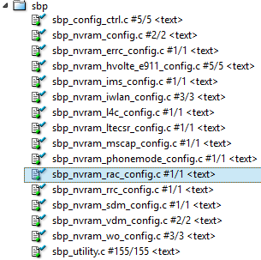
SBP files re-arch
We separate SBP APIs, which is located at sbp_utility.c originally, into different files to avoid patch release dependency
  sbp_utility.c
  Sbp_config_ctrl.c
  sbp_nvram_config.c
  Sbp_nvram_xxx.c

Slide 15
SBP files re-arch
sbp_utility.c – SBP utility File
  Provide SBP utility functions, only SBP FW FPM could modify this file
Sbp_config_ctrl.c - SBP configuration control file
  SBP user could only modify this function when user want to add a new API which is in the sbp_nvram_xxx.c
sbp_nvram_config.c – SBP Feature/Data configuration file
  User could set SBP feature/data in this file according to the input SBP ID in the following function
    sbp_md_feature_overwrite()
    sbp_md_feature_data_overwrite()
    nvram_custom_config_sbp() ← We set SBP feature/data according to the SBP ID here
  The usage is the same as before

Slide 16
SBP files re-arch
sbp_nvram_xxx.c – Configuration files for other NV
  We have separate configuration of other NVs into files
  How to group APIs into a file could be decided by module owner.
    Please consider patch release dependency to avoid providing too many unused patch to customer.
  If you want to add a new file or a new API, please follow the SOP described in the P17~P19 of “SBP_guideline_UMOLYA.pptx”

Slide 17
Feature Defined Mechanism of SBP
The defined mechanism in Gen91/92
  SBP Feature
    Add/Modify sbp_feature.def
    Add/Modify VERNO in the sbp_nvram_def.h
  SBP Data
    Add/Modify sbp_data.def
    Add/Modify meta description in the sbp_nvram_editor.h
    Add/Modify default value in the sbp_nvram_def.c
    Add/Modify VERNO in the sbp_nvram_def.h
From Gen93, you only need to modify sbp_feature.def or sbp_data.def
  SBP Feature
    Add/Modify sbp_feature.def
  SBP Data
    Add/Modify sbp_data.def
For detail, please refer to the SOP described in the P35~P43 of “SBP_guideline_UMOLYA.pptx”

Slide 18
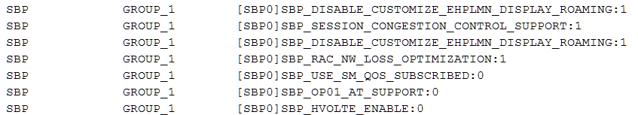
Case Study 1
If you want to know which SBP is enabled or not, please enable TRACE_GROUP_1 of MOD_SBP
  The log will be shown when someone query it using SBP’s API.
    We will not print the log if user query the same one continuously.
  This log is disabled by default currently because we need to reduce logs (throughput is 6KB/s)

Slide 19
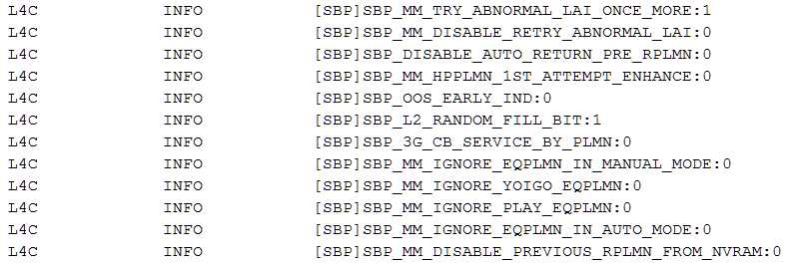
Case Study 1
If you want to know which SBP is enabled or not, You could also find out the logs from MOD_L4C, It will print the SBP logs when
  ELT is connected
  SIM is ready and trigger D-SBP flow

Slide 20
Case Study 2
When is D-SBP triggered? D-SBP flow will be triggered only when
  If DSBP is disabled and SIM SBP ID == Static SBP ID → Judge if D-SBP is needed or not.
  If DSBP is enabled → Always judge if D-SBP is needed or not.
  Judge if D-SBP is needed or not.
    Always trigger for first time.
    SBP ID is changed
    SBP ID is not changed, but MCC/MNC is changed
    SBP ID is not changed, but the prefix of ICCID is changed
If you have any question, please discuss with SBP FPM first.

Slide 21
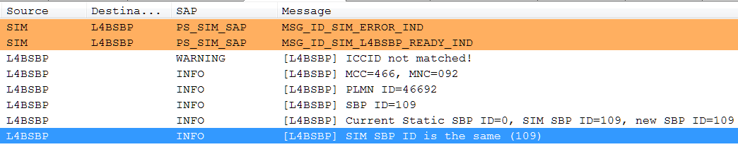
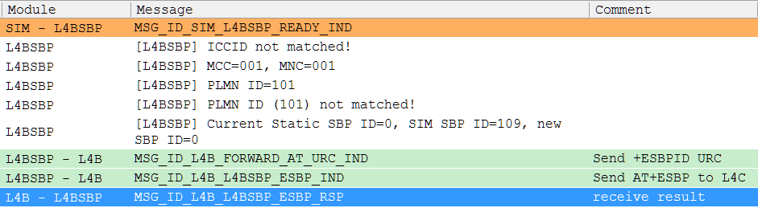
Case Study 2
Not trigger D-SBP
Trigger D-SBP

Slide 22
Case Study 3
If you doubt that Static SBP ID or SIM SBP ID is not correct
  Please check L4C’s log to see if it is as your expectation or not
If SBP IDs are not as expectation, please contact with SBP FPM

Slide 23
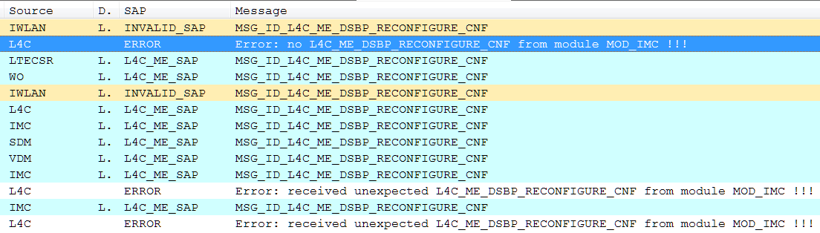
Case Study 4
How to check if there is any abnormal D-SBP Flow?
  Normally, some modules don’t complete D-SBP flow so that the flow is abnormal
  Please find MSG_ID_L4C_ME_DSBP_RECONFIGURE_CNF in the L4C
  You could see which modules are abnormal.

