Slide 1
MT6293 MP1 SQC Workshop SDM (SMS Domain Selection)
15 May 2017

Slide 2
Outline
Introduction
Architecture
Flow Change
IMS/CS SMS AT Merge
UTK/STK SMS AT Merge
AT Command Change
SBP Change

Slide 3
Outline
Introduction
Architecture
Flow Change
IMS/CS SMS AT Merge
UTK/STK SMS AT Merge
AT Command Change
SBP Change

Slide 4
SDM Introduction
SDM stands for “SMS Domain Selection”
Job
MO SMS : Determinate the target domain
MT SMS : Relay to proper domain
Retry logic and retry domain determination
Notes:
MO management object

Slide 5
Outline
Introduction
Architecture
Flow Change
IMS/CS SMS AT Merge
UTK/STK SMS AT Merge
AT Command Change
SBP Change

Slide 6
6293 SMS Architecture
IMS Core
RIL
SMS UA
Call UA
REG UA
IMCB
ATP
IMC
ILM
ATP_IO
IMCSMS
ATP
ATP_2
SDM
ILM
ILM
AT in ILM
ILM
L4 Task
L4B Group
AT in ILM
L4B
AT in ILM
L4BXXX
L4BSMS
L4BCC
L4BYYY
L4BSMS_2
L4BCC_2
ATCI/L4C
SMSAL
CVAL

Slide 7
Highlight
IMSP is replaced by ATP
VAL emigrated to MD1 and renamed to CVAL
Communication path leverage:
SDM <-> IMS SMS : ILM
SDM <-> 3GPP CS SMS : AT in ILM (via ATP/L4B)
SDM <-> 3GPP2 CS SMS : ILM

Slide 8
Outline
Introduction
Architecture
Flow Change
IMS/CS SMS AT Merge
UTK/STK SMS AT Merge
AT Command Change
SBP Change

Slide 9
IMS/CS MT SMS AT Merge
Background:
Since there is no more MD3, for the sake of AP convenient and fitting AOSP , AP initiated this change.
Main concept:
Using same AT URC for MT SMS , no matter it’s from IMS or CS domain
Still use different AT URC to distinguish 3GPP/3GPP2
3GPP |  | 3GPP2
IMS MT | CS MT | IMS MT | CS MT
+CMT / AT+CNMA |  | +EC2KCMT / AT+EC2KCNMA

Slide 10
3GPP MT SMS over IMS
RIL
+CMT
AT+CNMA
[=<n>
[,<length>,PDU]]
<CR>
ATP
SMSUA
ATP_AT_CMD_REQ (AT+EIMSCNMA)
❹
ATP_IO_URC_IND
(+CMT)
ATP_L4B_AT_CMD_REQ (AT+ESMSMTIP = <len>, <SCA_LEN><SCA><TPDU>
ATP_IO
IMCSMS
SDM_ATP_CMD_SEND_DELIVER_REPORT_IND (AT+CNMA)
SDM_ATP_SMS_DELIVER_URC_IND
(+CMT)
ATP
SDM_ATP_CMD_SEND_SMS_DELIVER_IND
(+EIMSCMT)
❸
SDM
SDM_ATP_URC_RCV_SMS_REQ (local=<sca>)
(Peer buf = <tpdu>)
L4B/ATCI
SDM_IMCSMS_DELIVERY_REPORT_ACK/NAK
(local = <smi>)
(peer buff =<TPDU>)
❷
❶
+EIMSCMT
SDM_IMCSMS_DELIVER
(local = <smi>, <sca>)
(peer buff = <TPDU>)
SMSAL
Notes:
[Hsuanchang@20170418] revise the MT flow

Slide 11
3GPP MT SMS over CS - receive single short message and send deliver report
RIL
AT+CNMA
[=<n>
[,<length>,PDU]]
<CR>
ATP
+CMT
SMSUA
ATP_AT_CMD_REQ (AT+CNMA)
❸
ATP_L4B_AT_CMD_REQ (AT+CNMA)
ATP_IO_URC_IND
(+CMT)
ATP_L4B_AT_URC_IND
(+CMT)
ATP_IO
IMCSMS
MSG_ID_SDM_ATP_CMD_SEND_CS_DELIVER_REPORT
(AT+CNMA)
SDM_ATP_CMD_SEND_SMS_DELIVER_IND
(+CMT)
ATP
SDM_ATP_SMS_DELIVER_URC_IND
(+CMT)
❹
❷
SDM
SDM_ATP_CMD_SEND_DELIVER_REPORT_IND (AT+CNMA)
L4B/ATCI
❶
AT+CNMA
+CMT
SMSAL
Notes:
[Hsuanchang@20170418] revise the MT flow

Slide 12
3GPP2 MT SMS over IMS
RIL
+EC2KCMT
AT+EC2KCNMA
= <len>, <pdu>
ATP
❷
SMSUA
ATP_AT_CMD_REQ (AT+EC2KCNMA)
❸
ATP_IO_URC_IND (+EC2KCMT: <len>, <pdu>)
ATP_IO
IMCSMS
ATP_L4B_AT_CMD_REQ
(AT+EC2KCNMA)
ATP
SDM
ATP_L4B_AT_URC_IND(+EC2KCMT)
❹
SDM_CVAL_C2K_SMS_IND (C2K_ACK)
L4B/ATCI
SDM_IMCSMS_C2K_ACKNOWLEDGE
(pdu)
AT+EC2KCNMA
+EC2KCMT
❶
CVAL
IMCSMS_CVAL_C2K_SMS_RECV_REQ
Notes:
[Hsuanchang@20170418] revise the MT flow

Slide 13
3GPP2 MT SMS over CS
RIL
❷
AT+EC2KCCNMA
ATP
+EC2KCCMT
SMSUA
ATP_AT_CMD_REQ (AT+EC2KCNMA)
ATP_IO_URC_IND
ATP_L4B_AT_URC_IND
ATP_IO
IMCSMS
ATP
SDM
L4B/ATCI
❶
AT+EC2KCNMA
L4B_CVAL_AT_URC_IND (+EC2KCCMT)
CVAL

Slide 14
Highlight
3GPP:
SDM relay and transform the SMS Deliver from IMS/CS domain into +CMT
SDM relay and transform the Deliver Report (CNMA) to IMS/CS SMS module
Domain conflict is handled by SMSAL
3GPP2:
CVAL receives SMS Deliver from IMS/CS domain and manufacture the +EC2KCMT
The C2K Deliver Report (EC2KCNMA) is handled by CVAL firstly, if it is for IMS domain, then CVAL dispatch it to SDM and SDM relay it to IMCSMS
Domain conflict is handed by CVAL

Slide 15
Outline
Introduction
Architecture
Flow Change
IMS/CS SMS AT Merge
UTK/STK SMS AT Merge
AT Command Change
SBP Change

Slide 16
UTK/STK SMS AT Merge
Background:
Respond to the SIM/UIM merged in 6293, the STK/UTK SMS flow is merged as well
Main concept:
Using same +STKPCI to notify AP STK/UTK SMS
AP use same AT+STKSMS = 0 to initiate sending of STK/UTK SMS

Slide 17
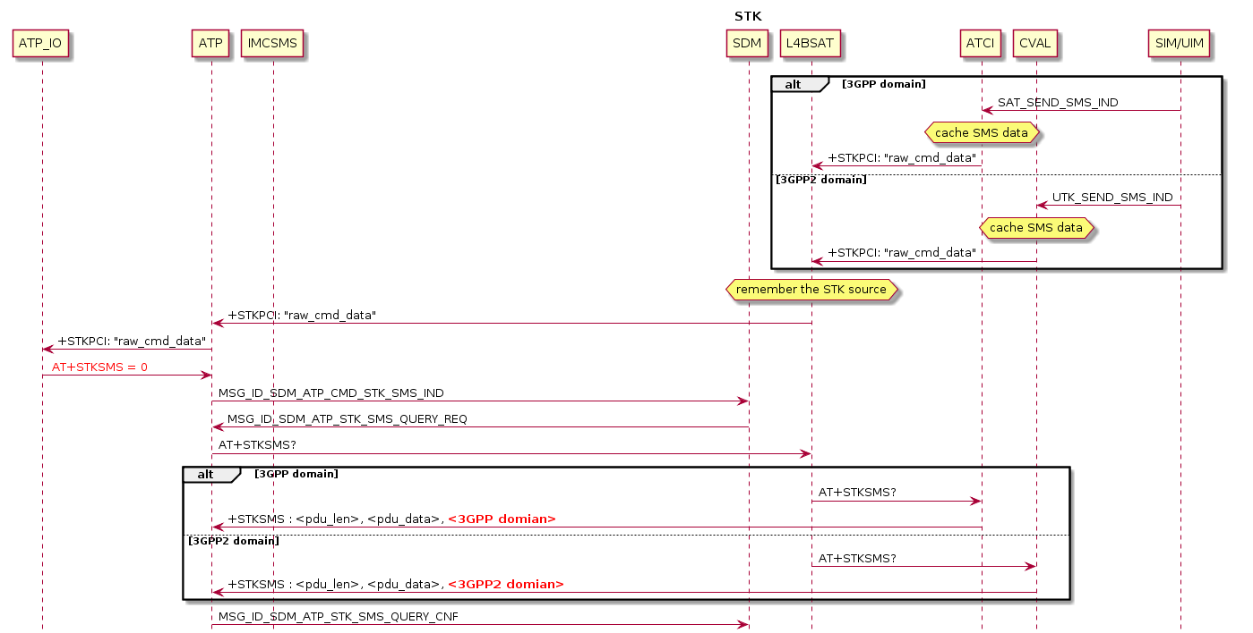
3GPP STK/UTK SMS (1/)

Slide 18
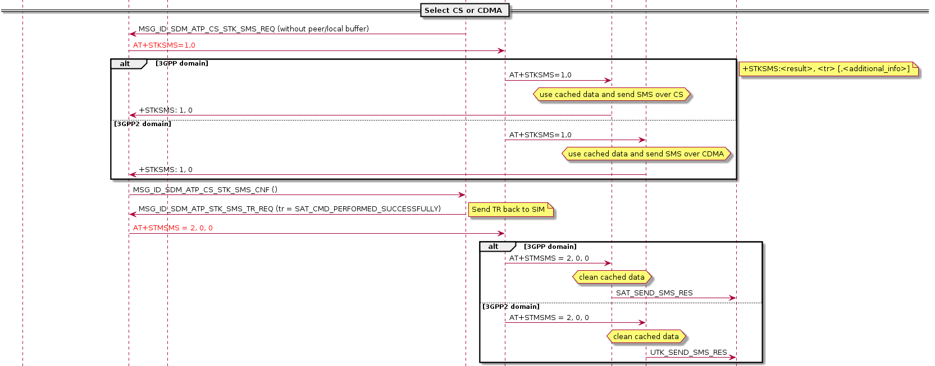
3GPP STK/UTK SMS (2/)

Slide 19
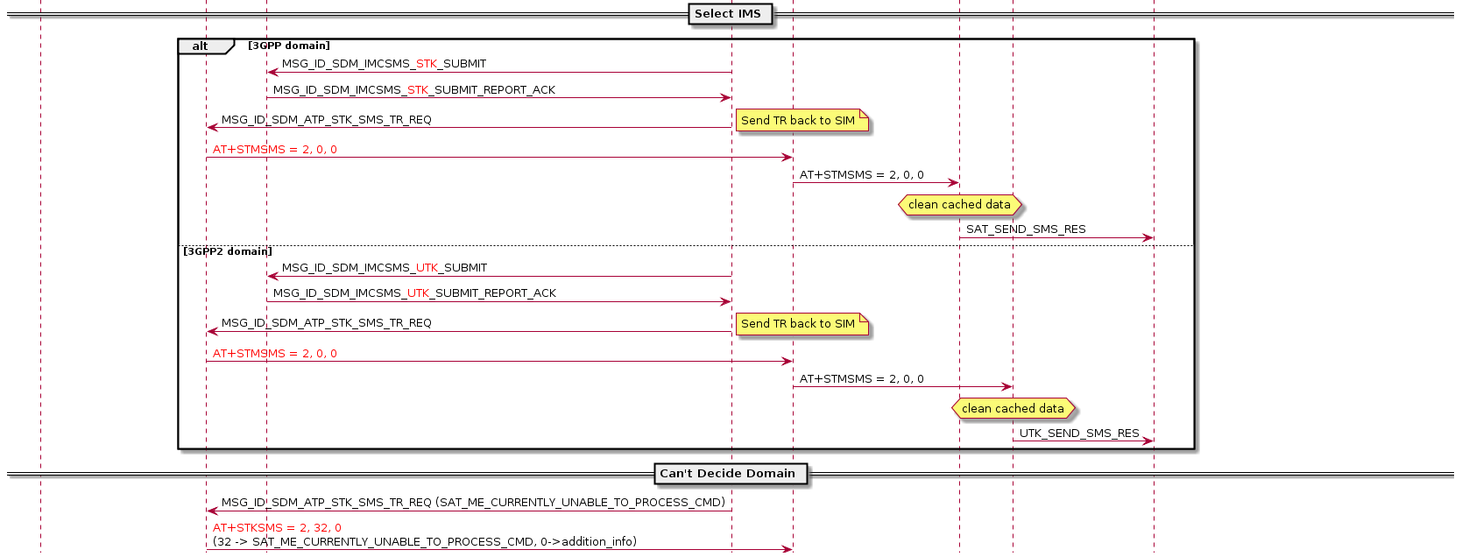
3GPP STK/UTK SMS (3/)

Slide 20
Highlight
SDM leverage old STK SMS flow and apply it on both STK/UTK SMS, i.e.
3GPP/3GPP2 RAT determination is handled by L4BSAT
 | STK SMS | UTKSMS
Query raw data | AT+STKSMS? | AT+STKSMS?
Send xTK SMS | CS: AT+STKSMS=1,0 IMS: SDM_IMCSMS_STK_SUBMIT | CS: AT+STKSMS=1,0 IMS: SDM_IMCSMS_UTK_SUBMIT
Send TR | AT+STKSMS=2,0,0 | AT+STKSMS=2,0,0

Slide 21
Outline
Introduction
Architecture
Flow Change
IMS/CS SMS AT Merge
UTK/STK SMS AT Merge
AT Command Change
SBP Change

Slide 22
AT Command Change
 | 91/92 | 93
MT SMS from IMS | AT+EIMSCNMA | AT+CNMA
Send C2K SMS | AT+C2KCMGS | AT+EC2KCMGS
ACK of C2K SMS | AT+C2KCNMA | AT+EC2KCNMA
WFC switch | AT+EIMSWFC | AT+EIMSCFG
ACK of Status Report | N/A | AT+ECDSCNMA

Slide 23
Outline
Introduction
Architecture
Flow Change
IMS/CS SMS AT Merge
UTK/STK SMS AT Merge
AT Command Change
SBP Change

Slide 24
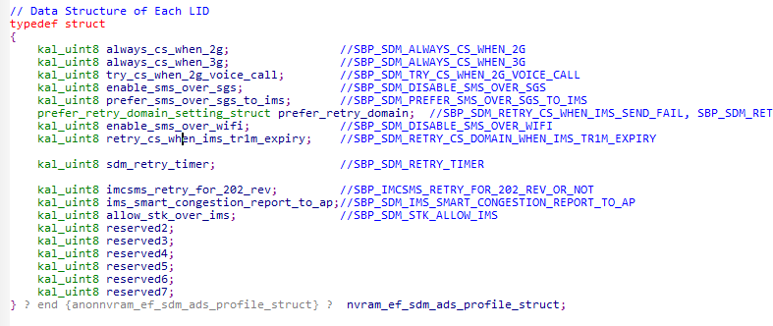
SBP Changes
SDM SBP is re-grouped to NVRAM_EF_SDM_ADS_PROFILE_LID from NVRAM_EF_SBP_MODEM_CONFIG_LID,
so change value from NVRAM_EF_SBP_MODEM_CONFIG_LID will take NO effect, please change it from NVRAM_EF_SDM_ADS_PROFILE_LID

Slide 25
Thank You!

