Slide 1
Gen93
SQC Workshop – EPDG & WiFi-Offloading
WSP/SE7/SD5
Tim Liu
  2017.05.12

Slide 2
Outline
EPDG Introduction
EPDG Modules Relationship
Gen93 EPDG & WO Software Architecture
Message Flow
Initial Handshake between EPDG and WO
Gen 93 WO Configuration / EM
Command Table
ELT Log Analysis

Slide 3
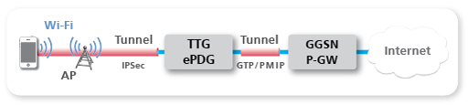
EPDG Introduction
The ePDG (Evolved Packet Data Gateway) provides security mechanism such as IPsec tunneling of UE connections over an untrusted access network.

Slide 4
EPDG Modules Relationship
Gen90~92
Gen93
MAL
AP
EPDG Adapter
AP
wod_action
wod_sim
Strong
swan
EPDG Daemon
Strong
swan
EPDG Daemon
wod_ipsec
wod_ipsec
tty dev.
MD
MD
WO

Slide 5
Android Framework
AP branch
RIL request
IMS
Sub-System
MD Application
netagent
RILD
VOLTE stack/UA
XCAP
vendor-ril
IMCB
IMCB_IMSM
interface
IMSM
StrongSwan
EPDG
AT/URC
(proprietary )
AT
AP
char. dev.
char. dev.
tty dev.
tty dev.
tty dev.
BIP
MD
IMC
Common Data Interface
MOD_IMSM
ATP
DSBP
D2
(task)
SIM
SIMMNGR
TCP/IP
Stack
IWLAN
AT in ILM
L4
WO
DDM
L4BPDN
SIM

Slide 6
Message Flow
EPDG Daemon
WO
IWLAN
SIMMNGR
MSG_ID_IWLAN_WO_ACT_DATA_CALL_REQ
woattach REQ
woattach RSP
ACT DATA CALL
wosimeauth REQ
MSG_ID_SIMMNGR_SIM_AKA_REQ
wosimeauth RSP
MSG_ID_SIMMNGR_SIM_AKA_CNF
+woattach NTY
MSG_ID_IWLAN_WO_ACT_DATA_CALL_CNF
MSG_ID_IWLAN_WO_DEACT_DATA_CALL_REQ
DEACT DATA CALL
wodetach REQ
wodetach RSP
MSG_ID_IWLAN_WO_DEACT_DATA_CALL_CNF
+wodetach NTY
PDN DISCONNECT
+wodisconnect NTY
MSG_ID_IWLAN_WO_PDN_DISCONN_IND

Slide 7
Message Flow (Conti.)
EPDG Daemon
WO
IWLAN
DSBP
MSG_ID_IWLAN_WO_ACT_DATA_CALL_REQ
woattach REQ
ABORT DATA CALL
woattach RSP
MSG_ID_IWLAN_WO_ABORT_DATA_CALL_REQ
wodetach REQ
+woattach NTY
MSG_ID_IWLAN_WO_ACT_DATA_CALL_CNF
wodetach RSP
MSG_ID_IWLAN_WO_ABORT_DATA_CALL_CNF
+wodetach NTY
MSG_ID_WO_DSBP_RECONFIGURE_IND
DSBP Reconfig
MSG_ID_L4C_ME_DSBP_RECONFIGURE_REQ
wosbp REQ
MSG_ID_L4C_ME_DSBP_RECONFIGURE_CNF
wosbp RSP
woemset REQ
woemset RSP
…

Slide 8
Initial Handshake between EPDG and WO
EPDG Daemon
WO
WO_DAEMON_READY = 0
WO_ADPT_READY = 0
WO_DAEMON_READY = 0
WO_ADPT_READY = 0
wostatusget=1
Query WO_ADPT status
wostatusget:1,0
Reply WO_ADPT_READY status
WO_DAEMON_READY = 0
WO_ADPT_READY = 1
WO_DAEMON_READY = 0
WO_ADPT_READY = 1
wostatusget=0
Query DAEMON status
Reply WO_DAEMON_READY status
wostatusget:0,0
WO_DAEMON_READY = 1
WO_ADPT_READY = 1
WO_DAEMON_READY = 1
WO_ADPT_READY = 1
Exit Init Handshake loop
Exit Init Handshake loop

Slide 9
Gen 93 WO Configuration
AP
4. Write strongswan settings to conf
Strongswan
conf
5. Strongswan reload settings from conf
3. Daemon reset to default when receiving wosbp cmd and set cfgs from woemset cmds.
ePDG Daemon
Charon Daemon
CCCI
2. WO read cfg from EM NVram (this cfg priority higher than optr cfg). Then, WO send wosbp and woemset cmds with cfgs different from default value to ePDG Daemon.
WO
1. DSBP trigger reconfiguration callback and read optr cfgs from RAM. Then send cfgs with MSG_ID_WO_DSBP_RECONFIGURE_IND ilm to WO.
DSBP
EM NVram
RAM
OPxx config
Provision
NVram
MD

Slide 10
Gen 93 EM Get Configuration
AP
EM APP
1. Send AT+EWOCFGGET=xxx cmd
4. Receive +EWOCFGGET:xxx URC
CCCI
2. Send MSG_ID_ATP_WO_EWOCFGGET_REQ ilm to WO
CMUX
WO
ATP
3. Return cfg vale in RAM with MSG_ID_ATP_WO_CFG_GET_IND ilm to ATP
MD

Slide 11
Gen 93 EM Set Configuration
AP
EM APP
1. Send AT+EWOCFGSET=xxx cmd
4. Daemon reset to default when receiving wosbp cmd and set cfgs from woemset cmds.
ePDG Daemon
6. Receive +EWOCFGSET:xxx URC
CCCI
2. Send MSG_ID_ATP_WO_EWOCFGSET_REQ ilm to WO
CMUX
WO
ATP
5. Return cfg vale in RAM with MSG_ID_ATP_WO_CFG_SET_IND ilm to ATP
3. Update cfg in RAM and write cfg to EM NVram
EM NVram
Provision
NVram
MD

Slide 12
WOD Commands
PDN Operation
WOD Command | Command Response | Notification | Description
woattach=<ps_id>,<apn>,<cid>,<interface>,<protocol>,<pdn_type>,<pcscf_restore>,<timeout> | woattach:<ps_id>,<apn>,<cid>,<status> | +woattach:<ps_id>,<apn>,<cid>,<status>,[<ipv6>,<ipv4>,<epdg_addr>,<is_visited>,<mtu>/<sub_error_code>,<retry_timer>]
wohol=<ps_id>,<apn>,<cid>,<interface>,<protocol>,<pdn_type>,<pcscf_restore>,<timeout>,<ipv6>,<ipv4> | wohol:<ps_id>,<apn>,<cid>,<status> | +wohol:<ps_id>,<apn>,<cid>,<status>,[<ipv6>,<ipv4>,<epdg_addr>,<is_visited>,<mtu>/<sub_error_code>,<retry_timer>]
wodetach=<ps_id>,<apn>,<cid> | wodetach:<ps_id>,<apn>,<cid>,<status> | +woddetach:<ps_id>,<apn>,<cid>,<status>
 |  | +wodisconnect:<ps_id>,<apn>,<cid>,<status>,<sub_error_code>
 |  | +wooos:<ps_id>,<apn>,<cid>,<oos_status>
 |  | +wopcscf:<ps_id>,<apn>,<cid>,<num_pcscfv6>,<num_pcscfv4>[,<pcscfv6_1>,[<pcscfv6_2,…>]] >[,<pcscfv4_1>,[<pcscfv4_2,…>]]
 |  | +wodns:<ps_id>,<apn>,<cid>,<num_dnsv6>,<num_dnsv4>[,<dnsv6_1>,[<dnsv6_2,…>]] >[,<dnsv4_1>,[<dnsv4_2,…>]]

Slide 13
WOD Commands
Settings – SIM & WiFi info
WOD Command | Command Response | Description
wosimimsi=<ps_id>,”<imsi>” | wosimimsi:<ps_id>,<status>
wosimimpi=<ps_id>,”<impi>” | wosimimpi:<ps_id>,<status>
wosimimei=<ps_id>,”<imei>” | wosimimei:<ps_id>,<status>
wosimplmn=<ps_id>,”<plmn>” | wosimplmn:<ps_id>,<status>
wosimmcc=<ps_id>,”<mcc>” | wosimmcc:<ps_id>,<status>
wosimmnc=<ps_id>,”<mnc>” | wosimmnc:<ps_id>,<status>
wosim=<ps_id>,”<imsi>”,”<plmn>”,”<imei>”,”<impi>” | wosim:<ps_id>,<status>
wowifiif=<wifi_id>,”<wifi_interface>” | wowifiif:<wifi_id>,<status>
wowifiapmac=<wifi_id>,”<wifi_ap_mac>” | wowifiapmac:<wifi_id>,<status>
wowifiaddrv4=<wifi_id>,”<wifi_ipv4>” | wowifiaddrv4:<wifi_id>,<status>
wowifiaddrv6=<wifi_id>,”<wifi_ipv6>” | wowifiaddrv6:<wifi_id>,<status>
wowifi=<wifi_id>, ”<wifi_interface>” ,”<wifi_ipv6>” ,”<wifi_ipv4>” ,”<wifi_ap_mac>” | wowifi:<wifi_id>,<status>

Slide 14
WOD Commands
Others
WOD Command | Command Response | Description
wosbp=<ps_id>,<sbp_id>,<mcc>,<mnc> | wosbp:<ps_id>,<status>
woemget=<ps_id>,<cfg_name> | woemget:<ps_id>,<cfg_name>,<cfg_value>
woemset=<ps_id>,<cfg_name>,<cfg_value> | woemset:<ps_id>,<cfg_name>,<statuc>
woespflush=<cid> | woespflush:<status>
wohplmn=<ps_id>,<hplmn> | wohplmn:<ps_id>,<status>
wooplmn=<ps_id>,<oplmn> | wooplmn:<ps_id>,<status>
woepdgidtfr=<ps_id>,<add_type>,<value> | woepdgidtfr:<ps_id>,<status>
woepdgidtfrem=<ps_id>,<add_type>,<value> | woepdgidtfrem:<ps_id>,<status>
woselectinfo=<ps_id>,<add_type>,<value> | woselectinfo:<ps_id>,<status>
woselectinfoem=<ps_id>,<add_type>,<value> | woselectinfoem:<ps_id>,<status>
wonwstate=<ps_id>,<is_roaming>,<plmn>,<tac_lac> | wonwstate:<ps_id>,<status>
woquerypcscf=<ps_id>,<cid> | woquerypcscf:<ps_id>,<cid>,<num_pcscfv6>,<num_pcscfv4>[,<pcscfv6_1>,[<pcscfv6_2,…>]] >[,<pcscfv4_1>,[<pcscfv4_2,…>]]
wostatusget=<type> | wostatusget:<type>,<status>
woreset= | woreset:

Slide 15
AT Commands
AT Command | Command Response | Description
AT+EWIFIASC=<if_name>,<assoc>,<ssid>,<ap_mac> | AT+EWIFIASC:ok | WiFi AP association info
AT+EWIFIADDR=<if_name>,<ipv4>,<ipv6> | AT+EWIFIADDR:ok | WiFi IP info
AT+EPVSSET=<pvs_name>,<pvs_value> | AT+EPVSSET:ok | Provision data info
AT+EWOCFGSET=<cfg_name>,<cfg_value> | AT+EWOCFGSET:ok +EWOCFGSET: <cfg_name>,<status> | Set WO configuration
AT+EWOCFGGET=<cfg_name> | AT+EWOCFGGET:ok +EWOCFGGET: <cfg_name>,<cfg_value> | Get WO configuration
AT+EEPDG=<enable> | AT+EEPDG:ok | EPDG capability
URC | Description
+EWOPDNOOS: <apn>,<cid>,<oos_status> | WO Out-of-Service notification
+EWOCFGSET: <cfg_name>,<status> | Set WO configuration result notification
+EWOCFGGET: <cfg_name>,<cfg_value> | Get WO configuration result notification

Slide 16
WO Configuration
<cfg name> (default value)
epdg_fqdn (“”) | Ikev2if (“wlan0”) | ike_algo (“”) | esp_algo (“”) | ike_rekey_timer (“36000”) | esp_rekey_timer (“18000”) | rekey_margin (“180”)
dpd_timer (“120”) | keep_timer (“180”) | port (“500”) | port_natt (“4500”) | IDi (“0”) | IDr (“0”) | retrans_to (“2”)
retrans_tries (“4”) | retrans_base (“1”) | cpa_nm (“0”) | cpa_dns4 (“1”) | cpa_dns6 (“1”) | no_ic (“0”) | no_eap (“0”)
fragment (“0”) | mobike (“0”) | esp_setup_time (“15”) | mtu (“1400”) | mss4_off (“68”) | mss6_off (“88”) | leftauth (“0”)
eap (“0”) | cert_used (“1”) | urlcert (“0”) | ocsp (“0”) | nocert (“1”) | debug.skipcert (“0”) | no_id_check (“1”)
dns_timer (“0”) | dns_type (“3”) | cust_pcscf_4 (“20”) | cust_pcscf_6 (“21”) | cust_imei_cp (“0”) | force_tsi_64 (“1”) | force_tsi_full (“1”)
use_cfg_vip (“0”) | oos (“7”) | reauth_addr (“0”) | wdrv_keep_alive (“0”) | key.display (“1”) | key.dump (“0”) | debug.dpd (“0”)
log_level (“1”) | fastreauth (“0”) | select_info (“”) | epdg_identifier (“”) | retry_vector (“”) | pre_post_ping (“0” | dns_cache (“1”)
pcscf_restore (“0”) | emergency_ind (“0”) | liveness_check (“0”) | device_identity (“0”) | reset

Slide 17
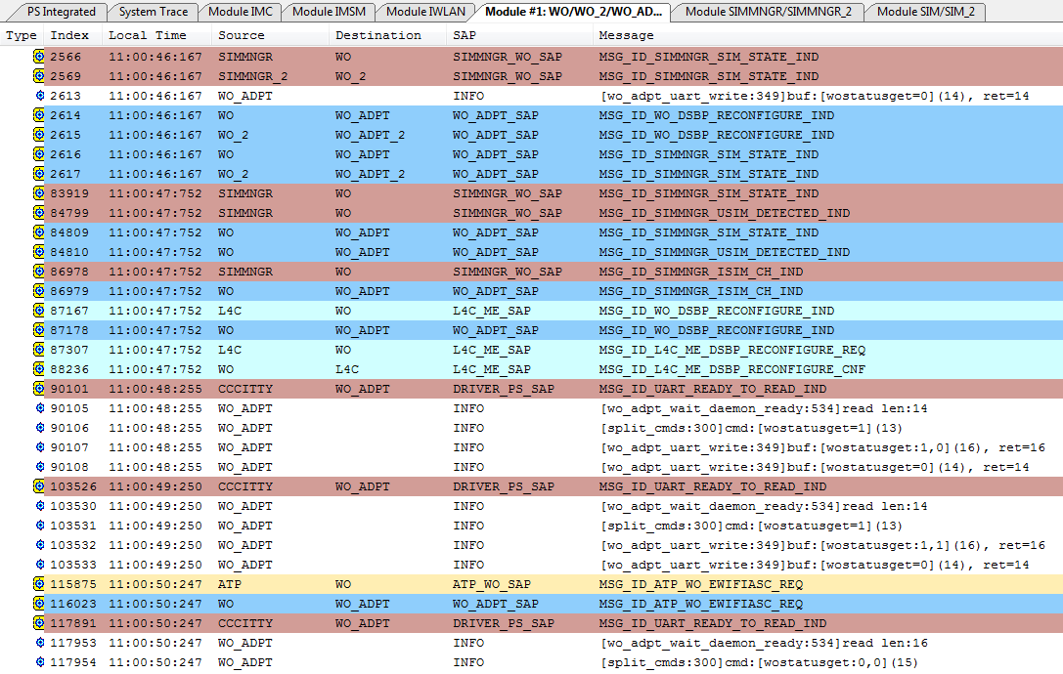
WO ELT Log – Initial Handshake (1)

Slide 18
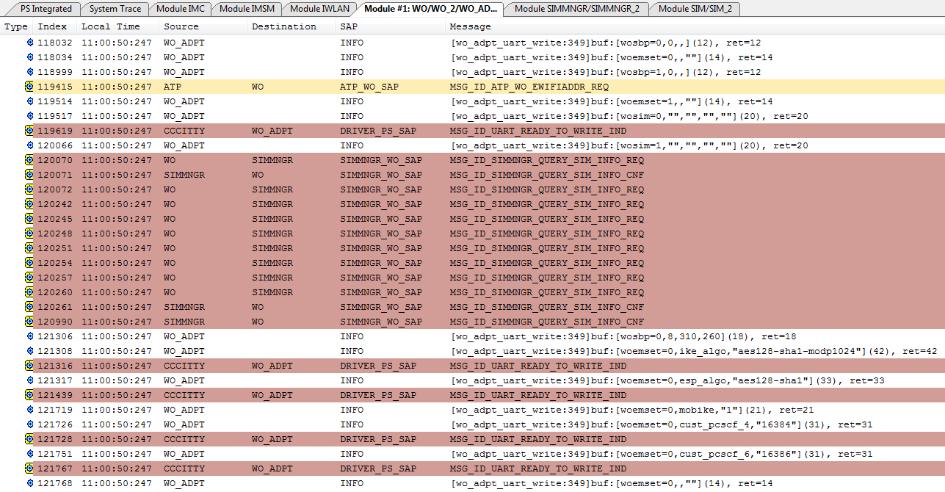
WO ELT Log – Initial Handshake (2)

Slide 19
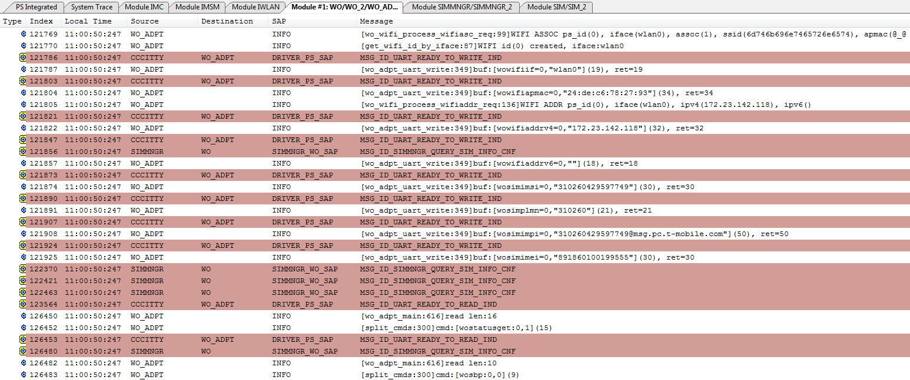
WO ELT Log – Initial Handshake (3)

Slide 20
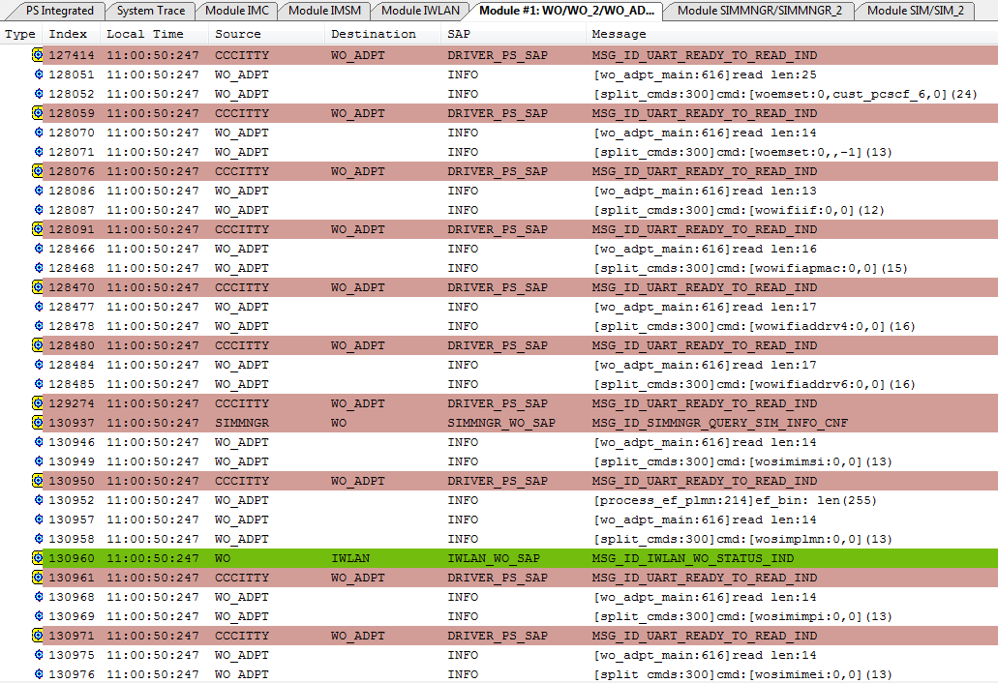
WO ELT Log – Initial Handshake (4)

Slide 21
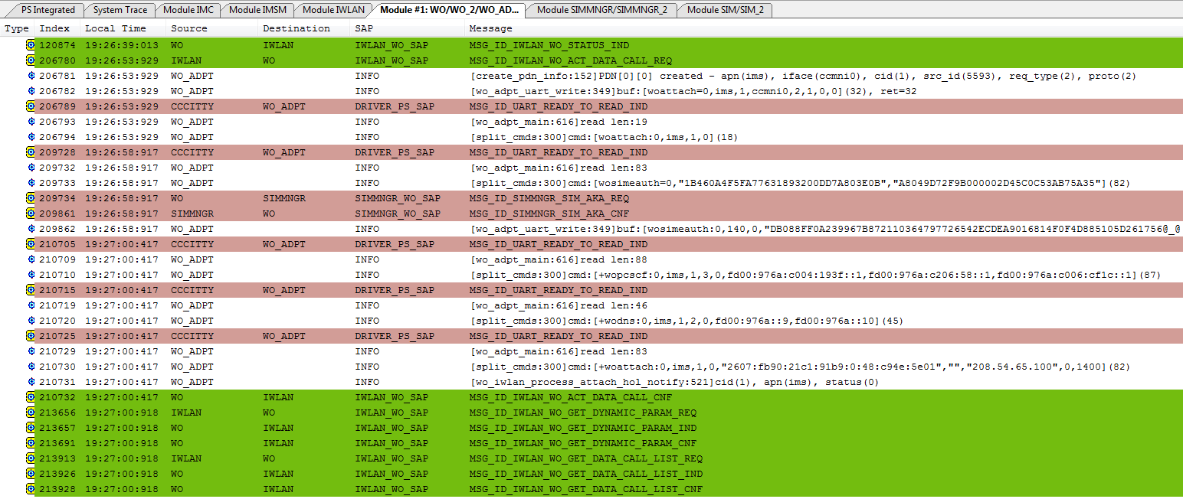
WO ELT Log – ACT DATA CALL

Slide 22
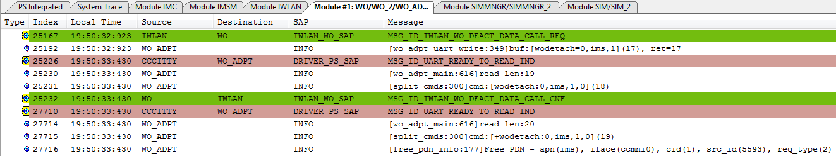
WO ELT Log – DEACT DATA CALL

Slide 23
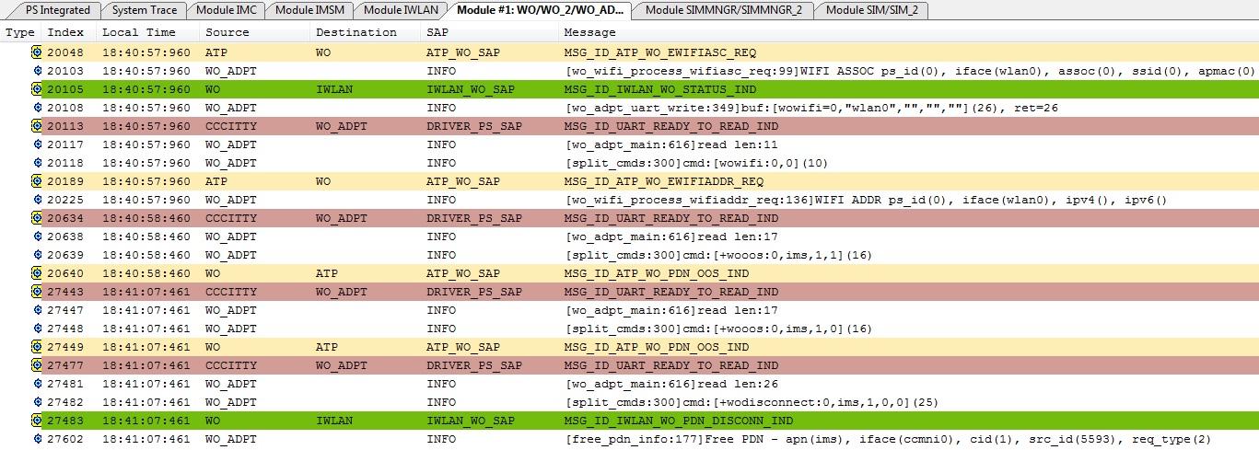
WO ELT Log – OOS & PDN DISCONNECT

