Slide 1
93 RE-ARCH - VoLTE

Slide 2
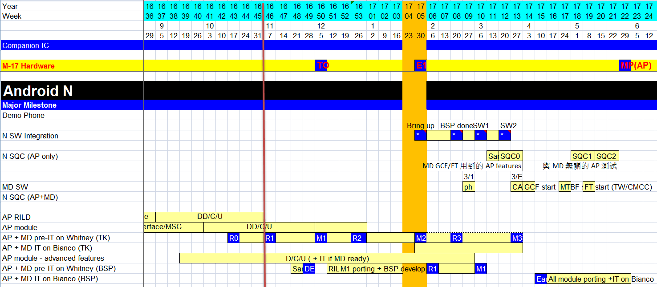
AP SQC Schedule
http://wiki.mediatek.inc/display/WCDACF/6293+AP+development
SQC0 is only for logging test (Telephony function is excluded)

Slide 3
VoLTE Part - Schedule

Slide 4
93MD ReArch Background
Move MD-owned modules to really MD processor
MOD_IMSM, MOD_DAST, MOD_DDM, IWLAN
PDN management is move from RIL to MD
All AP (APLS)-MD communication are converged to RIL/AT Command Interface

Slide 5
Before and After
Android Framework (Java)
Android Framework (Java)
5
WOS
WOS
XCAP
BIP
IMSService
Telephony FW
IMSService
Telephony FW
4
Native Layer (C/C++)
Native Layer (C/C++)
6
3
MAL/RDS
IMSM
RILD
XCAP
VTService
4
RILD
VTService
1
IMS repo
RILProxy
IMS repo
VoLTE UA/Stack
ePDGd
2
VoLTE UA/Stack
ePDGd
IMCB
GSM
C2K
IMCB
93 Vendor-RIL
IMSM
MD1
C2K
LWCTG
2
IMC
L4
CVAL
IMC
D2
IWLAN
WO/DDM
ATP
3
5
BIP
1
L4B

Slide 6
Current (90/91/92) Architecture IMS PDN Establishment Flow
3
REQ
Android Framework
4
Handle the REQ. and then dispatch it to the right MD/EPDG
15
Response without CID/EBI
14
Handle the RES. and then response to IMCB
Network ID allocation
Data Retry
RIL_REQUEST_SETUP_DATA_CALL
5
Modem Application Framework
(MAL)
13
Response to both
Android FW and MAL
2
Pass IMS Para
IMSM
(to support VoLTE)
Query IMS Para &
assigned rat type
7
16
RDS
9
Get IMS info
11
17
RILProxy
RES
6
non-C2K or C2K
8
Query RAN
REQ
1
12
Handle the RES.
SVLTE
IMCB
10
SETUP PDN on WIFI
RILD1
RILD3 (c2k)
ePDGd
MD1
C2K

Slide 7
93 Architecture IMS PDN Establishment Flow
VoLTE stack/ua
(MD APP@AP)
MD Application
VoLTE IMCB
(MD APP@AP)
TCP/IP
Stack
netagent
RILD
AP
XCAP/GBA
(MD APP@AP)
IMSM
(MD APP@AP)
AT/URC
(proprietary )
AT
tty dev.
tty dev.
BIP
(MD APP@MD)
MD
D2Adapter
D2IMSM
D2AT
ATP
SSDS
Common Data Interface
D2CM
D2AM
D2PM
TCP/IP
Stack
D2 Task
IWLAN
AT in ILM
IMC
SIMMNGR
DDM
WO
L4
L4BPDN
L4BNW

Slide 8
Design Change

Slide 9
Recommend Test Scope - Basic

Slide 10
Recommend Test Scope - PDN

Slide 11
Recommend Test Scope - SIM

Slide 12
Recommend Test Scope - CC

Slide 13
Recommend Test Scope - Relay

Slide 14
Recommend Test Scope - SYS

Slide 15
Recommend Test Scope – Others
Wifi Calling
ViLTE
Wifi ←→LTE Handover

Slide 16
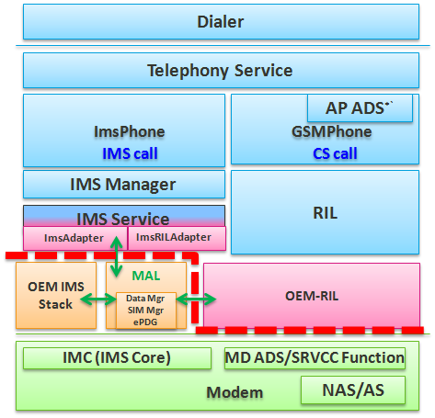
IMS Repo Phase 3
IMS code base prebuilt and deliverred to AP integration like MD image.

Slide 17
IMS Repository Maintenance Concept
MD MP Branches
IMS AP
ALPS MP Branches
90 : MOLY.MP7
IMS MD
IMS AP
alsp-mp-gen90ims
90 : alps-mp-n0.mp7
90 : MOLY.MP7.CMCC
IMS MD
IMS AP
90 : alps-mp-n0.mp12
Phase 2 Model
91 : LR11.MP1
Code sync
IMS MD
IMS AP
90 : alps-mp-n0.mp8.tc?sp
91 : LR11.MP2
IMS MD
IMS AP
alsp-mp-gen91ims
91 : alps-mp-n0.mp1
91 : LR11.MP2.CMCC
IMS MD
IMS AP
91 : alps-mp-n0.mp5
91 : LR11.MP3
IMS MD
IMS AP
91 : alps-mp-n0.mp11
MD MP Branches
IMS AP
ALPS MP Branches
90 : MOLY.MP7
IMS.AP
IMS MD
90 : MOLY.MP7.CMCC
IMS.AP
IMS Repo release with
MD image, volte binary and DSP
IMS MD
Phase 3 Model
IMS MD
91 : LR11.MP1
IMS.AP
91 : LR11.MP2
IMS.AP
IMS MD
91 : LR11.MP2.CMCC
IMS.AP
IMS MD
IMS MD
91 : LR11.MP3
IMS.AP

Slide 18
IMS Repo Phase 3 - Objective
MTK IMS is MD based solution
Align MD branch plan and SW management (i.e. P4, MOLY CQ)
IMS Repo move to MD depot (same level as mcu/dsp) and adjust build flow for pre-built binaries
Pre-build with Google NDK that guantee Android version backward compitible.
AP/MD Interface will include IMS to lock down and sync-up with WSD
AP Coordinator : Kaiwen Liu / Johnny Shih
MD Coordinator : Shawn Lin
IMS Contact : Nick Wang

Slide 19
Target
Milestone :
Deliver IMS repo pre-built binaries to ALPS
16Q4 開始，目標在 17H1 配合Gen93 Android N 版上線。
Android O版全面上線 (with MD Gen90/91/92/93)
Scope :
Pre-build System
IMS module Repository
Patch release Management System

Slide 20
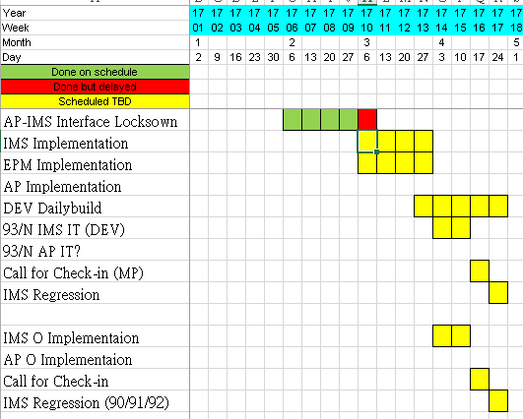
IMS Repo Phase 3 – Schedule/MileStone
AP/MD Interface Lockdown – W06~W10
Implementation - W10~W13.5
Integration Test – W13~W17
MP patch back/Regression - W16~W17
O branches Check-in/Regression – W16~W17

Slide 21
N1 Branch Transition Phase for Gen93
We Need AP branches for legacy and new MD can be resident on separated branches.
WK09.1
alps-dev-bianco.sb
Bianco VoLTE 1st Call
WK02.4
N0 Trunk
(alps-trunk-n0.*)
WK06
Branch
out N1
from N0
Some MTK repos co-trunk between N0/N1/O0
N1 Trunk (alps-trunk-n1.*)
WK06.4 (2/9)
Auto-merge N1 with android-7.1.1
WK07.5 (2/17)
Jade Sanity Pass
>WK08
Start Bianco N-MR1 development
Legacy-MD-compatible VoLTE
New-MD-compatible VoLTE
Bianco SQC/MP branch

