Slide 1
D2/DDM Introduction
Tutorials for Trouble Shooting
Speaker: Chia-Yu Ku
Date: 2017/07/18

Slide 2
Change Log
Date | Remark
2017/07/16 | Initial release for trouble shooting

Slide 3
Outline
Overview of D2/DDM in Gen93 Arch.
Background of D2CM/D2PM
  PDN state machine in D2PM
Logical Flow Chart
  APN setting
  ACT Data Call
  DEACT Data Call
  Network-interface Status Notification
Issue Assignment Policy
Summary

Slide 4
Overview of D2/DDM in Gen93 Arch.
TCP/IP
Stack
netagent
RILD
MD Application
IMSM
(MD APP@AP)
AT/URC
(proprietary )
AT
AP
tty dev.
tty dev.
MD
BIP
(MD APP@MD)
Adapter
D2IMSM
D2AT
ATP
Common Data Interface
D2CM
TCP/IP
Stack
D2AM
D2PM
D2 Task
D2RM
IWLAN
AT in ILM
DDM
WO
L4
L4BPDN
L4BNW

Slide 5
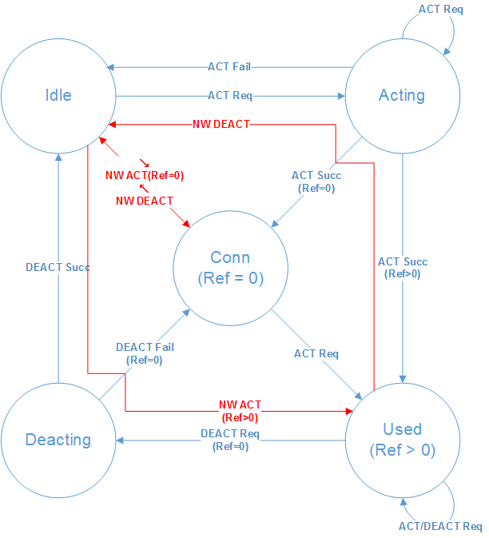
Background of D2CM/D2PM
Reference count (Ref)
  # of users ACT data call
  Data call exists when Ref=0
ACT data call
  Ref=0
    IA, NW(HRPD)
  Ref>0
    AP, IMSM, BIP, XCAP, NW(DED. Bearer)
DEACT data aall
  Ref=0
    ESM #49

Slide 6
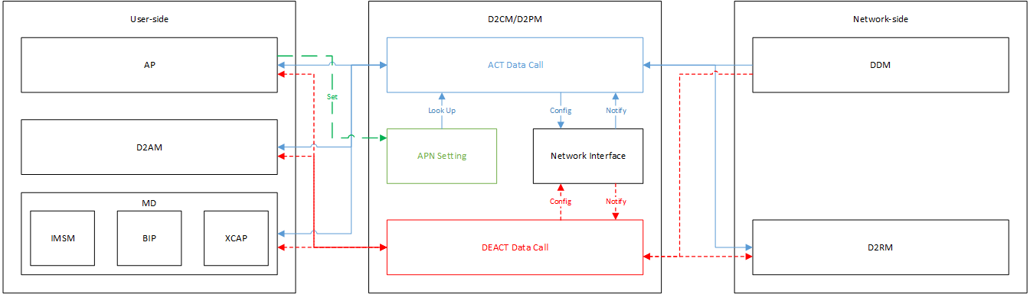
Logical Flow Chart
APN setting from AP
ACT data call
  Look up APN setting for the PDP context
  Network interface
    Configure when requesting data call
    Wait for the interface-up notification after success
DEACT data call
  Network interface
    Wait for the interface-down notification after success

Slide 7
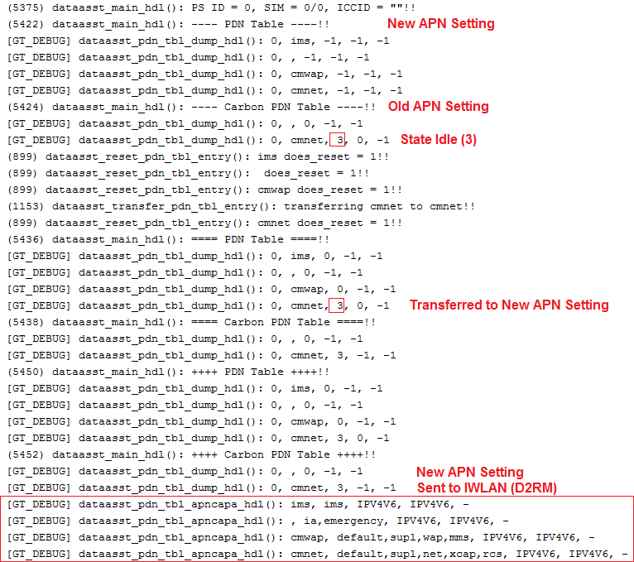
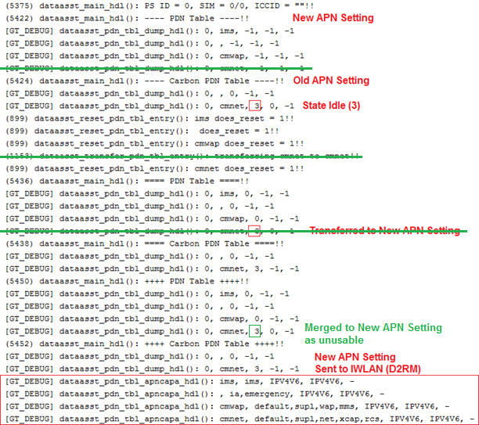
APN Setting
AT+EAPNLOCK=1
  APN setting start
AT+EAPNSET
  APN setting detail
AT+EAPNLOCK=0
  APN setting ends
Actions
  Inherit PDN state
  Merge unusable PDN

Slide 8
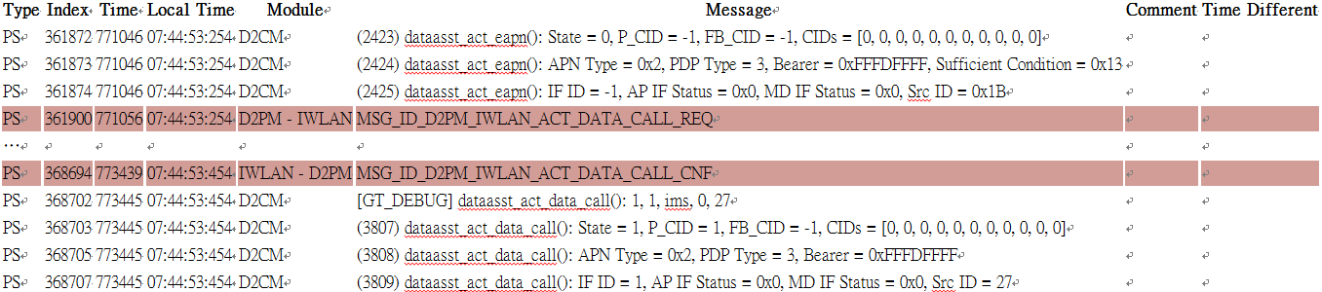
ACT Data Call
Start: dataasst_act_eapn()
  To check the behaviors according to ‘State’
    Idle (0): ACT_DATA_CALL_REQ or ‘+CGEV: NW [PDN] ACT <cid>’
    Acting (0): Wait for the previous ACT_DATA_CALL_REQ
    Conn (3): ACT_DATA_CALL_REQ with a held CID
    Used (4): Reused and replied immediately
End: dataasst_act_data_call() when ACT_DATA_CALL_REQ
  To check the ACT_DATA_CALL_CNF
    Res
    Err_cause in d2pm_ddm_prv

Slide 9
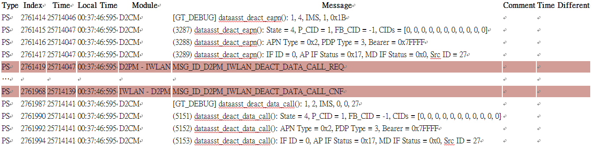
DEACT Data Call
Start: dataasst_deact_eapn()
  To check the behaviors according to ‘State’
    Used (4): DEACT_DATA_CALL_REQ when ref_cnt 1→0
End: dataasst_deact_data_call()
  To check the behaviors according to ‘State’
    Deacting (2): When DEACT_DATA_CALL_REQ
    Conn(3): When ‘+CGEV: NW [PDN] DEACT <cid>’ from DDM
    Used(4): When DEACT_DATA_CALL_IND from D2RM

Slide 10
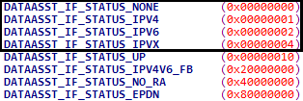
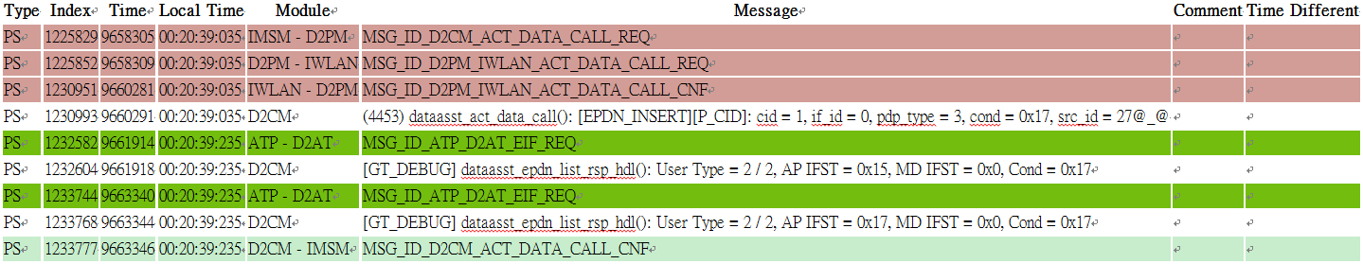
Network-interface Status Notification
Postpone response until net-if satisfy the condition
  AP: +EPDN: <aid>,”new”/”update”
  MD: ACT_DATA_CALL_CNF
  To find [EPDN_INSERT] when the condition is NOT satisfied
  To check the condition
  To examine net-if status in dataasst_epdn_list_rsp_hdl()
  To check AP/MD IFST
  Send response when the condition is satisfied

Slide 11
Issue Assignment Policy
Category | Syndrome | Owner
APN Setting | No APN setting | RIL-Data (Kevin-CC Wang) RIL-IMS (Kaiwen Liu)
 | Incorrect content
ACT Data Call | No ACT_DATA_CALL_CNF | IWLAN (Jen-Ping Huang)
 | No +CGEV | DDM (Dennis Tsai)
 | Failure with 0x16F1 | IWLAN (Jen-Ping Huang)
 | Failure with 0x1671 | D2AM (Chang-Yen Chih)
 | Failure except 0x16D0~0x16EF | L4BPDN (Poying Chuang, Max Mo)
DEACT Data Call | No DEACT_DATA_CALL_CNF | IWLAN (Jen-Ping Huang)
 | No +CGEV | DDM (Dennis Tsai)
Net-if Status Notification | No +EIF | D2CM-Netif (Verit Chen)
Invalid User Argument Illegal User Behavior | AP | RIL-Data (Ben Liao)
 | IMS | IMSM (Ke Cheng)
 | BIP | BIP (CS Huang)
 | XCAP | SSDS (Xiaosan Zhi)

Slide 12
Summary
D2CM interacts with user
  For ACT/DEACT_DATA_CALL and Network-interface status
D2PM manages APN setting and PDN state
Case study for trouble shooting
  APN setting
  ACT_DATA_CALL
  DEACT_DATA_CALL
  Network-interface status notification
Owner list of cooperative modules
Further Discussion

Slide 13
Everyday Genius
Q&A

Slide 14
Appendix
Message Flow Chart

Slide 15
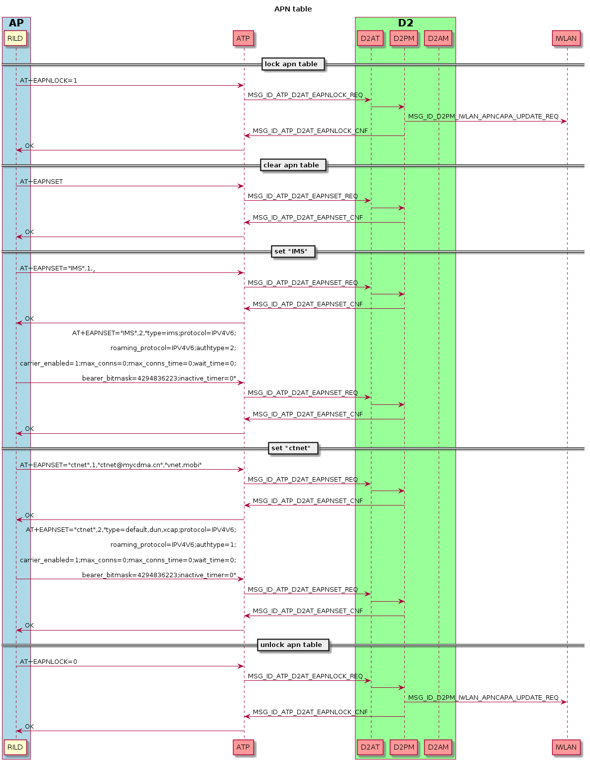
APN Setting

Slide 16
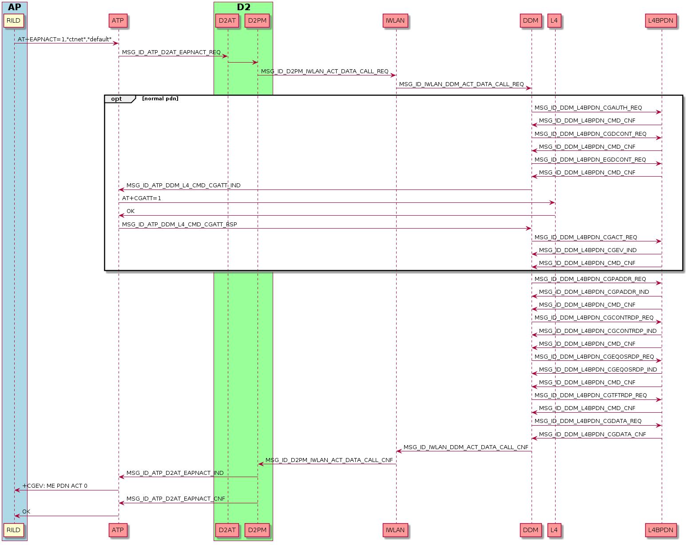
ACT Data Dall

Slide 17
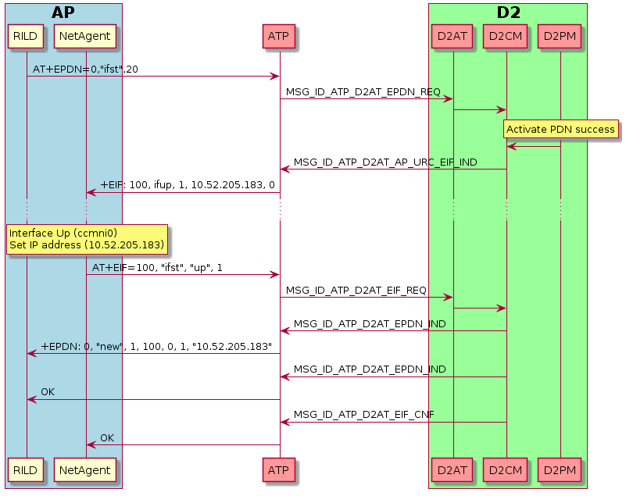
Configure Network Interface
Interface ID = 100
1 → transaction id
00 -> ccmni interface id

Slide 18
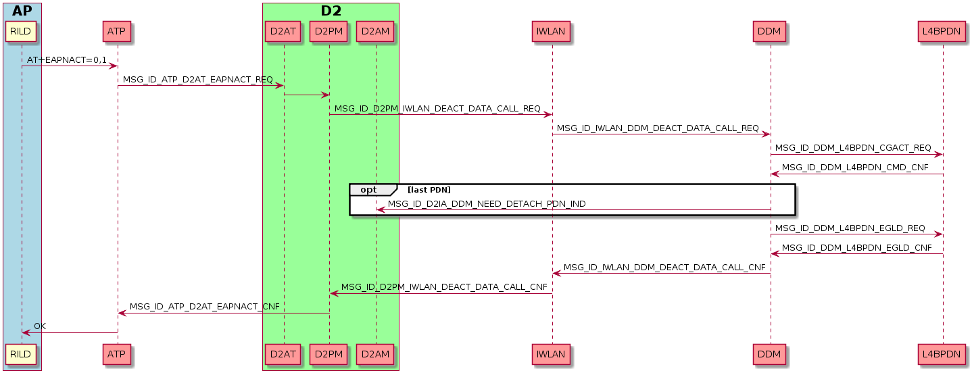
DEACT Data Call

Slide 19
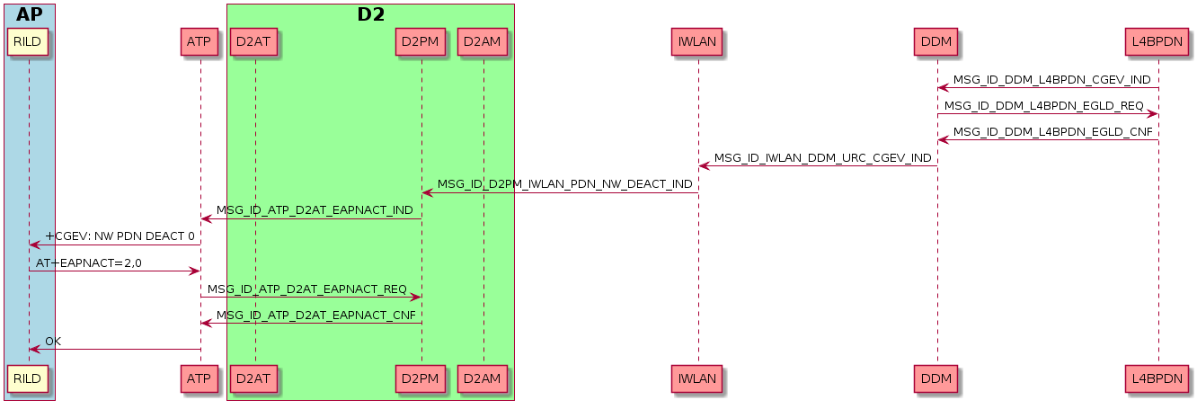
DEACT Data Call by Network

