Slide 1
IMS/WO/IWLAN NVRAM
2017/7/17
WSP/SE7/SD7, Ben/Savvas
WSP/SE7/SD5, Hsin-Jun/Tim

Slide 2
Outline
NVRAM customization
IMC
IWLAN
WO

Slide 3
Design Enhancement from Gen92
Design before gen92
Too many write NVRAM operation (embedded in SBP/DSBP/read IMSI flow)
Inconsistency of tester operation using EM setting
Some parameters might be overwrote after triggering SBP/DSBP flow (because those parameters need to be customized by sbp_id)

Slide 4
Inconsistency NVRAM of Gen92
Boot-up
Boot-up next time
SBP/DSBP
Operator Configurations
NVRAM/EM Configurations
SBP
EM setting
Default NVRAM
overwrite
Operator Configurations
NVRAM/EM Configurations
overwrite
Default NVRAM
Operator Configurations
NVRAM/EM Configurations
EM setting will be removed!!!!!!!
Test begin
Default NVRAM

Slide 5
Framework SW Arch Gen92 vs. Gen93
Gen92
Gen93
Operator Configurations
EM Configurations
Operator Configurations
EM Configurations
MTK NVRAM Structure
MTK NVRAM Structure
LID1
(default NVRAM value)
LID1
(NVRAM 0xFF)
RAM
RAM(default NVRAM value)
Priority: high
Priority: high
NVRAM/EM Configurations
Operator Configurations
NVRAM/EM Configurations
Default NVRAM
Operator Configurations
Priority: low
Priority: low
Default NVRAM

Slide 6
93 NVRAM customization flow
Customization step
Read default value
Overwrite SBP customization
Overwrite NVRAM value
Customization timing
IMC boot up
Update default value to RAM
NVRAM/EM Configurations
Operator Configurations
DSBP customization
Customization by operator configuration
Default NVRAM
NVRAM/EM Configurations
Operator Configurations
IMSI read done
Customization by mnc/mcc
Default NVRAM
Overwrite by NVRAM
NVRAM/EM Configurations
Operator Configurations
Default NVRAM
default values and customization values are stored in
mcu/pcore/custom/modem/common/ps/custom_imc_config.c
mcu/pcore/custom/modem/common/ps/custom_iwlan_config.c
mcu/pcore/custom/modem/common/ps/custom_wo_config.c

Slide 7
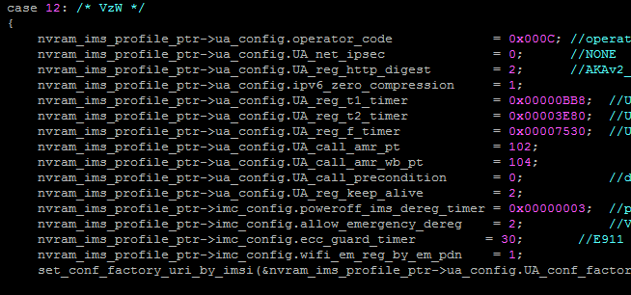
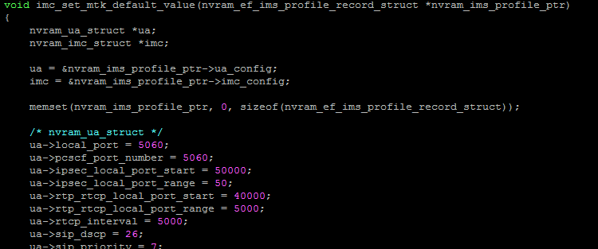
Modify customization and default in custom_imc_config.c
imc_nvram_customization
imc_set_mtk_default_value
Modify default value here!!!
Add or modify operator customization

Slide 8
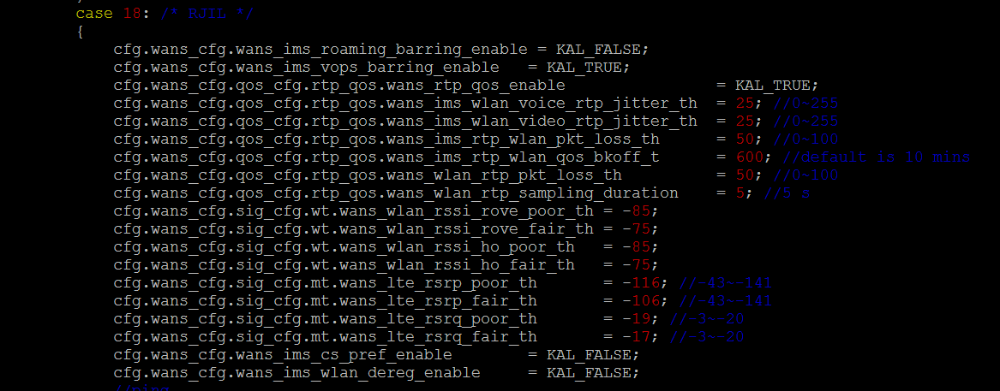
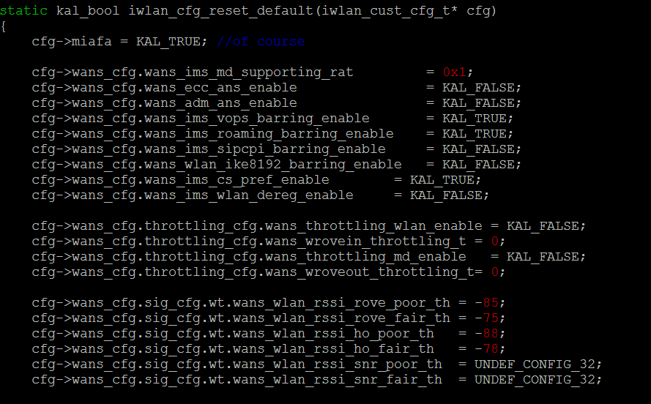
Modify customization and default in custom_iwlan_config.c
iwlan_cust_init
iwlan_cfg_reset_default
Modify default value here!!!
Add or modify operator customization

Slide 9
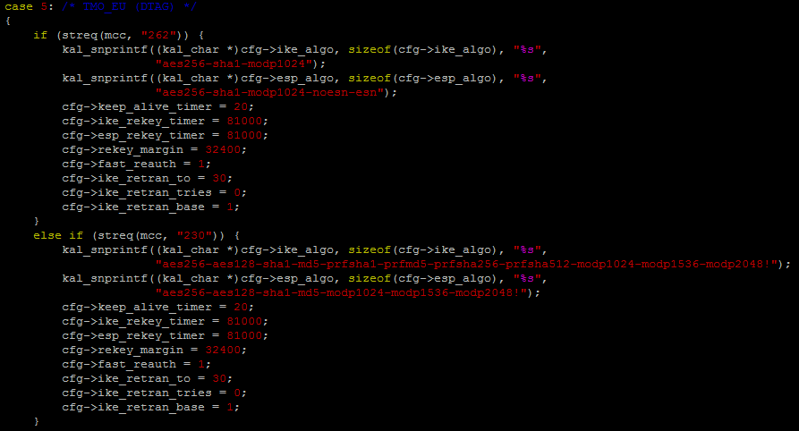
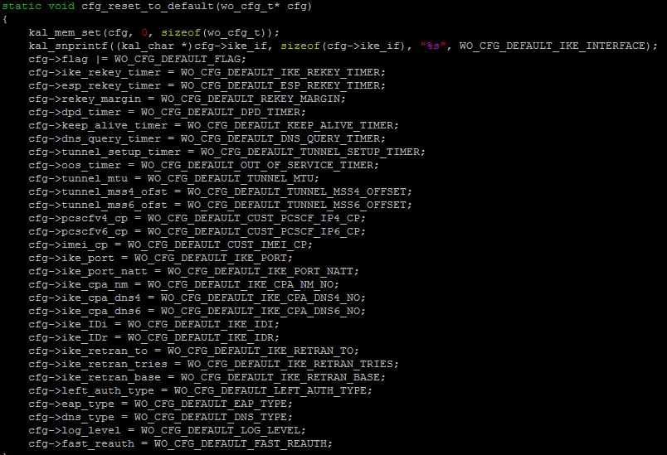
Modify customization and default in custom_wo_config.c
custom_wo_cfg_get
cfg_reset_to_default
Modify default value here!!!
Add or modify operator customization

Slide 10
AT CMD for modifying NVRAM
 | AT CMD format | Reset CMD
IMC | AT+ECFGSET=“cfg_name”,”value_str” | AT+ECFGSET=“reset_ims_to_default”
IWLAN | AT+EIWLCFGSET=“cfg_name”,”value_str” | AT+EIWLCFGSET=“wans_reset”
WO | AT+EWOCFGSET=“cfg_name”,”value_str” | AT+EWOCFGSET="reset"

Slide 11
EM Setting Integration with New Framework
For internal LAB test
For reset to default(operator)
AT+ECFGSET=“reset_ims_to_default”
Example : config PCT test
Example: test want to restore the EM setting
Internal operator_code:
8475
Ericsson
PCT
CMW500
NSN
EM set internal operator_code-PCT
EM set -“reset_ims_to_default”
Update RAM
Reset NVRAM and
Config RAM to current operator default value
NVRAM/EM Configurations – PCT setting
NVRAM/EM Configurations
Operator Configurations
Operator Configurations
Default value
Default NVRAM
operator_code + 28 configurations are stored in RAM and NVRAM
RAM update to operator configuration

