Slide 1
Gen93
Workshop – EPDG & WiFi-Offloading
WSP/SE7/SD5
Tim Liu
  2017.05.12

Slide 2
EPDG Modules Relationship
Gen90~92
Gen93
MAL
AP
EPDG Adapter
AP
wod_action
wod_sim
Strong
swan
EPDG Daemon
Strong
swan
EPDG Daemon
wod_ipsec
wod_ipsec
tty dev.
MD
MD
WO

Slide 3
Android Framework
AP branch
RIL request
IMS
Sub-System
MD Application
netagent
RILD
VOLTE stack/UA
XCAP
vendor-ril
IMCB
IMCB_IMSM
interface
IMSM
StrongSwan
EPDG
AT/URC
(proprietary )
AT
AP
char. dev.
char. dev.
tty dev.
tty dev.
tty dev.
BIP
MD
IMC
Common Data Interface
MOD_IMSM
ATP
DSBP
D2
(task)
SIM
SIMMNGR
TCP/IP
Stack
IWLAN (R1)
D2RM (R2)
AT in ILM
L4
WO
DDM
L4BPDN
SIM

Slide 4
Message Flow
EPDG Daemon
WO
IWLAN
SIMMNGR
DISCONNCETED
NONE
MSG_ID_IWLAN_WO_ACT_DATA_CALL_REQ
woattach REQ
CONNCETING
CONNCETING
woattach RSP
ACT DATA CALL
wosimeauth REQ
MSG_ID_SIMMNGR_SIM_AKA_REQ
wosimeauth RSP
MSG_ID_SIMMNGR_SIM_AKA_CNF
CONNCETED
+woattach NTY
CONNCETED
MSG_ID_IWLAN_WO_ACT_DATA_CALL_CNF
CONNCETED
CONNCETED
DEACT DATA CALL
MSG_ID_IWLAN_WO_DEACT_DATA_CALL_REQ
wodetach REQ
DISCONNCETING
DISCONNCETING
wodetach RSP
MSG_ID_IWLAN_WO_DEACT_DATA_CALL_CNF
DISCONNCETED
+wodetach NTY
NONE
CONNCETED
+wodisconnect NTY
CONNCETED
MSG_ID_IWLAN_WO_PDN_DISCONN_IND
PDN DISCONNECT
DISCONNCETED
NONE

Slide 5
Message Flow (Conti.)
EPDG Daemon
WO
IWLAN
DSBP
DISCONNCETED
NONE
MSG_ID_IWLAN_WO_ACT_DATA_CALL_REQ
woattach REQ
CONNCETING
CONNCETING
woattach RSP
MSG_ID_IWLAN_WO_ABORT_DATA_CALL_REQ
ABORT DATA CALL
wodetach REQ
ABORT
+woattach NTY
MSG_ID_IWLAN_WO_ACT_DATA_CALL_CNF
wodetach RSP
MSG_ID_IWLAN_WO_ABORT_DATA_CALL_CNF
DISCONNCETED
NONE
MSG_ID_WO_DSBP_RECONFIGURE_IND
DSBP Reconfig
MSG_ID_L4C_ME_DSBP_RECONFIGURE_REQ
wosbp REQ
MSG_ID_L4C_ME_DSBP_RECONFIGURE_CNF
wosbp RSP
woemset REQ
woemset RSP
…

Slide 6
Message Flow (Conti.)
EPDG Daemon
WO
IWLAN
DSBP
DISCONNCETED
NONE
MSG_ID_IWLAN_WO_ACT_DATA_CALL_REQ
woattach REQ
CONNCETING
CONNCETING
woattach RSP
MSG_ID_IWLAN_WO_ABORT_DATA_CALL_REQ
ABORT DATA CALL 2
wodetach REQ
ABORT
CONNCETED
+woattach NTY
ABORT_CONNECTING
MSG_ID_IWLAN_WO_ACT_DATA_CALL_CNF
wodetach RSP
MSG_ID_IWLAN_WO_ABORT_DATA_CALL_CNF
DISCONNCETED
+wodetach NTY
NONE

Slide 7
Data Call State Machine
recv MSG_ID_IWLAN_WO_ACT_DATA_CALL_REQ
send MSG_ID_IWLAN_WO_ACT_DATA_CALL_CNF
recv +wopcscf nty
send MSG_ID_IWLAN_WO_MODIFY_DATA_CALL_IND
recv +woattach/+wohol status code != 0
send MSG_ID_IWLAN_WO_ACT_DATA_CALL_CNF
free PDN_info
recv +woattach/+wohol status code == 0
send MSG_ID_IWLAN_WO_ACT_DATA_CALL_CNF
CONNECTING
CONNECTED
recv MSG_ID_IWLAN_WO_ACT_DATA_CALL_REQ
create PDN_info
send woattach/wohol req
recv +wodisconnect nty
send MSG_ID_IWLAN_WO_PDN_DISCONN_IND
free PDN_info
recv MSG_ID_IWLAN_WO_ABORT_DATA_CALL_REQ
send wodetach req
recv MSG_ID_IWLAN_WO_ABORT_DATA_CALL_REQ
send wodetach req
NONE
recv MSG_ID_IWLAN_WO_DEACT_DATA_CALL_REQ
send wodetach req
recv wodetach rsp
free PDN_info
recv +woattach/+wohol status code != 0
send MSG_ID_IWLAN_WO_ACT_DATA_CALL_CNF
ABORT
recv +woattach/+wohol status code == 0
send MSG_ID_IWLAN_WO_ACT_DATA_CALL_CNF
recv wodetach rsp status != 0
free PDN_info
recv +wodetach nty
free PDN_info
recv wodetach rsp status != 0
free PDN_info
recv +wodetach nty
free PDN_info
ABORT_
DISCONNECTING
recv wodetach rsp
send MSG_ID_IWLAN_WO_DEACT_DATA_CALL_CNF
DISCONNECTING
recv wodetach rsp
send MSG_ID_IWLAN_WO_ABORT_DATA_CALL_CNF

Slide 8
Initial Handshake between EPDG and WO
EPDG Daemon
WO
WO_DAEMON_READY = 0
WO_ADPT_READY = 0
WO_DAEMON_READY = 0
WO_ADPT_READY = 0
wostatusget=1
Query WO_ADPT status
wostatusget:1,0
Reply WO_ADPT_READY status
WO_DAEMON_READY = 0
WO_ADPT_READY = 1
WO_DAEMON_READY = 0
WO_ADPT_READY = 1
wostatusget=0
Query DAEMON status
Reply WO_DAEMON_READY status
wostatusget:0,0
WO_DAEMON_READY = 1
WO_ADPT_READY = 1
WO_DAEMON_READY = 1
WO_ADPT_READY = 1
Exit Init Handshake loop
Exit Init Handshake loop

Slide 9
ATcmd to Enable/Disable EPDG Capability
AT+EEPDG=<0/1>
  AP will send this ATcmd to notify MD if AP’s EPDG capability is enabled/disabled when MD boots up.
  If WO is disabled by this ATcmd, WO will quit the initial handshake and will not send msg to daemon.
  This ATcmd can NOT enable WO from the disabled state.

Slide 10
Gen 93 - Flow of OP Setting Changed
AP
4. Write strongswan settings to conf
Strongswan
conf
5. Strongswan reload settings from conf
3. Daemon reset to default when receiving wosbp cmd and set cfgs from woemset cmds.
ePDG Daemon
Charon Daemon
CCCI
2. WO read cfg from EM NVram (this cfg priority higher than optr cfg). Then, WO send wosbp and woemset cmds with cfgs different from default value to ePDG Daemon.
WO
1. DSBP trigger reconfiguration callback and read optr cfgs from RAM. Then send cfgs with MSG_ID_WO_DSBP_RECONFIGURE_IND ilm to WO.
DSBP
EM NVram
RAM
OPxx config
Provision
NVram
MD

Slide 11
Gen 93 - Flow of EM Get Configuration
AP
EM APP
1. Send AT+EWOCFGGET=xxx cmd
4. Receive >+EWOCFGGET:xxx rsp
>OK
CCCI
2. Send MSG_ID_ATP_WO_EWOCFGGET_REQ ilm to WO
CMUX
WO
ATP
3. Return cfg vale in RAM with MSG_ID_ATP_WO_CFG_GET_CNF ilm to ATP
MD

Slide 12
Gen 93 - Flow of EM Set Configuration
AP
EM APP
1. Send AT+EWOCFGSET=xxx cmd
ePDG Daemon
6. Receive >+EWOCFGSET:xxx rsp
>OK
4. Set cfgs from woemset cmds.
CCCI
2. Send MSG_ID_ATP_WO_EWOCFGSET_REQ ilm to WO
CMUX
WO
ATP
5. Return cfg vale in RAM with MSG_ID_ATP_WO_CFG_GET_CNF ilm to ATP
3. Update cfg in RAM and write cfg to EM NVram
EM NVram
RAM
OPxx config
Provision
NVram
MD

Slide 13
Configuration Source
Gen90~92 -
  Epdg_wod:
    alps-xxx/vendor/mediatek/proprietary/external/epdg/wod/src/wo_settings.h
    alps-xxx/vendor/mediatek/proprietary/external/epdg/wod/src/wo_settings.c
    alps-xxx/vendor/mediatek/proprietary/external/epdg/wod/src/s2b/wo_ipsec_cfg.c
  Strongswan:
    alps-xxx/vendor/mediatek/proprietary/external/strongswan/epdg_conf/wod_optr.conf
    alps-xxx/vendor/mediatek/proprietary/external/strongswan/epdg_conf/wod_cust.conf
Gen93 -
  Epdg_wod:
    //UMOLYA/TRUNK/UMOLYA/apps/module/epdg/wod/src/wo_settings.h
    //UMOLYA/TRUNK/UMOLYA/apps/module/epdg/wod/src/wo_settings.c
    //UMOLYA/TRUNK/UMOLYA/apps/module/epdg/wod/src/s2b/wo_ipsec_cfg.c
  Strongswan:
    //UMOLYA/TRUNK/UMOLYA/apps/module/strongswan/epdg_conf/strongswan.conf
  WO:
    //UMOLYA/TRUNK/UMOLYA/mcu/pcore/custom/modem/common/ps/custom_wo_config.h
    //UMOLYA/TRUNK/UMOLYA/mcu/pcore/custom/modem/common/ps/custom_wo_config.c
    //UMOLYA/TRUNK/UMOLYA/mcu/pcore/modem/wo/adapter/inc/wo_cfg.h
    //UMOLYA/TRUNK/UMOLYA/mcu/pcore/modem/wo/adapter/src/wo_cfg.c

Slide 14
Gen93 - Operator Default Configuration
//UMOLYA/TRUNK/UMOLYA/mcu/pcore/custom/modem/common/ps/custom_wo_config.c
kal_bool custom_wo_cfg_get(wo_cfg_t* cfg, kal_uint8 sim_id, kal_uint32 sbp_id,
const kal_char *mcc, const kal_char *mnc)
{
…
case 155: /* Digi Malaysia */
{
kal_snprintf((kal_char *)cfg->ike_algo, sizeof(cfg->ike_algo), "%s",
"aes128-aes256-sha1-prfaesxcbc-modp1024");
kal_snprintf((kal_char *)cfg->esp_algo, sizeof(cfg->esp_algo), "%s",
"aes128-aes256-3des-sha1");
cfg->ike_rekey_timer = 86400;
cfg->esp_rekey_timer = 86400;
cfg->rekey_margin = 180; ←
cfg->ike_retran_to = 1;
cfg->ike_retran_tries = 3;
cfg->ike_retran_base = 2;
cfg->pcscfv4_cp = 16384;
cfg->pcscfv6_cp = 16386;
cfg->fast_reauth = 1;
cfg->oos_timer = 30; ←
disable_flag(cfg, FLAG_CERT_REQ); //Disable CERT_REQ
enable_flag(cfg, FLAG_MOBIKE); //Enable MOBIKE
break;
}
always add rekey_margin if ike_rekey_timer/esp_rekey_timer is defined
always add oos_timer if MOBIKE is enabled

Slide 15
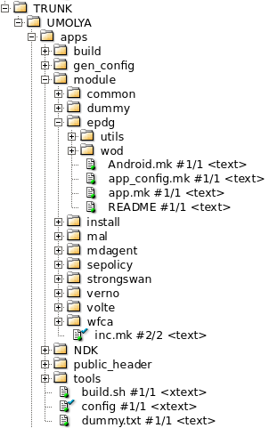
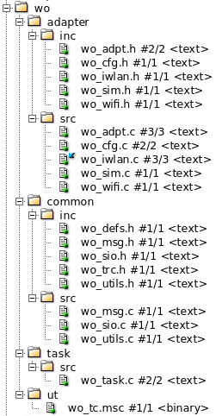
Source Tree
//UMOLYA/TRUNK/UMOLYA/apps/module/epdg
//UMOLYA/TRUNK/UMOLYA/apps/module/strongswan
//UMOLYA/TRUNK/UMOLYA/mcu/pcore/modem/wo

Slide 16
WOD Commands
PDN Operation
WOD Command | Command Response | Notification | Description
woattach=<ps_id>,<apn>,<cid>,<interface>,<protocol>,<pdn_type>,<pcscf_restore>,<timeout> | woattach:<ps_id>,<apn>,<cid>,<status> | +woattach:<ps_id>,<apn>,<cid>,<status>,[<ipv6>,<ipv4>,<epdg_addr>,<is_visited>,<mtu>/<sub_error_code>,<retry_timer>]
wohol=<ps_id>,<apn>,<cid>,<interface>,<protocol>,<pdn_type>,<pcscf_restore>,<timeout>,<ipv6>,<ipv4> | wohol:<ps_id>,<apn>,<cid>,<status> | +wohol:<ps_id>,<apn>,<cid>,<status>,[<ipv6>,<ipv4>,<epdg_addr>,<is_visited>,<mtu>/<sub_error_code>,<retry_timer>]
wodetach=<ps_id>,<apn>,<cid> | wodetach:<ps_id>,<apn>,<cid>,<status> | +woddetach:<ps_id>,<apn>,<cid>,<status>
 |  | +wodisconnect:<ps_id>,<apn>,<cid>,<status>,<sub_error_code>
 |  | +wooos:<ps_id>,<apn>,<cid>,<oos_status>
 |  | +wopcscf:<ps_id>,<apn>,<cid>,<num_pcscfv6>,<num_pcscfv4>[,<pcscfv6_1>,[<pcscfv6_2,…>]] >[,<pcscfv4_1>,[<pcscfv4_2,…>]]
 |  | +wodns:<ps_id>,<apn>,<cid>,<num_dnsv6>,<num_dnsv4>[,<dnsv6_1>,[<dnsv6_2,…>]] >[,<dnsv4_1>,[<dnsv4_2,…>]]

Slide 17
WOD Commands
Settings – SIM & WiFi info
WOD Command | Command Response | Description
wosimimsi=<ps_id>,”<imsi>” | wosimimsi:<ps_id>,<status>
wosimimpi=<ps_id>,”<impi>” | wosimimpi:<ps_id>,<status>
wosimimei=<ps_id>,”<imei>” | wosimimei:<ps_id>,<status>
wosimplmn=<ps_id>,”<plmn>” | wosimplmn:<ps_id>,<status>
wosimmcc=<ps_id>,”<mcc>” | wosimmcc:<ps_id>,<status>
wosimmnc=<ps_id>,”<mnc>” | wosimmnc:<ps_id>,<status>
wosim=<ps_id>,”<imsi>”,”<plmn>”,”<imei>”,”<impi>” | wosim:<ps_id>,<status>
wowifiif=<wifi_id>,”<wifi_interface>” | wowifiif:<wifi_id>,<status>
wowifiapmac=<wifi_id>,”<wifi_ap_mac>” | wowifiapmac:<wifi_id>,<status>
wowifiaddrv4=<wifi_id>,”<wifi_ipv4>” | wowifiaddrv4:<wifi_id>,<status>
wowifiaddrv6=<wifi_id>,”<wifi_ipv6>” | wowifiaddrv6:<wifi_id>,<status>
wowifi=<wifi_id>, ”<wifi_interface>” ,”<wifi_ipv6>” ,”<wifi_ipv4>” ,”<wifi_ap_mac>” | wowifi:<wifi_id>,<status>

Slide 18
WOD Commands
Others
WOD Command | Command Response | Description
wosbp=<ps_id>,<sbp_id>,<mcc>,<mnc> | wosbp:<ps_id>,<status>
woemget=<ps_id>,<cfg_name> | woemget:<ps_id>,<cfg_name>,<cfg_value>
woemset=<ps_id>,<cfg_name>,<cfg_value> | woemset:<ps_id>,<cfg_name>,<statuc>
woespflush=<cid> | woespflush:<status>
wohplmn=<ps_id>,<hplmn> | wohplmn:<ps_id>,<status>
wooplmn=<ps_id>,<oplmn> | wooplmn:<ps_id>,<status>
woepdgidtfr=<ps_id>,<add_type>,<value> | woepdgidtfr:<ps_id>,<status>
woepdgidtfrem=<ps_id>,<add_type>,<value> | woepdgidtfrem:<ps_id>,<status>
woselectinfo=<ps_id>,<add_type>,<value> | woselectinfo:<ps_id>,<status>
woselectinfoem=<ps_id>,<add_type>,<value> | woselectinfoem:<ps_id>,<status>
wonwstate=<ps_id>,<is_roaming>,<plmn>,<tac_lac> | wonwstate:<ps_id>,<status>
woquerypcscf=<ps_id>,<cid> | woquerypcscf:<ps_id>,<cid>,<num_pcscfv6>,<num_pcscfv4>[,<pcscfv6_1>,[<pcscfv6_2,…>]] >[,<pcscfv4_1>,[<pcscfv4_2,…>]]
wostatusget=<type> | wostatusget:<type>,<status>
woreset= | woreset:

Slide 19
AT Commands
AT Command | Command Response | Description
AT+EWIFIASC=<if_name>,<assoc>,<ssid>,<ap_mac> | OK | WiFi AP association info
AT+EWIFIADDR=<if_name>,<ipv4>,<ipv6> | OK | WiFi IP info
AT+EPVSSET=<pvs_name>,<pvs_value> | OK | Provision data info
AT+EWOCFGSET=<cfg_name>,<cfg_value> | +EWOCFGSET: <cfg_name>,<status> OK | Set WO configuration
AT+EWOCFGGET=<cfg_name> | +EWOCFGGET: <cfg_name>,<cfg_value> OK | Get WO configuration
AT+EEPDG=<enable> | OK | EPDG capability
URC | Description
+EWOPDNOOS: <apn>,<cid>,<oos_status> | WO Out-of-Service notification

Slide 20
WO Configuration
<cfg name> (default value)
epdg_fqdn (“”) | Ikev2if (“wlan0”) | ike_algo (“”) | esp_algo (“”) | ike_rekey_timer (“36000”) | esp_rekey_timer (“18000”) | rekey_margin (“180”)
dpd_timer (“120”) | keep_timer (“180”) | port (“500”) | port_natt (“4500”) | IDi (“0”) | IDr (“0”) | retrans_to (“2”)
retrans_tries (“4”) | retrans_base (“1”) | cpa_nm (“0”) | cpa_dns4 (“1”) | cpa_dns6 (“1”) | no_ic (“0”) | no_eap (“0”)
fragment (“0”) | mobike (“0”) | esp_setup_time (“15”) | mtu (“1400”) | mss4_off (“68”) | mss6_off (“88”) | leftauth (“0”)
eap (“0”) | cert_used (“1”) | urlcert (“0”) | ocsp (“0”) | nocert (“1”) | debug.skipcert (“0”) | no_id_check (“1”)
dns_timer (“0”) | dns_type (“3”) | cust_pcscf_4 (“20”) | cust_pcscf_6 (“21”) | cust_imei_cp (“0”) | force_tsi_64 (“1”) | force_tsi_full (“1”)
use_cfg_vip (“0”) | oos (“7”) | reauth_addr (“0”) | wdrv_keep_alive (“0”) | key.display (“1”) | key.dump (“0”) | debug.dpd (“0”)
log_level (“1”) | fastreauth (“0”) | select_info (“”) | epdg_identifier (“”) | retry_vector (“”) | pre_post_ping (“0” | dns_cache (“1”)
certreq_critical (“0”) | pcscf_restore (“0”) | emergency_ind (“0”) | liveness_check (“0”) | device_identity (“0”) | reset

Slide 21
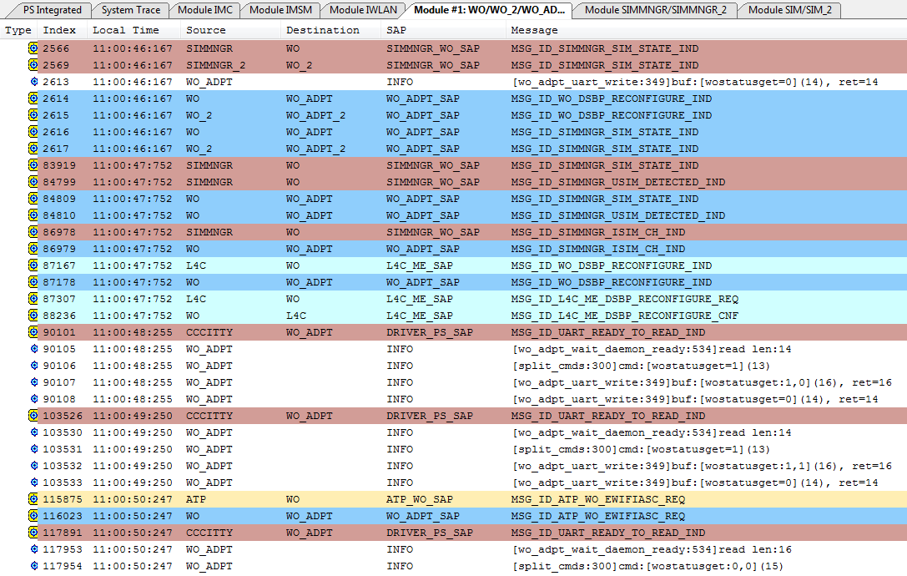
WO ELT Log – Initial Handshake (1)

Slide 22
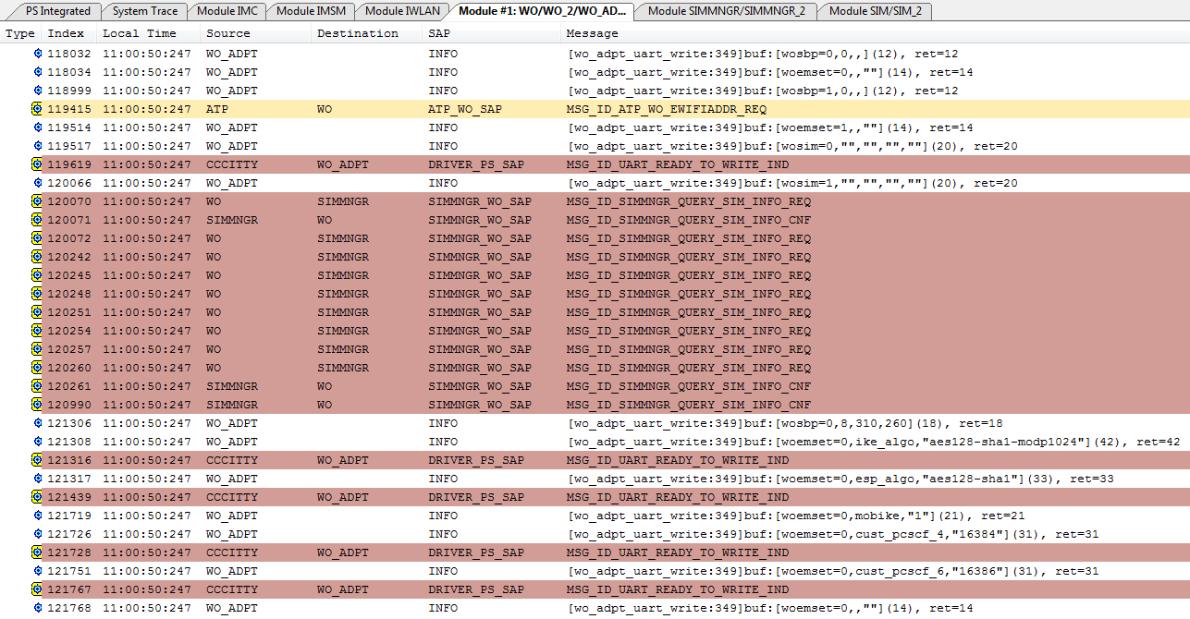
WO ELT Log – Initial Handshake (2)

Slide 23
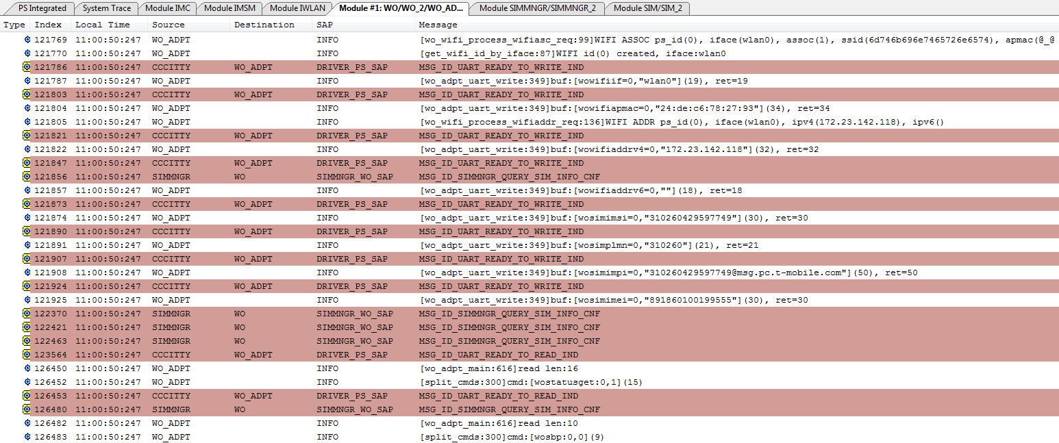
WO ELT Log – Initial Handshake (3)

Slide 24
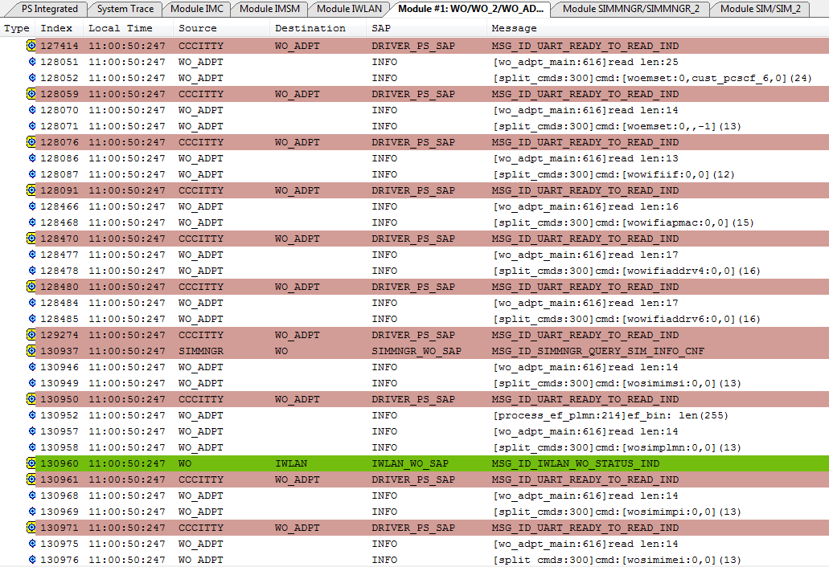
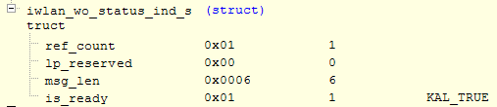
WO ELT Log –
Initial Handshake (4)
typedef enum {
WO_STATUS_FLAG_DAEMON_READY = (1 << 0),
WO_STATUS_FLAG_ADPT_READY = (1 << 1),
WO_STATUS_FLAG_SIM_READY = (1 << 2),
WO_STATUS_FLAG_WIFI_READY = (1 << 3),
WO_STATUS_FLAG_CFG_READY = (1 << 4),
} wo_status_flag_t;
#define WO_STATUS_ALL_READY (WO_STATUS_FLAG_DAEMON_READY | WO_STATUS_FLAG_ADPT_READY | \
WO_STATUS_FLAG_SIM_READY | WO_STATUS_FLAG_WIFI_READY | \
WO_STATUS_FLAG_CFG_READY)

Slide 25
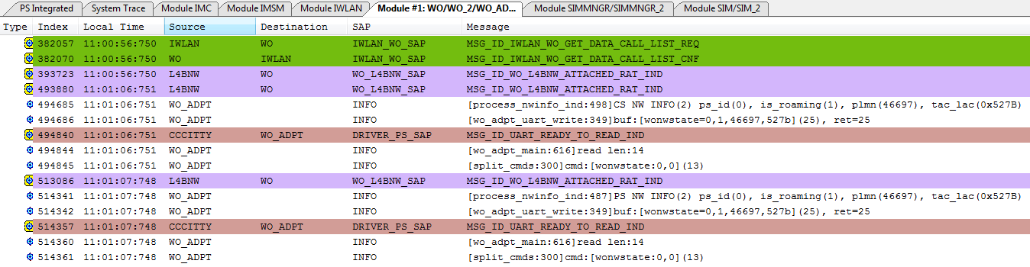
WO ELT Log – Initial Handshake (5)

Slide 26
EPDG main_log – Initial Handshake (1)
04-26 11:23:13.789 I/[epdg_wo]( 3869): [DMN] starting WI-FI OFFLOAD DAEMON
04-26 11:23:13.792 I/[epdg_wo]( 3869): [NID] create post_routing chain
04-26 11:23:17.030 I/[epdg_wo]( 3869): [C3I] wo_ccci_open: status:MD ready
04-26 11:23:17.030 I/[epdg_wo]( 3869): [WOA] Open /dev/ccci_woa successfully (fd:5); wait adpt ready...
04-26 11:23:17.030 I/[epdg_wo]( 3869): [C3I] wo_ccci_write ret:14, buf:[wostatusget=1], len:14
04-26 11:23:18.030 I/[epdg_wo]( 3869): [C3I] wo_ccci_read ret:16
04-26 11:23:18.031 I/[epdg_wo]( 3869): [WOA] split_cmds: cmd:[wostatusget:1,0](15)
04-26 11:23:18.031 I/[epdg_wo]( 3869): [C3I] wo_ccci_write ret:14, buf:[wostatusget=1], len:14
04-26 11:23:19.032 I/[epdg_wo]( 3869): [C3I] wo_ccci_read ret:14
04-26 11:23:19.032 I/[epdg_wo]( 3869): [WOA] split_cmds: cmd:[wostatusget=0](13)
04-26 11:23:19.032 I/[epdg_wo]( 3869): [C3I] wo_ccci_write ret:16, buf:[wostatusget:0,0], len:16
04-26 11:23:19.032 I/[epdg_wo]( 3869): [WOA] Daemon & Adpt are ready.
04-26 11:23:19.032 I/[epdg_wo]( 3869): [SKT] external server socket[wod_action]-fd:-1 init successfully
04-26 11:23:19.033 I/[epdg_wo]( 3869): [SKT] external server socket[wod_sim]-fd:-1 init successfully
04-26 11:23:19.033 I/[epdg_wo]( 3869): [SKT] external server socket[wod_ipsec]-fd:6 init successfully
04-26 11:23:19.034 I/[epdg_wo]( 3869): [DMN] WI-FI OFFLOAD DAEMON started

Slide 27
EPDG main_log – Initial Handshake (2)
04-26 11:23:19.035 I/[epdg_wo]( 3869): [CFG] Reset settings[0] to default
04-26 11:23:19.035 I/[epdg_wo]( 3869): [CFG] Reset settings[1] to default
04-26 11:23:19.038 I/[epdg_wo]( 3869): [DNS] Handle DNS Cmd Loop: dns_handler 630
04-26 11:23:19.112 I/[epdg_wo]( 3869): [WOA] split_cmds: cmd:[wostatusget:1,1](15)
04-26 11:23:19.112 I/[epdg_wo]( 3869): [WOA] split_cmds: cmd:[wostatusget=0](13)
04-26 11:23:19.112 I/[epdg_wo]( 3869): [C3I] wo_ccci_write ret:16, buf:[wostatusget:0,1], len:16
04-26 11:23:19.112 I/[epdg_wo]( 3869): [WOA] split_cmds: cmd:[wosbp=0,0,,](11)
04-26 11:23:19.112 I/[epdg_wo]( 3869): [CFG] Reset settings[0] to default
04-26 11:23:19.113 I/[epdg_wo]( 3869): [C3I] wo_ccci_write ret:10, buf:[wosbp:0,0], len:10
04-26 11:23:19.113 I/[epdg_wo]( 3869): [WOA] split_cmds: cmd:[woemset=0,,""](13)
04-26 11:23:19.113 I/[epdg_wo]( 3869): [C3I] wo_ccci_write ret:14, buf:[woemset:0,,-1], len:14
04-26 11:23:19.113 I/[epdg_wo]( 3869): [WOA] split_cmds: cmd:[wosbp=1,0,,](11)
04-26 11:23:19.114 I/[epdg_wo]( 3869): [CFG] Reset settings[1] to default
04-26 11:23:19.114 I/[epdg_wo]( 3869): [C3I] wo_ccci_write ret:10, buf:[wosbp:1,0], len:10
04-26 11:23:19.114 I/[epdg_wo]( 3869): [WOA] split_cmds: cmd:[woemset=1,,""](13)
04-26 11:23:19.114 I/[epdg_wo]( 3869): [C3I] wo_ccci_write ret:14, buf:[woemset:1,,-1], len:14
04-26 11:23:19.115 I/[epdg_wo]( 3869): [WOA] split_cmds: cmd:[wosim=0,"","","",""](19)
04-26 11:23:19.115 I/[epdg_wo]( 3869): [C3I] wo_ccci_write ret:10, buf:[wosim:0,0], len:10
04-26 11:23:19.115 I/[epdg_wo]( 3869): [WOA] split_cmds: cmd:[wosim=1,"","","",""](19)
04-26 11:23:19.115 I/[epdg_wo]( 3869): [C3I] wo_ccci_write ret:10, buf:[wosim:1,0], len:10

Slide 28
EPDG main_log – Initial Handshake (3)
04-26 11:23:19.115 I/[epdg_wo]( 3869): [WOA] split_cmds: cmd:[wosbp=0,8,310,260](17)
04-26 11:23:19.116 I/[epdg_wo]( 3869): [CFG] Reset settings[0] to default
04-26 11:23:19.116 I/[epdg_wo]( 3869): [C3I] wo_ccci_write ret:10, buf:[wosbp:0,0], len:10
04-26 11:23:19.116 I/[epdg_wo]( 3869): [WOA] split_cmds: cmd:[woemset=0,ike_algo,"aes128-sha1-modp1024"](41)
04-26 11:23:19.118 I/[epdg_wo]( 3869): [CFG] wo_setting_em_set: name=ike_algo, value=aes128-sha1-modp1024, ret=0
04-26 11:23:19.118 I/[epdg_wo]( 3869): [C3I] wo_ccci_write ret:21, buf:[woemset:0,ike_algo,0], len:21
04-26 11:23:19.118 I/[epdg_wo]( 3869): [WOA] split_cmds: cmd:[woemset=0,esp_algo,"aes128-sha1"](32)
04-26 11:23:19.120 I/[epdg_wo]( 3869): [CFG] wo_setting_em_set: name=esp_algo, value=aes128-sha1, ret=0
04-26 11:23:19.120 I/[epdg_wo]( 3869): [C3I] wo_ccci_write ret:21, buf:[woemset:0,esp_algo,0], len:21
04-26 11:23:19.120 I/[epdg_wo]( 3869): [WOA] split_cmds: cmd:[woemset=0,mobike,"1"](20)
04-26 11:23:19.122 I/[epdg_wo]( 3869): [CFG] wo_setting_em_set: name=mobike, value=1, ret=0
04-26 11:23:19.122 I/[epdg_wo]( 3869): [C3I] wo_ccci_write ret:19, buf:[woemset:0,mobike,0], len:19
04-26 11:23:19.122 I/[epdg_wo]( 3869): [WOA] split_cmds: cmd:[woemset=0,cust_pcscf_4,"16384"](30)
04-26 11:23:19.124 I/[epdg_wo]( 3869): [CFG] wo_setting_em_set: name=cust_pcscf_4, value=16384, ret=0
04-26 11:23:19.124 I/[epdg_wo]( 3869): [C3I] wo_ccci_write ret:25, buf:[woemset:0,cust_pcscf_4,0], len:25
04-26 11:23:19.124 I/[epdg_wo]( 3869): [WOA] split_cmds: cmd:[woemset=0,cust_pcscf_6,"16386"](30)
04-26 11:23:19.126 I/[epdg_wo]( 3869): [CFG] wo_setting_em_set: name=cust_pcscf_6, value=16386, ret=0
04-26 11:23:19.126 I/[epdg_wo]( 3869): [C3I] wo_ccci_write ret:25, buf:[woemset:0,cust_pcscf_6,0], len:25
04-26 11:23:19.127 I/[epdg_wo]( 3869): [WOA] split_cmds: cmd:[woemset=0,,""](13)
04-26 11:23:19.127 I/[epdg_wo]( 3869): [C3I] wo_ccci_write ret:14, buf:[woemset:0,,-1], len:14

Slide 29
EPDG main_log – Initial Handshake (4)
04-26 11:23:19.127 I/[epdg_wo]( 3869): [WOA] split_cmds: cmd:[wosimimsi=0,"310260429597749"](29)
04-26 11:23:19.127 I/[epdg_wo]( 3869): [C3I] wo_ccci_write ret:14, buf:[wosimimsi:0,0], len:14
04-26 11:23:19.128 I/[epdg_wo]( 3869): [WOA] split_cmds: cmd:[wosimplmn=0,"310260"](20)
04-26 11:23:19.128 I/[epdg_wo]( 3869): [C3I] wo_ccci_write ret:14, buf:[wosimplmn:0,0], len:14
04-26 11:23:19.128 I/[epdg_wo]( 3869): [WOA] split_cmds: cmd:[wosimimpi=0,"310260429597749@msg.pc.t-mobile.com"](49)
04-26 11:23:19.128 I/[epdg_wo]( 3869): [C3I] wo_ccci_write ret:14, buf:[wosimimpi:0,0], len:14
04-26 11:23:19.128 I/[epdg_wo]( 3869): [WOA] split_cmds: cmd:[wosimimei=0,"891860100199555"](29)
04-26 11:23:19.129 I/[epdg_wo]( 3869): [C3I] wo_ccci_write ret:14, buf:[wosimimei:0,0], len:14
04-26 11:23:19.129 I/[epdg_wo]( 3869): [WOA] split_cmds: cmd:[wohplmn=0,"310260"](18)
04-26 11:23:19.290 I/[epdg_wo]( 3869): [WOA] split_cmds: cmd:[wowifiif=0,"wlan0"](18)
04-26 11:23:19.290 I/[epdg_wo]( 3869): [C3I] wo_ccci_write ret:13, buf:[wowifiif:0,0], len:13
04-26 11:23:19.290 I/[epdg_wo]( 3869): [WOA] split_cmds: cmd:[wowifiapmac=0,"24:de:c6:78:27:93"](33)
04-26 11:23:19.291 I/[epdg_wo]( 3869): [C3I] wo_ccci_write ret:16, buf:[wowifiapmac:0,0], len:16
04-26 11:23:19.328 I/[epdg_wo]( 3869): [WOA] split_cmds: cmd:[wowifiaddrv4=0,"172.23.142.118"](31)
04-26 11:23:19.328 I/[epdg_wo]( 3869): [C3I] wo_ccci_write ret:17, buf:[wowifiaddrv4:0,0], len:17
04-26 11:23:19.328 I/[epdg_wo]( 3869): [WOA] split_cmds: cmd:[wowifiaddrv6=0,""](17)
04-26 11:23:19.328 I/[epdg_wo]( 3869): [C3I] wo_ccci_write ret:17, buf:[wowifiaddrv6:0,0], len:17
04-26 11:23:35.835 I/[epdg_wo]( 3869): [WOA] split_cmds: cmd:[wonwstate=0,1,46697,527b](24)
04-26 11:23:35.837 I/[epdg_wo]( 3869): [C3I] wo_ccci_write ret:14, buf:[wonwstate:0,0], len:14

Slide 30
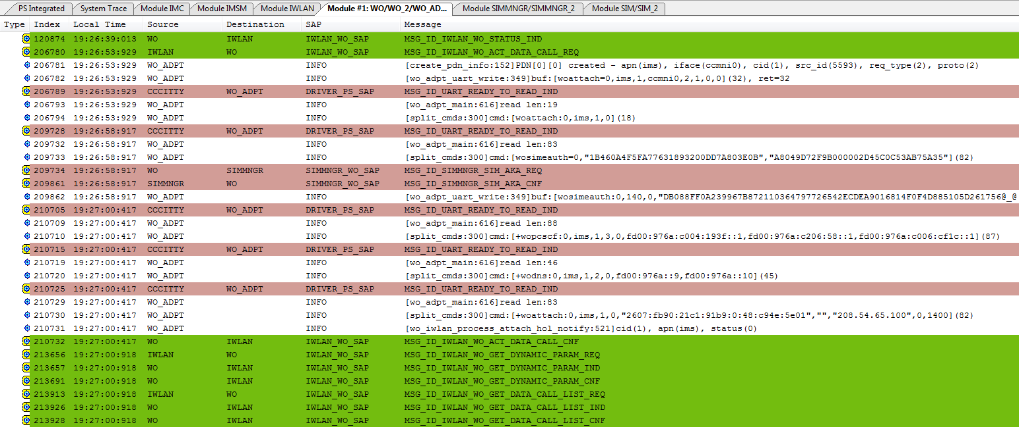
WO ELT Log – ACT DATA CALL

Slide 31
EPDG main_log – ACT DATA CALL (1)
04-25 19:26:53.582 I/[epdg_wo]( 516): [WOA] split_cmds: cmd:[woattach=0,ims,1,ccmni0,2,1,0,0](31)
04-25 19:26:53.589 D/[epdg_wo]( 516): [FSM] PDN <> SIM <0>: [NONE] -> [CONNECTING]
04-25 19:26:53.590 I/[epdg_wo]( 516): [DNS] Send DNS req(1) - fqdn(0x74b222f290):epdg.epc.mnc260.mcc310.pub.3gppnetwork.org, addr_type:2
04-25 19:26:53.603 I/[epdg_wo]( 516): [NID] activate interface [ccmni0] success
04-25 19:26:53.936 I/[epdg_wo]( 516): [PDN] Try to attach to ePDG: FQDN <epdg.epc.mnc260.mcc310.pub.3gppnetwork.org>, Address: <208.54.65.100>
04-25 19:26:53.940 I/[epdg_wo]( 516): [IKE] /vendor/bin/starter --daemon charon
04-25 19:26:57.563 I/[epdg_wo]( 516): [CFG] epdg_fqdn=[]
04-25 19:26:57.565 I/[epdg_wo]( 516): [CFG] cfg_sim0: ikev2if=[wlan0],select_info=[],epdg_identifier=[],retry_vector=[],ike_algo=[aes128-sha1-modp1024],esp_algo=[aes128-sha1],ike_rekey_timer=[36000],esp_rekey_timer=[18000],rekey_margin=[180],dpd_timer=[120],keep_timer=[180],port=[500],port_natt=[4500],IDi=[0],IDr=[0],retrans_to=[2],retrans_tries=[4],retrans_base=[1],cpa_nm=[0],cpa_dns4=[1],cpa_dns6=[1],no_ic=[0],no_eap=[0],fragment=[0],mobike=[1],esp_setup_time=[15],mtu=[1400],mss4_off=[68],mss6_off=[88],leftauth=[0],eap=[0],cert_used=[1],urlcert=[0],ocsp=[0],nocert=[1],debug.skipcert=[0],noid=[1],dns_timer=[0],dns_type=[3],cust_pcscf_4=[16384],cust_pcscf_6=[16386],cust_imei_cp=[0],force_tsi_64=[1],force_tsi_full=[1],use_cfg_vip=[0],oos=[7],reauth_addr=[0],wdrv_keep_alive=[0],key.display=[1],key.dump=[0],debug.dpd=[0],log_level=[1],fastreauth=[0],pre_post_ping=[0],dns_cache=[1]pcscf_restore=[0],emergency_ind=[0],liveness_check=[0],device_identity=[0]
04-25 19:26:57.569 D/[epdg_wo]( 516): [IKE] writing [/data/ipsec/wo/pdn_0_1.conf]...
04-25 19:26:57.574 I/[epdg_wo]( 516): [IKE] updating configuration files...
04-25 19:26:57.574 I/[epdg_wo]( 516): [IKE] /vendor/bin/stroke up-nb pdn_0_1
04-25 19:26:58.754 I/[epdg_wo]( 516): [SKT] [wod_ipsec] received: [ipseceauth=310260429597749,"1B460A4F5FA77631893200DD7A803E0B","A8049D72F9B000002D45C0C53AB75A35"] (fd: [9])
04-25 19:26:58.755 I/[epdg_wo]( 516): [C3I] wo_ccci_write ret:83, buf:[wosimeauth=0,"1B460A4F5FA77631893200DD7A803E0B","A8049D72F9B000002D45C0C53AB75A35"], len:83
04-25 19:26:58.888 I/[epdg_wo]( 516): [WOA] split_cmds: cmd:[wosimeauth:0,140,0,"DB088FF0A239967B872110364797726542ECDEA9016814F0F4D885105D261756887656698EB94AE39ACFD822"](109)
04-25 19:26:58.888 I/[epdg_wo]( 516): [SKT] [wod_ipsec] sending: [ipseceauth:140,0,"DB088FF0A239967B872110364797726542ECDEA9016814F0F4D885105D261756887656698EB94AE39ACFD822"], len: 108 (fd: [9])

Slide 32
EPDG main_log – ACT DATA CALL (2)
04-25 19:27:00.196 I/[epdg_wo]( 516): [SKT] [wod_ipsec] received: [ipsecpcscf=0,1,3,0,fd00:976a:c004:193f::1,fd00:976a:c206:58::1,fd00:976a:c006:cf1c::1] (fd: [9])
04-25 19:27:00.196 I/[epdg_wo]( 516): [SKT] [wod_ipsec] sending: [ipsecpcscf:ok], len: 14 (fd: [9])
04-25 19:27:00.197 I/[epdg_wo]( 516): [C3I] wo_ccci_write ret:88, buf:[+wopcscf:0,ims,1,3,0,fd00:976a:c004:193f::1,fd00:976a:c206:58::1,fd00:976a:c006:cf1c::1], len:88
04-25 19:27:00.199 I/[epdg_wo]( 516): [SKT] [wod_ipsec] received: [ipsecdns=0,1,2,0,fd00:976a::9,fd00:976a::10] (fd: [9])
04-25 19:27:00.199 I/[epdg_wo]( 516): [SKT] [wod_ipsec] sending: [ipsecdns:ok], len: 12 (fd: [9])
04-25 19:27:00.200 I/[epdg_wo]( 516): [C3I] wo_ccci_write ret:46, buf:[+wodns:0,ims,1,2,0,fd00:976a::9,fd00:976a::10], len:46
04-25 19:27:00.201 I/[epdg_wo]( 516): [SKT] [wod_ipsec] received: [ipsecattach=0,1,0,0,2607:fb90:21c1:91b9:0:48:c94e:5e01,,0] (fd: [9])
04-25 19:27:00.202 I/[epdg_wo]( 516): [SKT] [wod_ipsec] sending: [ipsecattach:ok], len: 15 (fd: [9])
04-25 19:27:00.202 D/[epdg_wo]( 516): [FSM] PDN <ims> SIM <0>: [CONNECTING] -> [CONNECTED]
04-25 19:27:00.202 I/[epdg_wo]( 516): [C3I] wo_ccci_write ret:83, buf:[+woattach:0,ims,1,0,"2607:fb90:21c1:91b9:0:48:c94e:5e01","","208.54.65.100",0,1400], len:83

Slide 33
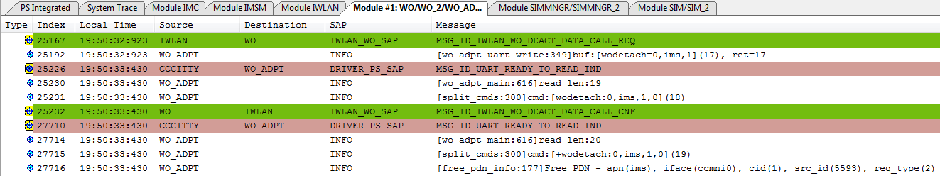
WO ELT Log – DEACT DATA CALL

Slide 34
EPDG main_log – DEACT DATA CALL
04-25 19:50:32.896 I/[epdg_wo]( 516): [WOA] split_cmds: cmd:[wodetach=0,ims,1](16)
04-25 19:50:32.896 D/[epdg_wo]( 516): [FSM] PDN <ims> SIM <0>: [CONNECTED] -> [DISCONNECTING]
04-25 19:50:32.896 I/[epdg_wo]( 516): [IKE] /vendor/bin/stroke down-nb pdn_0_1
04-25 19:50:32.964 D/[epdg_wo]( 516): [IKE] deleted [/data/ipsec/wo/pdn_0_1.conf]
04-25 19:50:32.964 I/[epdg_wo]( 516): [C3I] wo_ccci_write ret:19, buf:[wodetach:0,ims,1,0], len:19
04-25 19:50:33.130 I/[epdg_wo]( 516): [SKT] [wod_ipsec] received: [ipsecdetach=0,1,0] (fd: [9])
04-25 19:50:33.130 I/[epdg_wo]( 516): [SKT] [wod_ipsec] sending: [ipsecdetach:ok], len: 15 (fd: [9])
04-25 19:50:33.130 I/[epdg_wo]( 516): [C3I] wo_ccci_write ret:20, buf:[+wodetach:0,ims,1,0], len:20
04-25 19:50:33.130 D/[epdg_wo]( 516): [FSM] PDN <ims> SIM <0>: [DISCONNECTING] -> [DISCONNECTED]

Slide 35
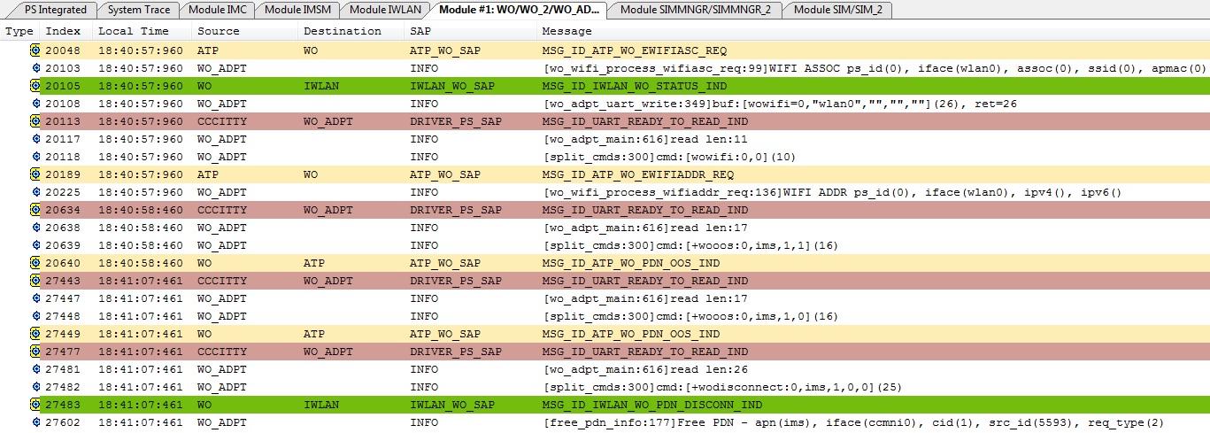
WO ELT Log – OOS & PDN DISCONNECT

Slide 36
EPDG main_log – OOS & PDN DISCONNECT
04-25 18:40:57.589 I/[epdg_wo]( 597): [WOA] split_cmds: cmd:[wowifi=0,"wlan0","","",""](25)
04-25 18:40:57.590 I/[epdg_wo]( 597): [C3I] wo_ccci_write ret:11, buf:[wowifi:0,0], len:11
04-25 18:40:58.125 I/[epdg_wo]( 597): [SKT] [wod_ipsec] received: [ipsecoos=0,3,1] (fd: [9])
04-25 18:40:58.125 I/[epdg_wo]( 597): [SKT] [wod_ipsec] sending: [ipsecoos:ok], len: 12 (fd: [9])
04-25 18:40:58.125 I/[epdg_wo]( 597): [C3I] wo_ccci_write ret:17, buf:[+wooos:0,ims,1,1], len:17
04-25 18:41:07.136 I/[epdg_wo]( 597): [SKT] [wod_ipsec] received: [ipsecoos=0,3,0] (fd: [9])
04-25 18:41:07.136 I/[epdg_wo]( 597): [SKT] [wod_ipsec] sending: [ipsecoos:ok], len: 12 (fd: [9])
04-25 18:41:07.136 I/[epdg_wo]( 597): [C3I] wo_ccci_write ret:17, buf:[+wooos:0,ims,1,0], len:17
04-25 18:41:07.145 I/[epdg_wo]( 597): [SKT] [wod_ipsec] received: [ipsecdetach=0,3,0] (fd: [9])
04-25 18:41:07.145 I/[epdg_wo]( 597): [SKT] [wod_ipsec] sending: [ipsecdetach:ok], len: 15 (fd: [9])
04-25 18:41:07.146 D/[epdg_wo]( 597): [IKE] deleted [/data/ipsec/wo/pdn_0_3.conf]
04-25 18:41:07.146 I/[epdg_wo]( 597): [C3I] wo_ccci_write ret:26, buf:[+wodisconnect:0,ims,1,0,0], len:26
04-25 18:41:07.146 D/[epdg_wo]( 597): [FSM] PDN <ims> SIM <0>: [CONNECTED] -> [DISCONNECTED]

Slide 37
WiFi OOS (MOBIKE disabled) (1)
001588 07-11 15:17:50.751308 2497 2515 I /vendor/bin/charon: 11[ENC] [generate_message() 1737] generating IKE_AUTH request 1 [ IDi N(INIT_CONTACT) CERTREQ IDr CPRQ(ADDR6 DNS6 (16386)) SA TSi TSr N(MOBIKE_SUP) N(NO_ADD_ADDR) N(EAP_ONLY) ]
001747 07-11 15:17:51.295531 2497 2509 I /vendor/bin/charon: 05[ENC] [parse_body() 2654] parsed IKE_AUTH response 1 [ IDr EAP/REQ/AKA ]
001811 07-11 15:17:51.442191 2497 2509 I /vendor/bin/charon: 05[ENC] [generate_message() 1737] generating IKE_AUTH request 2 [ EAP/RES/AKA ]
001926 07-11 15:17:51.871654 2497 2516 I /vendor/bin/charon: 12[ENC] [parse_body() 2654] parsed IKE_AUTH response 2 [ EAP/SUCC ]
001929 07-11 15:17:51.872811 2497 2516 I /vendor/bin/charon: 12[ENC] [generate_message() 1737] generating IKE_AUTH request 3 [ AUTH ]
002008 07-11 15:17:52.586121 2497 2517 I /vendor/bin/charon: 13[ENC] [parse_body() 2654] parsed IKE_AUTH response 3 [ AUTH CPRP(ADDR6 DNS6 DNS6 (16386) (16386) (16386)) SA TSi TSr ]
002094 07-11 15:17:52.632630 887 2476 D [epdg_wo]: [FSM] PDN <ims> SIM <0>: [CONNECTING] -> [CONNECTED]
002096 07-11 15:17:52.633126 887 2476 I [epdg_wo]: [C3I] wo_ccci_write end, ret:83, buf:[+woattach:0,ims,1,0,"2607:fb90:28cc:b6b8:0:46:2b8c:5a01","","208.54.65.100",0,1280], len:83
009728 07-11 15:18:40.376456 2497 2510 I /vendor/bin/charon: 06[ENC] [generate_message() 1737] generating INFORMATIONAL request 4 [ ]
009729 07-11 15:18:40.377072 2497 2510 I /vendor/bin/charon: 06[NET] [send_() 101] sending packet: from 172.26.125.6[14500] to 208.54.65.100[4500] (76 bytes)
009782 07-11 15:18:40.616049 2497 2512 I /vendor/bin/charon: 08[NET] [execute() 73] received packet: from 208.54.65.100[4500] to 172.26.125.6[14500] (76 bytes)
009787 07-11 15:18:40.616532 2497 2512 I /vendor/bin/charon: 08[ENC] [parse_body() 2654] parsed INFORMATIONAL response 4 [ ]
No N(MOBIKE_SUP)

Slide 38
WiFi OOS (MOBIKE disabled) (2)
016345 07-11 15:25:18.049882 2497 2517 I /vendor/bin/charon: 13[KNL] [process_addr() 992] 172.20.10.5 disappeared from wlan0
016394 07-11 15:25:18.070064 2497 2509 I /vendor/bin/charon: 05[KNL] [process_addr() 992] fe80::20c:e7ff:fe54:560 disappeared from wlan0
016546 07-11 15:25:18.125488 887 887 I [epdg_wo]: [WOA] split_cmds: cmd:[wowifi=0,"wlan0","","",""](25)
016547 07-11 15:25:18.125560 887 887 I [epdg_wo]: [IKE] /vendor/bin/stroke data_path down wlan0
016563 07-11 15:25:18.189187 2497 2519 I /vendor/bin/charon: 15[CFG] [stroke_data_path_status_notify() 646] received stroke: data_path_status_notify(down), interface(wlan0)
016564 07-11 15:25:18.189470 2497 2519 I /vendor/bin/charon: 15[CFG] [data_path_status_notify() 784] data path (wlan0) is not ready
016624 07-11 15:25:18.601458 2497 2511 I /vendor/bin/charon: 07[KNL] [get_route() 1682] no address found to reach 208.54.65.100
016625 07-11 15:25:18.602123 2497 2511 I /vendor/bin/charon: 07[IKE] [is_any_path_valid() 2599] old path is not available anymore, try to find another
016626 07-11 15:25:18.602793 2497 2511 I /vendor/bin/charon: 07[IKE] [is_any_path_valid() 2607] looking for a route to 208.54.65.100 ...
016627 07-11 15:25:18.603561 2497 2511 I /vendor/bin/charon: 07[KNL] [get_route() 1682] no address found to reach 208.54.65.100
016628 07-11 15:25:18.604108 2497 2511 I /vendor/bin/charon: 07[IKE] [roam() 2662] no route found to reach 208.54.65.100, MOBIKE update deferred
016635 07-11 15:25:18.607262 887 2476 I [epdg_wo]: [C3I] wo_ccci_write end, ret:17, buf:[+wooos:0,ims,1,1], len:17
016637 07-11 15:25:18.608178 2497 2511 I /vendor/bin/charon: 07[IKE] [roam() 2670] ============================= oos enabled (sn=6): 30s

Slide 39
WiFi OOS (MOBIKE disabled) (3)
020750 07-11 15:25:20.818759 2497 2513 I /vendor/bin/charon: 09[KNL] [process_addr() 1013] 172.26.125.6 appeared on wlan0
021207 07-11 15:25:21.886732 2497 2519 I /vendor/bin/charon: 15[KNL] [process_addr() 1013] fe80::20c:e7ff:fe54:560 appeared on wlan0
021301 07-11 15:25:23.106489 887 887 I [epdg_wo]: [WOA] split_cmds: cmd:[wowifiaddrv4=0,"172.26.125.6"](29)
021302 07-11 15:25:23.106584 887 887 I [epdg_wo]: [IKE] /vendor/bin/stroke data_path up wlan0
021309 07-11 15:25:23.209314 2497 2514 I /vendor/bin/charon: 10[CFG] [stroke_data_path_status_notify() 646] received stroke: data_path_status_notify(up), interface(wlan0)
021310 07-11 15:25:23.209647 2497 2514 I /vendor/bin/charon: 10[CFG] [data_path_status_notify() 784] data path (wlan0) is ready
021314 07-11 15:25:23.211938 887 887 I [epdg_wo]: [WOA] split_cmds: cmd:[wowifiaddrv6=0,""](17)
021320 07-11 15:25:23.761505 2497 2515 I /vendor/bin/charon: 11[KNL] [get_route() 1677] using 172.26.125.6 as address to reach 208.54.65.100
021321 07-11 15:25:23.762379 2497 2515 I /vendor/bin/charon: 11[IKE] [is_any_path_valid() 2599] old path is not available anymore, try to find another
021322 07-11 15:25:23.764745 2497 2515 I /vendor/bin/charon: 11[IKE] [is_any_path_valid() 2607] looking for a route to 208.54.65.100 ...
021324 07-11 15:25:23.765864 2497 2515 I /vendor/bin/charon: 11[KNL] [get_interface_address() 694] ============================ ip: 172.26.125.6, scope:0
021325 07-11 15:25:23.766565 2497 2515 I /vendor/bin/charon: 11[KNL] [get_route() 1677] using 172.26.125.6 as address to reach 208.54.65.100
021328 07-11 15:25:23.767131 2497 2515 I /vendor/bin/charon: 11[IKE] [roam() 2711] src_ip changed - send DPD to check if connection is valid
021331 07-11 15:25:23.771302 2497 2515 I /vendor/bin/charon: 11[ENC] [generate_message() 1737] generating INFORMATIONAL request 11 [ ]
021333 07-11 15:25:23.776677 2497 2515 I /vendor/bin/charon: 11[KNL] [get_route() 1677] using 172.26.125.6 as address to reach 208.54.65.100
021334 07-11 15:25:23.777828 2497 2515 I /vendor/bin/charon: 11[IKE] [retransmit() 474] *** update ike_sa & message src 172.20.10.5 to 172.26.125.6 ***
021337 07-11 15:25:23.778568 2497 2515 I /vendor/bin/charon: 11[NET] [send_() 101] sending packet: from 172.26.125.6[14500] to 208.54.65.100[4500] (76 bytes)
021345 07-11 15:25:24.014113 2497 2509 I /vendor/bin/charon: 05[NET] [execute() 73] received packet: from 208.54.65.100[4500] to 172.26.125.6[14500] (76 bytes)
021346 07-11 15:25:24.015336 2497 2509 I /vendor/bin/charon: 05[ENC] [parse_body() 2654] parsed INFORMATIONAL response 11 [ ]
021347 07-11 15:25:24.015915 2497 2509 I /vendor/bin/charon: 05[IKE] [process_i() 89] *** update child_sa ***
021390 07-11 15:25:24.023948 887 2476 I [epdg_wo]: [C3I] wo_ccci_write end, ret:17, buf:[+wooos:0,ims,1,0], len:17
021401 07-11 15:25:24.027128 2497 2509 I /vendor/bin/charon: 05[IKE] [process_i() 92] ============================= receive DPD reply, oos disabled.
Server supports Dynamic Update

Slide 40
WiFi OOS (MOBIKE enabled) (1)
02762 07-04 17:13:37.970184 2420 2443 I /vendor/bin/charon: 15[ENC] [generate_message() 1737] generating IKE_AUTH request 1 [ IDi N(INIT_CONTACT) CERTREQ IDr CPRQ(ADDR6 DNS6 (16386)) SA TSi TSr N(MOBIKE_SUP) N(NO_ADD_ADDR) N(EAP_ONLY) ]
02988 07-04 17:13:38.556301 2420 2444 I /vendor/bin/charon: 16[ENC] [parse_body() 2654] parsed IKE_AUTH response 1 [ IDr EAP/REQ/AKA ]
03161 07-04 17:13:38.714684 2420 2444 I /vendor/bin/charon: 16[ENC] [generate_message() 1737] generating IKE_AUTH request 2 [ EAP/RES/AKA ]
03708 07-04 17:13:39.466560 2420 2436 I /vendor/bin/charon: 08[ENC] [parse_body() 2654] parsed IKE_AUTH response 2 [ EAP/SUCC ]
03711 07-04 17:13:39.468527 2420 2436 I /vendor/bin/charon: 08[ENC] [generate_message() 1737] generating IKE_AUTH request 3 [ AUTH ]
04133 07-04 17:13:40.129725 2420 2439 I /vendor/bin/charon: 11[ENC] [parse_body() 2654] parsed IKE_AUTH response 3 [ AUTH CPRP(ADDR6 DNS6 DNS6 (16386) (16386) (16386)) N(INIT_CONTACT) N(MOBIKE_SUP) SA TSi TSr ]
04253 07-04 17:13:40.172533 849 2407 D [epdg_wo]: [FSM] PDN <ims> SIM <0>: [CONNECTING] -> [CONNECTED]
04255 07-04 17:13:40.172736 849 2407 I [epdg_wo]: [C3I] wo_ccci_write end, ret:83, buf:[+woattach:0,ims,1,0,"2607:fb90:1bc6:da75:0:3b:1945:9901","","208.54.85.111",0,1280], len:83
04258 07-04 17:13:40.173461 2420 2439 I /vendor/bin/charon: 11[IKE] [process_payloads() 131] peer supports MOBIKE
09304 07-04 17:13:44.960458 2420 2442 I /vendor/bin/charon: 14[ENC] [generate_message() 1737] generating INFORMATIONAL request 4 [ N(NATD_S_IP) N(NATD_D_IP) ]
09310 07-04 17:13:44.962304 2420 2442 I /vendor/bin/charon: 14[NET] [send_() 101] sending packet: from 172.26.125.70[14500] to 208.54.85.111[4500] (124 bytes)
10002 07-04 17:13:45.235223 2420 2444 I /vendor/bin/charon: 16[NET] [execute() 73] received packet: from 208.54.85.111[4500] to 172.26.125.70[14500] (124 bytes)
10003 07-04 17:13:45.236161 2420 2444 I /vendor/bin/charon: 16[ENC] [parse_body() 2654] parsed INFORMATIONAL response 4 [ N(NATD_D_IP) N(NATD_S_IP) ]

Slide 41
WiFi OOS (MOBIKE enabled) (2)
22846 07-07 11:20:58.834639 2581 2600 I /vendor/bin/charon: 16[KNL] [process_addr() 992] 192.168.1.102 disappeared from wlan0
22886 07-07 11:20:58.849018 2581 2597 I /vendor/bin/charon: 13[KNL] [process_addr() 992] fe80::20c:e7ff:fe54:562 disappeared from wlan0
23195 07-07 11:20:58.927416 923 923 I [epdg_wo]: [WOA] split_cmds: cmd:[wowifi=0,"wlan0","","",""](25)
23196 07-07 11:20:58.927479 923 923 I [epdg_wo]: [IKE] /vendor/bin/stroke data_path down wlan0
23232 07-07 11:20:58.986515 2581 2591 I /vendor/bin/charon: 07[CFG] [stroke_data_path_status_notify() 646] received stroke: data_path_status_notify(down), interface(wlan0)
23233 07-07 11:20:58.986636 2581 2591 I /vendor/bin/charon: 07[CFG] [data_path_status_notify() 784] data path (wlan0) is not ready
23320 07-07 11:20:59.385337 2581 2598 I /vendor/bin/charon: 14[KNL] [get_route() 1682] no address found to reach 208.54.70.104
23321 07-07 11:20:59.385571 2581 2598 I /vendor/bin/charon: 14[IKE] [is_any_path_valid() 2599] old path is not available anymore, try to find another
23322 07-07 11:20:59.385703 2581 2598 I /vendor/bin/charon: 14[IKE] [is_any_path_valid() 2607] looking for a route to 208.54.70.104 ...
23323 07-07 11:20:59.385891 2581 2598 I /vendor/bin/charon: 14[KNL] [get_route() 1682] no address found to reach 208.54.70.104
23324 07-07 11:20:59.385989 2581 2598 I /vendor/bin/charon: 14[IKE] [roam() 2662] no route found to reach 208.54.70.104, MOBIKE update deferred
23331 07-07 11:20:59.387072 923 2546 I [epdg_wo]: [C3I] wo_ccci_write end, ret:17, buf:[+wooos:0,ims,1,1], len:17
23333 07-07 11:20:59.387539 2581 2598 I /vendor/bin/charon: 14[IKE] [roam() 2670] ============================= oos enabled (sn=2): 30s

Slide 42
WiFi OOS (MOBIKE enabled) (3)
24028 07-07 11:21:04.346720 2581 2590 I /vendor/bin/charon: 06[KNL] [process_addr() 1013] 172.26.125.33 appeared on wlan0
24405 07-07 11:21:04.956562 923 923 I [epdg_wo]: [WOA] split_cmds: cmd:[wowifiaddrv4=0,"172.26.125.33"](30)
24406 07-07 11:21:04.956631 923 923 I [epdg_wo]: [IKE] /vendor/bin/stroke data_path up wlan0
24415 07-07 11:21:05.045599 2581 2595 I /vendor/bin/charon: 11[CFG] [stroke_data_path_status_notify() 646] received stroke: data_path_status_notify(up), interface(wlan0)
24416 07-07 11:21:05.046143 2581 2595 I /vendor/bin/charon: 11[CFG] [data_path_status_notify() 784] data path (wlan0) is ready
24420 07-07 11:21:05.048888 923 923 I [epdg_wo]: [WOA] split_cmds: cmd:[wowifiaddrv6=0,""](17)
24429 07-07 11:21:05.598183 2581 2599 I /vendor/bin/charon: 15[KNL] [get_route() 1677] using 172.26.125.33 as address to reach 208.54.70.104
24430 07-07 11:21:05.598767 2581 2599 I /vendor/bin/charon: 15[IKE] [is_any_path_valid() 2599] old path is not available anymore, try to find another
24431 07-07 11:21:05.599471 2581 2599 I /vendor/bin/charon: 15[IKE] [is_any_path_valid() 2607] looking for a route to 208.54.70.104 ...
24434 07-07 11:21:05.601378 2581 2599 I /vendor/bin/charon: 15[IKE] [roam() 2691] requesting address change using MOBIKE
24435 07-07 11:21:05.602254 2581 2599 I /vendor/bin/charon: 15[KNL] [get_route() 1677] using 172.26.125.33 as address to reach 208.54.70.104
24436 07-07 11:21:05.602848 2581 2599 I /vendor/bin/charon: 15[ENC] [generate_message() 1737] generating INFORMATIONAL request 11 [ ]
24438 07-07 11:21:05.605219 2581 2599 I /vendor/bin/charon: 15[KNL] [get_route() 1677] using 172.26.125.33 as address to reach 208.54.70.104
24439 07-07 11:21:05.605815 2581 2599 I /vendor/bin/charon: 15[IKE] [transmit() 384] checking path 172.26.125.33[14500] - 208.54.70.104[4500]
24440 07-07 11:21:05.606403 2581 2599 I /vendor/bin/charon: 15[NET] [send_() 101] sending packet: from 172.26.125.33[14500] to 208.54.70.104[4500] (76 bytes)
24475 07-07 11:21:05.851248 2581 2597 I /vendor/bin/charon: 13[NET] [execute() 73] received packet: from 208.54.70.104[4500] to 172.26.125.33[14500] (76 bytes)
24476 07-07 11:21:05.852472 2581 2597 I /vendor/bin/charon: 13[ENC] [parse_body() 2654] parsed INFORMATIONAL response 11 [ ]
24483 07-07 11:21:05.854841 923 2546 I [epdg_wo]: [C3I] wo_ccci_write end, ret:17, buf:[+wooos:0,ims,1,0], len:17
24485 07-07 11:21:05.855976 2581 2597 I /vendor/bin/charon: 13[IKE] [process_i() 564] ============================= receive MOBIKE DPD reply, oos disabled.

Slide 43
WiFi OOS (MOBIKE enabled) (4)
24512 07-07 11:21:05.860792 2581 2597 I /vendor/bin/charon: 13[ENC] [generate_message() 1737] generating INFORMATIONAL request 12 [ N(UPD_SA_ADDR) N(NATD_S_IP) N(NATD_D_IP) N(COOKIE2) N(NO_ADD_ADDR) ]
24538 07-07 11:21:05.863635 2581 2597 I /vendor/bin/charon: 13[NET] [send_() 101] sending packet: from 172.26.125.33[14500] to 208.54.70.104[4500] (172 bytes)
24541 07-07 11:21:06.126166 2581 2594 I /vendor/bin/charon: 10[NET] [execute() 73] received packet: from 208.54.70.104[4500] to 172.26.125.33[14500] (156 bytes)
24542 07-07 11:21:06.128467 2581 2594 I /vendor/bin/charon: 10[ENC] [parse_body() 2654] parsed INFORMATIONAL response 12 [ N(NATD_D_IP) N(NATD_S_IP) N(COOKIE2) ]
24545 07-07 11:21:06.129330 2581 2594 I /vendor/bin/charon: 10[IKE] [process_i() 575] detected changes in NAT mappings, initiating MOBIKE update
24546 07-07 11:21:06.130403 2581 2594 I /vendor/bin/charon: 10[KNL] [get_interface_address() 694] ============================ ip: 172.26.125.33, scope:0
24547 07-07 11:21:06.131028 2581 2594 I /vendor/bin/charon: 10[KNL] [get_route() 1677] using 172.26.125.33 as address to reach 208.54.70.104
24548 07-07 11:21:06.132310 2581 2594 I /vendor/bin/charon: 10[ENC] [generate_message() 1737] generating INFORMATIONAL request 13 [ N(UPD_SA_ADDR) N(NATD_S_IP) N(NATD_D_IP) N(COOKIE2) N(NO_ADD_ADDR) ]
24551 07-07 11:21:06.136846 2581 2594 I /vendor/bin/charon: 10[NET] [send_() 101] sending packet: from 172.26.125.33[14500] to 208.54.70.104[4500] (172 bytes)
24554 07-07 11:21:06.225551 2581 2598 I /vendor/bin/charon: 14[KNL] [get_interface_address() 694] ============================ ip: 172.26.125.33, scope:0
24555 07-07 11:21:06.226241 2581 2598 I /vendor/bin/charon: 14[KNL] [get_route() 1677] using 172.26.125.33 as address to reach 208.54.70.104
24556 07-07 11:21:06.226764 2581 2598 I /vendor/bin/charon: 14[IKE] [roam() 2647] sending address list update using MOBIKE
24557 07-07 11:21:06.227298 2581 2598 I /vendor/bin/charon: 14[IKE] [initiate() 585] delaying task initiation, INFORMATIONAL exchange in progress
24558 07-07 11:21:06.431175 2581 2589 I /vendor/bin/charon: 05[NET] [execute() 73] received packet: from 208.54.70.104[4500] to 172.26.125.33[14500] (156 bytes)
24559 07-07 11:21:06.433428 2581 2589 I /vendor/bin/charon: 05[ENC] [parse_body() 2654] parsed INFORMATIONAL response 13 [ N(NATD_D_IP) N(NATD_S_IP) N(COOKIE2) ]
MOBIKE messsage exchange

Slide 44
Contact Window
EPDG (AP) & WO: Tim-YW Liu
IWLAN: Jen-Ping Huang
SIMMNGR: Lambert Wang
L4BNW: Allen Hsu
DSBP: Danny Kuo
MWIS (AP): Megad Lu

