Slide 1
IMSM 93 Study Report
WCT2/SE7/SD11
2016/08/01

Slide 2
Agenda
IMSM 93 Introduction
IMSM Interactive Module
IMSM Work Model
Business Flow
AP IMSM Start/Stop
PDN Activate
PDN Deactivate
Dedicate bearer Act/Deact
Handover Start/Stop

Slide 3
IMSM Interactive Module
MD Application
IMCB
AP_IMSM
1
AP
AP
ccci.
tty dev.
MD
SIMMNGR
2
D2
3
MOD_IMSM
5
ATP
4
MOD_D2CM
IMSM 93 function is composed of AP_IMSM and MOD_IMSM.
1. IMCB <--> AP_IMSM: PDN related message, same with 90~92
2. AP_IMSM<--> MD_IMSM: All request or response message
3. MD_IMSM <--> SIMMNGR: sim relate info
4. MD_IMSM <--> MD_D2CM: PDN related info
5. MD_IMSM <--> ATP : Message that forward/received to/from AP

Slide 4
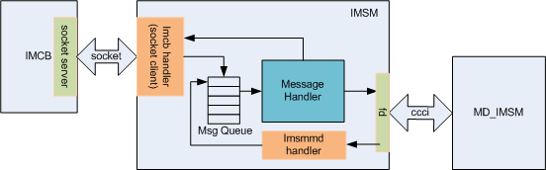
IMSM Work Model

Slide 5
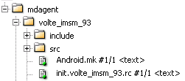

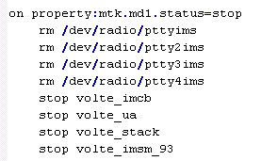
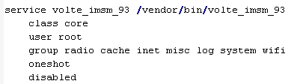
AP IMSM Start/Stop
When MD status is ready, ap imsm and related volte process will be bring up.
When MD status is stop, ap imsm and related volte process will be killed.
Set the service as disabled which means that the service can only
be explicitly started by name.

Slide 6
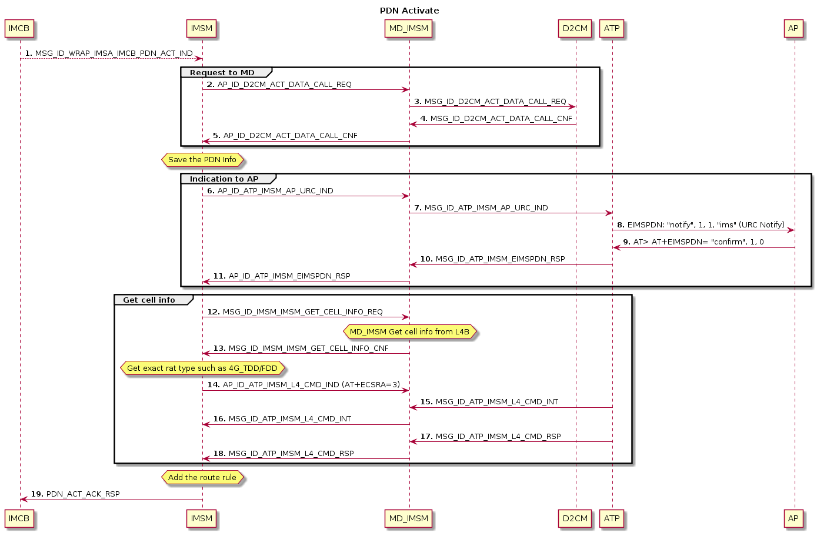

Slide 7
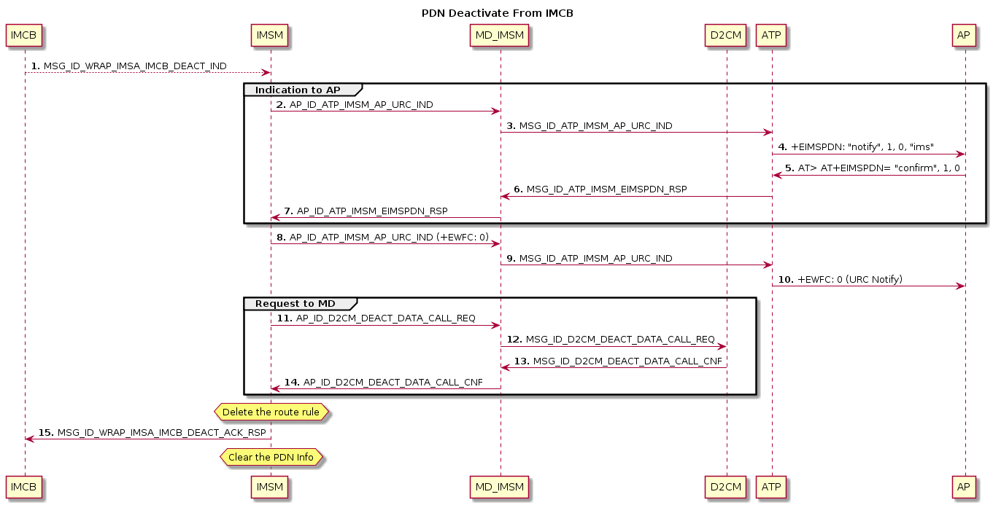

Slide 8
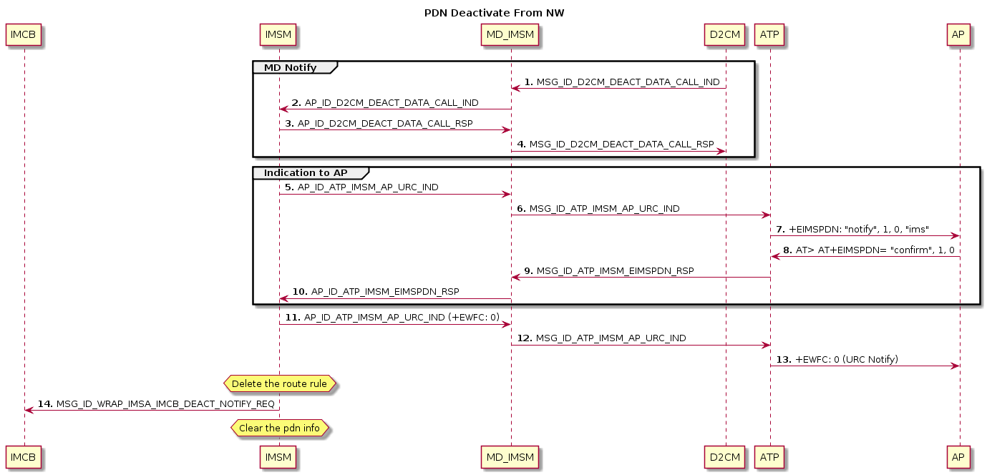

Slide 9
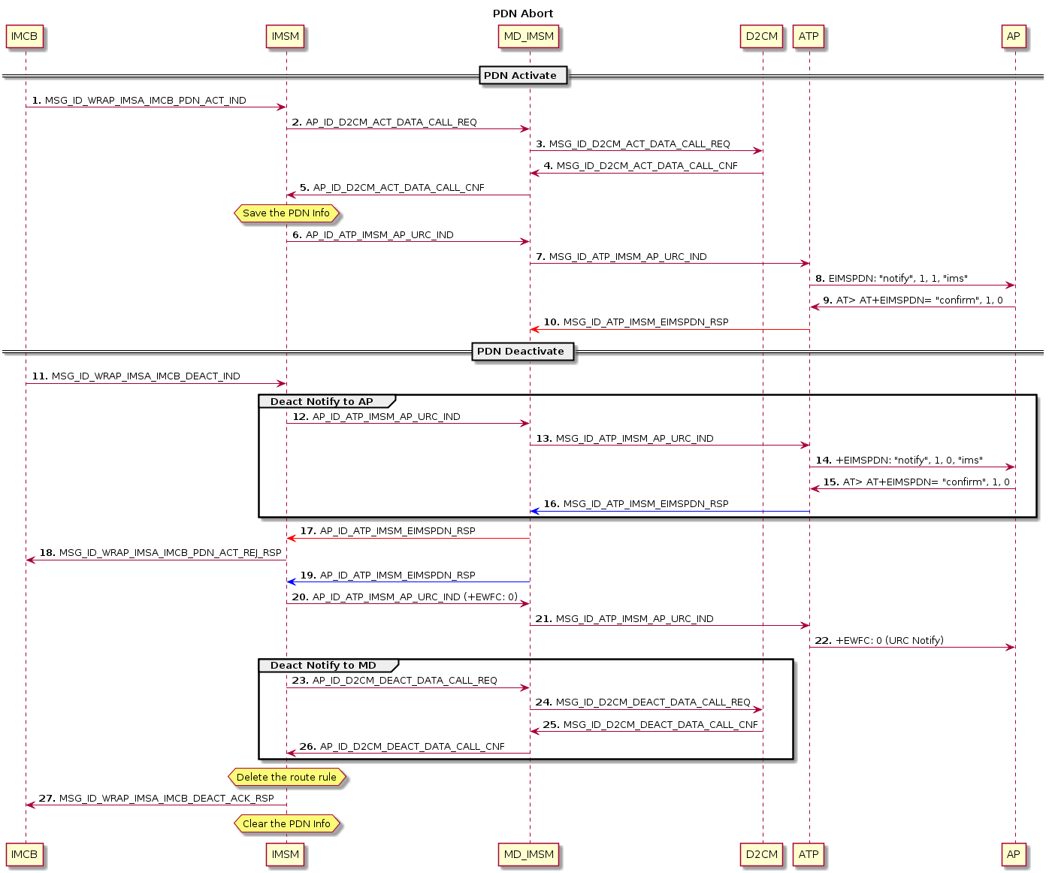

Slide 10
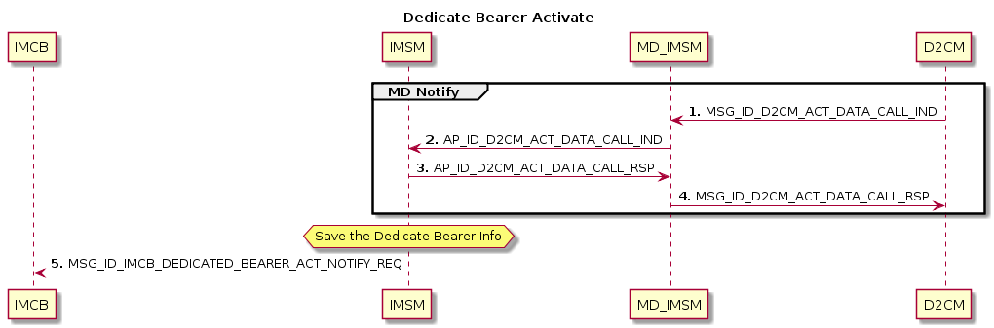

Slide 11
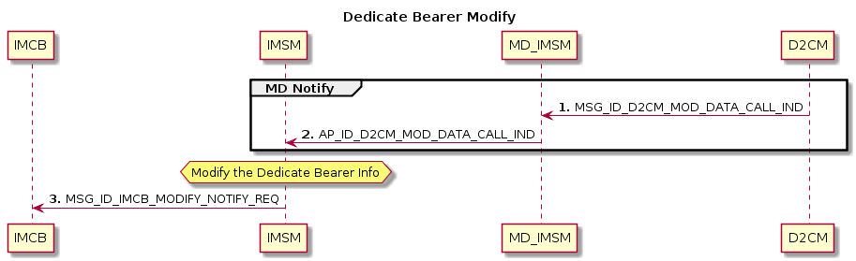

Slide 12
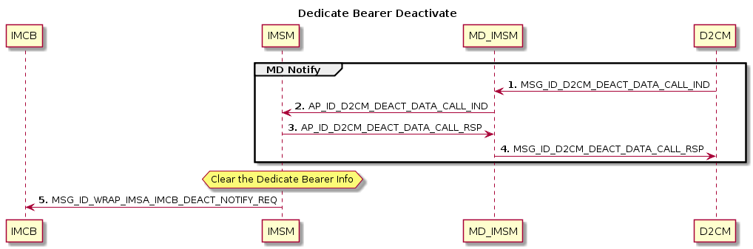

Slide 13
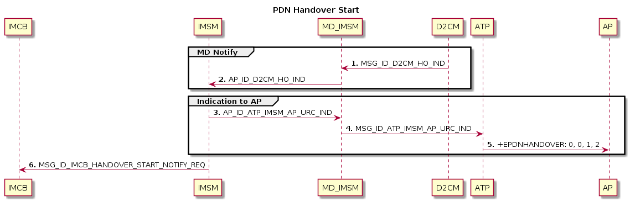

Slide 14
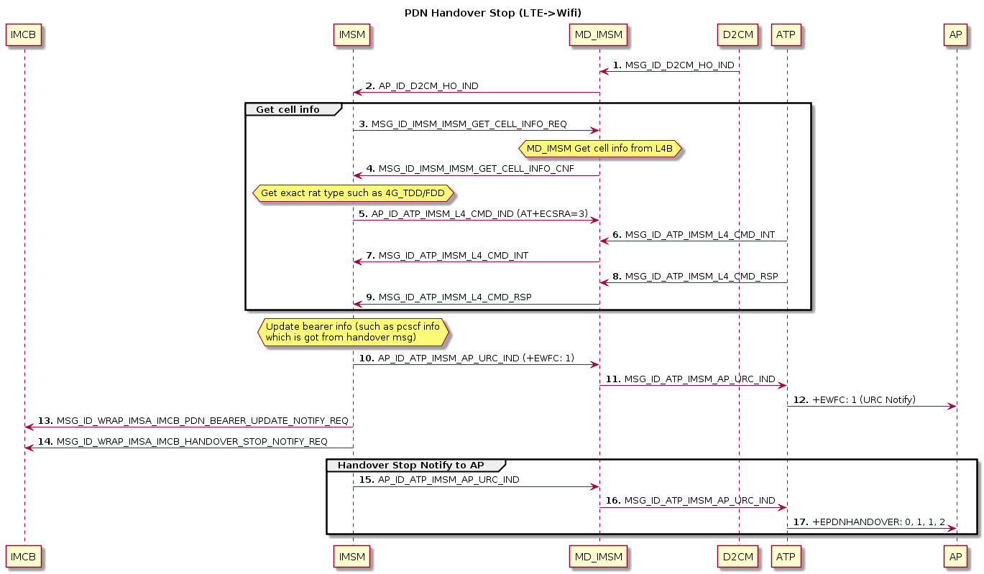

Slide 15
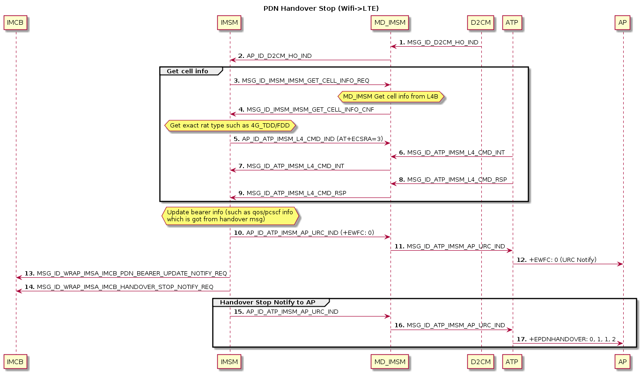

Slide 17
Appendix

