Slide 1
IMS Repo Phase 3 (IMS RP3 ) Workshop – MCS/SV part
Nick Wang

Slide 2
Outline
IMS Repo Phase 3 Introduction
Issues check flow
IMS Apps (MD apps) temp load push

Slide 3
IMS Repo Phase 3 – The Solution
Modules in IMS Repo
  Volte
    alps/vendor/mediatek/proprietary/frameworks/opt/volte/
  Mal (92/91/90 only)
    alps/vendor/mediatek/proprietary/frameworks/opt/mal/
  epdg
    alps/vendor/mediatek/proprietary/external/epdg/
  strongswan
    alps/vendor/mediatek/proprietary/external/strongswan/
  wfca
    alps/vendor/mediatek/proprietary/external/wfca
  Mdagent ( 93 and after 93)
    alps/vendor/mediatek/proprietary/frameworks/opt/mal/volte_imsm_93
IMS Repo
Preloader
system.img
ALPS/Git
md1rom.img
IMS Repo
md1dsp.img
MCU
Others
Phone
DSP
MOLY/P4

Slide 4
IMS RP3 Issue Category and Contact
Load out Issue – First Contact: EPM
  No IMS Repo Binary released to ALPS
  md_apps and mcu image un-compatibility issue
  Customer Release issue
  Customer Build Issue
ALPS Build Issue – First Contact: APLS
  TE build error issue
MD Build Issue – First Contact: RD Module
Runtime Issue – First Contact: RD Module
  Process not launch
  Runtime NE
  Permission issue on TE files
  Functional not workable

Slide 5
Phase 3 Module List and Contact
Module | Owner | CUS_REL_Type
volte | Nick Wang | Binary
epdg | Po-Chun Lee | Binary
strongswan | Po-Chun Lee | Source
wfca | Sheng-Lung Liu | Binary
mal | Mingchuang Qiao | Binary
mdagent | MingChun Cheng | Binary
EPM Flow | Jerry, Gerry, Miffy, Fantasy | EPM Flow Customer Release
ALPS | Kaiwen (Po-hu, Peng Li) | ALPS Issue

Slide 6
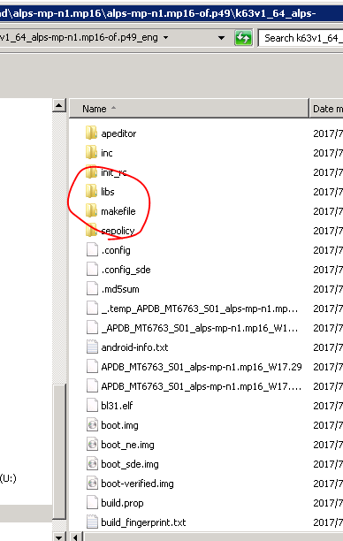
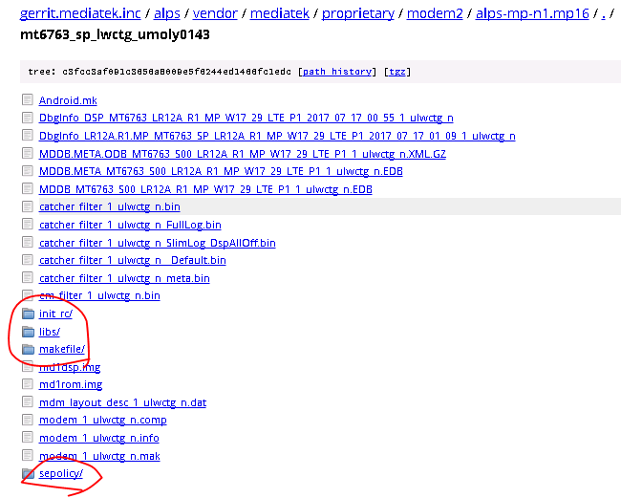
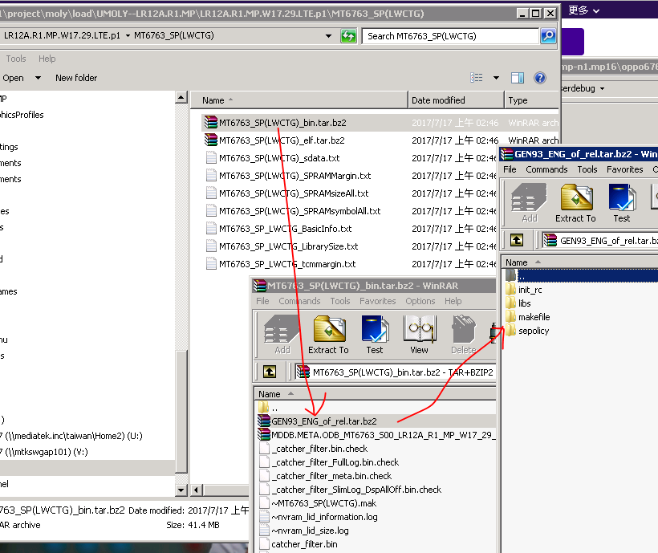
Check if No IMS Repo Binary Release to ALPS
http://gerrit.mediatek.inc:8080/plugins/gitiles/alps/vendor/mediatek/proprietary/modem2/+/alps-mp-n1.mp16/mt6763_sp_lwctg_umoly0143/
4
System Property check
-[ro.md_apps.support]: [1]
1
3
2

Slide 7
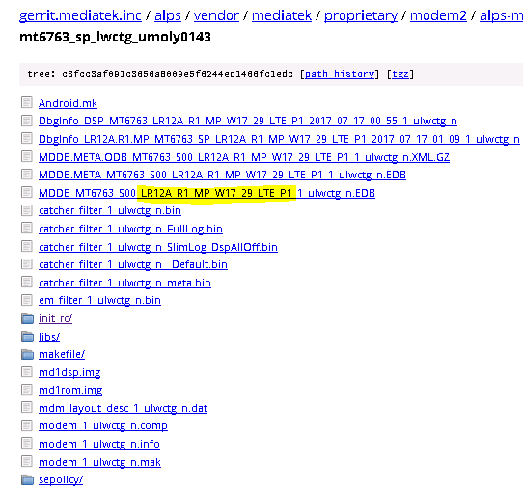
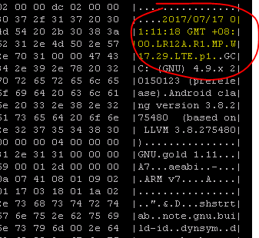
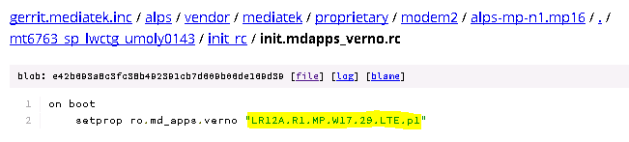
Check MD-Apps and MD-mcu un-compatibility
adb pull /vendor/lib/libverno.so
hexdump –C libverno.so
2
Preloader
system.img
md1rom.img
1
md1dsp.img
Others
Phone

Slide 8
IMS Repo Phase 3 – Landing Status
    ALPS IMS RP3 phase-in branches list (http://wiki.mediatek.inc/display/IMS/IMS+repo+phase+3#IMSrepophase3-Deploymentbranchlist)
MD Generation | MD already landed branch | AP Phase 3 already landed branch
Gen90 | LR9.W1444.MD.LWTG.MP | o0 Telephony DEV o0 TRUNK
Gen91 | LR11.W1630.MD.MP | o0 Telephony DEV o0 TRUNK
Gen92 | LR12.W1706.MD.MP LR12 (and new ) | n1.mp15 o0 Telephony DEV o0 TRUNK
Gen93 | UMOLYA LR12A.R1 LR12A.R2 (and new ) | n1.tk n1.mp15 n1.mp16 fpb.mp16 n1.mp18 o0 Telephony DEV o0 TRUNK

Slide 9
IMS Repo Phase 3 Concept – MD Apps load
A new type of image released by MD build flow
It should be pushed into ALPS filesystem (system.img)
Example to know it
  MD load:
    \\mtkswgfs101\project\moly\load\UMOLY--LR12A.MP1\LR12A.MP1.W17.25.LTE.p10\MT6763_SP(LWCTG)
  APLS Load:
    \\10.19.23.204\public1\Daily_Build\alps-mp-n1.mp16\Load\2017_06_20_23_00\k63v1_64_eng
IMS Repo (MD Apps): GEN93_ENG_of_rel.tar.bz2
Preloader
New
system.img
MD image:
MT6763_SP_MDBIN_PCB01_MT6763_S00.LR12A_MP1_W17_25_LTE_P10.bin
md1rom.img
DSP Image:
DSP_MT6763_LR12A_MP1_W17_25_LTE_P10.bin
md1dsp.img
Others
Others
MOLY Load
ALPS Load

Slide 10
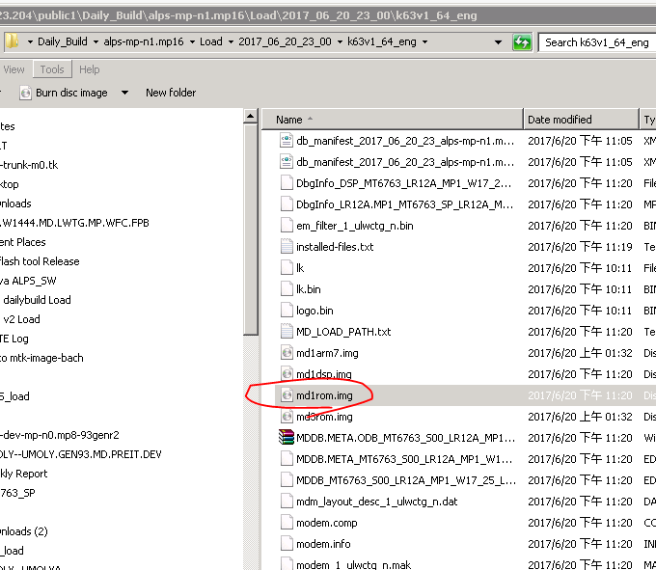
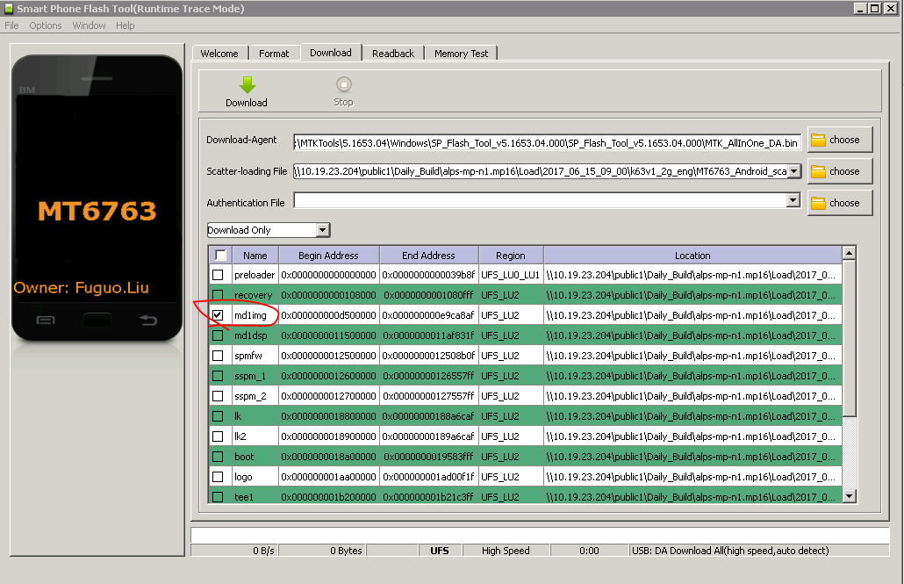
Typical MD Image Replacement Review
Using ADB push
  Abandoned after Android M.
Using flash tool

Slide 11
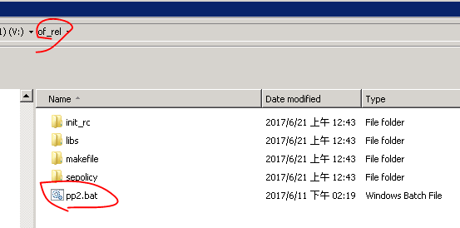
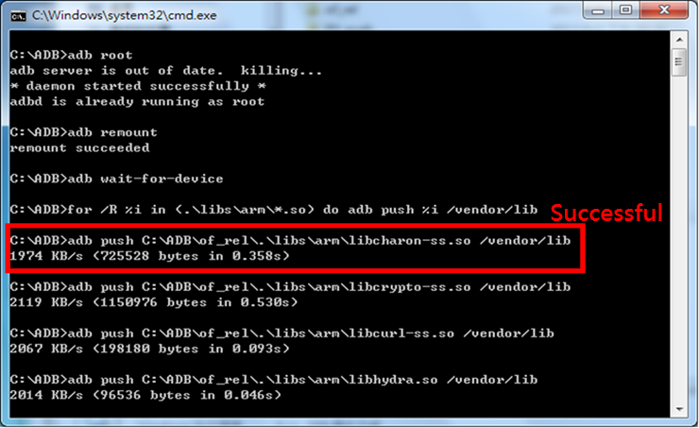
MD Apps Load Replacement
Using ADB push
MUST be Replacement Condition
  Testing scope
    Packet switches
    WFC/VoLTE/ePDG related Test case
  Branches view – all RP3 phase-in scope
    New N1 or O branches,
    Or 93 MD generation
    ALPS IMS RP3 phase-in branches list (http://wiki.mediatek.inc/display/IMS/IMS+repo+phase+3#IMSrepophase3-Deploymentbranchlist)
Steps
  Step 1. get MD Apps load and Extract to of_rel.tar.bz
    From original MD image, ex. \\mtkswgfs101\project\moly\load\
    From specific MD apps images, ex. \\mtksfs18\moly\IMS_load
  Step 2. disable Verity (user-debug load)
    ROOT device and disable verity
      adb disable-verity
      adb reboot
  Step 3. re-Boot Phone
  Step 4. Copy script and Run it (pp2.bat) , and it will copy patches to phone.
  Step 5. Check it
  Step 6. re-Boot Phone
Wiki –
http://wiki.mediatek.inc/x/rIPTE
pp2.bat -
http://wiki.mediatek.inc/download/attachments/282297260/pp2_new.bat?version=1&modificationDate=1497248762000&api=v2

Slide 12
Links
Sharepoint Root
  http://teams.mediatek.inc/sites/LTE/MM_SW/Connection%20Manager/Forms/AllItems.aspx?RootFolder=%2Fsites%2FLTE%2FMM%5FSW%2FConnection%20Manager%2FIMS%2F99%20IMS%20Repo&View=%7bAA7733AB%2d017D%2d43A4%2d8A77%2dD5C5C1029448%7d
AP/MD Interface
  http://teams.mediatek.inc/sites/LTE/MM_SW/Connection%20Manager/IMS/99%20IMS%20Repo/01%20AP-MD%20Interface/IMS_ALPS_interface_v1.0.xlsx
  Released headers
    http://teams.mediatek.inc/sites/LTE/MM_SW/Connection%20Manager/Forms/AllItems.aspx?RootFolder=%2fsites%2fLTE%2fMM%5fSW%2fConnection%20Manager%2fIMS%2f99%20IMS%20Repo%2f01%20AP%2dMD%20Interface%2fReference%2freleased&FolderCTID=&View=%7bAA7733AB%2d017D%2d43A4%2d8A77%2dD5C5C1029448%7d
  Review SOP and Guideline
    http://teams.mediatek.inc/sites/LTE/MM_SW/Connection%20Manager/IMS/99%20IMS%20Repo/01%20AP-MD%20Interface/Interface_Review_SOP.ppt
    http://wiki.mediatek.inc/pages/viewpage.action?title=Compatitble+API+design+guideline+and+example&spaceKey=IMS
Workshop and development slides
  http://teams.mediatek.inc/sites/LTE/MM_SW/Connection%20Manager/Forms/AllItems.aspx?RootFolder=%2fsites%2fLTE%2fMM%5fSW%2fConnection%20Manager%2fIMS%2f99%20IMS%20Repo%2fPhase%203%20%2ddev&FolderCTID=&View=%7bAA7733AB%2d017D%2d43A4%2d8A77%2dD5C5C1029448%7d
Regular Meeting
  http://teams.mediatek.inc/sites/LTE/MM_SW/Connection%20Manager/Forms/AllItems.aspx?RootFolder=%2fsites%2fLTE%2fMM%5fSW%2fConnection%20Manager%2fIMS%2f99%20IMS%20Repo%2fPhase%203%20Meetings&FolderCTID=&View=%7bAA7733AB%2d017D%2d43A4%2d8A77%2dD5C5C1029448%7d

Slide 14
ALPS share codebase
From: Jerry Chang (張哲銘)
Sent: Wednesday, June 07, 2017 5:54 PM
To: Nick Wang (王建壹) <Nick.Wang@mediatek.com>
Cc: Gerry Liao (廖仁傑) <Gerry.Liao@mediatek.com>; Shane Chang (張政賢) <shane.chang@mediatek.com>; Shawn Lin (林信宏) <Shawn.Lin@mediatek.com>; DongJhen Liu (劉東振) <dongjhen.liu@mediatek.com>
Subject: ALPS share codebase
Hi Nick,
關於APPS需要整合到alps load進行build & verify
SST 有提供一套share codebase的作法可以讓RD快速拿到一份”build好的alps load codebase”
詳細的使用方式可以參考Wiki: http://wiki.mediatek.inc/display/SSTSYSTEM/RD+Shared+Codebase
如果有問題的話也可以請教DongJhen
謝謝。

Slide 15
Q&A

Slide 16
What is not in the scope of IMS Repo phase 3 ?
(X) IMS repo module can gets MD Feature Option.
(X)

Slide 17
What should be consider
New Feature development on (ALPS fpb + MD MP) branches

Slide 18
Current IMS Repo status
 | L,M | N | O | Yocto/BACH
90/91 | Phase 1 | Phase 2 | Phase 3 | Phase 1
92 Whitney | - | Phase 1 | Phase 3 | -
92 non-Whitney | - | Phase 3 (must N1 and after) | Phase 3 | TBD
93 | - | Phase 3 | Phase 3 | TBD

Slide 19
IMS Repo Interface Review – Background and SOP

Slide 20
Changes of RC and TE files

Slide 21
Interface Design Concept
Capability Framework

Slide 22
Changes for IMS Repo Phase 3
Makefiles
Porting
RC and TE files change
Design changes (not expected by IMS Repo Phase 3)

Slide 23
Output file Concept
Per module build env.

Slide 24
Code check-in SOP

Slide 25
Phase 3 Module List and Contact
EPM Contact
  Gerry, Jerry
MD Generation | Module | Owner | CUS_REL_Type
Gen90~Gen93 | volte | Nick Wang | Binary
Gen90~Gen93 | epdg | Po-Chun Lee | Binary
Gen90~Gen93 | strongswan | Po-Chun Lee | Source
Gen90~Gen93 | wfca | Sheng-Lung Liu | Binary
Gen90~Gen92 | mal | Mingchuang Qiao | Binary
Gen93 | mdagent | MingChun Cheng | Binary

Slide 26
Schedule and Branch Plan
AP N1, O
MD Branches

Slide 27
IMS Repo can not get any feature option from MD project config

Slide 28
Build Flow

Slide 29
How to push temp load

Slide 30
How to sync the development between Phase 2 and Phase 3 ?
Get diff file
Patch to your p4
  Checkout all files
  Patch your changes

Slide 31
GIT/Perforce Command Mapping
https://www.perforce.com/perforce/r15.1/manuals/dvcs/_git_perforce_command_mappings.html
Git Command | Perforce Command
git add | p4 reconcile
git branch | p4 switch -l
git checkout --orphan new_branch | p4 switch -cm new_stream
git checkout branch | p4 switch stream
git clone repository | p4 clone -p host:port -r remote
git commit | p4 submit
git init | p4 init
git merge branch | p4 merge --from stream
git pull | p4 fetch -u -r remote -S stream
git pull --all | p4 fetch -u
git push | p4 push -r remote -S stream
git push --all | p4 push
git rebase | p4 unsubmit followed by p4 resubmit
git remote | p4 remotes
git remote add new_remote repository | p4 remote new_remote
git status | p4 status

Slide 32
UT on phase 3

Slide 33
How to Create a new modules ?

Slide 34
How to add/remove released files

Slide 35
EWS

Slide 36
EPM Sharing
command、加module SOP、產生檔案的位置
pack
release flow
我們預期 customer 怎麼使用
有甚麼不該做的事情
還有如何申請 和哪些 file 是列管 不能更動
新增 刪除 module , release file要怎麼作

Slide 37
ALPS Build
3、若只有32bit，没有64bit，请把path_of_LOCAL_SRC_FILES_arm64的位置留空
例如
$(call mtk-install-ims,\
LOCAL_MODULE,\
LOCAL_MODULE_SUFFIX,\
LOCAL_MODULE_CLASS,\
,\
libs/arm/,\
LOCAL_INIT_RC,\
LOCAL_REQUIRED_MODULES,\
)
4、请问有哪个module会不论feature option开关都会always install的吗？
我本来的想法是把其它受条件控制的module作为此module的LOCAL_REQUIRED_MODULES
例如
my_required_modules :=
ifeq ($(MTK_ABC_SUPPORT),yes)
my_required_modules += abc
endif
ifeq ($(MTK_DEF_SUPPORT),yes)
my_required_modules += def
endif
$(call mtk-install-ims,\
module_always,\
LOCAL_MODULE_SUFFIX,\
LOCAL_MODULE_CLASS,\
path_of_LOCAL_SRC_FILES_arm64,\
path_of_LOCAL_SRC_FILES_arm,\
LOCAL_INIT_RC,\
$(my_required_modules),\
)
$(call mtk-install-ims,\
abc,\
LOCAL_MODULE_SUFFIX,\
LOCAL_MODULE_CLASS,\
path_of_LOCAL_SRC_FILES_arm64,\
path_of_LOCAL_SRC_FILES_arm,\
LOCAL_INIT_RC,\
)
$(call mtk-install-ims,\
def,\
LOCAL_MODULE_SUFFIX,\
LOCAL_MODULE_CLASS,\
path_of_LOCAL_SRC_FILES_arm64,\
path_of_LOCAL_SRC_FILES_arm,\
LOCAL_INIT_RC,\
)
1、mtk-install-ims每个参数对应如下的LOCAL_xxx：
#$(call mtk-install-ims,\
# LOCAL_MODULE,\
# LOCAL_MODULE_SUFFIX,\
# LOCAL_MODULE_CLASS,\
# path_of_LOCAL_SRC_FILES_arm64,\
# path_of_LOCAL_SRC_FILES_arm,\
# LOCAL_INIT_RC,\
# LOCAL_REQUIRED_MODULES,\
#)
2、LOCAL_REQUIRED_MODULES是用空格分隔多个module，写在mtk-install-ims里面也是同理。
例如
$(call mtk-install-ims,\
LOCAL_MODULE,\
LOCAL_MODULE_SUFFIX,\
LOCAL_MODULE_CLASS,\
path_of_LOCAL_SRC_FILES_arm64,\
path_of_LOCAL_SRC_FILES_arm,\
LOCAL_INIT_RC,\
required1 required2 required3,\
)

