Slide 1
MD TCPIP Stack Debugging Guide - 20170718
WSP/SE7/SD1
Christine-PL Tsai
7/18/2017

Slide 2
Outline
List:
Why MD TCP/IP stack in MD?
MD TCP/IP architecture.
Data transferring flow.
Tips to debug.
Summary.

Slide 3
Why TCP/IP Stack in MD?
Security concern
BIP (Bearer Independent Protocol) needs to be hidden in modem side.
The BIP needs TCP/IP protocol stack to process data.
UICC
Terminal
BIP Layer
Terminal application
CAT application
BIP Protocol
TCP / UDP Transport Layer
CAT server(e.g. web server)
Terminal Server
Http client (e.g. browser)
Terminal server mode
UICC Server mode
Remote Server
BIP communication
Notes:
Security concern: While establishing PDN, related parameters are plain and might be hacked in AP.
We need to provide networking stack in MD!
Start on Gen93.
UICC=SIM

Slide 4
Modules Interact with TCP/IP Stack
TCP/IP Stack
DHL/
ELT
L5/D2
MD Users
Nucleus OS
IPcore
Logging and debugging
Handling PDN in MD
Data path & filter
Existing OS API
Use MD networking

Slide 5
MD TCP/IP Architecture
MD User
TCP/IP KAL tasks
Network APP
1
Establish PDN
Using NAL API
TCP/IP stack
L5/D2
2
RX
TX
D2CM
NAL (socket, NW utilities)
...
D2PM
TCP
UDP
ICMP
RAW
...
STKBRG
STKDEMX
STKEVTD
STKBUF
STK driver (for IPcore)
routing
...
5
Debugging
device
StkIF
StkIF
StkIF
DHL
3
TX
4
RX
ELT
Filter Queue
Kernel API
IPCore
Nucleus OS

Slide 6
General MD Networking Application Flow
One MD network application (e.g., BIP) can setup one or more sockets with different settings.
MD network applications
NAL networking interface
Socket
Setup
Add
Filter
Send/
Receive
Resource
Cleaning
Establish
PDN
Disconnect
PDN
Socket
Setup
Add
Filter
Send/
Receive
Resource
Cleaning
…
Notes:
Such as different ports, different remote IP address on one PDN.

Slide 7
Establishing PDN --- MD Stack Interface
L5/D2
D2CM
...
D2PM
device
StkIF
StkIF
StkIF
Similar to IPCore, the mapping relationship between StkIF and PDN shown in the below.
StkIF
IPv4
IPv4 PDN
1
v4 or v6
standalone
IPv6
StkIF
IPv6 PDN
IPv4
IPv4 PDN
2
StkIF
v4 and v6
fallback
IPv6
IPv6 PDN
3
IPv4
StkIF
IPv4v6 PDN
v4 and v6
IPv6
Notes:
For each PDN establishment, we setup one corresponding MD interface; For the disconnection, we will down the interface.
That is, two PDNs will be mapped to the same STK device.
Special case: If the APN has v4v6 fallback, two PDNs will mapped to the same STK device respectively.

Slide 8
PDN Messages for Establishment
Network APP
1
Establish PDN
D2
5
Disconnect PDN
3
This message includes networkrelated parameters, such as PDN IP address, MTU, interface ID.
2
TCP/IP stack will update these parameters to STK interface.
MSG_ID_D2CM_STKBRG_ESTABLISHPDN_REQ
4
STK driver
(for IPcore)
MSG_ID_D2CM_STKBRG_ESTABLISHPDN_CNF
STKBRG
STK device
6
This message includes interface ID
StkIF
StkIF
StkIF
MSG_ID_D2CM_STKBRG_DISCONNECTION_REQ
7
8
TCP/IP stack close the STK interface by interface ID.
MSG_ID_D2CM_STKBRG_DISCONNECTION_CNF

Slide 9
PDN --- PDN Messages for Update
Interface change:
MSG_ID_D2CM_STKBRG_IFCHANGE_REQ
MSG_ID_D2CM_STKBRG_IFCHANGE_CNF
D2 would send changes (e.g., IP change) happening in PDN to STKBRG.
Global Address (with v6 address):
MSG_ID_D2CM_STKBRG_GLBADDR_REQ
MSG_ID_D2CM_STKBRG_GLBADDR_CNF
This message is used to update global address, and it’s usually be sent after D2 finishes using IPv6 global address.
Notes:
This messages will carry similar message as establishment one.
TCP/IP stack will update these parameters to the STKIF.
TCP/IP stack will update this IPv6 address to the STKIF.

Slide 10
Network Abstraction Layer
N
A
L
An abstraction layer to isolate the internal stack and MD users.
Also help users to configure the filters to IPCore easily.
Common Socket |  |  | Utility | Filter
nal_socket | nal_recvmsg | nal_fd_reset | nal_inet_pton | nal_add_filter
nal_bind | nal_getsockopt | nal_fd_set | nal_inet_ntop | nal_delete_filter
nal_get_sock_name | nal_setsockopt | nal_select | nal_htons | nal_update_filter
nal_connect | nal_shutdown |  | nal_ntohs
nal_is_connected | nal_close_socket |  | nal_htonl
nal_send | nal_fcntl |  | nal_ntohl
nal_recv | nal_fd_check
nal_send_to | nal_fd_init
nal_recv_from
nal_sendmsg
Notes:
Error code translation, user statistics, …

Slide 11
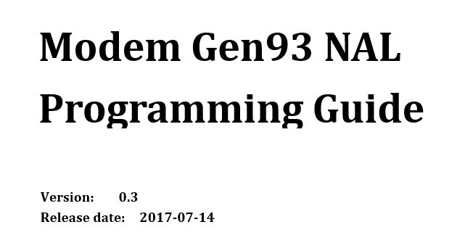
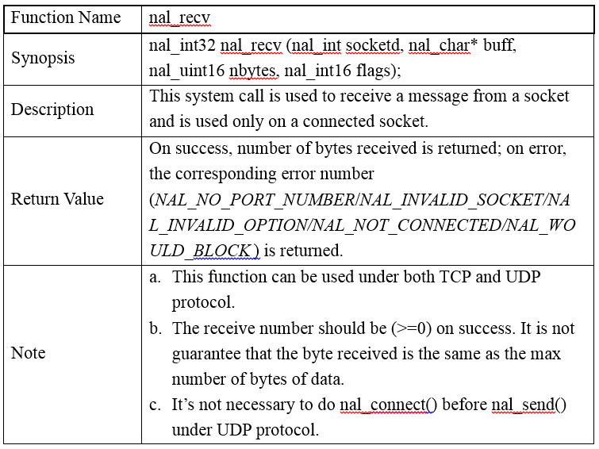
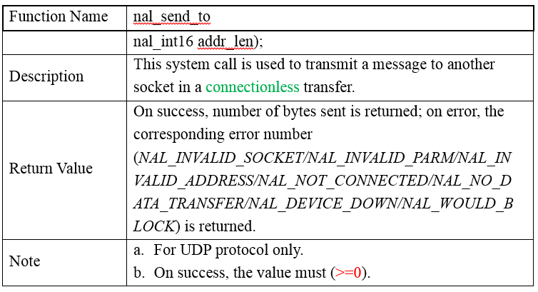
NAL User Guide
Link:
Continue updating if any.
http://mtkteams.mediatek.inc/sites/WCT/Project/MT6293_MT6295/MT6293/Shared%20Documents/SW/35_Workshop/New_Features_SE7-D1/Day_2/MD_TCPIP/Gen93_NAL_Programming_Guide.docx
Socket API description, socket usage flow, error code, …
Notes:
Error code translation, user statistics, …

Slide 12
General NAL Socket Usage [UDP]
UDP, connectionless:
An example to connect to remote server.
Socket
Setup
Send/
Receive
Resource
Cleaning
Server
socket()
MD Users
bind()
nal_socket()
recv_from()
nal_send_to()
send_to()
nal_recv_from()
close()
nal_close_socket()

Slide 13
General NAL Socket Usage [TCP]
TCP, connection based:
Need to connect before data transferring.
Server
Socket
Setup
Send/
Receive
Resource
Cleaning
socket()
MD Users
bind()
nal_socket()
optional
listen()
nal_bind()
accept()
3-way handshaking
nal_connect()
recv()
nal_send()
send()
nal_recv()
4-way handshaking
nal_close_socket()
close()

Slide 14
NAL Socket Usage
In general, the overall NAL socket usage is the same to common socket API.
But there are some extra notes to make MD networking applications workable:
Specify incoming and outgoing interface (the PDN).
Configure IPCore filters to receive packets in MD.
Although MD TCP/IP stack supports both blocking/non-blocking socket:
Due to MD behavior (RTOS), non-blocking socket is highly recommended.

Slide 15
MD NAL Socket Usage [UDP]
Connectionless:
Pink color is for the interface and filter configurations.
MD Users
nal_socket()
Server
nal_setsockopt()
Socket INFO
for filters
NAL_SO_BINDTODEVICE
socket()
nal_bind()
bind()
nal_add_filter()
recv_from()
nal_send_to()
send_to()
nal_recv_from()
close()
Delete filters
while closing socket
nal_close_socket()
Notes:
Basically, its usage is the same as the socket API in common. The figure below gives a brief view about how to use it.

Slide 16
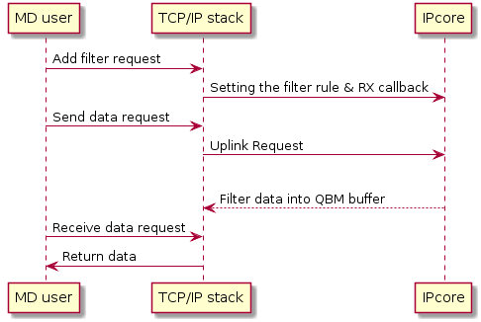
How Does the Filter Work?
Use socket INFO to distinguish data to MD from data to AP.
5-tuple filtering: General socket INFO are SRC address, DEST address, protocol, SRC port and DEST port.
5-tuple filtering
+ PDN & PS ID
D
D
D
D
D
D
MD
AP
filter

Slide 17
Data Transferring Overview
msg_send6(…,MSG_ID_D2CM_STKBRG_ESTABISHPDN_REQ,…)
nal_socket(protocol_type)
...
MD users
nal_bind(local_addr, ip_type)
nal_setsockopt(BINDTODEVICE, interface_id)
nal_add_filter(remote_addr)
TCP/IP stack
allocate port
interface_id
NAL
protocol
local addr
stk_id
socket operations
ip_type
remote addr
Nucleus socket layer
STKIF driver
nal_sys_register_filter()
pdn_id
NAL SYS
...
ps_id
StkIF
StkIF
StkIF
ipc_register_filter()
TX
RX
IPCore
ipc_uplink(…)
filter (callback)
UL packets
DL packets

Slide 18
General NAL Socket Usage [TCP]
Connection based
Nucleus Client
Linux Server
nal_socket()
socket()
NAL_SO_BINDTODEVICE
NAL_SO_LINGER (option)
nal_setsockopt()
bind()
nal_bind()
listen()
nal_add_filter()
accept()
3-way handshaking
nal_connect()
recv()
nal_send()
send()
nal_recv()
4-way handshaking
close()
nal_close_socket()

Slide 19
Tips to Debug --- Flow Overview
Issue
Find the fail stage
Fail stage found
Check data flow: From the beginning to the fail stage
Root Cause
Setup PDN success?
YES
Create socket success?
NO
YES
NO
PKTDUMP(ELT), Wireshark
NO
Error code
NO
Set socket option success?
Is packet correct?
TCP/IP logs
NO
NO
YES
Filter success?
YES
Bind success?
YES

Slide 20
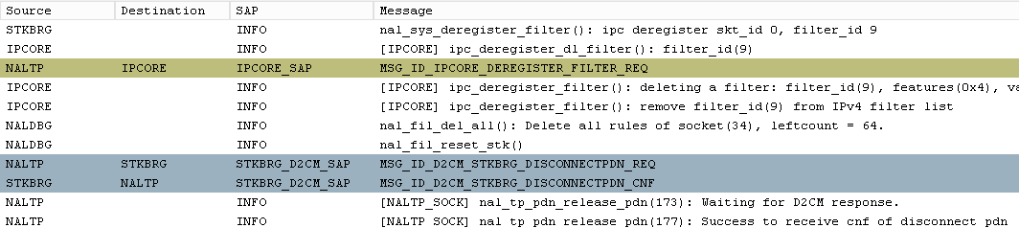
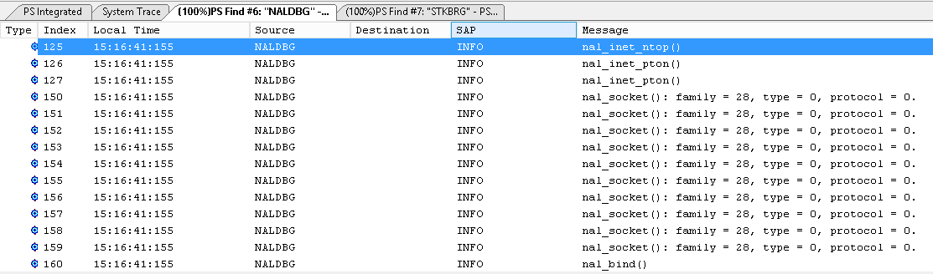
How to Find TCP/IP Related logs from ELT Trace?
Using “module ID” to find logs associated to TCP/IP components and tasks.
Module Name | NAL | STK Driver | TCP/IP Tasks
Module ID | NALDBG | STKDRV | STKDEMX/STKEVTD/STKBUF

Slide 21
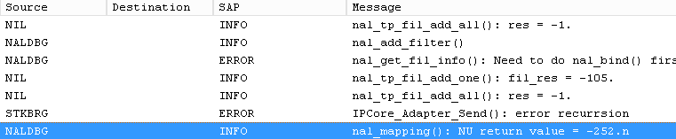
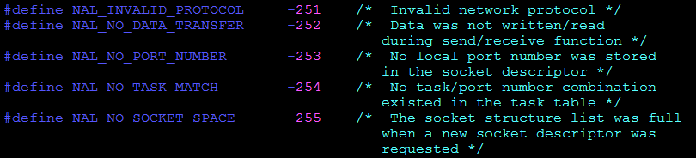

How to Check NAL Error Code ?
Using error code mapping table to get error messages.
FIL_NEED_BIND
Error Code Mapping
LINK

Slide 22
Same Error code in Different Functions
Same error messages in different functions refer to different things.
nal_get_sock_name
nal_connect
NAL_INVALID_PARM
The input address is null or the input address length is invalid.
The server address is null or IP type is not IPv4 or IPv6.

Slide 23
Check from the Data Transferring Flow --- UDP Uplink
Each stage would success only if stages before it succeed.
nal_send_to()
<PART>
Error Code Table
UDP send got an error and its not because out of buffer.
Check if the destination address is valid.
NAL_NO_DATA_TRANSFER
The non-blocking flag is set and there is no net buffer avalible.
NAL_WOULD_BLOCK
Not a real error.
NAL_INVALID_SOCKET
Check if the input is correct.
YES
The socket is out of range.
Check if nal_socket() succeeded.
If nal_socket() got a real socket ID?

Slide 24
Check from the Data Transferring Flow --- UDP Downlink
The debugging logic is the same as uplink.
nal_recv_from()
<PART>
Error Code Table
Check if NAL_SHUT_RD/ NAL_SHUT_RDWR has set
Read side channel has been closed.
NAL_NO_DATA_TRANSFER
The non-blocking flag is set and there is no packet recieved
NAL_WOULD_BLOCK
Not an real error.
The socket ID doesn’t point to a valid socket saved in the global socket structure.
nal_close_socket() has done?
NAL_NOT_CONNECTED

Slide 25
Case Study --- Cannot Connect to Server
Connect fail
Root Cause
Setup PDN success?
YES
Create socket success?
NO
YES
NO
NO
Error code
NO
PKTDUMP(ELT), Wireshark
Set socket option success?
Is packet correct?
TCP/IP logs
NO
NO
YES
Filter success?
YES
Bind success?
YES

Slide 26
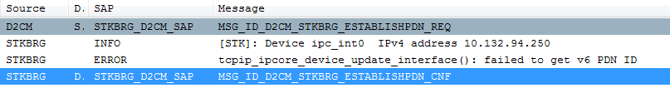
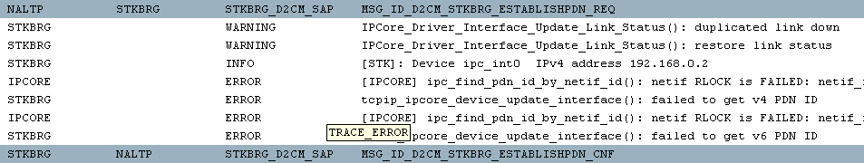
Check PDN Status
What ELT trace shows…
MSG_ID_D2CM_STKBRG_ESTABLISHPDN_REQ
SUCCESS!
success
MSG_ID_D2CM_STKBRG_ESTABLISHPDN_CNF
Compare to the fail case

Slide 27
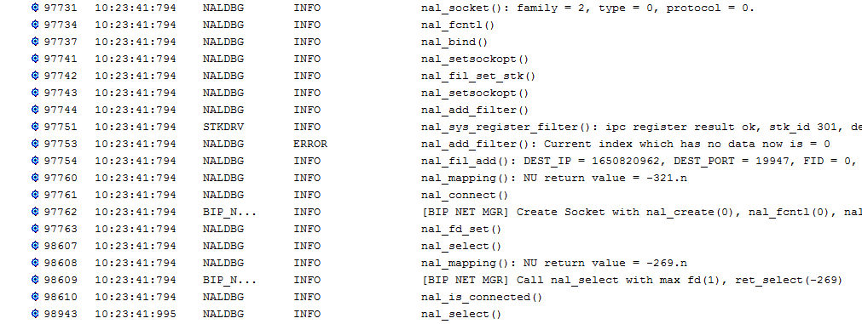
Check Socket Operation
No error has found.
SUCCESS!

Slide 28
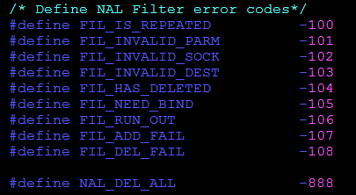
Is Filter Registration Success?
SUCCESS!
If it fails, an error code would return.
PATH: mcu/common/interface/service/nal/ nal_public_defs.h

Slide 29
Check Connecting Error Code
The client is still connecting to server.
NAL_IS_CONNECTING →Return value of non-blocking connection.
NAL_NO_DATA → None of the specified sockets is ready for data.

Slide 30
What to Do Next?
Till now, all socket operations are correct.
Check packet INFO → PKTDUMP
What else? TCP/IP logs
Root Cause
NO
PKTDUMP(ELT), Wireshark
Is packet correct?
TCP/IP logs
NO
YES
Filter success?

Slide 31

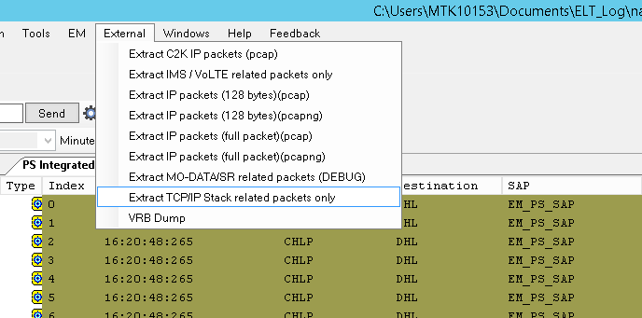
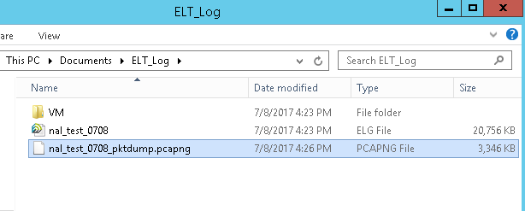
Packet Dumping - Dump Stack Packets in ELT (1/3)
Steps:
Launch ELT (after v2.1727.0).
Load the saved *.elg file.
Choose “External → Extract TCP/IP stack related packets only…”
It will convert elg into pcapng files.
A file with postfix, “pcapng”, would show up in the same folder.

Slide 32

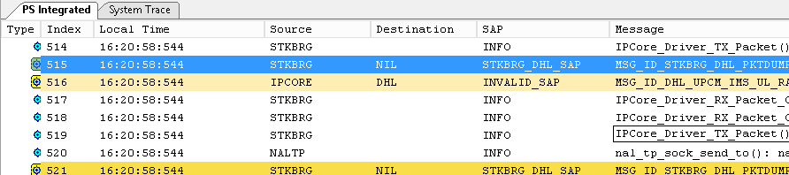
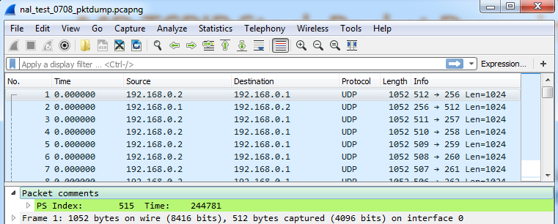
Packet Dumping - Dump Stack Packets in ELT (2/3)
List:
The *.pcapng can be opened by Wireshark.
You can check packet content in the tool.
The “PS Index” in “Packet comments” can mapped to the specific log in ELT.
You can also check the message “MSG_ID_STKBRG_PKTDUMP_REQ” in the ELT.

Slide 33
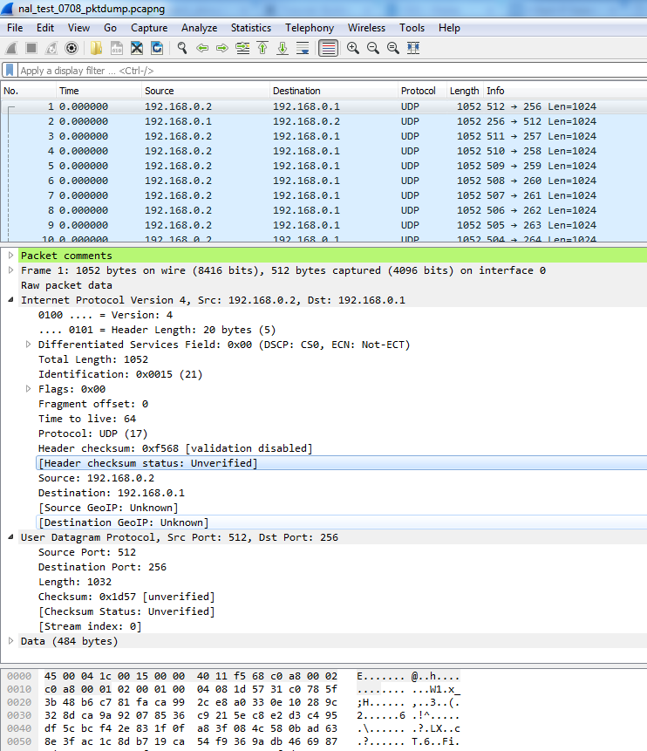
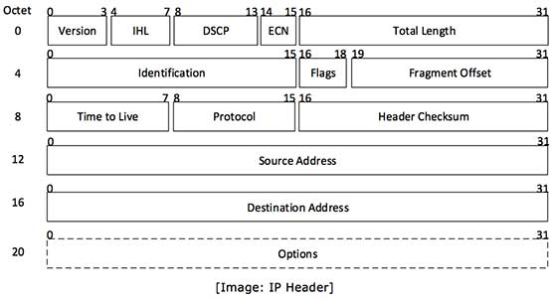
Packet Dumping - Dump Stack Packets in ELT (3/3)
List:
Wireshark usage:
https://www.wireshark.org/docs/wsug_html_chunked/
Packet headers:
http://disruptivelabs.in/art-of-packet-crafting-with-scapy/networking/packet_headers/index.html
Or google for more details.

Slide 34
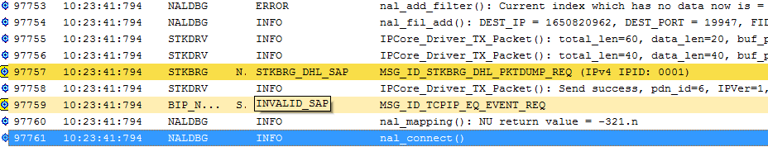
Look into other TCP/IP Logs
Find more logs near nal_connect().
Check the handshaking status.

Slide 35
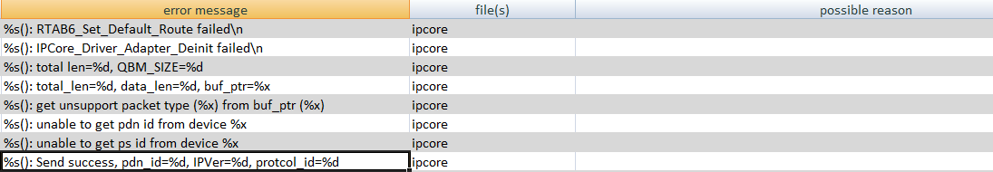
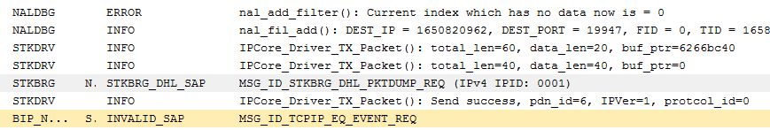
Mapping logs to TCP/IP Log table
LINK
You find this among ELT logs.
What else INFO the log implies ?

Slide 36
How To Debug?
NAL programming guide:
http://mtkteams.mediatek.inc/sites/WCT/Project/MT6293_MT6295/MT6293/Shared%20Documents/SW/35_Workshop/New_Features_SE7-D1/Day_2/MD_TCPIP/Gen93_NAL_Programming_Guide.docx?Web=1
NAL FAQ:
http://mtkteams.mediatek.inc/sites/WCT/Project/MT6293_MT6295/MT6293/Shared%20Documents/SW/35_Workshop/New_Features_SE7-D1/Day_2/MD_TCPIP/Gen93_NAL_FAQ.docx?Web=1
[ELT log] Check PDN is established or not.
[ELT log] Check NAL socket usage is correct or not.
[ELT log] Check NAL API parameters.
Users
MD Networking Applications
NAL
Stack
[ELT log] Check filter configurations.
[ELT log + Map Table] Check NAL function return value.
TCP/IP Stack
NAL function return errors:
http://mtkteams.mediatek.inc/sites/WCT/Project/MT6293_MT6295/MT6293/Shared%20Documents/SW/35_Workshop/New_Features_SE7-D1/Day_2/MD_TCPIP/NAL%20function%20return%20error%20code%20list.xlsx
[ELT log + Map Table] Check stack internal log messages.
[ELT log + PKTDUMP] Check packets dumping.
TCP/IP stack errors:
http://mtkteams.mediatek.inc/sites/WCT/Project/MT6293_MT6295/MT6293/Shared%20Documents/SW/35_Workshop/New_Features_SE7-D1/Day_2/MD_TCPIP/MD%20TCPIP%20stack%20error%20message%20list.xlsx?Web=1

Slide 37
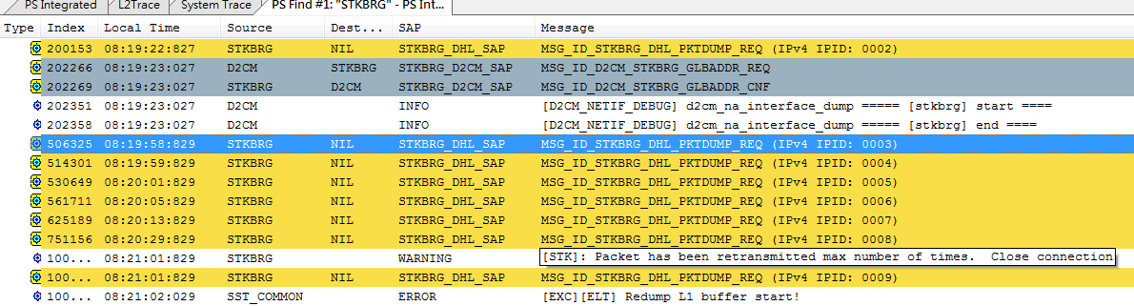
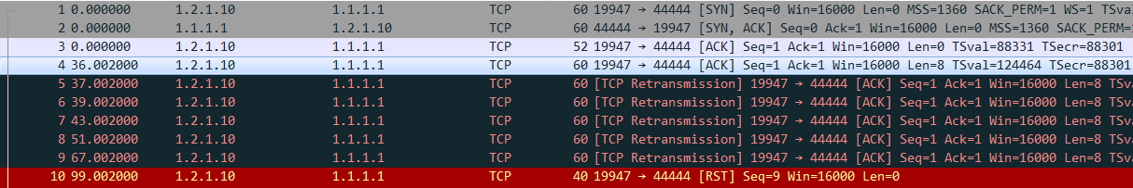
Case Study --- Socket Disconnection by BIP
Issue:
The socket is disconnected by BIP unexpectedly.
Analysis:
Check ELT log firstly ➔ find some messages in the stack [map in table].
Hit the threshold of retransmission times, close the connection.
Stack will retry 5 times, 1s + 2s + 4s + 8s + 16s ~ total is 31 seconds.
You can also check in the *.pcapng to see more packets details.
RST to close
connection

Slide 38
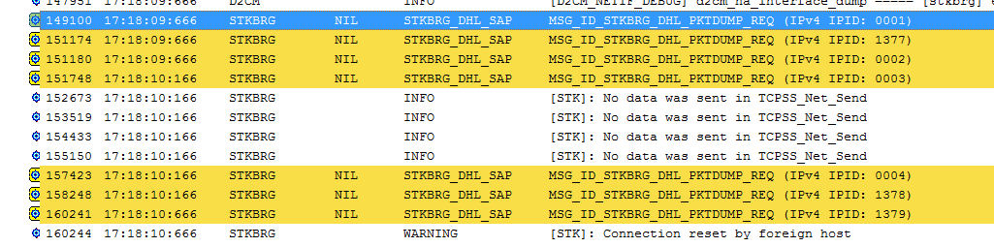
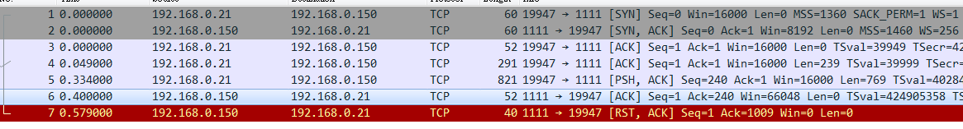
Case Study --- BIP Link Drop
Issue:
Link drop in BIP.
Analysis:
Check ELT log firstly ➔ find some messages in the stack [map in table].
We see a message that “connection reset by foreign host”.
You can also check in the *.pacpng to see more packets details.
Got RST packet from BIP server
Might need to cooperate with BIP to check why server sends this packet.
Such as wrong BIP data, any fail, …

Slide 39
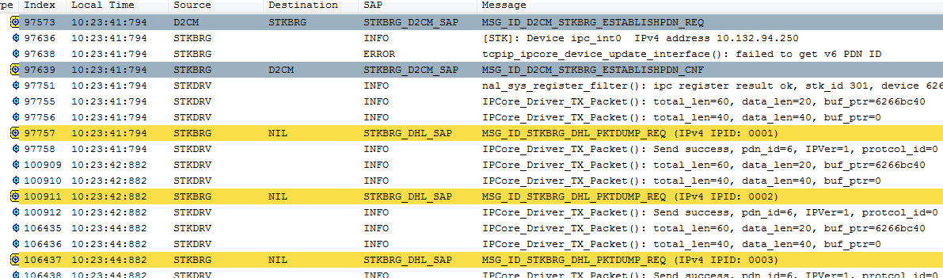
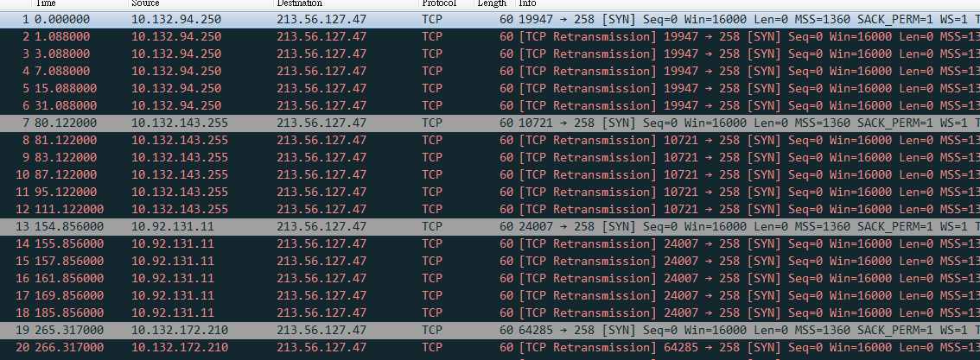
Case Study --- BIP Timeout to Disconnect
Issue:
Cannot setup socket connection ➔ BIP timeout to disconnect ➔ test case fail [CMCC].
Analysis:
Check ELT log firstly ➔ continue sending packets in ELT ➔
Convert to *pcapng ➔ Find that the packets are all SYN packets.
TCP three handshake: SYN, SYN+ACK, ACK.
No receive SYN+ACK from server.
➔ Server not response or IPCore not send/receive [advanced checking].
Establish
PDN
send one
packet

Slide 40
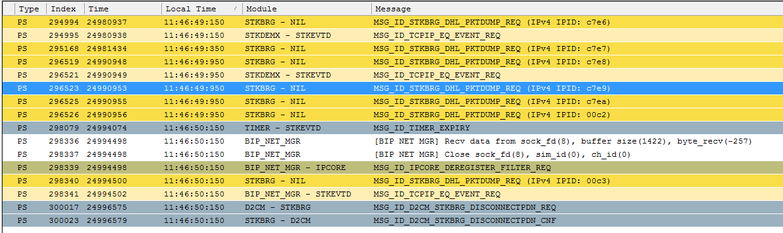
Case Study --- BIP Link Drop (1/2)
Issue:
Socket will disconnect unexpectedly.
Analysis:
Check ELT log firstly:
Got -257 in BIP NET MGR [map to table] ➔ -257 means NAL_NOT_CONNECTED. (no connection)
And PDN is disconnected later.

Slide 41
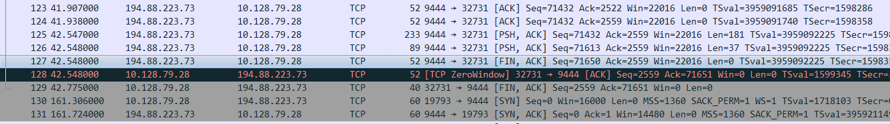
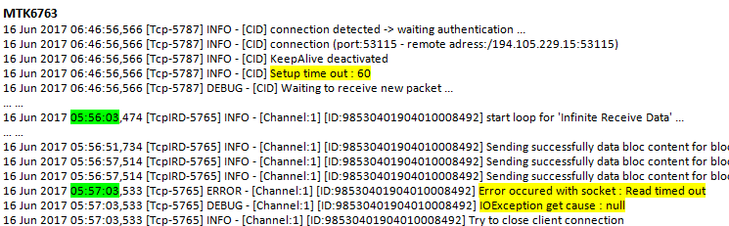
Case Study --- BIP Link Drop (2/2)
Analysis (Cont’):
Check *.pcapng:
Got the FIN packet from server.
➔ So the connection is closed ➔ disconnect on the socket to BIP.
Cooperate with BIP to find that the BIP server might close the connection after1minute.
➔ FIN packet.

Slide 42
Case Study --- BIP Server Not Response (1/2)
Issue:
BIP server does not response after we send packet.
IT3 + 8475 instrument GCF testing.
Analysis:
Extension from the first case.
Stack retries 5 times, then closing the connection.

Slide 43
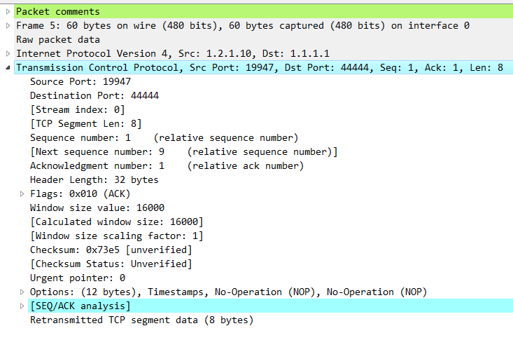
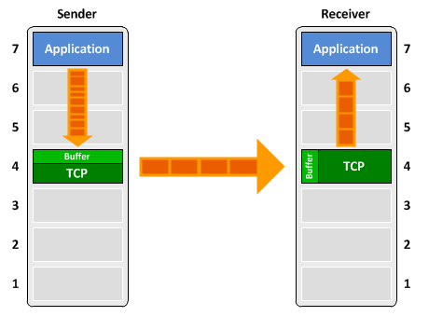
Case Study --- BIP Server Not Response (2/2)
Analysis (Cont’):
Compare with PASS log, the MD stack might send the packets without PSH BIT.
For the instrument testing, it seems we need to add PSH BIT for the testing.
Final solution:
Add PSH BIT to the last packet.
Or TCP_NODELAY option.
Notes:
Two effects on this bit:
The sending application informs TCP that data should be sent immediately.
➔ Some inputs and conditions, like no delay or timeout, to set this BIT.
The PSH flag in the TCP header informs the receiving host that the data should be pushed up to the receiving application immediately.
Conclusions:
Without PSH bit, we still can receive ACK from Windows stack.
Both Gemalto and NW+UE.
With NO_DELAY option, it will add PSH bit and push every packets; otherwise, will be aggregated depended on MSS and TCP window.
Receiver stack might have different configurations and implementations.
At least, for instrument testing, it might need to set PSH flag for the ACK.

Slide 44
Common Issue Type
List:
PDN does not be established.
MD interface is not up.
Socket parameters are incorrect.
Filter is configured wrong.
No downlink packets.
Cannot send out packets.
GPD buffer full…
Most issues are TCP cases:
Cannot connect to server.
Socket disconnection by server or local. (BIP link drop)
…

Slide 45
MD TCPIP Stack Debugging Guide - Reference Documents [Updating]
NAL programming guide:
http://mtkteams.mediatek.inc/sites/WCT/Project/MT6293_MT6295/MT6293/Shared%20Documents/SW/35_Workshop/New_Features_SE7-D1/Day_2/MD_TCPIP/Gen93_NAL_Programming_Guide.docx?Web=1
NAL FAQ:
http://mtkteams.mediatek.inc/sites/WCT/Project/MT6293_MT6295/MT6293/Shared%20Documents/SW/35_Workshop/New_Features_SE7-D1/Day_2/MD_TCPIP/Gen93_NAL_FAQ.docx?Web=1
NAL function return errors:
http://mtkteams.mediatek.inc/sites/WCT/Project/MT6293_MT6295/MT6293/Shared%20Documents/SW/35_Workshop/New_Features_SE7-D1/Day_2/MD_TCPIP/NAL%20function%20return%20error%20code%20list.xlsx
TCP/IP stack errors:
http://mtkteams.mediatek.inc/sites/WCT/Project/MT6293_MT6295/MT6293/Shared%20Documents/SW/35_Workshop/New_Features_SE7-D1/Day_2/MD_TCPIP/MD%20TCPIP%20stack%20error%20message%20list.xlsx?Web=1

Slide 46
MD TCPIP Stack Debugging Guide - Contact
TCP/IP stack:
Module | Contact
NAL | Christine-PL Tsai
TCP/IP stack | Crilit Tu / I-Chih Lu
Related modules:
Module | Contact
BIP / BIP NET MGR | CS Huang / Actory Ou
D2NA / D2CM | Verit Chen / Chia-Yu Ku
IPCore | Peter Hsu / Bo-Kai Huang

Slide 47
Q & A

