Slide 1
DDM – D2AM Attach Manager Troubleshooting Guide
Author: Yts Chen
Speaker: Chang-Yen chih
  July 18 2017

Slide 2
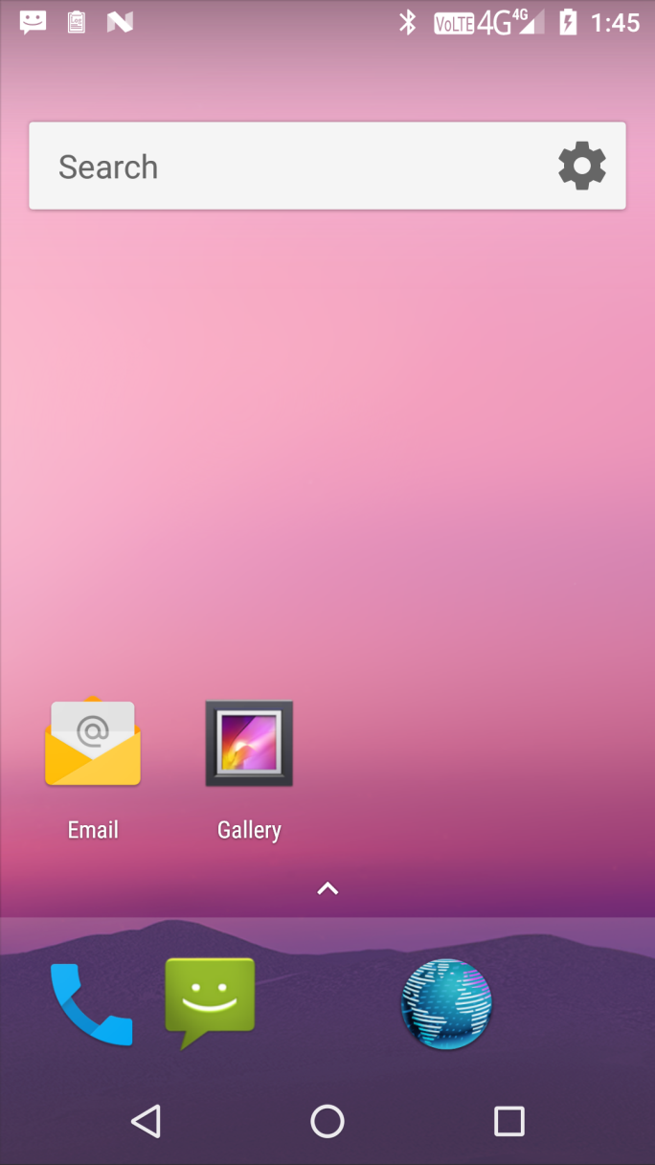
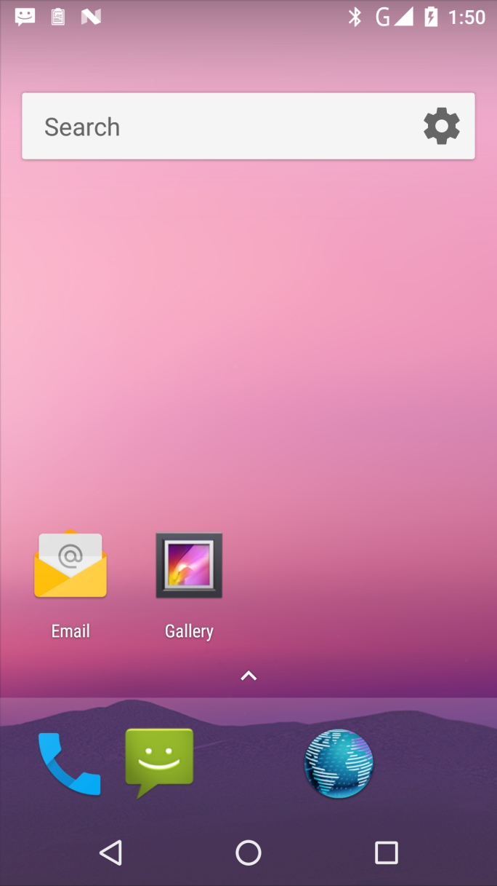
4G Icon Means 4G PS Attach Succeed
↑ PS attach
↑ no PS attach

Slide 3
PS Attach / Detach Triggering
Both AT+EFUN=1/3 and AT+EDALLOW=1 triggers D2AM to do PS attach.
EDALLOW=0 triggers D2AM to do PS detach
PS attach
  D2AM sends AT+EGTYPE=4 to L4
PS detach
  If RF on, D2AM sends AT+EGTYPE=0,1 to L4
  If RF off, D2AM sends AT+EGTYPE=0 to L4

Slide 4
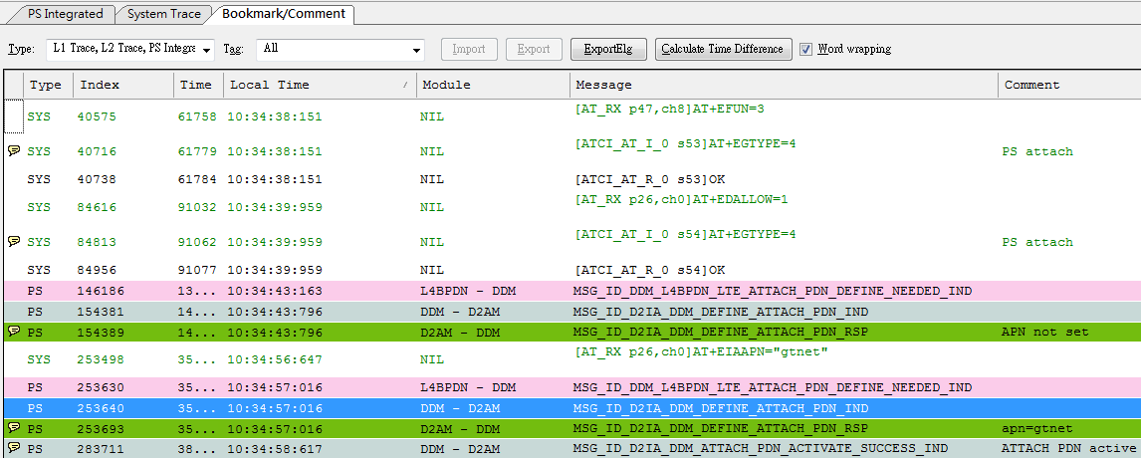
PS Attach Example 1
check point 1
check point 2
check point 3
check point 4

Slide 5
SOP
Check point 0: if No EGTYPE=4 contact Yts Chen or Chang-Yen Chih (WSP/SE7/SD2)
Check point 1: if EGTYPE=4 gets error, contact L4C owner Lucien Li (WCS/SE3/PS8) or Allen Hsu ((WCS/SE3/PS8)
Check point 2: if no “MSG_ID_DDM_L4BPDN_LTE_ATTACH_PDN_DEFINE_NEEDED_IND” event from L4BPDN contact L4BPDN owner Poying Chuang (WCS/SE3/PS5)
Check point 3: if no EIAAPN form AP, contact Andy Kauo (WSD/AF/AF13)
Check point 4: if no “MSG_ID_D2IA_DDM_ATTACH_PDN_ACTIVATE_SUCCESS_IND” from DDM, contact DDM owner Dennis Tsai (WSP/SE7/SD2)

Slide 6
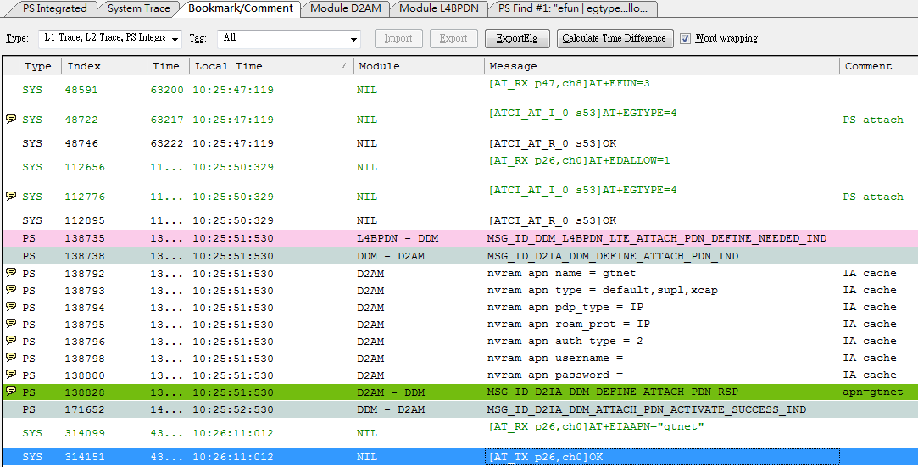
PS Attach Example 2
check point 1
check point 2
check point 3
check point 4

Slide 7
SOP
Check point 0: if No EGTYPE=4 contact WSP/SE7/SD2 Yts Chen or Chang-Yen Chih
Check point 1: if EGTYPE=4 gets error, contact L4C owner Lucien Li (WCS/SE3/PS8) or Allen Hsu (WCS/SE3/PS8)
Check point 2: if no “MSG_ID_DDM_L4BPDN_LTE_ATTACH_PDN_DEFINE_NEEDED_IND” event from L4BPDN contact L4BPDN owner Poying Chuang (WCS/SE3/PS5)
Check point 3: if IA cache exists, go to check point 4
Check point 4: if no “MSG_ID_D2IA_DDM_ATTACH_PDN_ACTIVATE_SUCCESS_IND” from DDM, contact DDM owner Dennis Tsai (WSP/SE7/SD2)

Slide 8
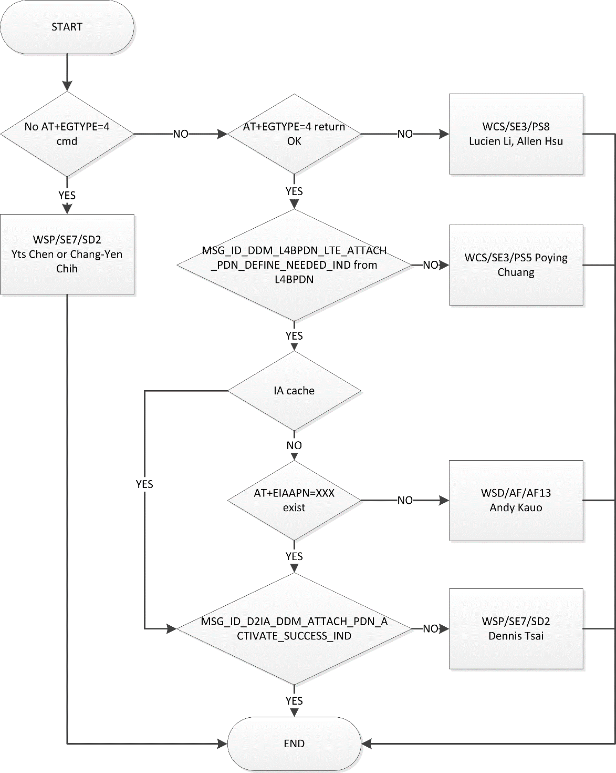
Troubleshooting
Flow

