Slide 1
DDM – DDM troubleshooting guide
Dennis Tsai
Yts Chen
  July 18 2017

Slide 2
DDM<->L4BPDN
Use src_id to identify a request sequence
  DDM maintain a src_id pool to allocate src_id
    Range: 0 ~ 37
  Each ps has its own src_id pool

Slide 3
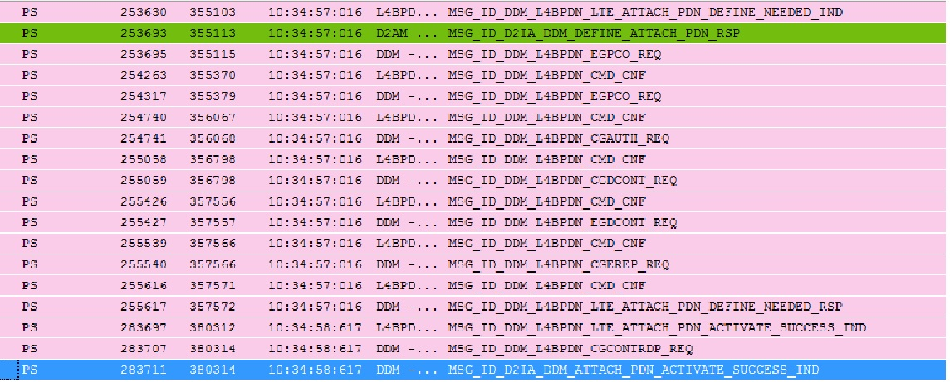
DDM cmd sequence for IA
In this time, we call this pdn is “dangling” pdn
  ➔if dangling pdn is deacted by NW, it should only report to D2PM by MSG_ID_D2PM_DDM_URC_CGEV_IND
Any cmd fail DDM will send MSG_ID_D2IA_DDM_ATTACH_PDN_ACTIVATE_FAILURE_IND to D2AM

Slide 4
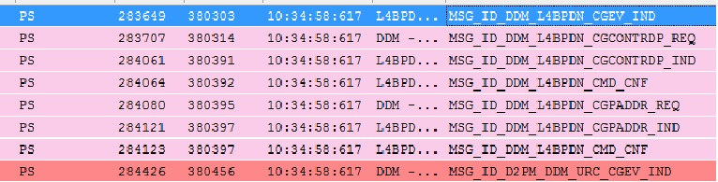
DDM cmd sequence for IA
This is dangling pdn, so DDM only report CGEV( which including net_info and ip_info) to D2PM

Slide 5
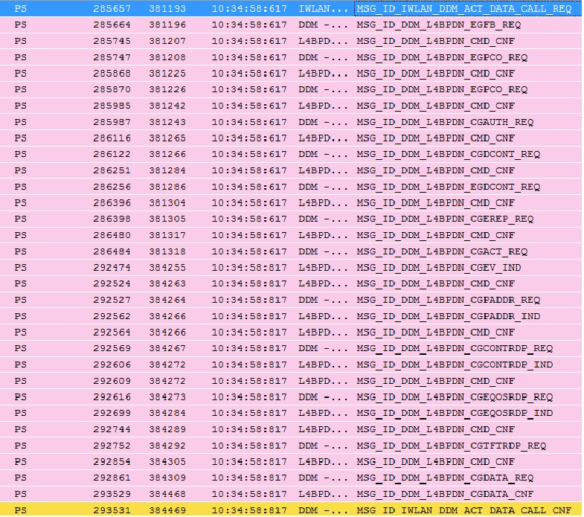
DDM cmd sequence for activate data call
check activate
data call
success
or
fail
read
ip_info
and
net_info
cgdata should
never fail!!
if fail, ask for
l4BPDN to check
In this time, we call this pdn is not “dangling” pdn
  ➔if this pdn is deacted by NW, it should report to IWLAN by MSG_ID_IWLAN_DDM_URC_CGEV_IND

Slide 6
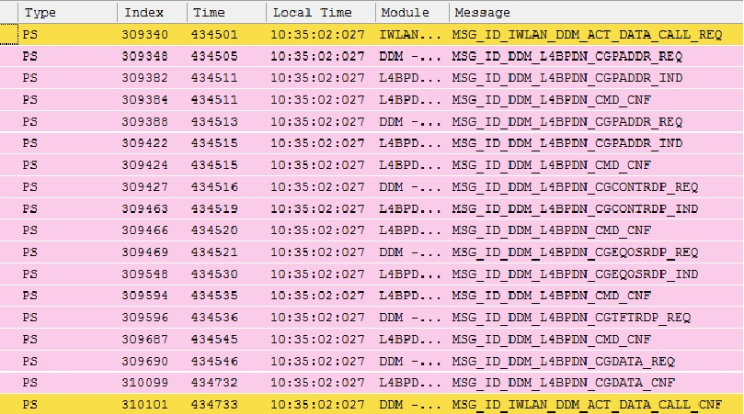
DDM cmd sequence for activate data call(reuse case)
In this time, we call this pdn is not “dangling” pdn
  ➔if this pdn is deacted by NW, it should report to IWLAN by MSG_ID_IWLAN_DDM_URC_CGEV_IND

Slide 7
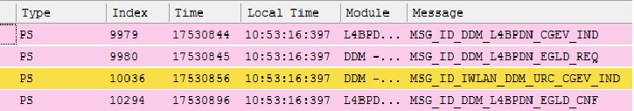
DDM NW PDN DEACT
If this cid is dangling, it should only notify D2AM by MSG_ID_D2PM_DDM_URC_CGEV_IND

Slide 8
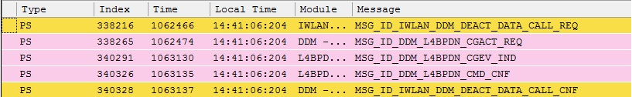
DDM DEACT DATA CALL
CGEV might be ME PDN DEACT or
NW PDN DEACT
Both of them should not report to IWLAN or D2PM

Slide 9
DDM DEACT DATA CALL
DDM always report IWLAN deact data call success, but it actually deact fail in some case:
  Last pdn(RMMI_ERR_LAST_PDN_DISC_NOT_ALLOWED)
    3GPP specify LTE should at least keep one pdn
  L4C_CMD_CONFLICT
    Usually CGEV:NW PDN DEACT will be issue to DDM from L4BPDN after this deact fail case
      This scenario DDM will not report CGEV to IWLAN
    DDM will retry deact data call for this error cause
If deact pdn fail, the error cause might be RMMI_ERR_LAST_PDN_DISC_NOT_ALLOWED(171), we call this pdn is “dangling” pdn
  if dangling pdn is deactivated by NW, it should only report to D2PM by MSG_ID_D2PM_DDM_URC_CGEV_IND

Slide 10
Activate data call fail
Check error cause
  Find it from mcu/pcore/interface/modem/general/ps_public_enum.h
    if reason is argument issue, check each argument is valid or not
    else reason can ask for L4BPDN to analyze

Slide 11
owner
IWLAN:
  jen-ping huang
D2PM:
  chia-yu ku
L4BPDN:
  poying chuang or max mo

