Slide 1
(a) Accuracy on ICCAD and Industry with 4 clients
(b) Accuracy on ICCAD and Industry with 10 clients

Slide 2
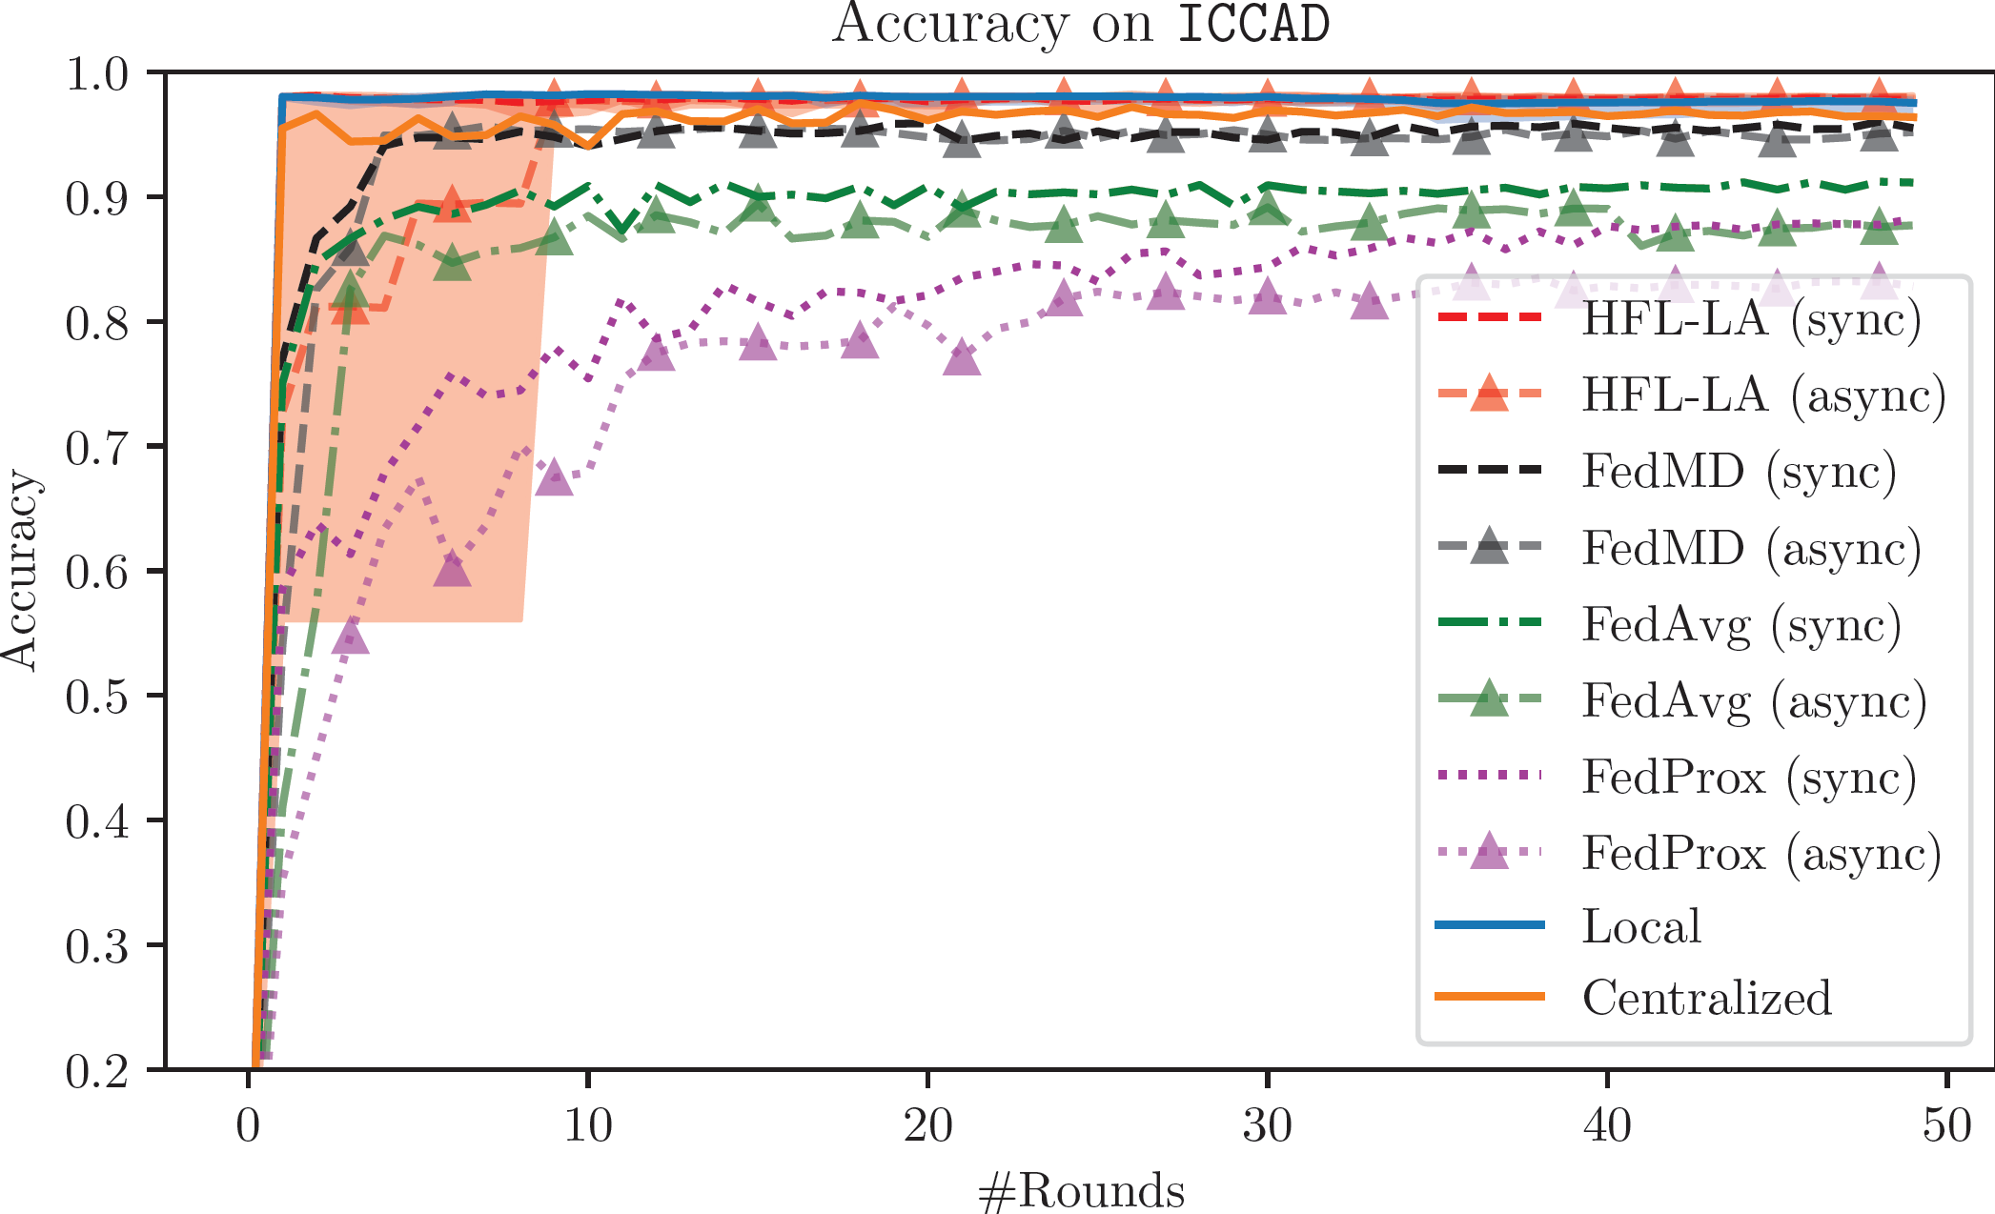
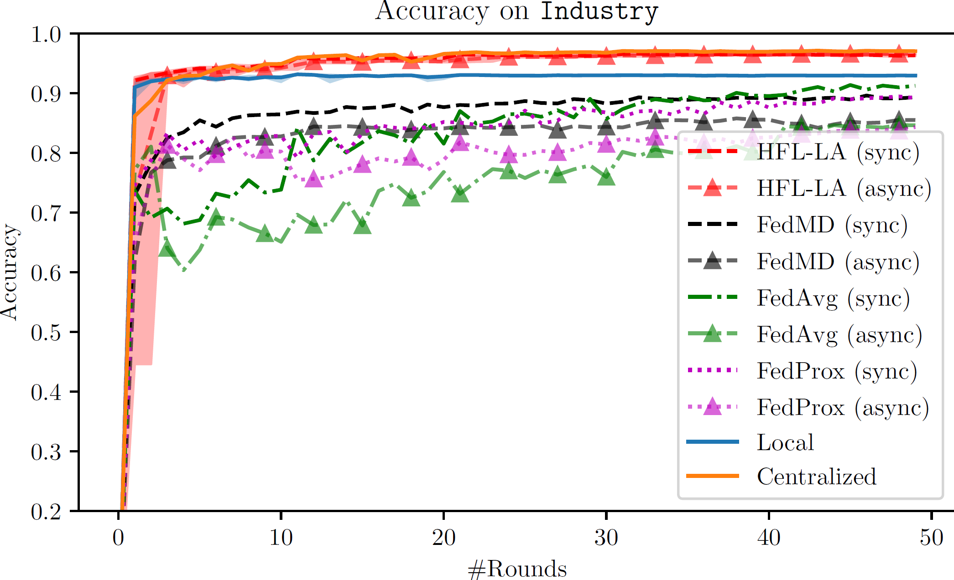
(a) ICCAD
(b) Industry

