Slide 1

问路
Ask the way

Slide 2
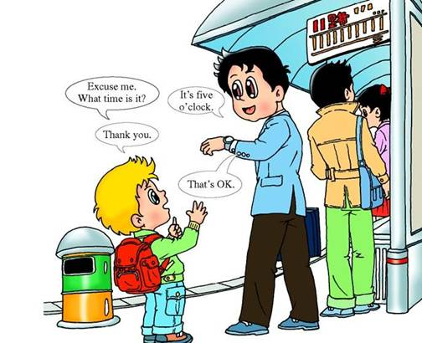

Slide 3
语法补充--倒装句

Slide 4

状语从句
Although（虽然）he is very poor, he is honest.
He is very poor, but he is honest.

Slide 5
状语从句练习
Although（虽然）he is very poor, he is honest.
___ ___he is, he is very honest

Slide 6
倒装句
Poor as he is ,he is honest.

Slide 7
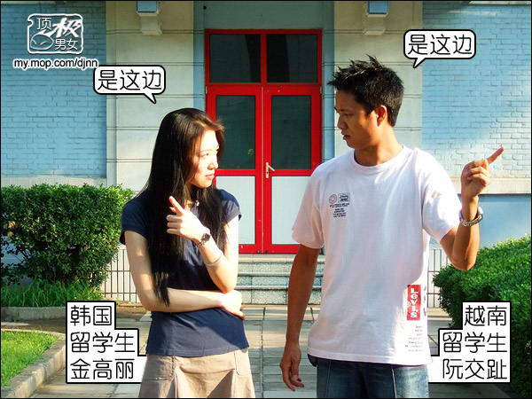

Slide 8
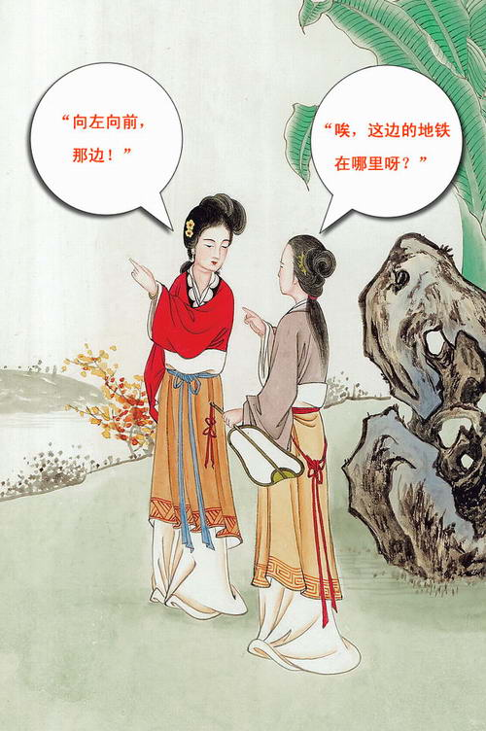

Slide 9
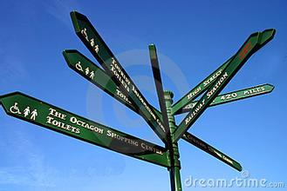
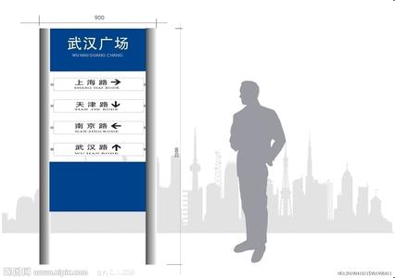
Road Sign

Slide 10
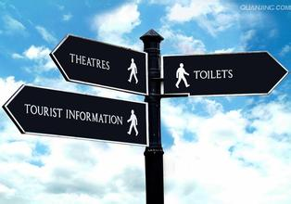


Slide 11


Slide 12


Slide 13


Slide 14
Task I:
A lady wants to buy a skirt or a dress, he is new here, How can she get to the nearest Shopping Mall?

Slide 15

How to ask the way?

Slide 16
问路:
Excuse me，could you tell me
the way to the shopping mall?

Slide 17
Excuse me, how can I get to…..
Where is ______?

Slide 18
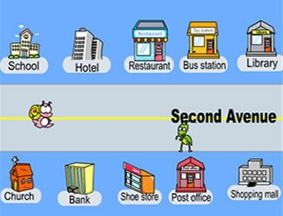

Slide 19

Words for
some public places.

Slide 20


Brainstorming
What English names of public places do you know?

Slide 21
Let’s learn the words together.

Slide 22





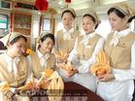
restaurant
hospital
police station

Slide 23
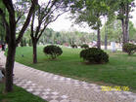

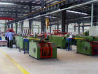
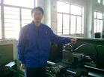

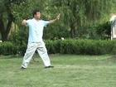
park
factory
swimming pool

Slide 24

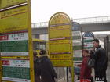

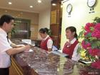
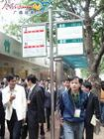
post office
bus stop
hotel

Slide 25
Guessing game (2)
Match the pictures with the words.

Slide 26

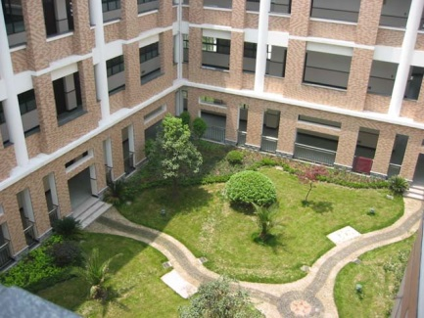
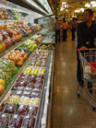
supermarket
clothes shop
middle school

Slide 27
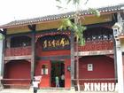


cinema
museum
apartment building

Slide 28
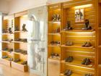
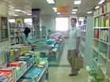
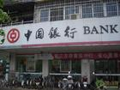
book shop
shoe store
bank

Slide 29
Guessing game (3)
Match the words with the meanings.
library
keep your car
parking lot
take trains
railway station
read books
zoo
see animals

Slide 30
Let’s get to know more words.

Slide 31
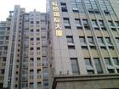

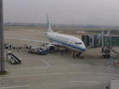
theater
office building
airport

Slide 32

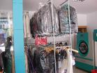
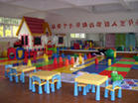
amusement park
kindergarten
laundry

Slide 33
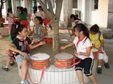

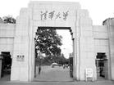
university
TV Station
primary school

Slide 34
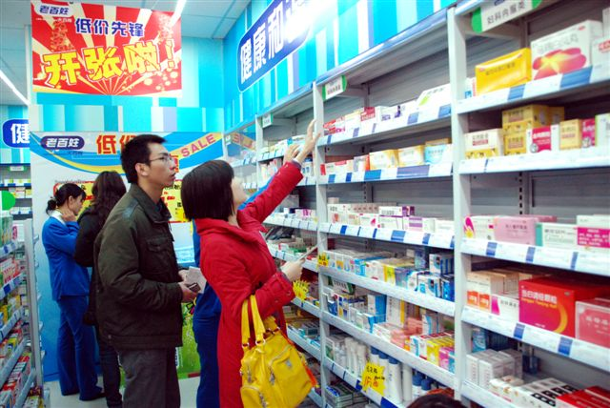

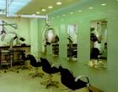

gym
barber shop
drug store

Slide 35
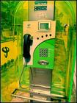

bakery
pay phone

Slide 36
Guessing game (3)
Match the words with the meanings.
historical site
take subways
flower shop
feel about the history
subway station
buy flowers
net bar
play computers

Slide 37
Structure1:
How
I
can
get
to
Mall
?
the
nearest
shopping

Slide 38
1: go along the road, then turn left at the second crossing, you can find it.
2: you'd better take a bus, it can take you there.
3:on the left/right side
4: walk down the road
5:sorry, I am new here.

Slide 39
1.径直走 go straight on
2.在十字路口 at the crossroads
3.在交通处 at the traffic lights
4.向右转 turn right
5.向左转 turn left
6.斑马线 zebra crossing
7.在你的左边 on your left

Slide 40
Fill in the blanket please!

Slide 41
1.Could you tell me ___ ____ ____ the park?
2.Which is ___ ____ ____ the park, please?
3.Do you know ___ ____ ____ the park?
4.Do you know ___ ___ ___ __ ___the park?
5.______ is the park, please?
6.____ can I ____ ____ the park?
7.____ _____ a park near here?

Slide 42
She must ____ ___ ___ if she wants to go to the cinema.（过马路）
She must go by a ________ if she wants to go to the park.（过斑马线）

Slide 43
开始要对被人礼貌的打扰了! 然后进入主题问路could you please tell me where the ……is：excuse me ？或者how I can get to+目的地
反正是麻烦到别人的地方尽量的要礼貌
希望能够帮到帮助
Excuse me,how can I get to ……？
这是比较礼貌的说法

Slide 44
英语问路
1.Excuse me,can you tell me the way to…?
2.Excuse me, would you like to tell me the way to……?
3.Where is ……?
4.How can I get to ……?
5.Do you know the way to ……？
6.I wonder where …… is.
7.I wonder the way to…….

Slide 45
