Slide 1
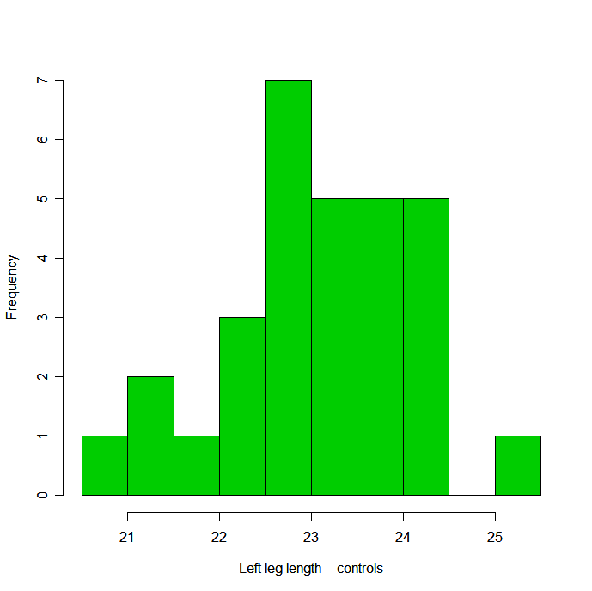
Frequency Table:
Interval Freq %
(20.5,21] 1 3.33
(21,21.5] 2 6.67
(21.5,22] 1 3.33
(22,22.5] 3 10.00
(22.5,23] 7 23.33
(23,23.5] 5 16.67
(23.5,24] 5 16.67
(24,24.5] 5 16.67
(24.5,25] 0 0.00
(25,25.5] 1 3.33
Histogram:

