Slide 1
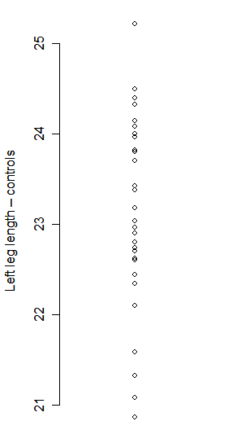
Dot Diagram:
Stem and Leaf Plot:
The decimal point is at the |
20 | 9
21 | 136
22 | 134667789
23 | 002444788
24 | 0011345
25 | 2

