Slide 1
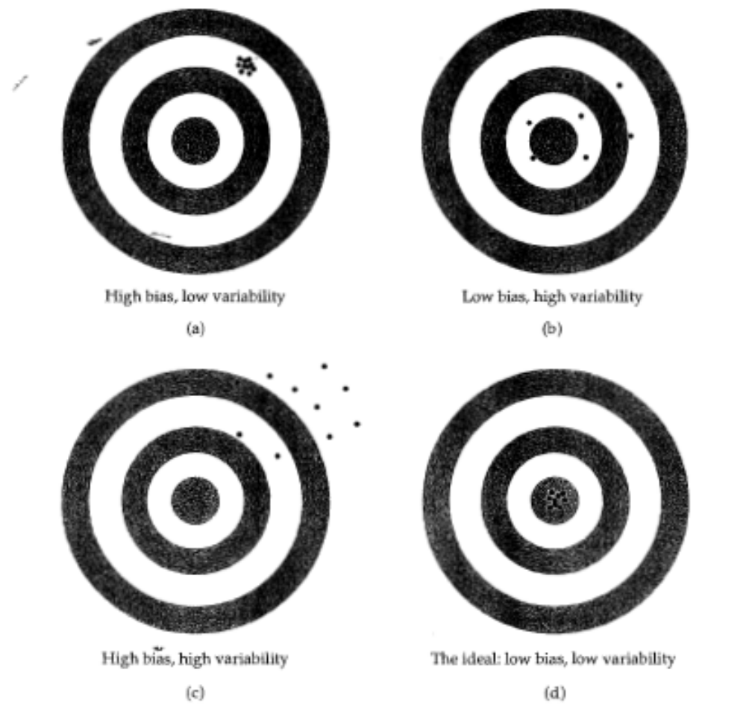
Biased, low variability
Unbiased, variable
Biased, highly variable
Unbiased, low variability

