Slide 1
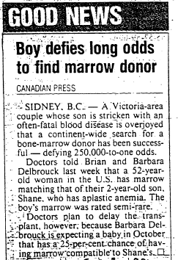
Gazette, Sept 8, 1991

