Slide 1
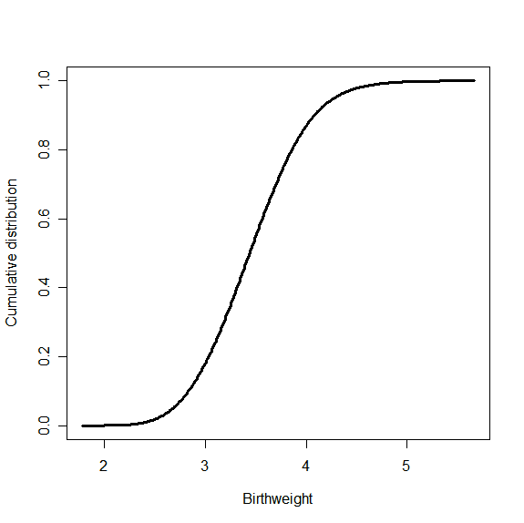
Cumulative density distribution:

