Slide 1
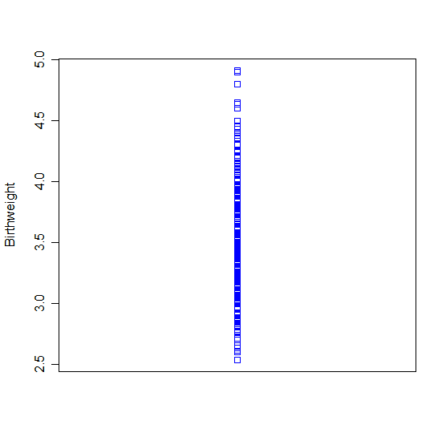
Dot plot:
Stem and leaf plot:
The decimal point is 1 digit(s) to the left of the |
25 | 4
26 | 000001355
27 | 0000001679
28 | 0000000011113444555555567778
29 | 00000000000000001122555556677
30 | 00000000000000000000001122244455555566678
31 | 0000000000000000000000134555555679
32 | 000000000000000000000000001112223445555555566666777888889
33 | 000000000000000000000000000233444445555555555555555555667789
34 | 00000000000000000000000000000111345555556677789
35 | 0000000000000000000000000000000002233444555555555555666778
36 | 00000000000000000000000012225555555555555777788999
37 | 000000000000000000000001344455555555677899
38 | 00000000000000000000001113445555555588899
39 | 0000000000000000001233455555778
40 | 0000000000011555778
41 | 00000000245577
42 | 000004556
43 | 0000568
44 | 0035
45 | 00
46 | 0035
47 |
48 | 0
49 | 01

