Slide 1
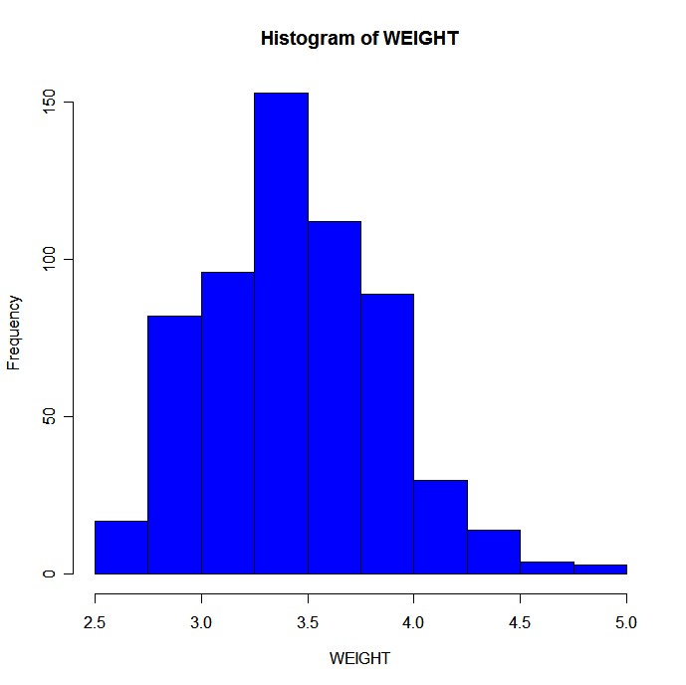
Frequency table:
Histogram:
Interval N %
---------------------
(2.5,2.75] 17 2.8
(2.75,3] 82 13.7
(3,3.25] 96 16.0
(3.25,3.5] 153 25.5
(3.5,3.75] 112 18.7
(3.75,4] 89 14.8
(4,4.25] 30 5.0
(4.25,4.5] 14 2.3
(4.5,4.75] 4 0.7
(4.75,5] 3 0.5

