Slide 1
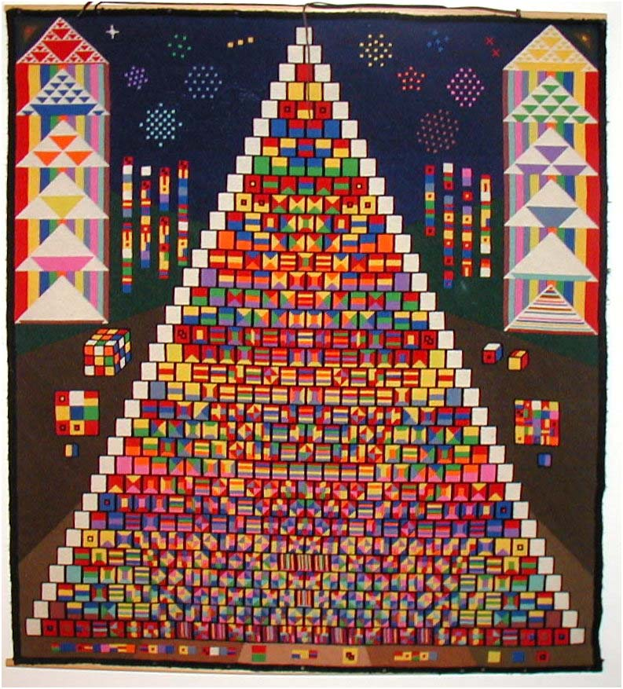
William H. Mitchell, who majored in Maths, started making quilts after he retired. His quilt featuring Pascal's triangle took several years to complete.
In Mitchell's design, prime numbers are shown in a single coloured square, while composite numbers are represented by its prime factor colours. For large composite numbers with requiring several prime factors, Mitchell used the colours of the prime factors in modified patterns.

