Slide 1
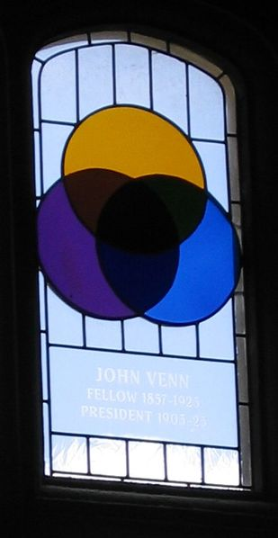
Venn diagram:
We use these to help show probability
relationships.
- The “universal set” is the sample space, containing all elements of the population.
- Each event that we want to consider is represented by a shape (usually a circle) inside the universal set
- If event A happening means event B cannot occur, the A and B are disjoint.
- If both event A and B can occur together, the intersection of the two circles indicates where both A and B occur. We write this as A∩B.
- We call the combined circles of A and B (that is, A and B and any place where they intersect) the union of A and B. We express this event as A or B, which we write as A∪B.
Stained glass window, Cambridge

