Slide 1
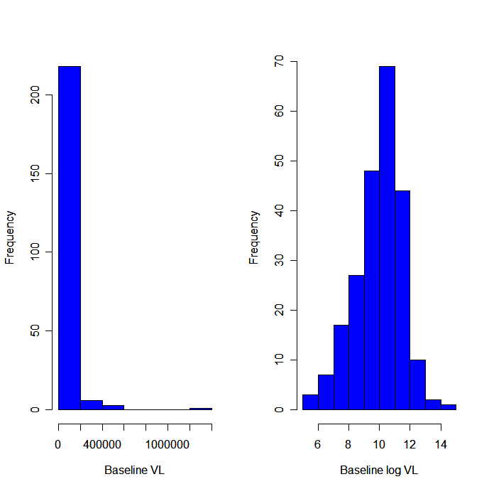
Data:
70737, 71111, 431, 38275, 524756, 90390, 18189, …, 32629, 6592, 55942, 21529, 100437
Summarize data:
Form probability model:
Binomial, Normal, Regression, …
Use probability model:
Estimate parameters in the data, test hypotheses

