Slide 1
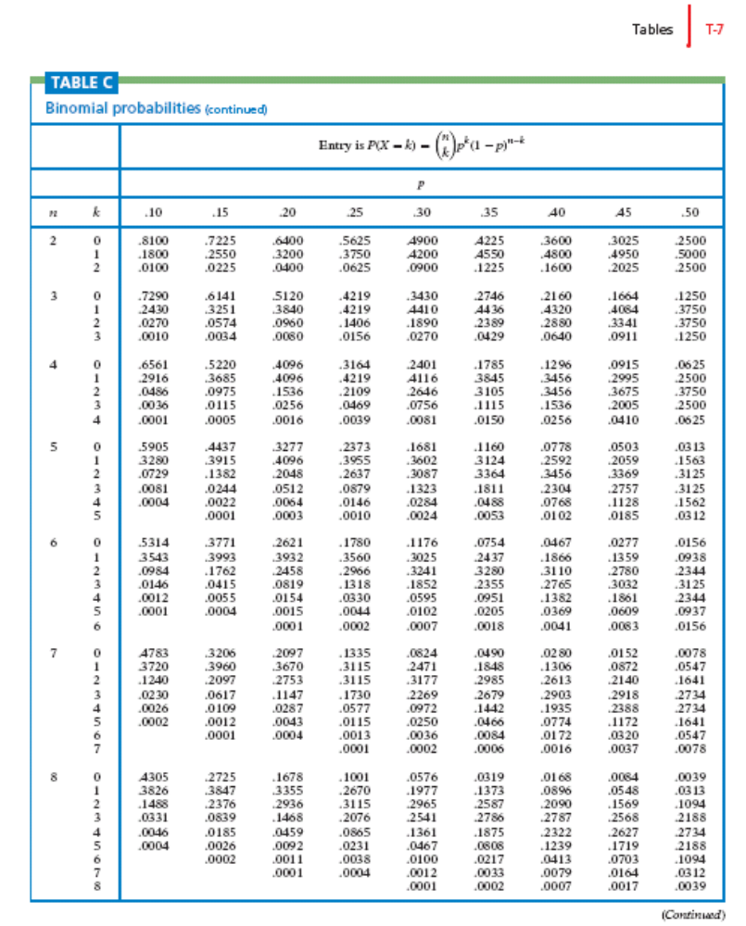
n=3 | k
 | 0 | .1250 (1/8)
 | 1 | .3750 (3/8)
 | 2 | .3750 (3/8)
 | 3 | .1250 (1/8)

