Slide 1
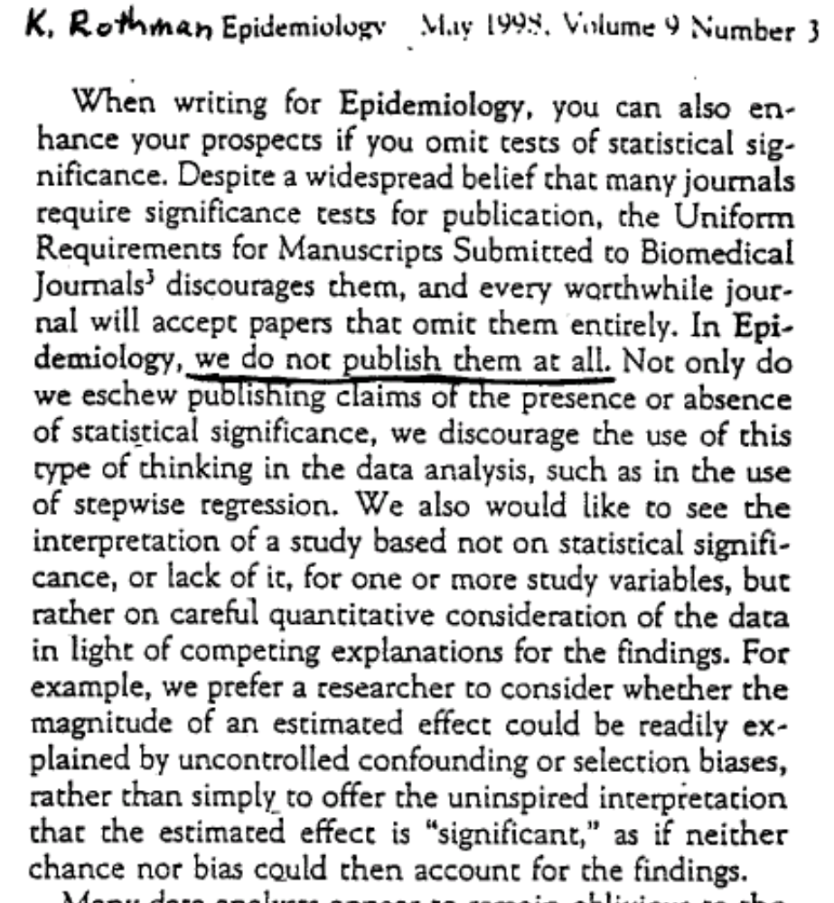
From Rothman (1998), Epidemiology v9:

