Slide 1
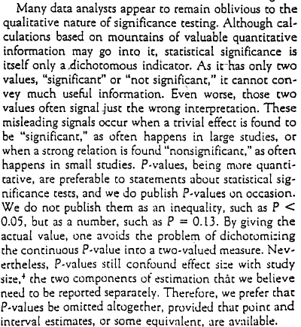
Rothman (1998), con’t:

