Slide 1
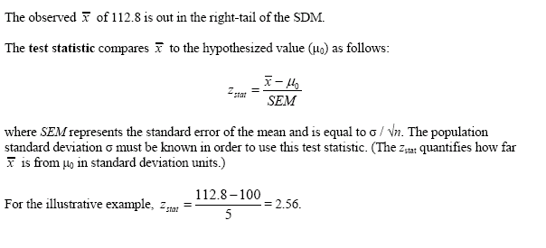
sampling distribution of the mean

