Slide 1
Adaptive Trees: a new approach to economic forecasting
Yu Li

Slide 2
Table of contents
Introduction
Data sources
Method
A tree-based approach to tackle non-linearities
From regression trees to adaptive trees: dealing with structural change
Feature engineering and feature selection to better detect tipping points
Results
Forecast simulations
Interpretation
Conclusion

Slide 3
1.Introduction
Failing to anticipate the 2008 crisis has called for a renewal of the forecasting methods (Romer, 2016[4]; Blanchard, 2014[5]).
Adaptive Trees is a new algorithm based on regression trees that addresses non-linearities and structural change in the macroeconomic data
A prediction made with Adaptive Trees can be additively decomposed into variable contributions, thus ensuring model interpretability.
The objective of supervised machine learning algorithms is to maximize the out-of- sample predictive accuracy for a target variable, for example quarterly GDP.
The flexibility of machine learning and richness of non-linear and time-varying processes that can be modelled make it potentially well-suited to capture complex economic relationships.
Complexity is related to the emergence of crises, and that is why non-linearities and structural breaks may be considered to be “where the danger lurks” (Blanchard, 2014[5]).
The more complex a machine learning algorithm, the more accurately it can fit a complex reality.

Slide 4
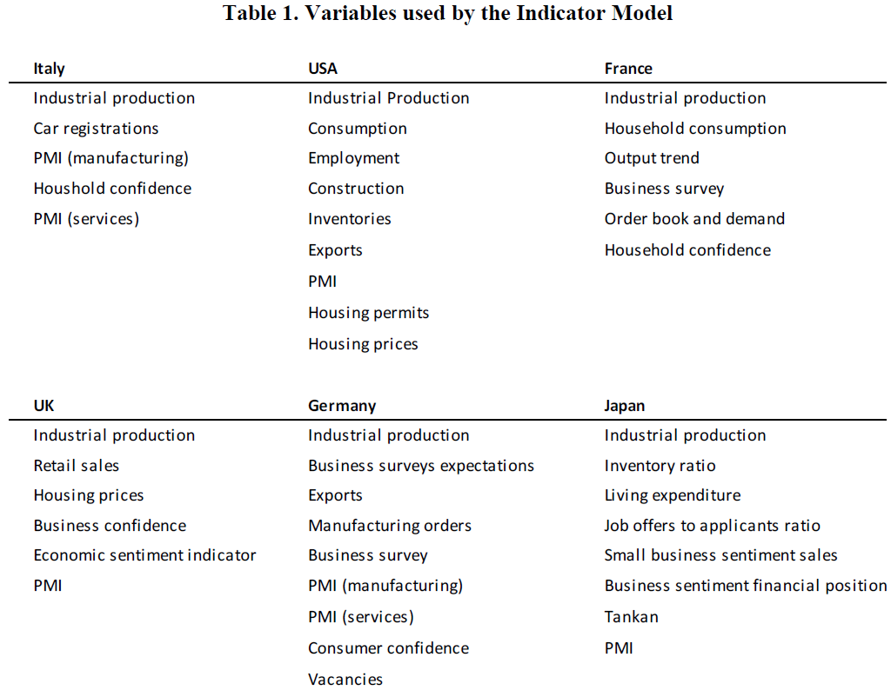
2.Data Sources
OECD Indicator Model (Ollivaud et al., 2016; Sédillot and Pain, 2003)
All base variables are monthly series, whereas GDP growth is quarterly.
The Indicator Model forecast is a simple average across forecasts from a pure hard indicator model, a survey indicator model and a mixed indicator model.
The forecast simulations from the Adaptive Trees and benchmark models are made in pseudo-real time, using the latest vintage of estimates from statistical agencies rather than data that was available in real-time.
Forecast performance is evaluated based on the root mean squared error (RMSE) of the different approaches over the period 2007Q1 to 2017Q1.

Slide 5
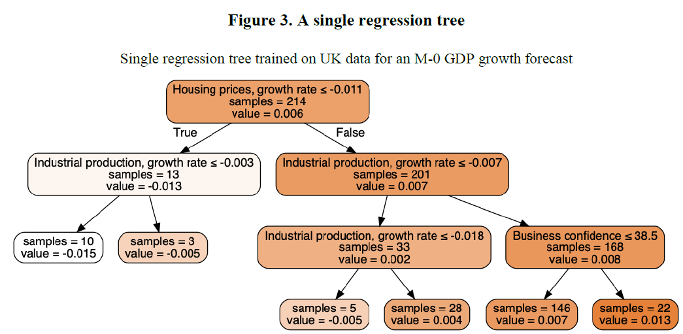

3.Method
3.1. A tree-based approach to tackle non-linearities
One of the reasons for choosing tree-based approaches is their intrinsic interpretability.
The core estimator used in the Adaptive Trees framework is XGBoost, an efficient implementation of the Gradient Boosting Trees algorithm.
$\hat{Y}$ = 0.6% + ∑𝐹𝑒𝑎𝑡𝑢𝑟𝑒 𝐶𝑜𝑛𝑡𝑟𝑖𝑏𝑢𝑡𝑖𝑜𝑛𝑠
In each node, “value” indicates the average value of GDP growth and “samples” the number of observations falling in the node.
First node “contains” the full-sample mean 0.6%. Each node split between observations that validate the condition (left) and observations that do not (right).
Algorithm splits observations between the growth of house prices is inferior to -1.1 % and observations where it is not.
For the former (left), the algorithms picks the growth rate of industrial production to make a split. For observations where house price growth is lower than -1.1% and the growth of industrial production less than -0.3%, the algorithm predicts that GDP growth will be equal to -1.5%.

Slide 6
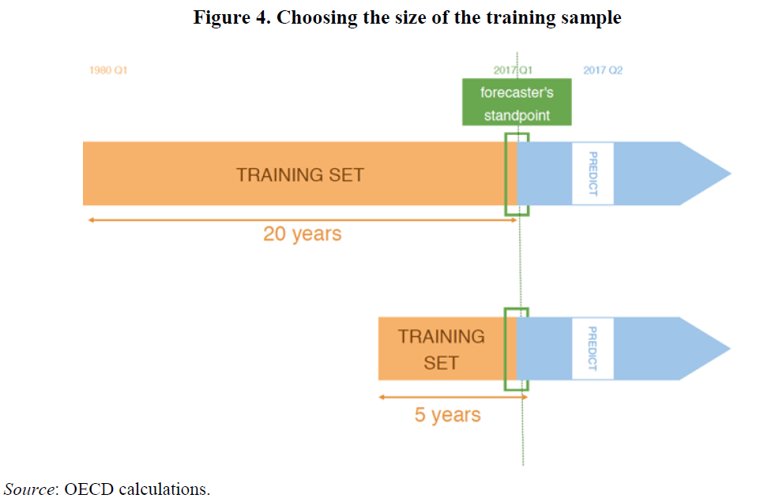

3.Method
3.2. From regression trees to adaptive trees: dealing with structural change
The economy may be seen as a complex ever-changing system. There can be sudden structural breaks or long-standing structural change, resulting for instance from technological changes.
Structural change is a problem known as “concept drift” (Žliobaitė, 2010[24]).
Because of structural change, using a small training window may yield more accurate predictions than with a larger training window
The parameter 𝛾 is optimized using cross-validation and is usually close to 15.
That means that in a sample of 10 years (120 months), the last observation (𝑡 = 𝑁) will have weight 1, the last but one (𝑡 = 𝑁 − 1) will have weight 0.88, at the middle of the sample (𝑡 = 𝑁/2), the weight is 0.0005 and at 𝑡 = 0 the weight is 3e-7.

Slide 7
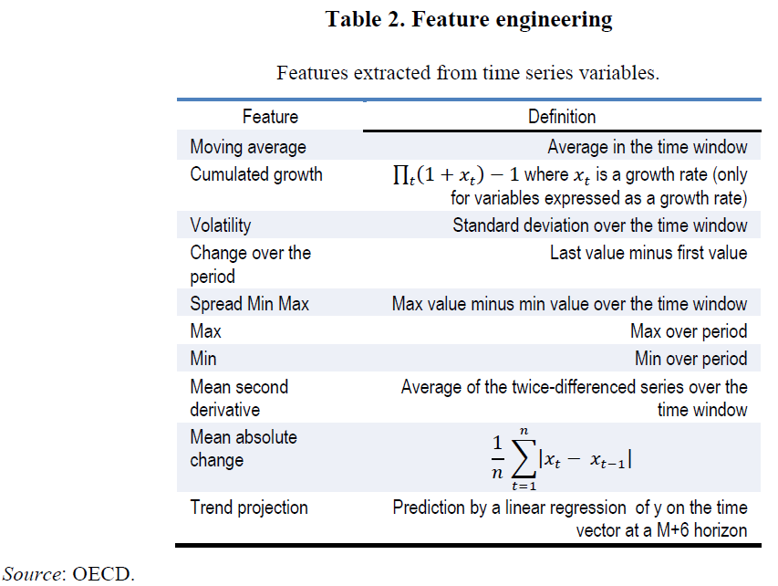
3.Method
3.3. Feature engineering and feature selection to better detect tipping points
Each feature is extracted over the 3, 6, 9, 12, 18, 24, and 36 past months. Should the original data include six variables, 6 * 7 * 10 = 420 features would be added to the training data.
The higher a feature intervenes in a tree, the more important it is. the feature importance score averages the feature importances computed for each tree. All features with null importance are removed. The resulting training set is then used for the training and prediction.

Slide 8
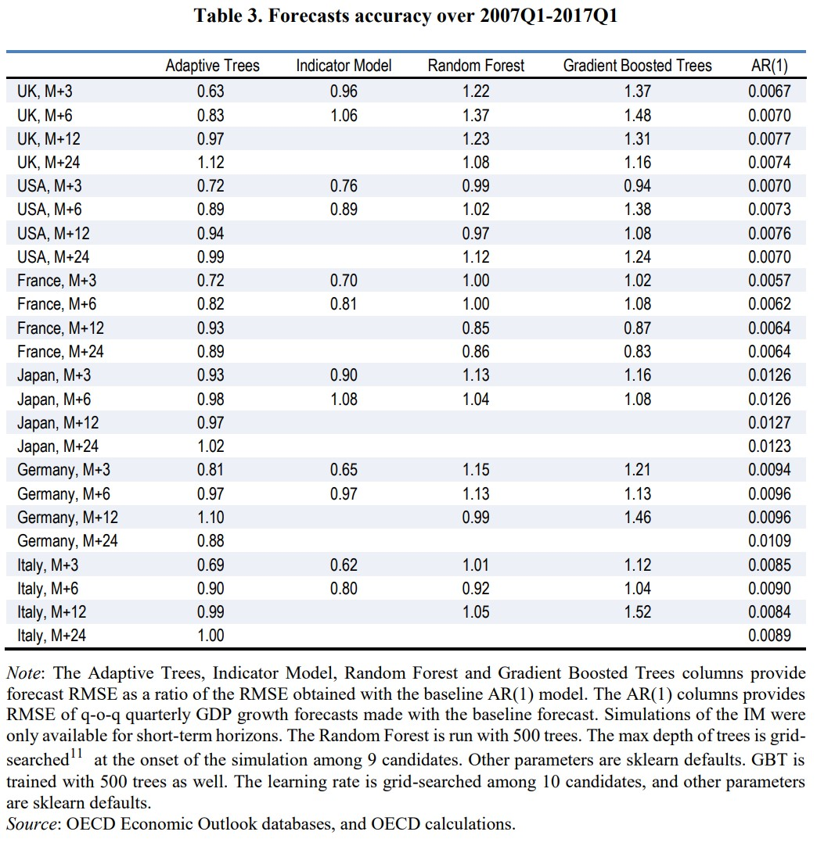
4.Results
The forecast performance of the Adaptive Trees model and IM and AR(1) benchmarks is assessed using a pseudo real-time approach.
The following paragraphs present the forecast results and performance for all G6 countries, at five time horizons: three months before the quarterly GDP release date (M+3), six (M+6), nine (M+9), twelve (M+12) and twenty-four (M+24).
Forecast’s RMSE are provided as a ratio of a baseline AR(1)’s RMSE.
The results may therefore depend to a degree on the specific nature of this sample period.
At terms larger than M+6, the Adaptive Trees forecasts perform similarly to a simple AR(1) model.
At M+3 and M+6, the Adaptive Trees outperform the Indicator Models for the UK, yields comparable performances for France, Japan and the US, and compares poorly in the cases of Germany and Italy.
The Adaptive Trees consistently outperforms both the Random Forest & Gradient Boosted Trees by a large margin.

Slide 9
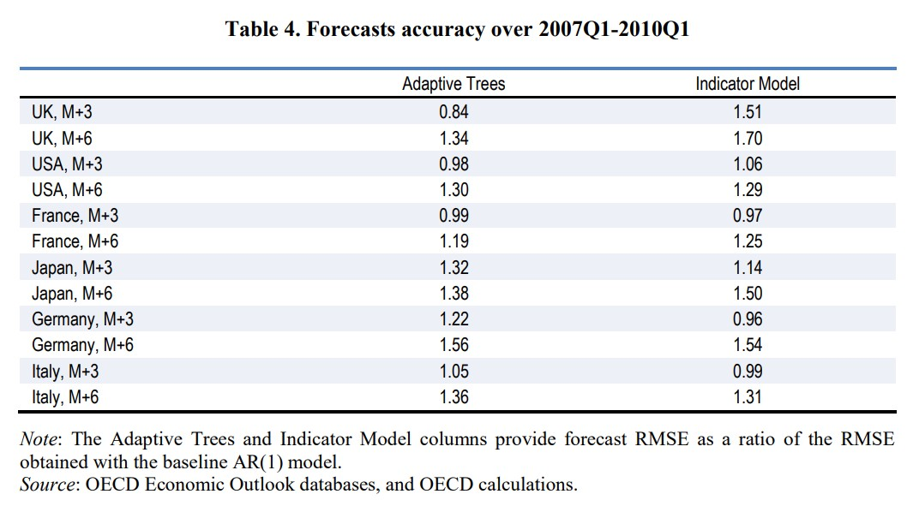
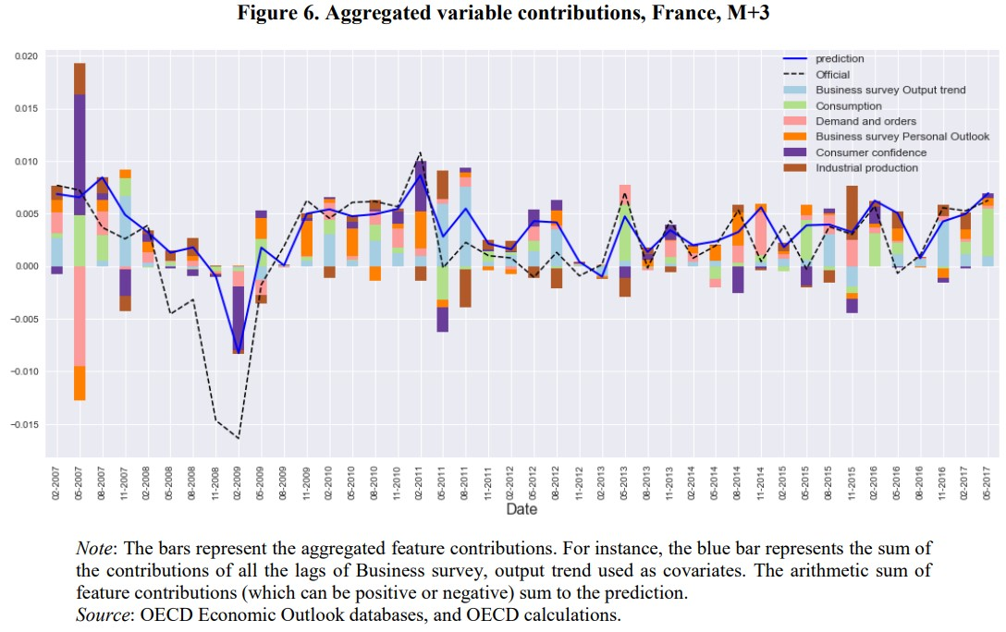
4.Results
The off-the-shelf machine learning methods (Random Forest and Gradient Boosted Trees) underperform the AR(1) in most cases.
Standard machine learning approaches not always give satisfactory results. This may be due to the problem-specific issues of macroeconomic forecasting.
Time series forecasting is not a standard supervised learning problem, as observations are not independent and identically distributed,
Global financial crisis (GFC). The Adaptive Trees perform better than the Indicator Models for the UK and the US, by a larger margin at M+3. For France and Italy, the results are comparable. The Indicator Model performs better in the cases of Japan and Germany.
4.2. Interpretation
One advantage of ensemble of trees, including Adaptive Trees, is that it is possible to decompose each variable’s contribution to a given prediction.
This provides a way to interpret each prediction.
Figure displays variable contributions to the France M+3 forecast.
The business survey variables and consumer confidence play a critical role in forecasts for recessions, thus proving the importance of soft indicators in this model.

Slide 10

5.Conclusion
Adaptive Trees consistently outperforms the Random Forest and Gradient Boosted Trees in the pseudo-real time simulations.
Adaptive Trees forecast perform well in the short run, but become uninformative past 12 months.
No long-term forecast simulations were available for the Indicator Model.
The Adaptive Trees machine learning algorithm can handle data in high dimensions, that is a large number of variables compared to the number of observations.
This capability has not been exploited in the like-for-like comparison used in this paper based on few variables. However, future research experimenting with larger data sets could increase the forecasting performance and advantage of the Adaptive Trees algorithm.
If Adaptive Trees, or other machine learning algorithms, can capture non-linearities and structural change in the economy, there may be other applications than forecasts.
Predictive algorithms may be used to predict counterfactuals in order to perform causal inference.
Powerful machine learning algorithms may be very useful in this regard
Even though linear models facilitate interpretability, the possibility to uncover non-linearities and structural changes provides supplementary arguments in favour of the use of machine learning algorithm for analysing economic policies.

Slide 11
Reference
Nicolas Woloszko(2020), “Adaptive Trees: a new approach to economic forecasting”, OECD Economics Department Working Papers No. 1593
OECD Indicator Model (Ollivaud et al., 2016; Sédillot and Pain, 2003)
Christ, M. et al. (2018), “Time Series FeatuRe Extraction on basis of Scalable Hypothesis tests (tsfresh – A Python package)”, Neurocomputing, Vol. 307, pp. 72-77
Christ, M., A. Kempa-Liehr and M. Feindt (2016), “Distributed and parallel time series feature extraction for industrial big data applications”
Clements, M. and A. Galvão (2008), “Macroeconomic Forecasting With Mixed-Frequency Data”, Journal of Business & Economic Statistics, Vol. 26/4, pp. 546-554
Cook, R. (1977), “Detection of Influential Observation in Linear Regression”, Technometrics, Vol. 19/1, pp. 15-18

Slide 12
Thank you for your attention !

