Slide 1
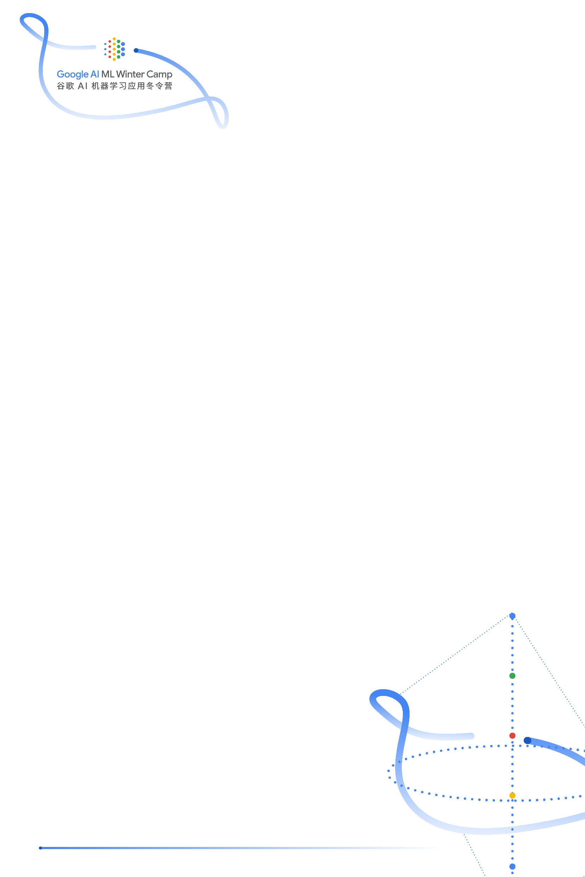
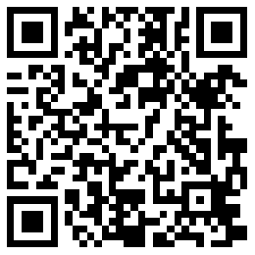
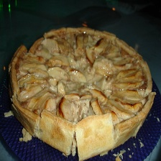

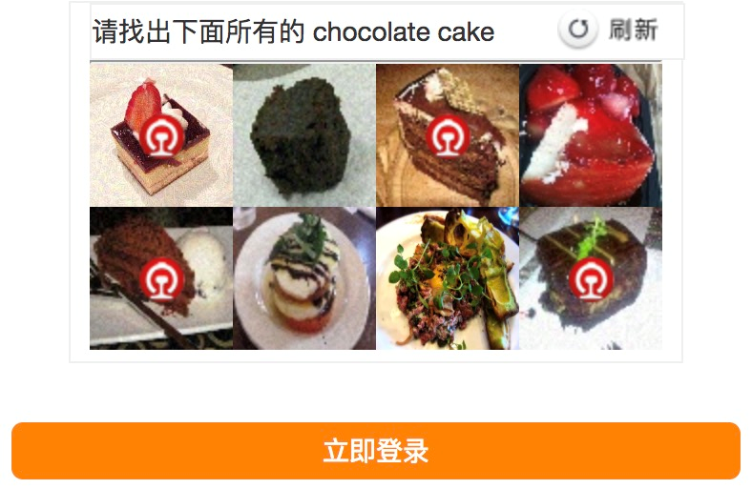

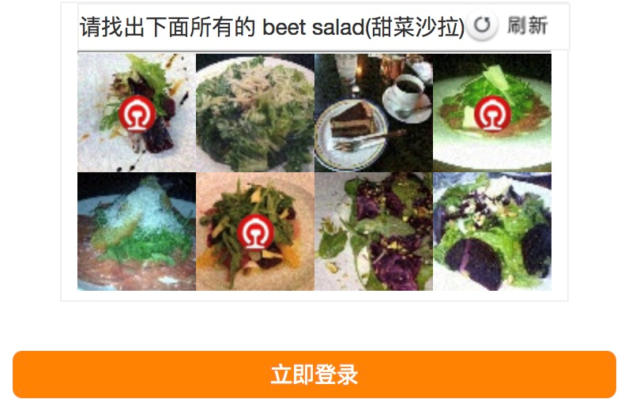








Confusing Food 101
Yan Yu, Peking University
Yao Luo, Tsinghua University
Shijie Rao, Beihang University
Introduction
Verification codes are widely used to prevent attackers from accessing a website, and they are easily recognized by neural networks [1]. In this project, we generate groups of verification codes based on the Food 101 dataset that can fight against recognizers [2].
Methodology
Our method of reducing the performance of a verification code recognizer includes three steps:
Determine the way of combination of verification codes;
Build the verification code data set by adding a perturbation [3];
Select the verification codes from the established data set.
Apple Pie (90.65%)
Peking Duck (99.99%)
Results
The generated verification codes reduce the accuracy of recognizers:
Networks | Original verification codes | Generated verification codes
ResNet-50 | 90.37% | 0.00%
Inception V3 | 90.12% | 0.14%
Confusing samples
Samples
$$S_{r_{1}}$$
$$S_{r_{2}}$$
$$S_{r_{3}}$$
$$S_{r_{4}}$$
ResNet-50
$$S_{o}$$
$$S_{o}$$
$$S_{o}$$
$$S_{o}$$
+
Perturbation
Target samples
The theory of the proposed method is briefly discussed as follows.
Theory of Adversarial Attacks
After adding the subtle perturbation, samples will pass through the decision boundary.
The perturbation is obtained by solving the constrained optimization problem:
Conclusions
We generate groups of verification codes based on the Food 101 dataset by adding a well-designed perturbation to the samples.
The perturbation calculated based on ResNet-50 is also effective to Inception V3 and ResNet-50 with different weights.
References
[1] F. Stark, C. Hazirbags, R. Triebel, D. Cremers, CAPTCHA Recognition with Active Deep Learning, In German Conference on Pattern Recognition Workshop, 2015
[2] C. Szegedy, W. Zaremba, I. Sutskever, J. Bruna, D. Erhan, I. Goodfellow, R. Fergus, Intriguing properties of neural networks, arXiv:1312.6199, 2014
[3] Y. Dong, F. Liao, T. Pang, H. Su, J. Zhu, X. Hu, J. Li, Boosting Adversarial Attacks with Momentum, arXiv:1710.06081, 2017

