Slide 1
Confusing Food 101: Fight Against Verification Code Recognizers
AI for Everyone
Yan Yu, Yao Luo, Shijie Rao
Jan 25, 2019, PEK

Slide 2

Background
The verification code is used to prevent attackers from accessing a website:
The verification code should be recognized by real people.
The verification code is easily recognized by deep learning models¹.
AI for Everyone
¹F. Stark, C. Hazirbags, R. Triebel, D. Cremers, CAPTCHA Recognition with Active Deep Learning, In German Conference on Pattern Recognition Workshop, 2015

Slide 3
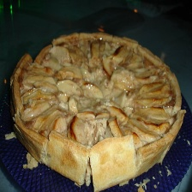
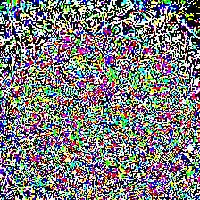
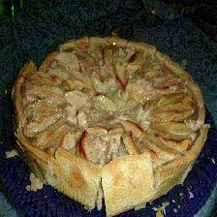
Project Description
We generate groups of verification codes based on the Food 101 data set that can fight against recognizers:
Determine the way of combination of verification codes
Build the verification code data set
Select the verification codes
+
=
Apple Pie (90.65%)
Perturbation
Peking Duck (99.99%)
AI for Everyone

Slide 4
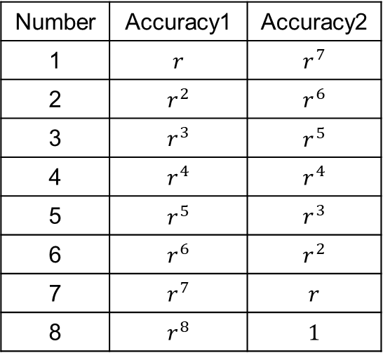
Methodology
Determine the way of combination of verification codes
The accuracy of a recognizer: $r$
Number | Accuracy1 | Accuracy2
1 | $$r$$ | $$r^{7}$$
2 | $$r^{2}$$ | $$r^{6}$$
3 | $$r^{3}$$ | $$r^{5}$$
4 | $$r^{4}$$ | $$r^{4}$$
5 | $$r^{5}$$ | $$r^{3}$$
6 | $$r^{6}$$ | $$r^{2}$$
7 | $$r^{7}$$ | $$r$$
8 | $$r^{8}$$ | $$1$$
AI for Everyone

Slide 5
Methodology
Build the verification code data set
Food 101 data set
Deep learning model
Correctly classified?
Samples +
Perturbation
Yes
No
Verification code data set
AI for Everyone

Slide 6
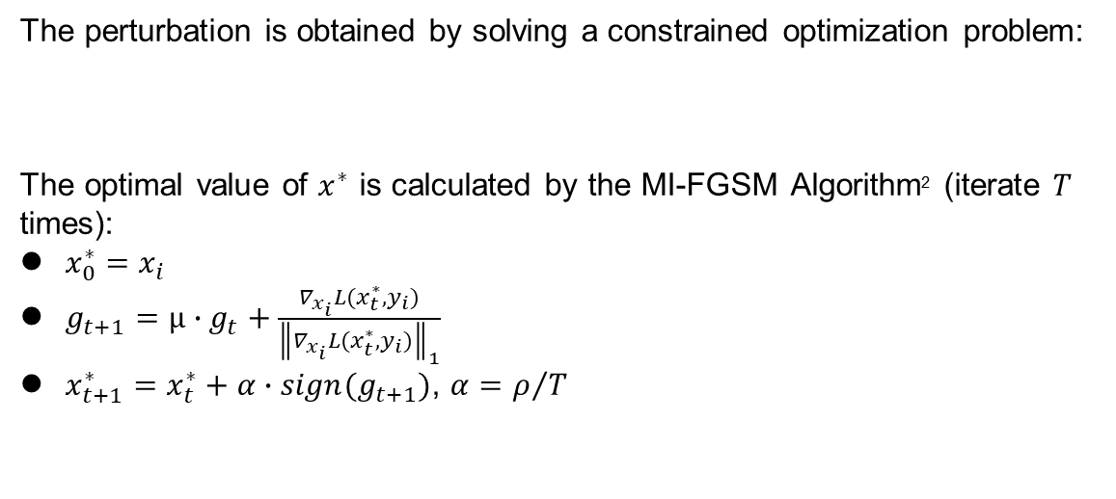
Methodology
Build the verification code data set
The perturbation is obtained by solving a constrained optimization problem:
The optimal value of $x^{∗}$ is calculated by the MI-FGSM Algorithm² (iterate $T$ times):
$x_{0}^{∗}=x_{i}$
$g_{t+1}=μ∙g_{t}+\frac{∇_{x_{i}}L(x_{t}^{∗},y_{i})}{{\left\|∇_{x_{i}}L(x_{t}^{∗},y_{i})\right\|}_{1}}$
$x_{t+1}^{∗}=x_{t}^{∗}+α∙sign(g_{t+1})$, $α=ρ/T$
AI for Everyone
²Y. Dong, F. Liao, T. Pang, H. Su, J. Zhu, X. Hu, J. Li, Boosting Adversarial Attacks with Momentum, arXiv:1710.06081, 2017

Slide 7
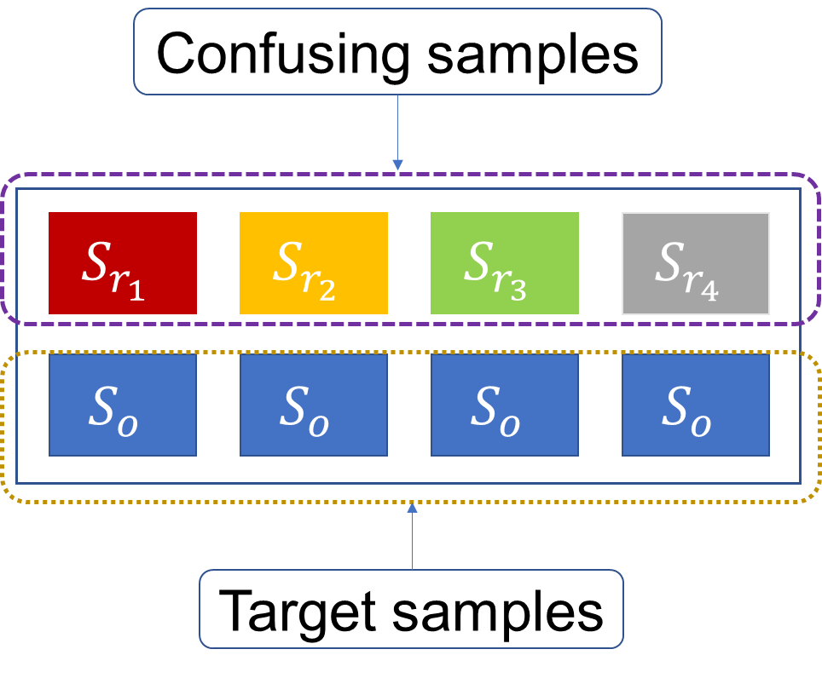
Methodology
Select the verification codes
Selection of samples
Four target samples with same label: randomly picked from the data set
The rest samples
AI for Everyone

Slide 8
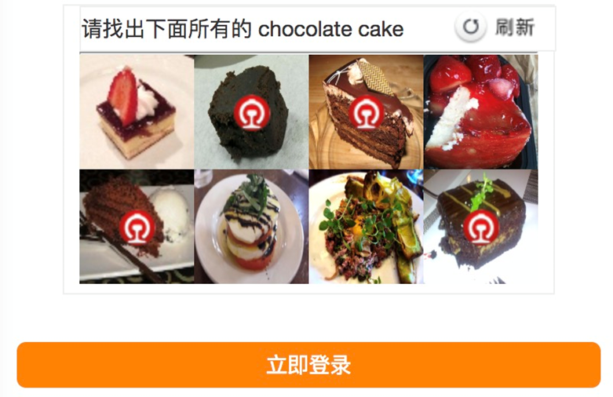
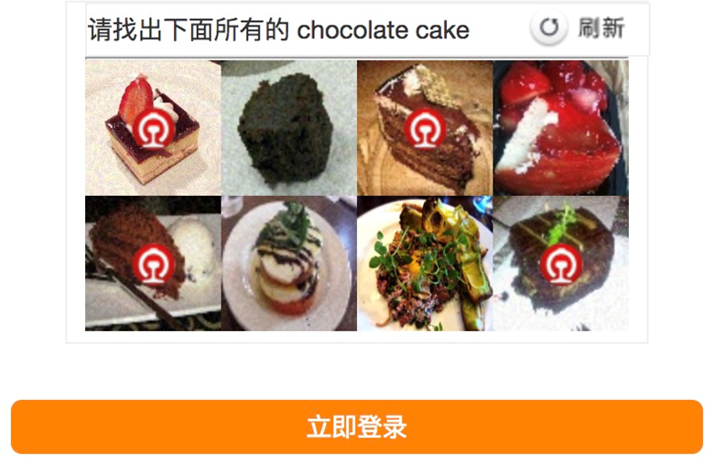
Experiment and Application
The generated verification codes reduce the accuracy of recognizers:
Networks | Original verification codes | Generated verification codes
ResNet-50 | 90.37% | 0.00%
Inception V3 | 90.12% | 0.14%
AI for Everyone

Slide 9
Conclusion
We generate groups of verification codes based on the Food 101 dataset by adding a well-designed perturbation to the samples.
The perturbation calculated based on ResNet-50 is also effective to Inception V3 and ResNet-50 with different weights.
Demo
AI for Everyone

Slide 10
AI for Everyone
Q&A
AI for Everyone

