Slide 1
Autonomous Driving Project
TUM "Introduction to ROS" 2026 — Group 10
Feng-En Yeh · Zeyun Yan · Yuan Li
Notes:
Good afternoon. This is our autonomous driving project for the Introduction to ROS course. I will walk through our system architecture, then planning, perception, and control, and finish with our test results.

Slide 2
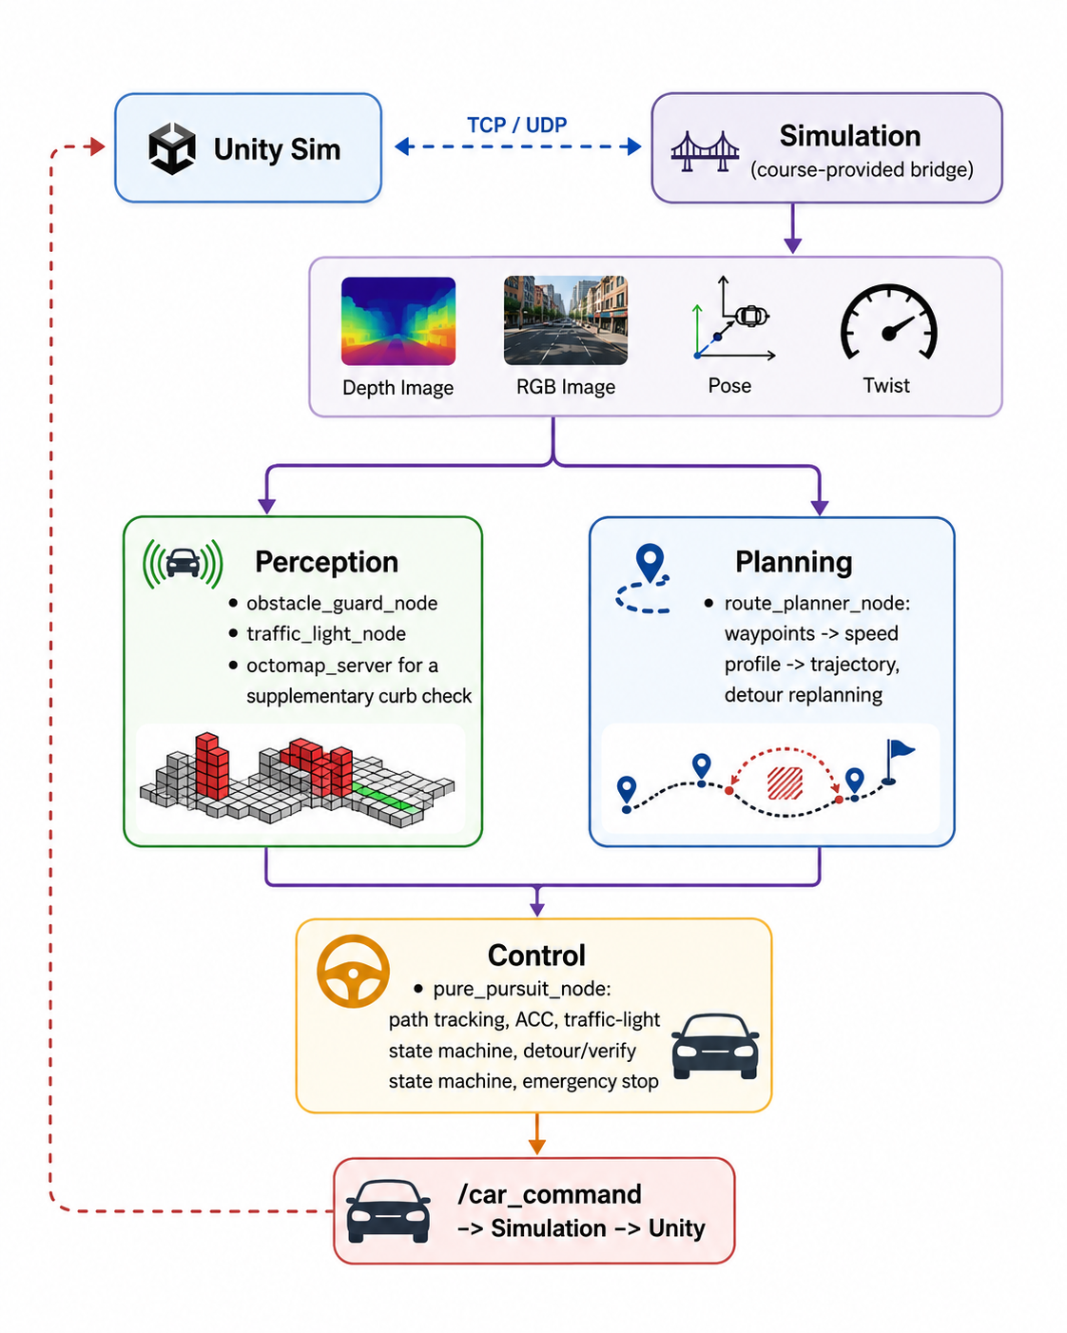
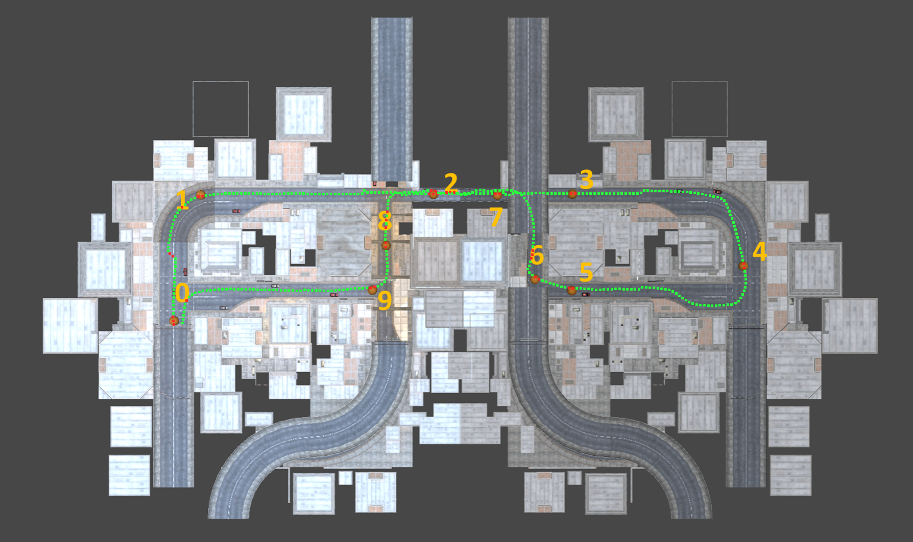
System Overview
• Fixed ~785 m urban loop; waypoints published once at startup
• 5 custom + 2 course-provided ROS 2 packages
• Three layers, matching Figure 1:
‒ Planning — decides destinations
‒ Perception — senses its surrounding environment
‒ Control — drives the car & reacts in real time
• Full benchmark run: 272 s, zero collisions, zero stalls, 1 detour, 2 correct red light stops
‒ Average speed 2.7 m/s, peak 7.5 m/s on the longest straights
Node/data-flow architecture
Route with 10 predefined goal poses
Notes:
Our car drives a fixed, roughly 785-meter urban loop, using waypoints published once at startup. We wrote five ROS 2 packages on top of two provided by the course, and we can think of the system in three layers, matching Figure 1. Planning decides where the car should go -- both the offline base route and online updates like rerouting around obstacles. Perception senses the world, including obstacles and traffic lights. And Control executes that path and reacts in real time, like steering, speed, and safety braking. Perception and planning both feed directly into control, and control is the only node that talks to the car itself. On the results side, a full benchmark run completed in 272 seconds with zero collisions, zero stalls, one obstacle detour, and two red-light stops handled correctly. Average speed was 2.7 meters per second, peaking at 7.5 on the two longest straights. The figure below shows the planned route on the course map, with the ten predefined goal poses our planner selects between.

Slide 3
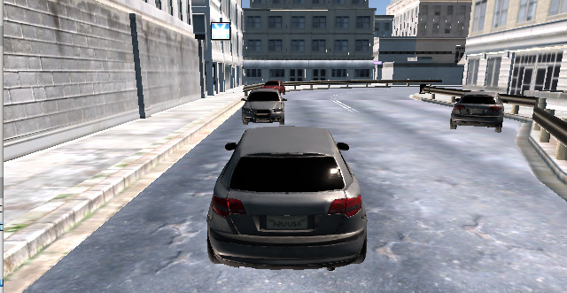
Planning — Deciding Destinations (Yeh Feng-En)
• Builds the path the car follows — offline, and online corrections while driving
• Offline planning at startup: smooth base path on the correct side of the road
‒ sets a safe speed for every turn — tighter turns, lower speed
• Online corrections: reactions to the world at the path level:
‒ when the perception node flags an obstacle and the control node confirms it's parked
→ smoothly reroutes a path segment around it, then returns
‒ continuously picks the next checkpoint to aim for
Original route
Detour
(reroute)
Notes:
Planning is where the car decides where to go -- both offline and online. At startup, it builds a smooth base path that stays on the right side of the road and sets a safe speed for every turn, eventually, tighter turns get lower speeds. But it doesn't stop there: while driving, planning also reacts to the world at the path level. When the perception node flags an obstacle ahead and the control node confirms it's actually parked, planning smoothly reroutes around it and returns to the normal path afterward. And it continuously picks the next checkpoint to aim for.

Slide 4
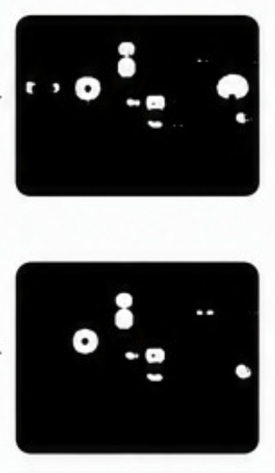
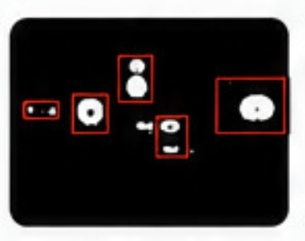
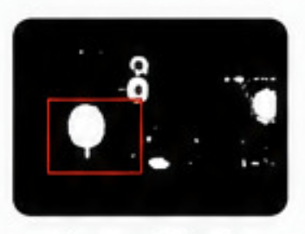
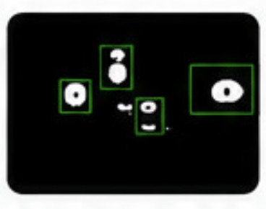
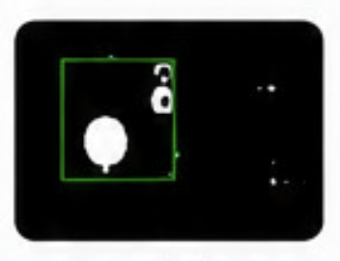
Perception — Sensing the World (Yan Zeyun)
• Feeds real-time awareness to both planning and control
• Obstacle detection: depth camera builds a 3D view of the road ahead
‒ tracks distance to the nearest obstacle, in the driving lane and to the sides
‒ ignores ground-level noise, only counts real obstacles
• Traffic-light detection: RGB camera tells red from green
‒ Deliberately never uses the labeled (semantic) camera
Red
RGB → Color mask
Component group
Select largest
detection
candidate
Green
Notes:
Perception's job is simple: sense the world and hand that information to planning and control.
An obstacle detector uses the depth camera to build a 3D view of the road ahead, and tracks how far away the nearest obstacle is, in the driving lane as well as to the sides. It ignores ground-level noise and only counts real obstacles, and a backup 3D map check catches low, curb-height obstacles the live camera might miss. A traffic-light detector uses color to tell red from green, and deliberately never uses the labeled semantic camera.

Slide 5
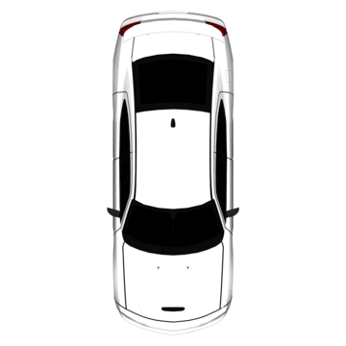


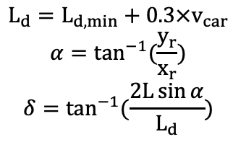





Control — Driving & Reacting in Real Time (Li Yuan)
• Takes the path from planning and the readings from perception, drives the car
‒ Steering aims at a point ahead on the path and calculates a corresponding steering angle
‒ Speed follows a safe distance from anything ahead under a desired velocity with a proportional and feedforward controller
‒ Stops correctly at red lights, resumes on green
‒ When the perception node flags a parked obstacle → verifies it's clear, takes a smooth detour
‒ Independent emergency brake if a collision risk is detected
Longitudinal Control (Speed)
Lateral Control (Steering)
$$L_{d}=L_{d,min}+0.3×v_{car}$$
$$α=\tan^{−1}{(\frac{y_{r}}{x_{r}})}$$
$$δ=\tan^{−1}{(\frac{2L\sin{α}}{L_{d}})}$$
$$Δv=v_{car} − v_{des}$$
$$Throttle=k_{p}×Δv+{Throttle}_{ff}×v_{des}$$
$$y$$
$$L_{d}=(x_{r},y_{r})$$
$$v_{des}$$
Lowers $v_{des}$ when there is a close object ahead
$$x$$
$$v_{car}$$
Notes:
Control takes the path from planning and the live readings from perception, and drives the car by steering and speed. We use Pure Pursuit for steering while we calculate a leading point and its corresponding steering angle.
We use P control with feed-forward for throttle and braking. It slows down with ACC, applies emergency braking when needed, and requests a detour for static obstacles. On top of that, it stops correctly at red lights, and when the perception node flags a parked obstacle, the control node verifies the path is clear before taking a smooth detour around it. Independent of everything else, an emergency-brake check runs continuously and stops the car immediately if a collision risk is detected.

Slide 6
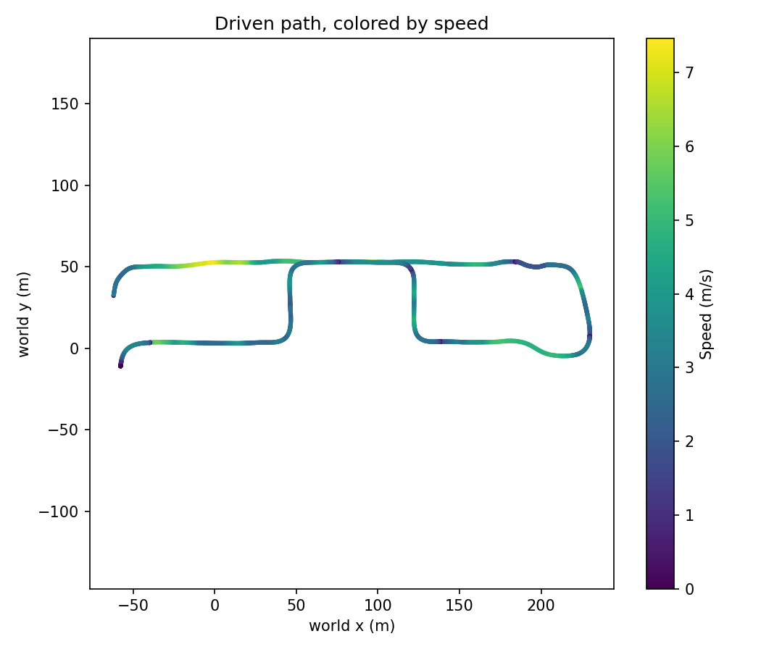
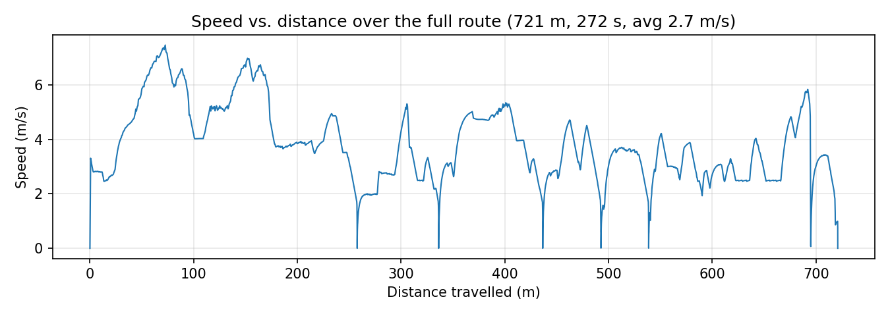
Results
• Full benchmark run completed successfully
‒ 272 seconds, zero collisions and zero stalls
‒ Fastest: 2 longest clear straights (peak 7.5 m/s)
‒ Slowest: detour spot, stops @ Traffic Light 2&3, vehicle merging and emergency brake
• Limitation 1: Full trajectory update on every detour replan
‒ Perception & control both fully rebuild their arc tables on every update, not just the changed window
• Limitation 2: wide corridor is over-sensitive to irrelevant roadside objects
‒ Can't distinguish real hazards from static roadside furniture
Detour
Driven path colored by speed
Speed vs. distance travelled
Notes:
The full run completed in 272 seconds with zero collisions, zero stalls. The figure above shows the driven path colored by speed, The one below shows the same against distance. We peak at 7.5 meters per second on the longest straights; the near-zero dips are the detour, two red-light stops, and two ACC slowdowns for Event I and Event II. One mitigation mattered a lot: a flat 2.5 meter-per-second wide-corridor cap was starving the whole run, since roadside furniture sits in that corridor sixty to ninety percent of the time -- ramping it to 6.5 fixed most of that. Two limitations remain, though. A detour replan isn't incremental -- it still re-profiles and republishes the entire trajectory, which won't scale to a longer or more dynamic map. And the wide corridor still can't tell a real hazard from roadside clutter, so the ramp only softens, not removes, that false caution -- likely a real reason our average speed is only 2.7 versus a 7.5 peak.

Slide 7
Thank you for attention!

