Slide 1
Autonomous Driving Project
TUM "Introduction to ROS" 2026 — Autonomous Driving Group Project
Author 1 · Author 2 · Author 3
Notes:
Good afternoon. This is our autonomous driving project for the Introduction to ROS course. I will walk through our system architecture, then planning, perception, and control, and finish with our test results.

Slide 2
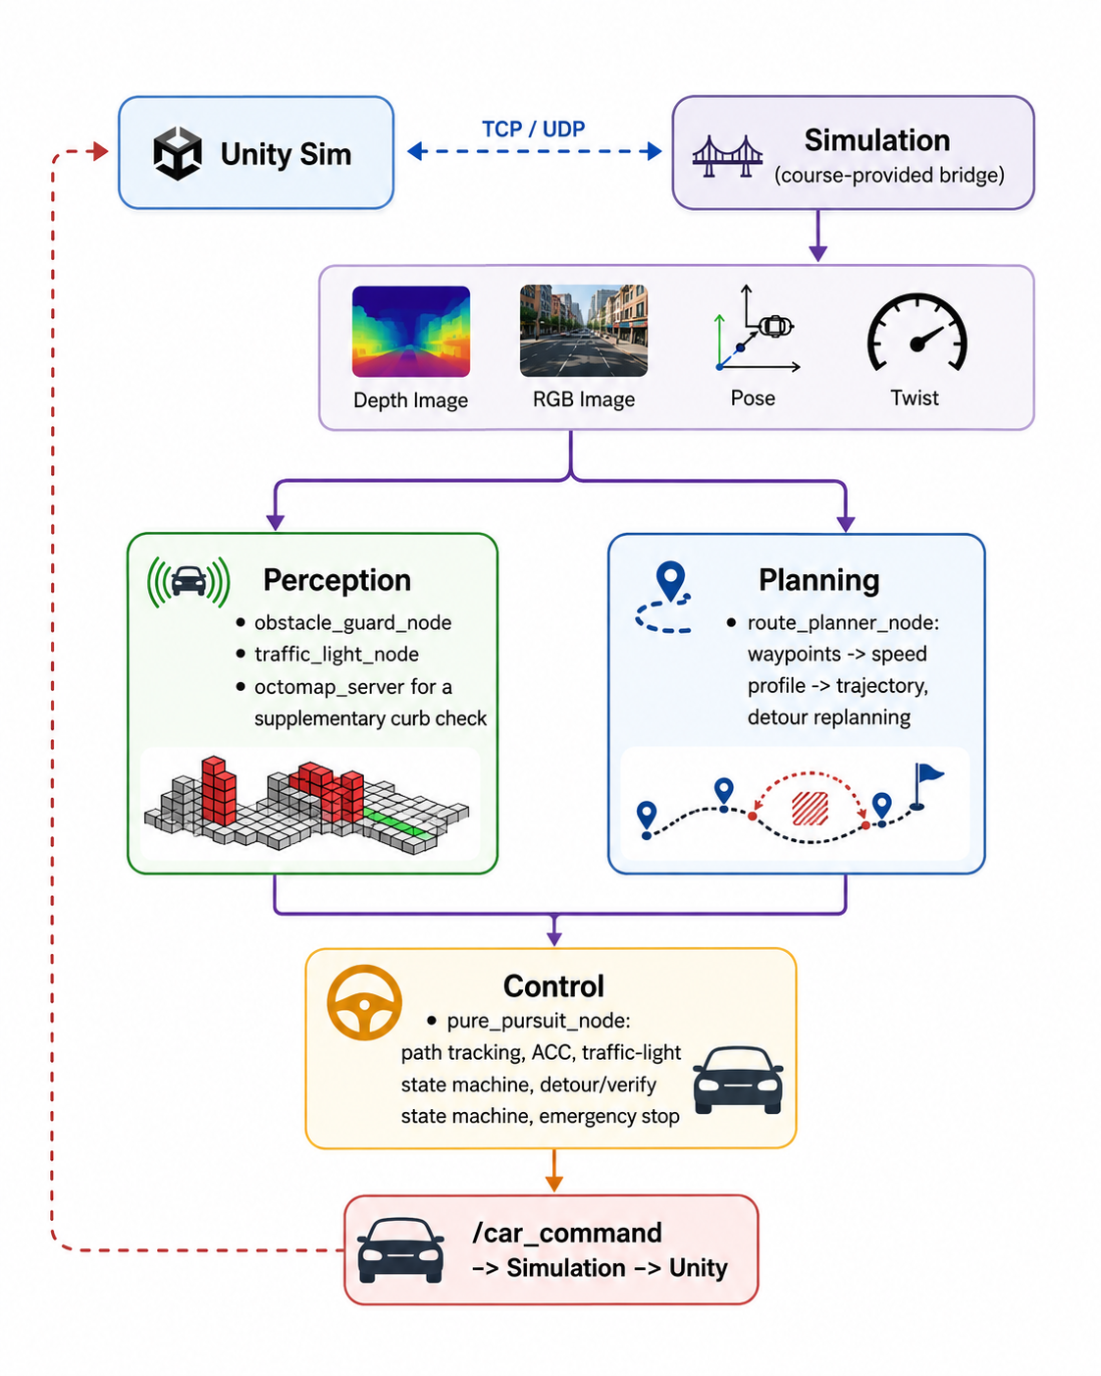
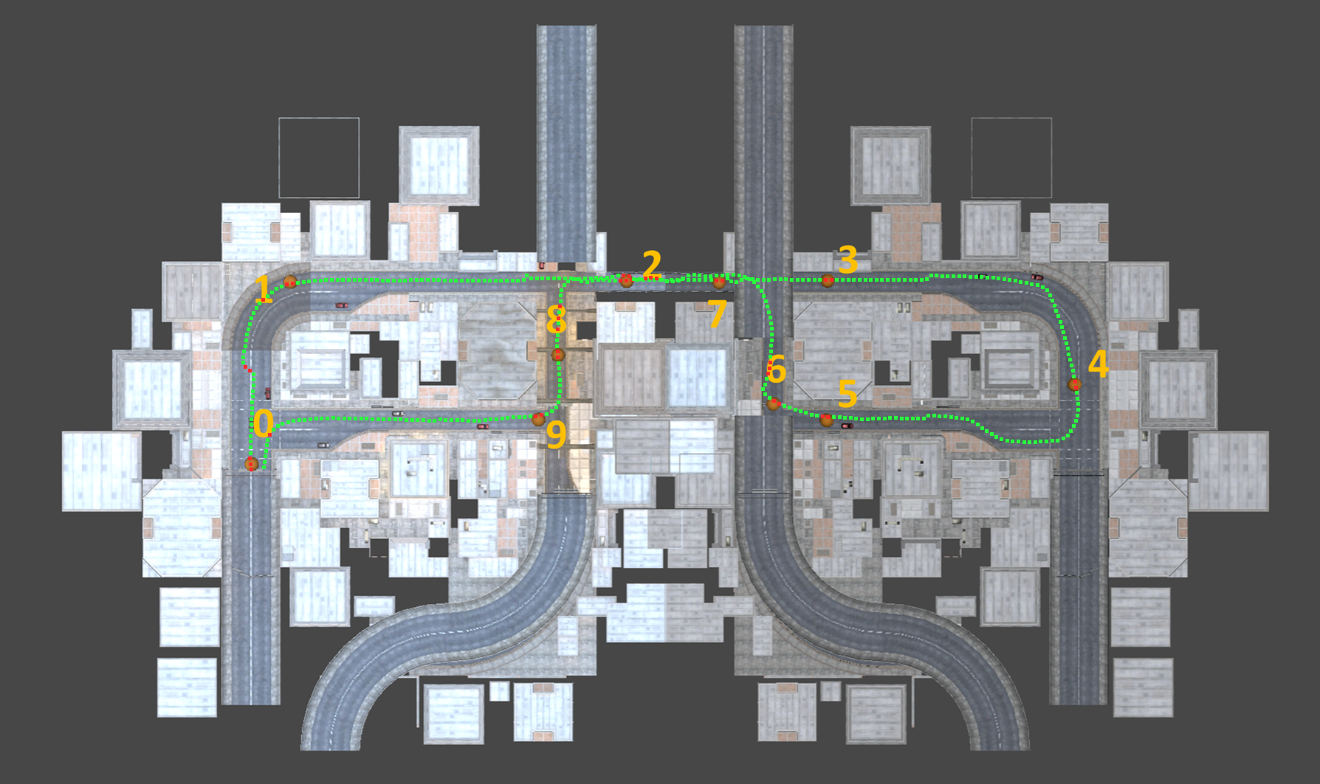
System Overview
• Fixed ~785 m urban loop; waypoints published once at startup
• 5 custom + 2 course-provided ROS 2 packages
• Three layers, matching Figure 1:
‒ Planning — decides destinations
‒ Perception — senses its surrounding environment
‒ Control — drives the car & reacts in real time
• Full benchmark run: 272 s, zero collisions, zero stalls, 1 detour, 2 correct red light stops
‒ Average speed 2.7 m/s, peak 7.5 m/s on the longest straights
Node/data-flow architecture
Route with 10 predefined goal poses
Notes:
Our car drives a fixed, roughly 785-meter urban loop, using waypoints published once at startup. We wrote five ROS 2 packages on top of two provided by the course, and we can think of the system in three layers, matching Figure 1. Planning decides where the car should go -- both the offline base route and online updates like rerouting around obstacles. Perception senses the world, including obstacles and traffic lights. And Control executes that path and reacts in real time, like steering, speed, and safety braking. Perception and planning both feed directly into control, and control is the only node that talks to the car itself. On the results side, a full benchmark run completed in 272 seconds with zero collisions, zero stalls, one obstacle detour, and two red-light stops handled correctly. Average speed was 2.7 meters per second, peaking at 7.5 on the two longest straights. The figure below shows the planned route on the course map, with the ten predefined goal poses our planner selects between.

Slide 3
Planning — Deciding Destinations
• Builds the path the car follows — offline, and online corrections while driving
• Offline at startup: smooth base path on the correct side of the road
‒ sets a safe speed for every turn — tighter turns, lower speed
• Online corrections: reactions to the world at the path level:
‒ when the perception node flags an obstacle and the control node confirms it's parked
‒ → smoothly reroutes around it, then returns
‒ continuously picks the next checkpoint to aim for
Notes:
Planning is where the car decides where to go -- both offline and online. At startup, it builds a smooth base path that stays on the right side of the road and sets a safe speed for every turn, eventually, tighter turns get lower speeds. But it doesn't stop there: while driving, planning also reacts to the world at the path level. When the perception node flags an obstacle ahead and the control node confirms it's actually parked, planning smoothly reroutes around it and returns to the normal path afterward. And it continuously picks the next checkpoint to aim for.

Slide 4
Perception — Sensing the World
• Feeds real-time awareness to both planning and control
• Obstacle detection: depth camera builds a 3D view of the road ahead
‒ tracks distance to the nearest obstacle, in the driving lane and to the sides
‒ ignores ground-level noise, only counts real obstacles
‒ backup 3D map check catches low, curb-height obstacles the camera misses
• Traffic-light detection: RGB camera tells red from green
‒ Deliberately never uses the labeled (semantic) camera
Notes:
Perception's job is simple: sense the world and hand that information to planning and control. An obstacle detector uses the depth camera to build a 3D view of the road ahead, and tracks how far away the nearest obstacle is, in the driving lane as well as to the sides. It ignores ground-level noise and only counts real obstacles, and a backup 3D map check catches low, curb-height obstacles the live camera might miss. A traffic-light detector uses color to tell red from green, and deliberately never uses the labeled semantic camera.

Slide 5
Control — Driving & Reacting in Real Time
• Takes the path from planning and the readings from perception, drives the car
‒ Steering aims at a point ahead on the path (classic "pursuit" steering)
‒ Speed follows a safe distance from anything ahead — like adaptive cruise control
‒ Stops correctly at red lights, resumes on green
‒ When the perception node flags a parked obstacle → verifies it's clear, takes a smooth detour
‒ Independent emergency brake if a collision risk is detected
Notes:
Control takes the path from planning and the live readings from perception, and drives the car -- steering and speed. Steering aims at a point on the path ahead, a classic and reliable method. Speed follows adaptive-cruise-control logic, keeping a safe distance from whatever perception detects ahead. On top of that, it stops correctly at red lights, and when the perception node flags a parked obstacle, the control node verifies the path is clear before taking a smooth detour around it. Independent of everything else, an emergency-brake check runs continuously and stops the car immediately if a collision risk is detected.

Slide 6
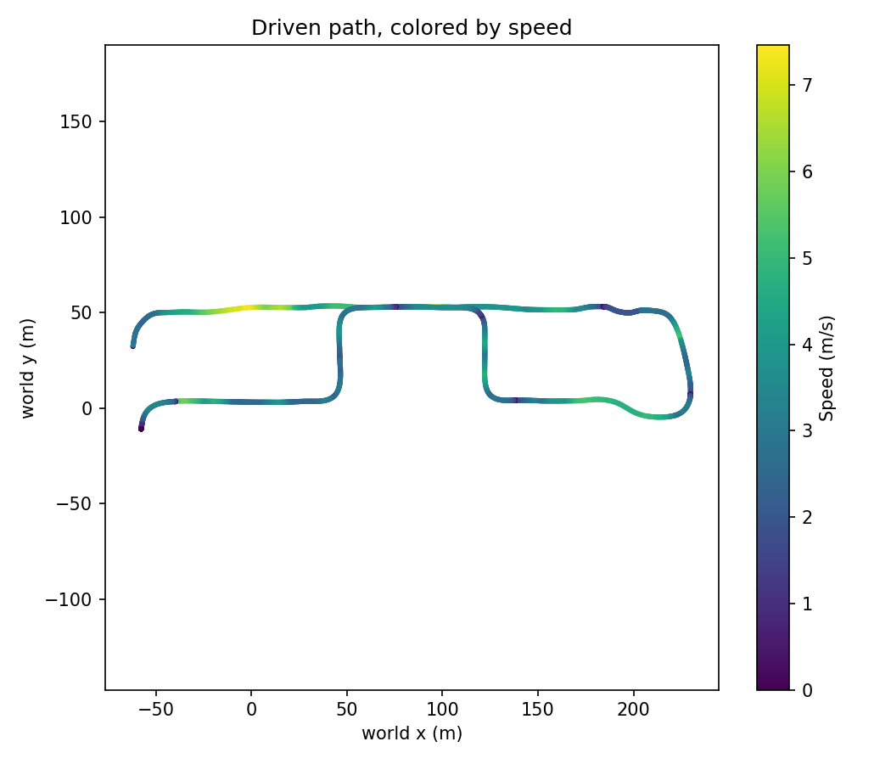
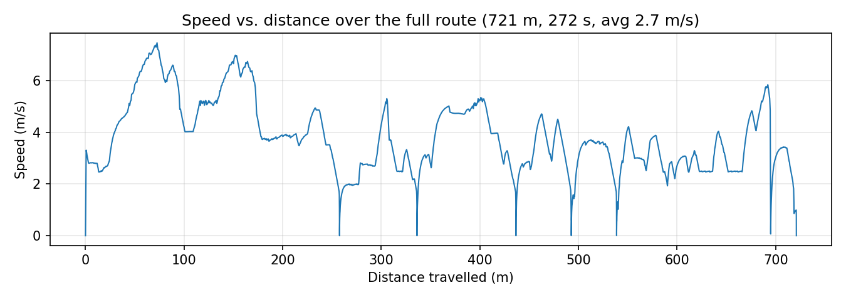
Results
• Full benchmark run completed successfully: 272 s, zero collisions, zero stalls
• Fastest: two longest clear straights, peak 7.5 m/s
• Slowest (near-zero dips): detour spot, TrafficLight2/TrafficLight3 stops, 2 Adaptive Cruise Control (ACC) slowdowns
‒ ACC dips = Event I (merge) and Event II (crossing + hard brake, s≈531)
• Design choice 1.: wide-corridor cap 2.5 → 2.5~6.5 m/s ramp
‒ roadside furniture occupies that corridor 60~90% of route time
‒ fixed route-wide starvation, not just one segment
• Design choice 2.: extra compute is localized to the detour segment (replan + re-profile)
Driven path colored by speed
Speed vs. distance travelled
Notes:
The full benchmark run completed successfully: 272 seconds with zero collisions and zero stalls. Figure 3 shows our driven path colored by speed, and Figure 4 shows that same speed against the distance that was travelled. The fastest segments are the two longest clear straights, where we peak at 7.5 meters per second. The near-zero dips mark where we're slower: the detour location, the two traffic lights that were red on this run, and two Adaptive Cruise Control, or ACC, slowdowns during vehicle merging and emergency brake. One design choice mattered a lot here: we originally capped wide-corridor speed at a flat 2.5 meters per second, but roadside furniture sits in that corridor sixty to ninety percent of route time, so it was starving the whole run. Ramping that cap up to 6.5 meters per second fixed it route-wide, not just locally.

