Slide 1
Text detection and recognition

Slide 2
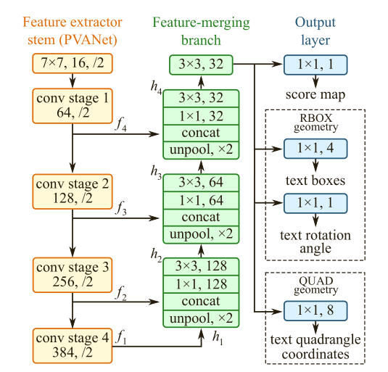
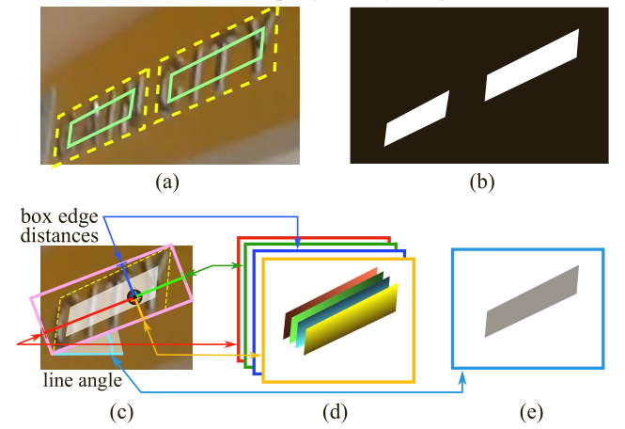

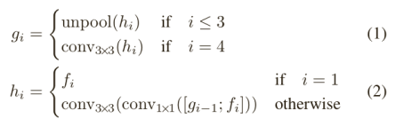
EAST(2017)-Text detect
Structure: a Fully Convolutional Network and an NMS merging stage.
Outputs: a score map, geometric shapes can be rotated boxes or quadrangles.
keys:
label generation
loss function
locality-aware NMS
Base -net | dataset | recall | precision | F-score
PVANET2x RBOX MS | ICDAR2015 | 0.7833 | 0.8327 | 0.8072
PVANET2x | MSRA-TD500 | 0.6743 | 0.8728 | 0.7608
VGG16 | COCO-Text | 0.324 | 0.5039 | 0.3945

Slide 3
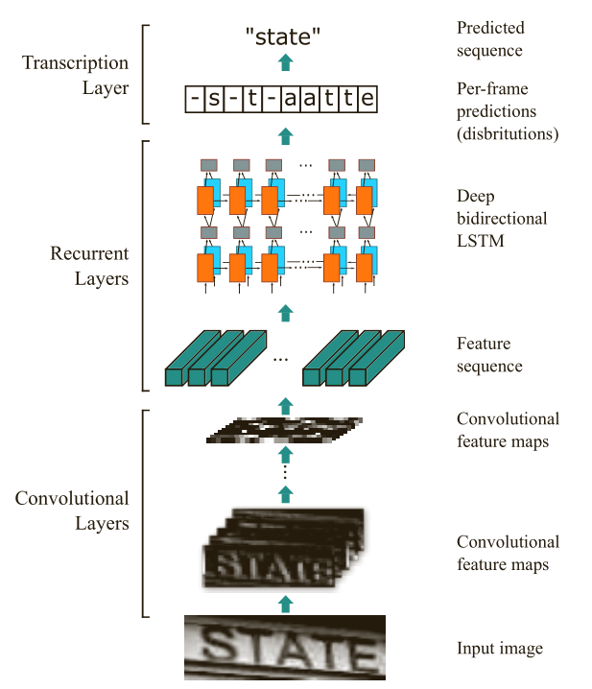
CRNN(2015)-Text recognition
Structure: CNN+RNN+CTC
Outputs: sequence
Keys:
pre-process: scaled to same height
feature sequence: one-pixel
learning rate: Adadeltea
Experiments
dataset | Lexicon | Accuracy(%)
IIIT5K | 50 | 97.6
1k | 94.4
None | 78.2
SVT | 50 | 96.4
None | 80.8
IC03 | 50 | 98.7
Full | 97.6
50k | 95.5
None | 89.4
IC13 | None | 86.7

Slide 4
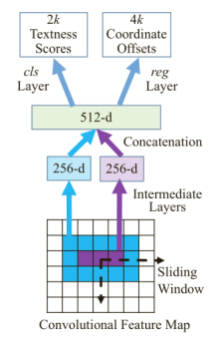
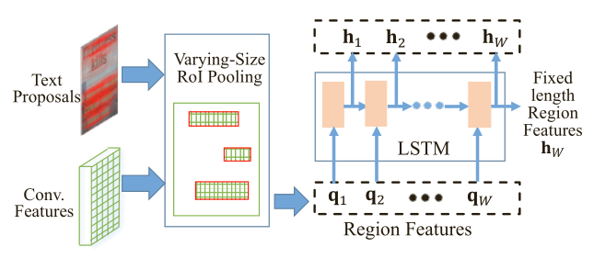
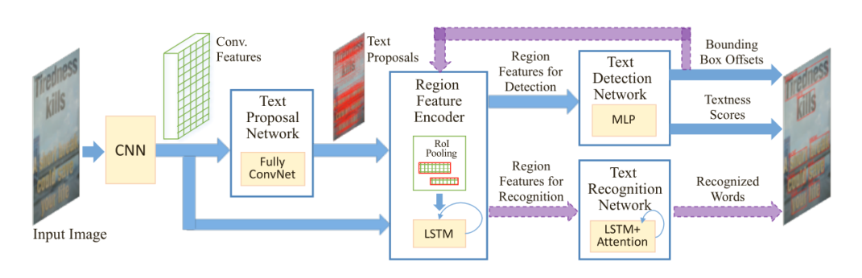
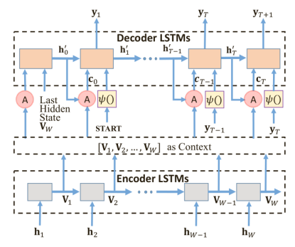
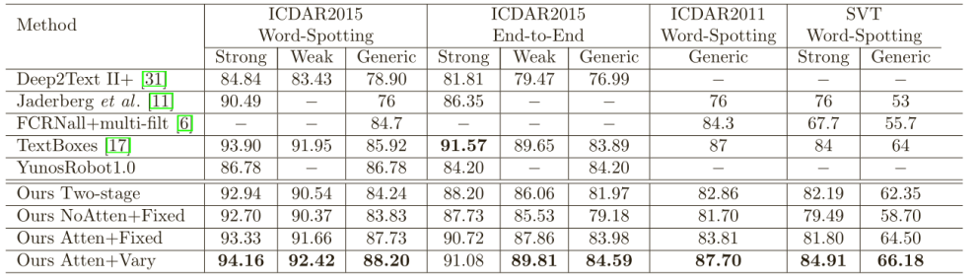
Towards End-to-end Text Spotting with Convolutional Recurrent Neural Networks(2017)
TPN
RFE
Structure: CNN+RNN+Attention
Outputs: text location and sequence
keys:
TPN: k=24 anchors, two 256-d rectangle filters
RFE: re-sample according to aspect ratios, use RNN encoding to a fixed length vector
TRN: attention mechanism
Curriculum Learning
experiments
dataset | recall | precision | F-score
ICDAR2015 | 80.5 | 91.4 | 85.6
ICDAR2011 | 81.7 | 89.2 | 085.4
TRN

Slide 5
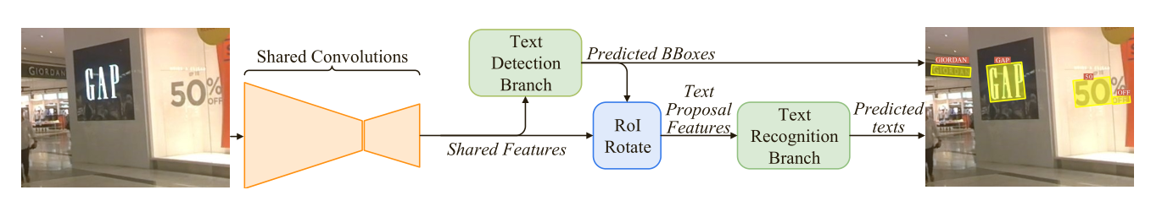
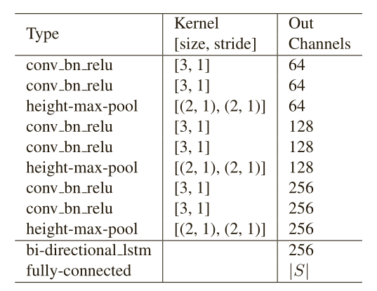
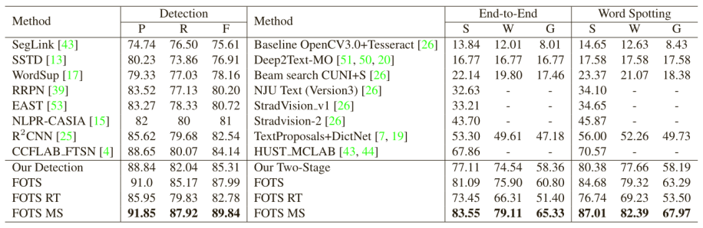
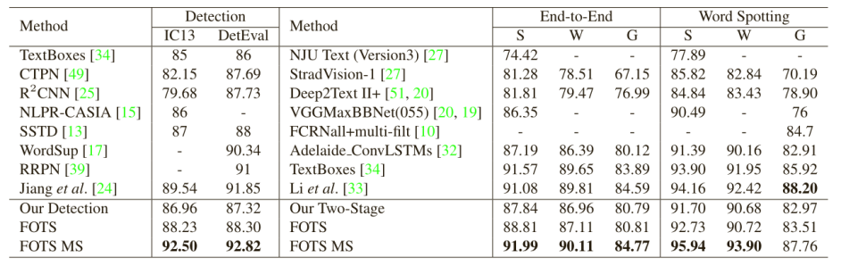
FOTS(2018)-Text spotting
structure: CNN+RNN+CTC
outputs: text location and sequence
keys:
augmentation:
feature map: deconv
TDB: similar with EAST
RoIRotate: affine transformation
TRB: CNN+RNN+CTC
experiment
ICDAR2015
ICDAR2013

Slide 6
总结
Github: EAST and CRNN source code
End-to-end Text Spotting: 训练时有特定思路，先利用合成数据训练，然后再用实际数据finetune，直接实现有困难

