Slide 1

Log in Operating systems
Group 6
Reporter: Mei, Luoyu 71117408
Group members: Zhou, Jiaying
Luo, Haowei
Yang, Qiuzhuo
Lin, Yuan
Ding, Wenyue
Zhang, Jingyuan
Liu, Yuxiao
71117336
71117332
71117326
71117325
71117401
71117402
71117405
2019/12/9

Slide 2
01
Introduction
Simple introduction of our discussion
02
About Windows & Ubuntu
Arrangements of what we have found
CONTENT
03
Comparison
Compare Windows and Ubuntu
04
Conclusion
Some thoughts and analyses

Slide 3
Introduction
1
Notes:
In this section we will make a simple introduction of our work , including division of labor among members and our work product

Slide 4
Group work
Mei, Luoyu
Zhang, Jingyuan
&
Liu, Yuxiao
Yang, Qiuzhuo
&
Luo, Haowei
Zhou, Jiaying
Integrate information
report
Comparison of Windows and Ubuntu
&
Lin, Yuan
Information of Windows system
Polish report
Make PPT
Search the use of logs
&
Ding, Wenyue
Record work
Group log
Information of Ubuntu system
Notes:
Mei, Luoyu: intergrate information of everyone , make a report at last
Lin, Yuan: Record everyone’s work and finish group log
Find information of Windows system, proofread articles and make ppt
Search the use of logs in Internet security
Zhou： Jiaying: finish the section: Comparison of windows and Ubuntu
Ding：Wenyue: Find information of Ubuntu

Slide 5
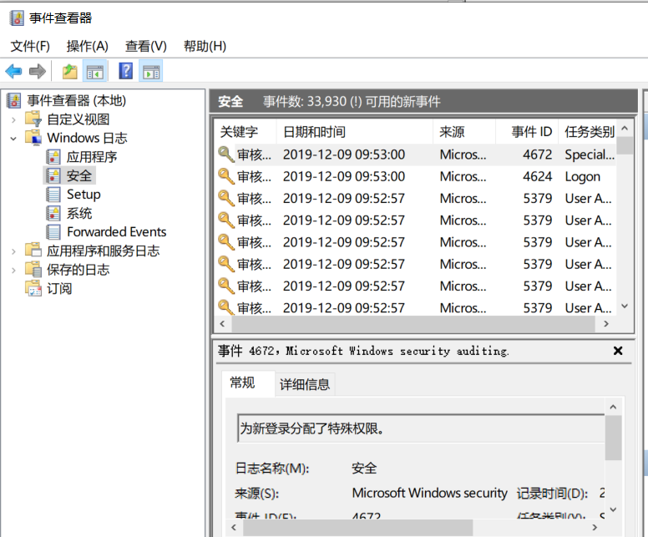
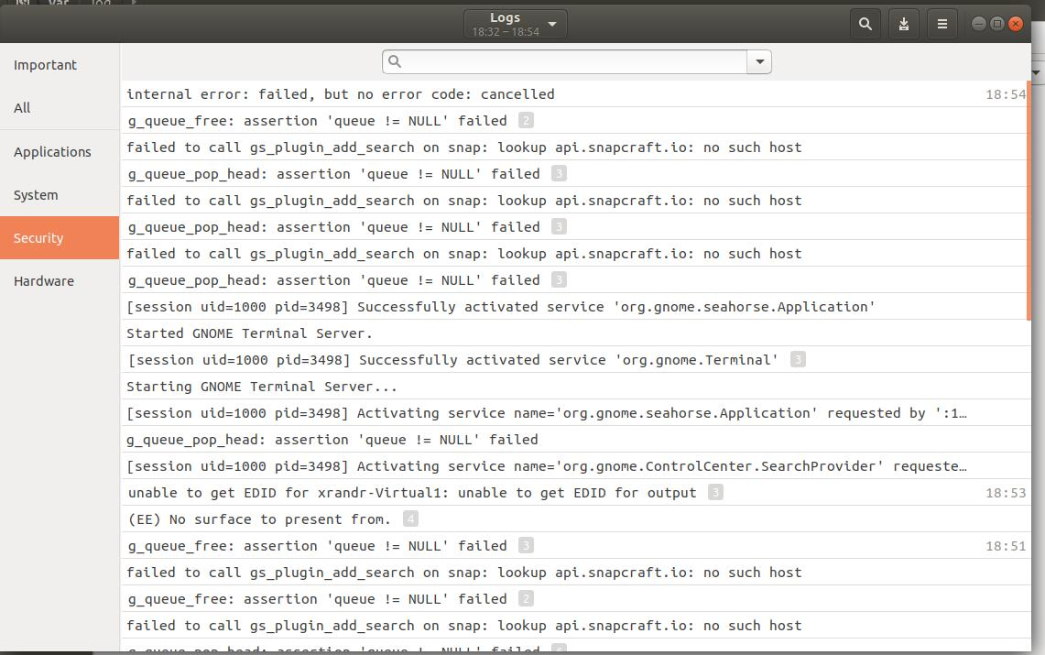
Windows
Ubuntu
Introduction

Slide 6
About Windows
& Ubuntu
2
Notes:
We searched information of two systems on the Internet and sorted data

Slide 7
Ubuntu
Name | Briefly Information | Remarks
alternatives.log | Update & system replace
apport.log | Application crash
apt/ | Install & uninstall application | folders
auth.log | Login check
boot.log | System boots
btmp | Failure record
Consolekit | Console information record
cpus | Printed information
dist-upgrade | Updata information using dist-upgrade
dmesg | Kernel ringbuffer, show hardware information on screen when poweron
dpkg.log | Install & uninstall dpkg application package
faillog | User login failure and wrong commands
fontconfig.log | Typeface related logs
kern.log | Logs produced by system kernel, can help when customize system kernel
lastlog | Recent information of all users.(Not ASCII type, use lastlog command to read)
mail | Mail system server addition logs
mail.err | Mail system server error logs
wtmp | Login information. Can be used to find who is connecting with system & which file or information have it checked
All the log files

Slide 8
Ubuntu
auto.log
Time | IP Address | Protocol | Description
Nov 22 06:26:11 | localhost | sshd[13118] | Failed password for root from 49.51.153.55 port 54128 ssh2
Nov 22 06:28:01 | localhost | CRON[13202] | pam_unix(cron:session): session opened for user root by (uid=0)
folder /var/log
Location
alternatives.log
Activities | Time | Operation
update-alternatives | 2019-11-04 16:11:23 | run with --install /etc/mysql/my.cnf my.cnf /etc/mysql/mysql.cnf 200

Slide 9
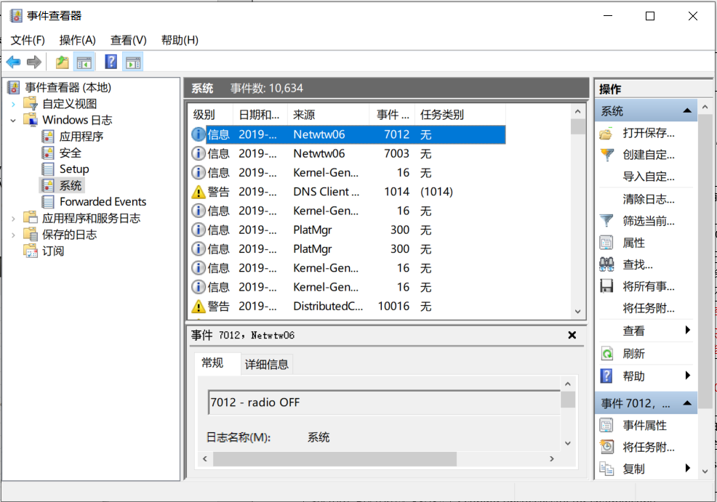
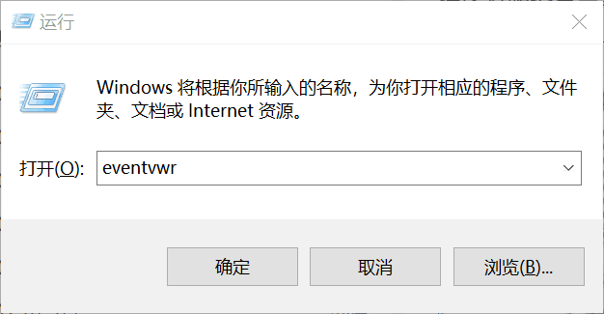
Windows
3
event viewer
2
1
Open

Slide 10
Windows
Brief Structure of Windows Log Files
System
Level | Time | Source | ID | Event kind
System
Application & Security
Application & Security
Key word | Time | Source | ID | Event kind

Slide 11
Windows
Security
System
Security
Source | ID | Description
Microsoft Windows security auditing. | 4624 | Successfully login account
 | 4634 | Successfully logout
 | 4672 | Distribute special authority for new login
 | 4797 | Try to find blank password account
 | 4798 | Enumerated local group user account
 | 4907 | Object check rules verification
 | 5379 | Credentials manager
 | 5382 | Vault credentials
System
Source | ID | Description
Killer Network Service | 0 | Service started/resumed
Kernel-General | 1 | System time change
Kernel-Power | 42 | System is entering sleep state Cause: Application API
 | 105 | Power change
WindowsUpdateClient | 43 | Update activated
 | 44 | Windows update begin to download
Kernel-Processor-Power (Microsoft-Windows-Kernel-Processor-Power) | 55 | Power limitations setting

Slide 12
Comparison
3
Notes:
Compare Ubuntu and windows system, find their differences and similarities

Slide 13
Comparison
Location
Types
Priority
logging service
Access method
%SystemRoot%\System32\winevt\Logs
Simple
None
Common Log File System (CLFS)
Event Viewer
/var/log
Complex
Emergency first
Syslog
Direct access

Slide 14

Comparison
Advantages
Windows
Ubuntu
The log type is relatively uniform
Eventvwr graphical interface
More detailed log types
The logs are not only classified by type, but also by priority
Advantages
&
Disadvantages
Disadvantages
Windows
Ubuntu
Log types are few and rough
No priority
Not convenient for troubleshooting
Users have no permission to edit
Log types are complex and complicated
Most of the log files checking needs to jump to the directory

Slide 15
Conclusion
4
Notes:
In this section,we made a conclusion of the report

Slide 16
Conclusion
Use of log
help network security operation and maintenance
security management
detect security threats
notify
Notes:
Notify operation and maintenance personnel when security incidents occur

Slide 17
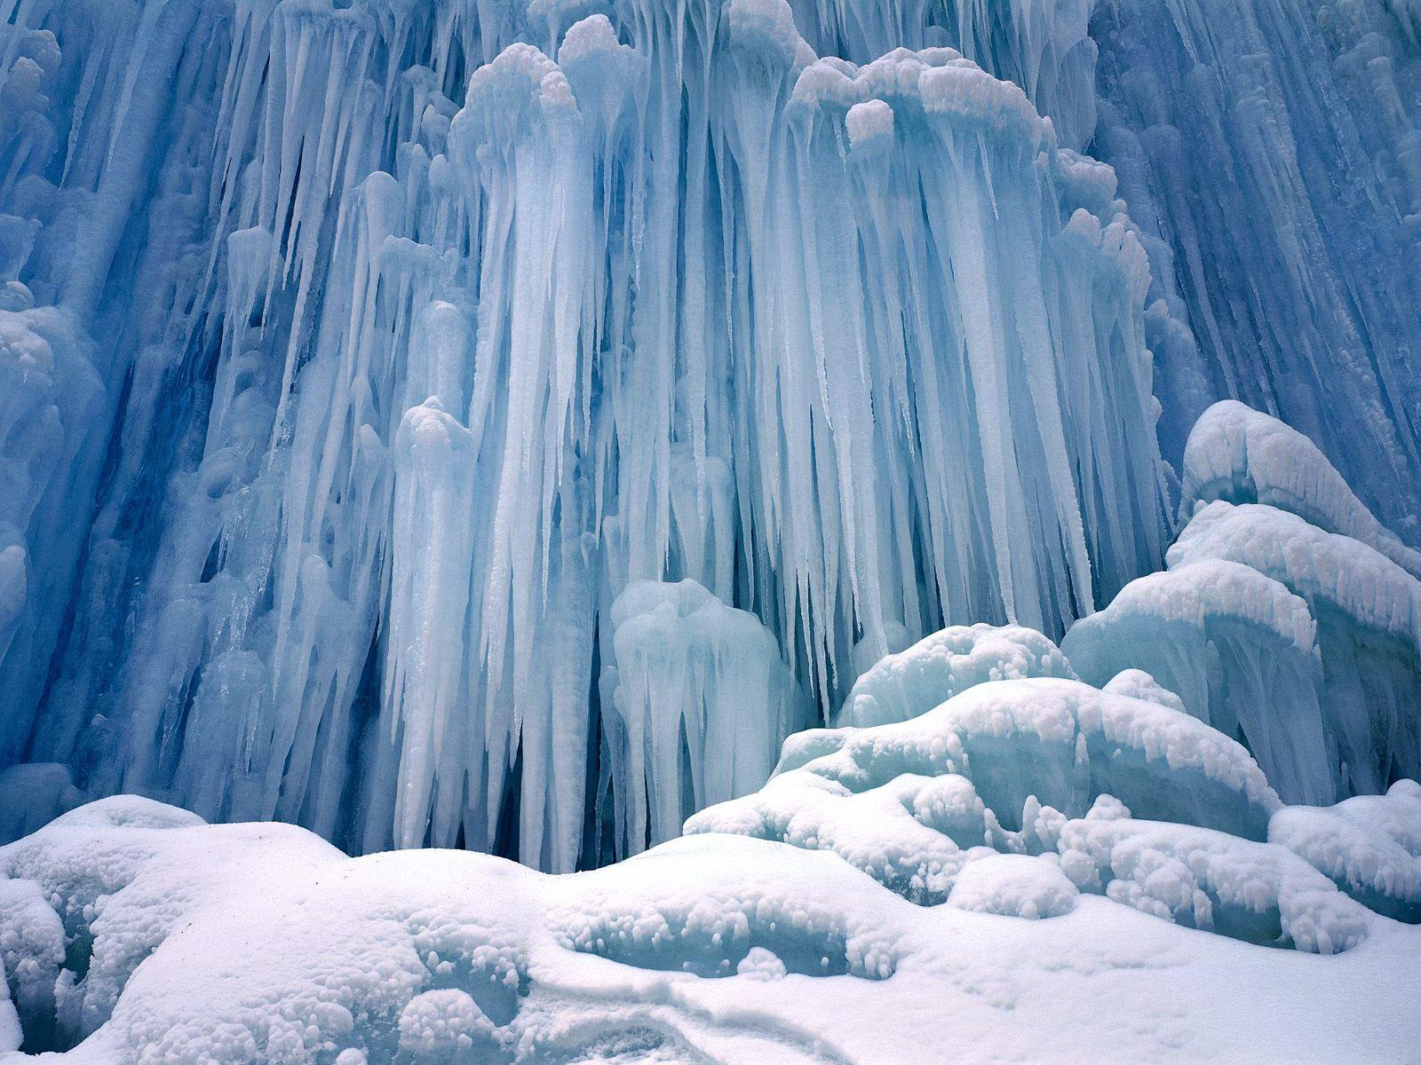
Conclusion
Log audit system
After the log audit system collects the logs of various log sources, the logs are formatted according to the log source type
The log audit system can notify operation and maintenance personnel in various ways when a security event occurs and record statistical security events, issue reports, etc

Slide 18
Conclusion
Secure big data platform
Building character portraits
Building an analysis model
When the users’ behaviors and character portraits are not consistent——sound the alarm
Match the common methods and sequences of attacks

Slide 19
Thank you for your listening!
Group 6

