Slide 1
Chapter 5 Syntax-Directed Translation
Section 0 Approaches to implement Syntax-Directed Translation
1、Basic idea
  Guided by context-free grammar (Translating when parsing )
  Attaching attributes to the grammar symbols representing the program construction.
  Values for attributes are computed by “semantic rules ”associated with the grammar productions.

Slide 2
Chapter 5 Syntax-Directed Translation
Section 0 Approaches to implement Syntax-Directed Translation
2、Two notations for associating semantic rules with productions
  Syntax-directed definitions
    High-level specifications for translations
    Hide implementation details
    No need to specify explicitly the order in which translation take place
    E→E₁+E₂ {E.val=E₁.val+E₂.val}

Slide 3
Chapter 5 Syntax-Directed Translation
Section 0 Approaches to implement Syntax-Directed Translation
2、Two notations for associating semantic rules with productions
  Translation schemes
    Indicate the order in which semantic rules are to be evaluated.
    Allow some implementation details to be shown
    S →{B.ps=10}B{S.ht=B.ht}

Slide 4
Chapter 5 Syntax-Directed Translation
Section 0 Approaches to implement Syntax-Directed Translation
3、Conceptual view of syntax-directed translation
Notes: 1)Evaluation of the semantic rules may generate code, save information in a symbol table , issue error messages, or perform any other activities.
Input
string
Parse
tree
Dependency
graph
Evaluation order
for semantic rules

Slide 5
Chapter 5 Syntax-Directed Translation
Section 0 Approaches to implement Syntax-Directed Translation
3、Conceptual view of syntax-directed translation
Note: 2) Special cases of syntax-directed definitions can be implemented in a single pass by evaluating semantic rules during parsing, without explicitly constructing a parse tree or a graph showing dependencies between attributes.

Slide 6
Chapter 5 Syntax-Directed Translation
Section 1 Syntax-Directed Definitions
1、Definitions
  1)Syntax-directed definition
    A generalization of a context-free grammar in which each grammar symbol has an associated set of attributes

Slide 7
Chapter 5 Syntax-Directed Translation
Section 1 Syntax-Directed Definitions
1、Definitions
  2)Attribute
    Represent anything we choose: a string, a number, a type, a memory location, etc.
    Notes: The value of an attribute at a parse-tree node is defined by a semantic rule associated with the production used at that node.

Slide 8
Chapter 5 Syntax-Directed Translation
Section 1 Syntax-Directed Definitions
1、Definitions
  3)Types of Attribute
    Synthesized attribute
      The value of a synthesized attribute at a node is computed from the values of attributes at the children of that node in the parse tree
    Inherited attribute
      The value of an inherited attribute is computed from the values of attributes at the siblings and parent of that node.

Slide 9
Chapter 5 Syntax-Directed Translation
Section 1 Syntax-Directed Definitions
1、Definitions
  4)Dependency graph
    A graph that represents dependencies between attributes set up by the semantic rules
    Notes: (1)From the dependency graph,we can derive an evaluation order for the semantic rules
    (2)Evaluation of the semantic rules defines the values of the attributes at the nodes in the parse tree
    (3)Semantic rule may have side effects, e,g, printing a value

Slide 10
Chapter 5 Syntax-Directed Translation
Section 1 Syntax-Directed Definitions
1、Definitions
  5)Annotated parse tree
    A parse tree showing the values of attributes at each node
    Notes: The process of computing the attribute values at the nodes is called annotating or decorating the parse tree.

Slide 11
Chapter 5 Syntax-Directed Translation
Section 1 Syntax-Directed Definitions
2、Form of a Syntax-Directed Definition
  Each grammar production A →α has associated with it a set of semantic rules of the form b=f(c1,c2,….,ck), f is a function,
  1) b is a synthesized attribute of A
  c1, c2,….,ck are attributes belonging to the grammar symbols of the production

Slide 12
Chapter 5 Syntax-Directed Translation
Section 1 Syntax-Directed Definitions
2、Form of a Syntax-Directed Definition
  2) b is an inherited attribute of one of the grammar symbols on the right side of the production
  c1, c2,….,ck are attributes belonging to the grammar symbols of the production
  Notes: In either case, we say that attribute b depends on attributes c1, c2,….,ck

Slide 13
Chapter 5 Syntax-Directed Translation
Section 1 Syntax-Directed Definitions
3、Attribute grammar
A syntax-directed definition in which the functions in semantic rules cannot have side effects.
Notes: (1)Functions in semantic rules will often be written as expressions.
(2) Occasionally, semantic rules are written as procedure calls or program fragments (in the time, we name the attribute of non-terminal as a dummy attribute)
(3)Values for attributes of terminals are usually supplied by the lexical analyzer

Slide 14
E.g.
Production | Semantic rules
A →E n (n for new-line) | Print(E.val) (A has a dummy attribute)
E →E ⁽¹⁾*E⁽²⁾ | E.val= E⁽¹⁾.val* E⁽²⁾.val
E →E ⁽¹⁾ + E⁽²⁾ | E.val= E⁽¹⁾.val+E⁽²⁾.val
E →(E ⁽¹⁾) | E.val= E⁽¹⁾.val
E → digit | E.val=digit.lexval

Slide 15
Chapter 5 Syntax-Directed Translation
Section 1 Syntax-Directed Definitions
4、 Synthesized Attributes
  S-attributed definition
  A syntax-directed definition that uses synthesized attributes exclusively

Slide 16
Chapter 5 Syntax-Directed Translation
Section 1 Syntax-Directed Definitions
4、 Synthesized Attributes
  2)Annotation for a parse tree for an S-attributed definition
  By evaluating the semantic rules for the attributes at each node bottom up, from the leaves to the root.

Slide 17
E.g. Annotated parse tree for 3*5+4 n
L
n
E.val=19
E.val=15 + T.val=4
T.val=15
F.val=4
T.val=3 * F.val=5
digit.lexval=4
F.val=3
digit.lexval =5
digit.lexval =3

Slide 18
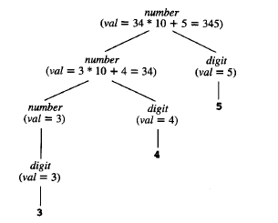

Slide 19
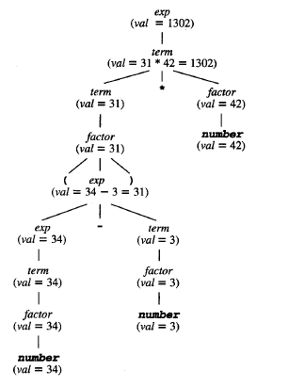

Slide 20
Chapter 5 Syntax-Directed Translation
Section 1 Syntax-Directed Definitions
5、Inherited Attributes
Although it is always possible to rewrite a syntax-directed definition to use only synthesized attributes, it is often natural to use syntax-directed definition with inherited attributes.

Slide 21
E.g. Syntax-directed definition with inherited attribute L.in
Production | Semantic rules
D →T L | L.in=T.type
T →int | T.type= integer
T →real | T.type=real
L →L ⁽¹⁾,id | L ⁽¹⁾.in=L.in addtype(id.entry, L.in)
L → id | addtype(id.entry, L.in)

Slide 22
E.g. Parse tree with inherited attribute in at each node labeled L. (real id1,id2,id3)
D
T.type=real L.in=real
real L.in=real , id3
L.in=real , id2
id1

Slide 23
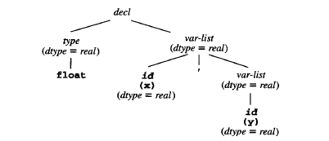

Slide 24
Chapter 5 Syntax-Directed Translation
Section 1 Syntax-Directed Definitions
6、Dependency graphs
1)Definition
  A directed graph that describes the inter-dependencies among the inherited and synthesized attributes at the nodes in a parse tree
  2)Constructing a dependency graph for a given parse tree

Slide 25
for each node n in the parse tree do
for each attribute a of the grammar symbol at n do
construct a node in the dependency graph for a;
for each node n in the parse tree do
for each semantic rule b=f(c1,c2,……,ck)
associated with the production used at n do
for (i=1, i<=k ,i++)
construct an edge from the node for ci to the node for b;

Slide 26
Chapter 5 Syntax-Directed Translation
Section 1 Syntax-Directed Definitions
6、Dependency graphs
2) Constructing a dependency graph for a given parse tree
E.g. when the following production is used in a parse tree, construct the dependency graph.
Production | Semantic rules
E →E ⁽¹⁾ + E⁽²⁾ | E.val= E⁽¹⁾.val+E⁽²⁾.val

Slide 27
E
•val
E⁽¹⁾ + E⁽²⁾
Val val
The three nodes of the dependency graph marked by • represent the synthesized attributes E.val, E⁽¹⁾.val, and E⁽²⁾.val at the corresponding nodes in the parse tree.
The dotted lines represent the parse tree and are not part of the dependency graph.

Slide 28

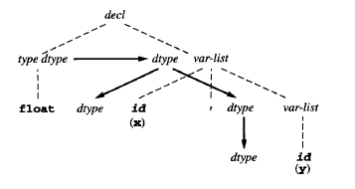

Slide 29
Chapter 5 Syntax-Directed Translation
Section 1 Syntax-Directed Definitions
7、 Evaluation order
  1) Basic idea
  In the topological sort of a DAG

Slide 30
Chapter 5 Syntax-Directed Translation
Section 1 Syntax-Directed Definitions
7、 Evaluation order
  2)Topological sort of a DAG
  Any ordering m1,m2,…,mk of the nodes of the graph such that edges go from nodes earlier in the ordering to later nodes.
    Notes: From a topological sort of a dependency graph, we obtain an evaluation order for the semantic rules.

Slide 31
Chapter 5 Syntax-Directed Translation
Section 1 Syntax-Directed Definitions
7、 Evaluation order
  3)An example

Slide 32
D
T type 4 in 5 L 6
real in 7 L 8 , id3 3 entry
In 9 L 10 , id2 2 entry
id1 1 entry

Slide 33
From this topological sort, we obtain the following program.(ai for the attribute associated with the node numbered i in the dependency graph.)
  a4=real;
  a5=a4;
  Addtype (id3.entry, a5);
  a7=a5;
  Addtype (id2.entry, a7);
  a9=a7;
  Addtype (id1.entry, a9);

Slide 34
Chapter 5 Syntax-Directed Translation
Section 1 Syntax-Directed Definitions
7、 Evaluation order
4)Methods for evaluating semantic rules
    Parse-tree methods
    Obtain an evaluation order from a topological sort of the dependency graph constructed from the parse tree for each input.
    Notes: It will fail if the dependency graph for the particular parse tree has a cycle.

Slide 35
Chapter 5 Syntax-Directed Translation
Section 1 Syntax-Directed Definitions
7、 Evaluation order
4)Methods for evaluating semantic rules
(2)Rule-based methods
    At compiler-construction time, the semantic rules associated with productions are analyzed.
    Notes: For each production, the order is predetermined .

Slide 36
Chapter 5 Syntax-Directed Translation
Section 1 Syntax-Directed Definitions
7、 Evaluation order
4)Methods for evaluating semantic rules
(3)Oblivious methods
    An evaluation order is chosen without considering the semantic rules.
    Note. Its order restricts the class of syntax-directed definitions that can be implemented.

Slide 37
Chapter 5 Syntax-Directed Translation
Section 1 Syntax-Directed Definitions
7、 Evaluation order
4)Methods for evaluating semantic rules
Notes: Rule-based and oblivious methods need not explicitly construct the dependency graph at compiler time, so they can be more efficient in their use of compiler time and space

Slide 38
Chapter 5 Syntax-Directed Translation
Section 1 Syntax-Directed Definitions
8、How to use syntax-directed definitions to specify translations
  Bottom-up evaluation of the S-attributed definitions
  Top-down translation of L-attributed definitions

Slide 39
Chapter 5 Syntax-Directed Translation
Section 1 Syntax-Directed Definitions
10、 L-attributed Definition
A syntax-directed definition is L-attributed if each inherited attribute of X_{j},1<=j<=n, on the right side of A →X₁X₂…X_{n}, depends only on
  1)The attributes of the symbols X₁,X₂,…X_{j-1} to the left of X_{j} in the production and
  2)The inherited attributes of A.

Slide 40
Chapter 5 Syntax-Directed Translation
Section 1 Syntax-Directed Definitions
10、 L-attributed Definition
Note: 1) L-attributes can always be evaluated in depth-first order
2) “L” means “left”, because L-attribute information appears to flow from left to right
3)Every S-attributed definition is L-attributed, because the restrictions in the definition apply only to inherited attributes.

Slide 41
Chapter 5 Syntax-Directed Translation
Section 2 Bottom-up evaluation of the S-attributed definitions
1、Basic idea
  Evaluated by a bottom-up parser as the input is being parsed.
  The parser keeps the values of the synthesized attributes associated with the grammar symbols on its stack.

Slide 42
Chapter 5 Syntax-Directed Translation
Section 2 Bottom-up evaluation of the S-attributed definitions
1、Basic idea
  When a reduction is made, the values of the new synthesized attributes are computed from the attributes appearing on the stack for the grammar symbols on the right side of the reducing production.

Slide 43
Chapter 5 Syntax-Directed Translation
Section 2 Bottom-up evaluation of the S-attributed definitions
1、Basic idea
  Notes: 1)A translator for an S-attributed definition can often be implemented with an LR-parser
  2)The stack is used to hold information about sub-trees that have been parsed.
  3)We can use extra fields in the parser stack to hold the values of synthesized attributes

Slide 44
Chapter 5 Syntax-Directed Translation
Section 2 Bottom-up evaluation of the S-attributed definitions
1、Basic idea
  E.g.
State | Symbol | Val
… |  | …
 | X | X.val
 | Y | Y.val
… |  | …

Slide 45
Chapter 5 Syntax-Directed Translation
Section 2 Bottom-up evaluation of the S-attributed definitions
2、Evaluating the Synthesized attributes
Production | Code fragment
L →E$ | Print(val[top])
E →E ⁽¹⁾ + T | Val[ntop]= val[top-2]+val[top]
E →T
T→T ⁽¹⁾*F | Val[ntop]= val[top-2]*val[top]
T →F
F→(E) | Val[ntop]= val[top-1]
F → digit

Slide 46
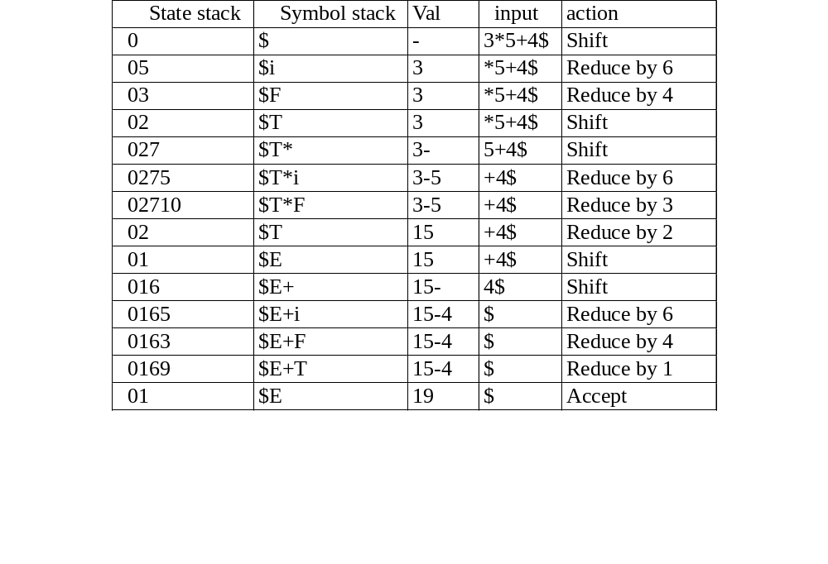
Moves made by translator on 3*5+4$

Slide 47
Transformed translation scheme with right-recursive grammar
  E →T {R.i=T.val}
  R {E.val=R.s}
  R →+
  T {R₁.i=R.i+T.val}
  R₁ {R.s=R₁.s}
  Notes: “s” means synthesized attribute , ”i” means inherited attribute

Slide 48
Transformed translation scheme with right-recursive grammar
  R →ε {R.s=R.i}
  T →(
  E
  ) {T.val=E.val}
  T →num {T.val=num.val}
  Notes: “s” means synthesized attribute,”i” means inherited attribute

Slide 49
Evaluation of the expression 9+5+2.
E
T.val=9 R.i=9
Num.val=9 + T.val=5 R.i=4
Num.val=5 + T.val=2 R.i=6
Num.val=2 ε

