Slide 1

2019
Robust Smartphone App Identification via Encrypted Network Traffic Analysis
Append code analysis
Luoyu Mei
PRESENTED BY : POWERPOINT

Slide 2
contacts
1
2
3
System
Dataset & Code
Evaluation
Fingerprint Making
Classiﬁer Training
Dataset
Ambiguity Detection
Comparison
Limitations

Slide 3

PART ONE
System
Fingerprint Making/
Classiﬁer Training

Slide 4
Fingerprint Making
Network Trace Capture:
UI fuzzing, Network Log tool
Traffic Burstification and Flow Separation:
Time of burst (4.5s), Separation(remote IP address)
Ambiguity Detection:
Using reinforcement learning to obtain robustness against ambiguous flows.

Slide 5
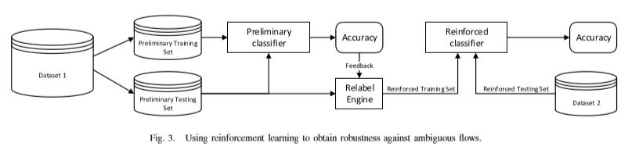
Classiﬁer Training
Three sizes are used:
Size of incoming packets only, Size of outgoing packets only, Size of both incoming and outgoing packets
Ambiguity Detections:

Slide 6
PART TWO
Dataset & Code
Dataset/
Ambiguity Detection

Slide 7
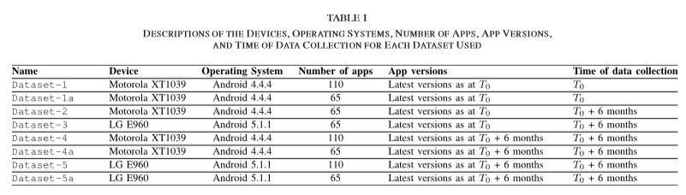
Datasets
We divide the data into two parts. One for training (noise free)
and another for testing (with noise).
Notes:
Dataset-1, which was collected using Device-A, a Motorola XT1039 running Android version 4.4.4. This dataset contains network trafﬁc from 110 apps using the latest version of each app at the time of initial data collection. We refer to this time of initial data collection as T0. All other main datasets (Dataset-2 to Dataset-5) were collected six months after T0, i.e., at time T0 +6 months.
Dataset-2 differs from Dataset-1 only by the time of data collection. Dataset-2 contains data from only 65 apps (instead of 110), because the remaining 45 apps refused to run without being updated. We hereafter refer to the 65 apps in Dataset-2 that ran without being updated as the run-without-update subset.
Dataset-3 was collected using Device-B, an LG E960 running Android version 5.1.1. Dataset-3 also used the run-without-update subset.
Dataset-4 and Dataset-5 were obtained by collecting network trafﬁc from the latest versions (at the time of data collection six months after initial data collection) of the
Fig. 4. CDF plot showing the number of ﬂows per app in each dataset.
original 110 apps and were collected using Device-A and Device-B respectively.
Additionally, we consider variants of the datasets that had 110 apps. These variants consider only apps in the run-without-update subset. We denote these dataset variants as Dataset-1a, Dataset-4a, andDataset-5a for Dataset-1, Dataset-4 and Dataset-5, respectively. These datasets were generated in order to offer a balanced analysis in the presence of datasets with less than 110 apps (i.e., Dataset-2 and Dataset-3).

Slide 8
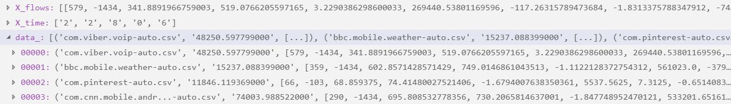
Entry in Datasets
Flow: Array of flows,
Time: Start time and duration of each flow,
Label: The packet flow use (ie : com.viber.voip-auto.csv)

Slide 9
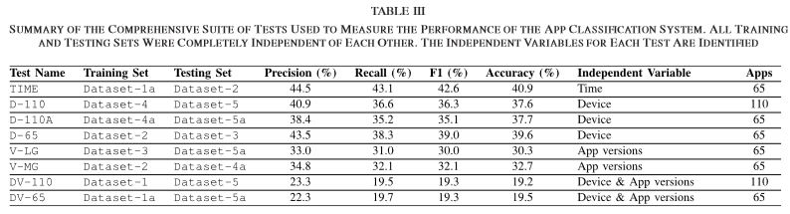
Datasets order
"D-110A“: Dataset-4a Dataset-5a
"D-65“: Dataset-2 Dataset-3
"V-LG “: Dataset-3 Dataset-5a
"V-MG “: Dataset-2 Dataset-4a
"DV-110 “: Dataset-1 Dataset-5
"DV-65 “: Dataset-1a Dataset-5a
Notes:
TIME: Trained a classiﬁer with Dataset-1a and tested with Dataset-2.
Different Device: Three tests: D-110, D-110A, andD-65. D-110 used Dataset-4 as a training set and Dataset-5 as a testing set.
App Versions: V-LG, V-MG
Different Device and Different App Versions: DV-110, DV-65

Slide 10
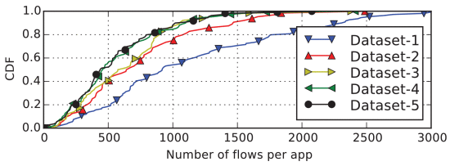
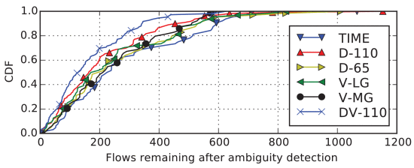
Ambiguity Detection
The noise-ﬁltered setting removes all noise from training and testing sets using NetworkLog.
The noise-ignored setting removes noise from the training sets, but leaves noise in the testing sets.
The noise-managed setting goes a step further by actually identifying and labelling noise in both training and testing sets.
Notes:
The noise-ﬁltered setting removes all noise from training and testing sets using NetworkLog. This gives the performance of the system assuming that devices do not have any network trafﬁc being generated from nonapp sources (such as the operating system).
The noise-ignored setting removes noise from the training sets, but leaves noise in the testing sets. This gives a realistic estimation of performance that might be expected in a real-world attack scenario. This is because the attacker can removenoise from their training sets but is unable to remove noise during an attack.
The noise-managed setting goes a step further by actually identifying and labelling noise in both training and testing sets. This allows the classiﬁers to understand what network trafﬁc coming from the Android operating
system itself looks like. Thus, classiﬁers are better able to identify noise in the real-world, which further improves accuracy.

Slide 11
Result of running
Systematically quantify how accurate Network Profiler was in terms of precision, recall, and overall accuracy.
Notes:
In early work on the topic, Dai et al. [20] propose NetworkProﬁler, an automated approach to proﬁling and identifying Android apps using dynamic methods. They use user-interface fuzzing (UI fuzzing) to automatically explore different activities and functions within an app, while capturing and logging the resulting network trafﬁc. The authors inspect HTTP payloads in their analysis and thus this technique only works with unencrypted trafﬁc. The authors did not have the full ground truth of the trafﬁc traces they were analysing, so it is difﬁcult to systematically quantify how accurate NetworkProﬁler was in terms of precision, recall, and overall accuracy.

Slide 12
PART THREE
Evaluation
Comparison /
Limitations

Slide 13
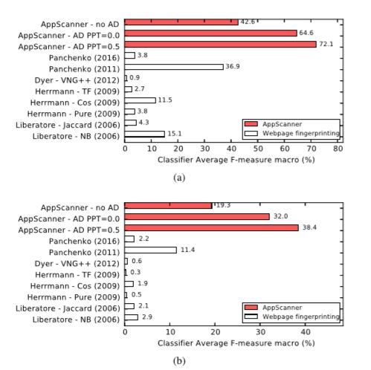
Comparation
Notes:
Comparison With Related Work
In general, all approaches performed better in the TIME test (Fig. 9a) than in the DV-110 test (Fig. 9b). Panchenko et al. [14] performed best with F-measures of 36.9% and 11.4% respectively. AppScanner with no ambiguity detection outperformed this work with 42.6% and 19.2% respectively. Adding ambiguity detection and classiﬁcation validation further improved the performance of AppScanner over related work.

Slide 14
Limitations
1. App identification is frustrated by a number of factors such as “flow coverage”
2. Apps may also have different behaviour if they are run at a different time.
3. Ambiguous trafﬁc also poses a problem for app identiﬁcation.
Notes:
App identiﬁcation is frustrated by a number of factors such as “ﬂow coverage”, changing app behaviour and ambiguous ﬂows. Flow coverage refers to the fraction of the number ﬂows that are actually triggered during UI fuzzing to the total number of ﬂows that can be made by an app. Indeed, UI fuzzing may not elicit all ﬂows from an app. Getting complete code coverage is a challenging task and even human participants were seen to only obtain 60% code coverage [33] in apps through manual interaction.
Apps may also have different behaviour if they are run at a different time. This may be because the apps themselves have been updated and now have a change in logic or theapps download (dynamic) conﬁguration parameters from a server at runtime. Either of these possibilities may cause apps to have different behaviour between training and testing. To mitigate this, repeated and continuous proﬁling of apps is necessary. Fortunately, proﬁling can be automated using virtual devices and UI fuzzing, obviating the need for physical hardware or manual intervention.
Ambiguous trafﬁc also poses a problem for app identiﬁcation. It degrades classiﬁer performance since classiﬁers may be trained with conﬂicting data. Additionally, since there are ﬁnitely many ﬂows that an app can generate, it is conceivable that more than one app will generate similar ﬂows. Thus, an ambiguity detection scheme is critical to identify the nonambiguous, distinctive ﬂows coming from apps. It may also be the case that some apps simply do not generatenon-ambiguous ﬂows. In this case, other approaches will need to be taken for identifying those apps as this is a fundamental limitation of app classiﬁcation using network trafﬁc analysis.

Slide 15
Thanks！
PRESENTED BY : POWERPOINT

