Slide 1
Chapter 13 & 14
Software Testing Strategies and Techniques
Software Engineering: A Practitioner’s Approach, 6th edition
by Roger S. Pressman

Slide 2
本章要点
软件测试策略
软件测试方法
测试用例生成、选择、约简、优先排序

Slide 3
Validation vs Verification
Verification – Are we building the product right?
  Is the code correct with respect to its specification?[确保软件正确地实现某一特定功能]
Validation – Are we building the right product?
  Does the specification reflect what it should?[确保开发的软件可追溯到用户需求]

Slide 4
V&V活动
正式技术评审
质量和配置审核
性能监控
仿真
可行性研究
文档评审
数据库评审
算法分析
开发测试
易用性测试
合格性测试
安装测试
…..

Slide 5
Software Testing
软件测试是V&V的一部分
Testing is the process of exercising a
program with the specific intent of finding
errors prior to delivery to the end user.

Slide 6

What Testing Shows
errors
requirements conformance
performance
an indication
of quality
软件的体检过程

Slide 7


Who Tests the Software?
developer
independent tester
Understands the system
Must learn about the system,
but, will test "gently"
but, will attempt to break it
and, is driven by "delivery"
and, is driven by quality

Slide 8
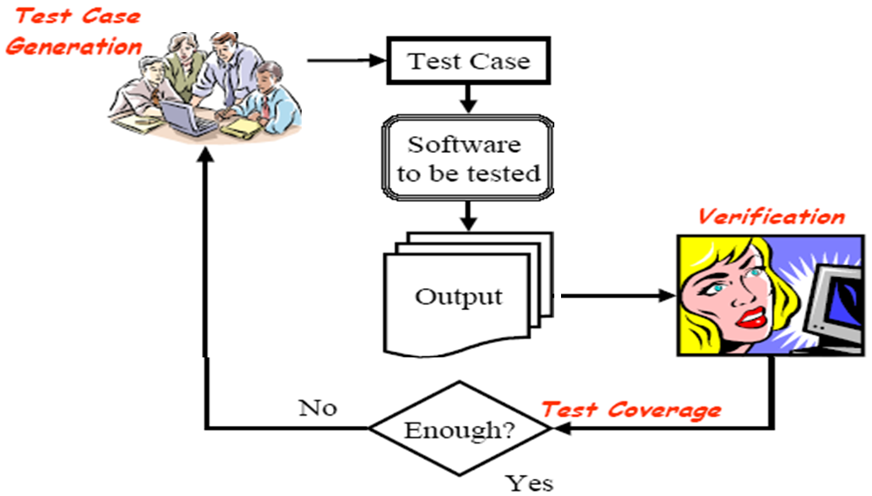
Software Testing Process

Slide 9

Testing Strategy
Unit test
Integration test
System test
Validation test

Slide 10
Testing Strategy
Begin with unit testing and work your way up to system testing.
Unit testing – test individual components (modules in procedural languages; classes in OO languages)
Integration testing – test collections of components that must work together
Validation testing – test the application as a whole against user requirements
System testing – test the application in the context of an entire system

Slide 11

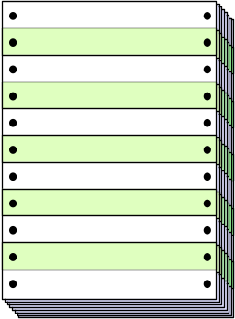
Unit Testing
module
to be
tested
results
software
engineer
test cases

Slide 12
Unit Testing
module
to be
tested
interface
local data structures
boundary conditions
independent paths
error handling paths
test cases

Slide 13
Unit Test Environment
driver
interface
local data structures
Module
boundary conditions
independent paths
error handling paths
stub
stub
test cases
RESULTS

Slide 14

Integration Testing Strategies
Options:
  • the “big bang” approach
  • an incremental construction strategy

Slide 15
Top Down Integration
A
top module is tested with
stubs
B
F
G
stubs are replaced one at
a time, "depth first"
C
as new modules are integrated,
some subset of tests is re-run
D
E

Slide 16
自顶向下增式集成
集成步骤：
  主控模块作为测试驱动，所有与主控模块直接相连的模块作为桩模块；
  根据集成的方式（深度或广度），每次用一个替换从属的桩模块；
  在每个模块被集成时，都必须已经进行了单元测试；
  进行回归测试以确定集成新模块后没有引入错误
上述过程从第2步重复进行，直到整个系统结构被集成完成。

Slide 17
Bottom-Up Integration
A
B
F
G
drivers are replaced one at a
time, "depth first"
C
worker modules are grouped into
builds and integrated
D
E
cluster

Slide 18
自底向上增式测试
工作程序：
  组装从最底层的模块开始，组合成一个构件，用以完成指定的软件子功能
  编制驱动程序，协调测试用例的输入与输出；
  测试集成后的构件
  按程序结构向上组装测试后的构件，同时除掉驱动程序

Slide 19
Regression Testing
The selective retesting of a modified system to help ensure that no bugs have been introduced during modification.
  Fixing one part of the code can break another

Slide 20
High Order Testing
Validation testing: focus is on software requirements
System testing: focus is on system integration
Alpha/Beta testing: focus is on customer usage
Recovery testing: forces the software to fail in a variety of ways and verifies that recovery is properly performed
Security testing: verifies that protection mechanisms built into a system will, in fact, protect it from improper penetration
Stress testing: executes a system in a manner that demands resources in abnormal quantity, frequency, or volume
Performance Testing: test the run-time performance of software within the context of an integrated system

Slide 21
What is a “Good” Test?
A good test is one that has a high probability of finding an error.

Slide 22
Test Case Design
"Bugs lurk in corners
and congregate at
boundaries ..."
Boris Beizer
OBJECTIVE
to uncover errors
CRITERIA
in a complete manner
CONSTRAINT
with a minimum of effort and time

Slide 23
Exhaustive Testing
loop < 20 X
14
There are 10 possible paths! If we execute one
test per millisecond, it would take 3,170 years to
test this program!!

Slide 24
Selective Testing
Selected path
loop < 20 X

Slide 25
Software Testing
white-box
methods
black-box
methods
Methods
Strategies

Slide 26

White-Box Testing
... our goal is to ensure that all
statements and conditions have
been executed at least once ...

Slide 27
Basis Path Testing
First, we compute the cyclomatic
complexity:
number of simple decisions + 1
or
number of enclosed areas + 1
In this case, V(G) = 4

Slide 28
Cyclomatic Complexity
A number of industry studies have indicated
that the higher V(G), the higher the probability
or errors.
modules
V(G)
modules in this range are
more error prone

Slide 29
Basis Path Testing
Next, we derive the
independent paths:
1
Since V(G) = 4,
there are four paths
2
Path 1: 1,2,3,6,7,8
3
4
Path 2: 1,2,3,5,7,8
5
6
Path 3: 1,2,4,7,8
Path 4: 1,2,4,7,2,4,...7,8
7
Finally, we derive test
cases to exercise these
8
paths.

Slide 30
Black-Box Testing
requirements
output
input
events

Slide 31
Equivalence Partitioning
user
queries
output
formats
FK
input
mouse
picks
data
prompts

Slide 32
Sample Equivalence Classes
Valid data
user supplied commands
responses to system prompts
file names
computational data
physical parameters
bounding values
initiation values
output data formatting
responses to error messages
graphical data (e.g., mouse picks)
Invalid data
data outside bounds of the program
physically impossible data
proper value supplied in wrong place

Slide 33
Boundary Value Analysis
user
queries
output
formats
FK
input
mouse
picks
data
prompts
output
domain
input domain

Slide 34
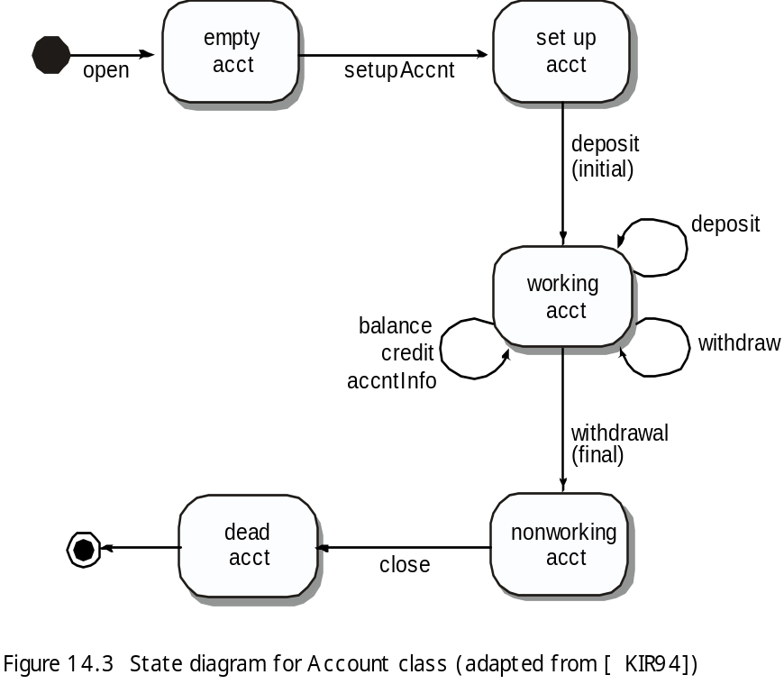
OOT Methods: Behavior Testing
The tests to be designed should achieve all state coverage [KIR94]. That is, the operation sequences should cause the Account class to make transition through all allowable states

Slide 35
Test case generation
测试用例S1: open · setupAccnt · deposit(initial) · withdraw(final) · close
测试用例S2: open · setupAccnt · deposit(initial) · deposit · balance · credit · withdraw(final) · close
测试用例S3: open · setupAccnt · deposit(initial) · deposit · withdraw · accntInfo · withdraw(final) · close

