Slide 1

Textual Sentiment Analysis
A Project to Identify Intensity Variation in Trending Twitter Topics over a Decade using Big Data Tools & Technologies
By:
Ayesha Nasim
Laxmi Yadav
Akhila Amaranayani
This Project Is Carried Out as Part of the Academic Course “DATA 603 Platforms for Big Data Processing” offered in MPS Data Science Graduate Program
at University of Maryland, Baltimore County (UMBC)

Slide 2



Agenda
Twitter Sentiment Analysis Using Big Data Tools
INTRODUCTION
Project Idea & Goals
Technology Stack
About the Data
STRATEGY & PLAN
Methodology
Project Architecture
Planned Vs. Achieved
IMPLEMENTATION
Visualizations & Results
Key Learnings

Slide 3

Introduction
| Project Goals
The Project we undertook is Twitter Sentiment Analysis in which we used multiple tools to create to effectively perform our analysis and learn new tools & technologies. Our Project Goals include:
Using the power of big data tools, social media, and advance NLP techniques, deduce how people used to think about a certain topic 10 years ago vs. Now
Perform sentiment analysis and calculate Polarity, Subjectivity, and Sentiment for each Tweet & Cumulatively

Slide 4

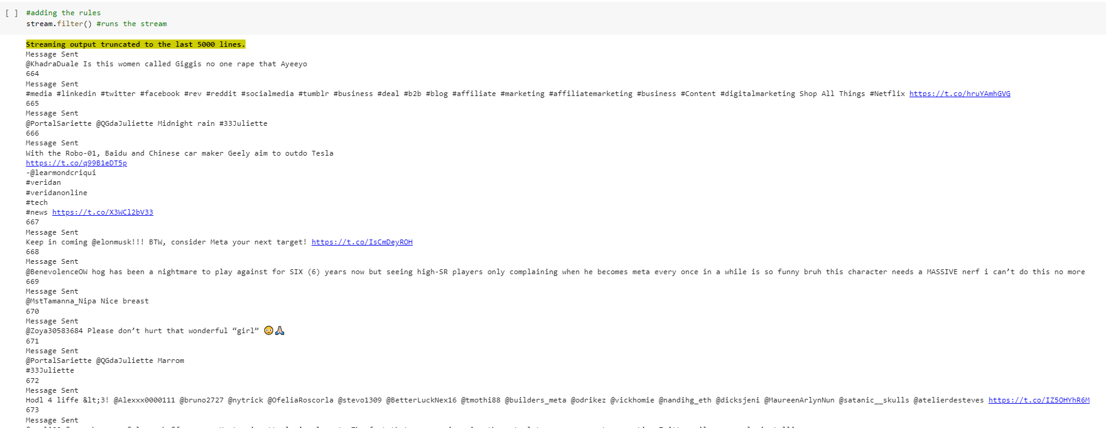
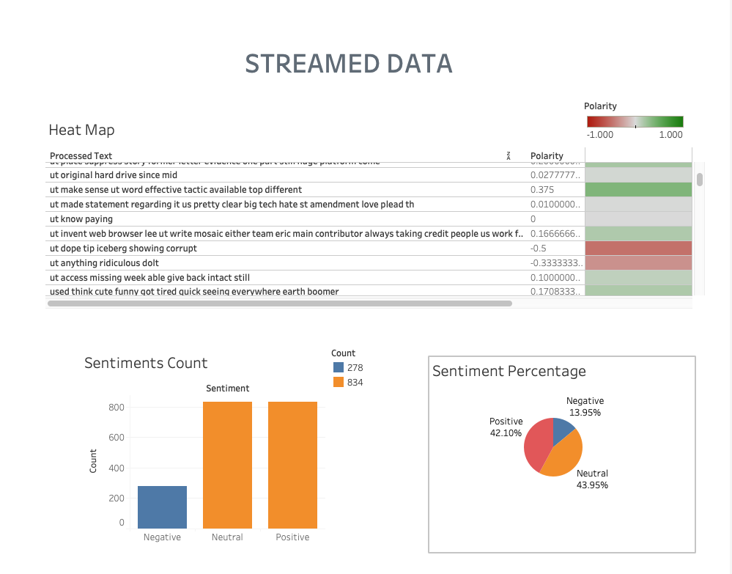
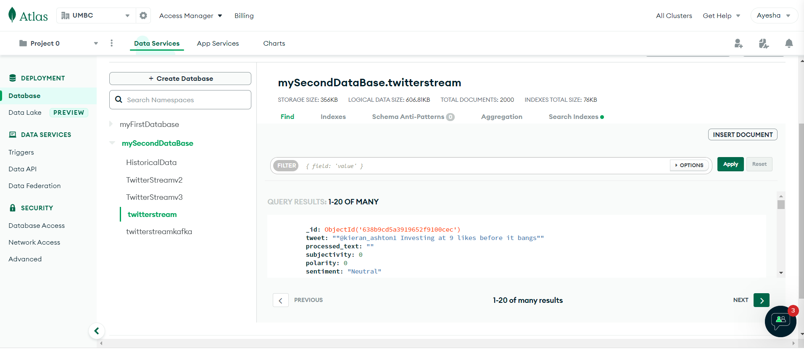





Introduction
Included in Tech Stack
Tweepy | Kafka | Spark | MongoDB | Pandas | Tableau
Usage of Big Data Tools & technologies
Integration of Multiple Tools
Advanced NLP Techniques
Visualizations & Documentation

Slide 5




Introduction
| About the Data
Selected Topic For Demonstration is [Facebook] [Meta] [Mark Zuckerberg]
Live Streaming Data From Twitter
Historical Dataset From Kaggle
1
2
We retrieved data from Twitter through Kafka into Apache Spark using Tweepy
Tweepy is a python library for twitter data extraction.
There is a limit of 100,000 requests per day
The dataset acquired from Kaggle features 1,600,000 tweets known as Sentiment140 extracted using twitter API
Our dataset consists of more than 1M rows and 6 columns.
The Time frame of these tweets are in the months of April 2009 and May 2009.

Slide 6





Strategy & Plan
| Methodology
Phase 1
Data Ingestion
Phase 2
Pre-Processing & Transformation
Phase 3
Analysis & Modelling
Phase 4
Data Storage
Phase 5
Visualization & Documentation

Slide 7







Strategy & Plan
| Project Architecture
Get Real-Time Streaming Data Using Tweepy API v2.0
Store Streaming Data in Apache Kafka
Create Spark Streaming Data Frame From Kafka Consumer as Source
Perform
Pre-Processing & Sentiment Analysis
Load Streaming Data in MongoDB
Create Spark Data Frame From Kaggle Data (CSV) as Source
Perform
Pre-Processing & Sentiment Analysis
Historical Data
Load Data in Tableau & Python Libraries and Perform Visualization

Slide 8

Strategy & Plan
| Planned Vs. Achieved
Installation & Configuration
Tweepy
Kafka
Spark
MongoDB
Tableau
Integration
Tweepy & Kafka
Kafka & PySpark
Kafka Stream & MongoDB
PySpark & MongoDB
MongoDB & Tableau
Results
Compare & Contrast Between Historical & Current Twitter Data

Slide 9
Implementation
| Project Details
Real-Time Data
Tweets streamed in real-time from Twitter via Tweepy API v2.0
Data Stream getting stored in Kafka Producer
Kafka Consumer receiving the data stream
Streaming Data Frame created in PySpark
MongoDB Database is connected to Tableau
Resultant Streaming Data gets transferred into MongoDB
Sentiment Analysis Performed on Streaming Data in PySpark
Real-Time data pre-processing done on Streaming Data in PySpark
Visualizations are created in Tableau
Compare &
Document Results
Static visualizations are created in Python Pandas
Historical Data
Static Visualizations are created in Python Pandas
Import historical tweets csv in PySpark Data Frame
Data pre-processing & Sentiment Analysis in PySpark Data Frame
Resultant data transferred into MongoDB
Visualization created in Tableau

Slide 10
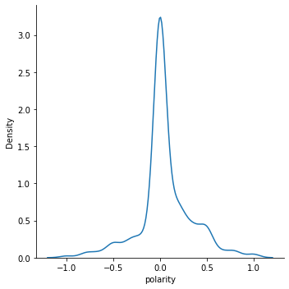
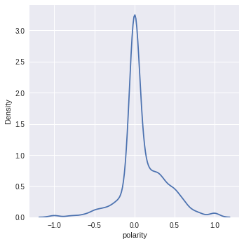
Implementation
| Visualizations & Results
Polarity Distribution Plot (KDE)
Historical Data
Current Data

Slide 11
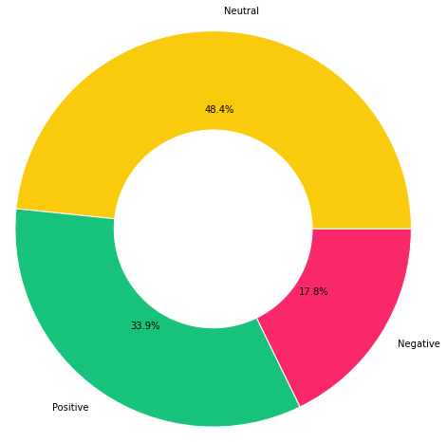
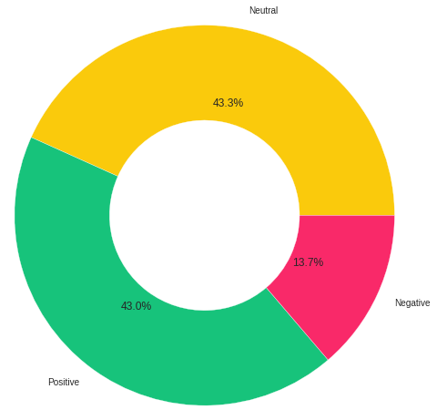
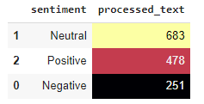
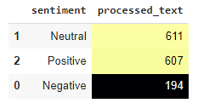
Implementation
| Visualizations & Results
Sentiments Counts & Percentages
Historical Data
Current Data

Slide 12
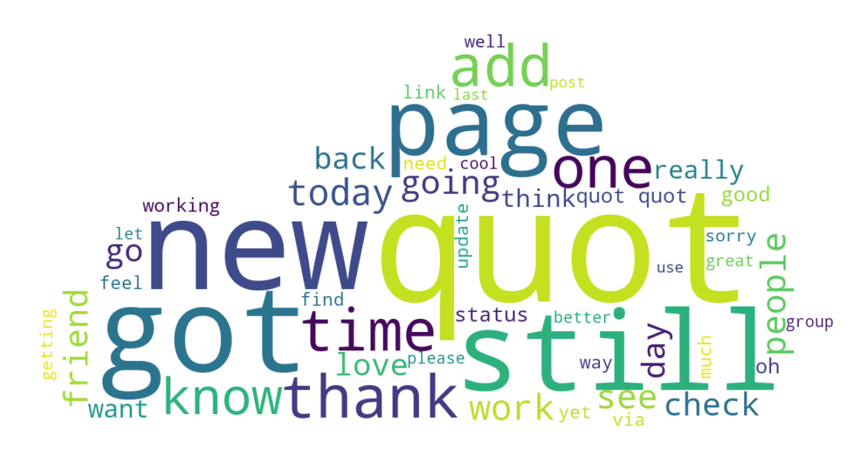
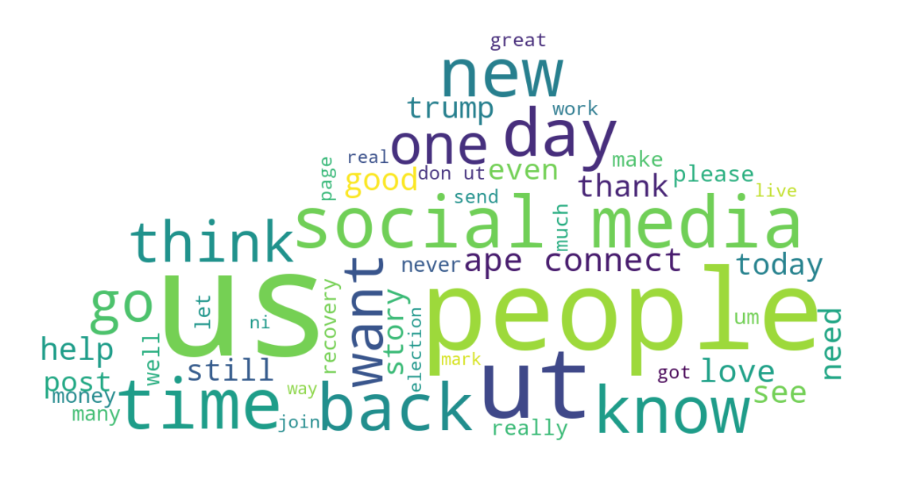
Implementation
| Visualizations & Results
Word Cloud
Historical Data
Current Data

Slide 13
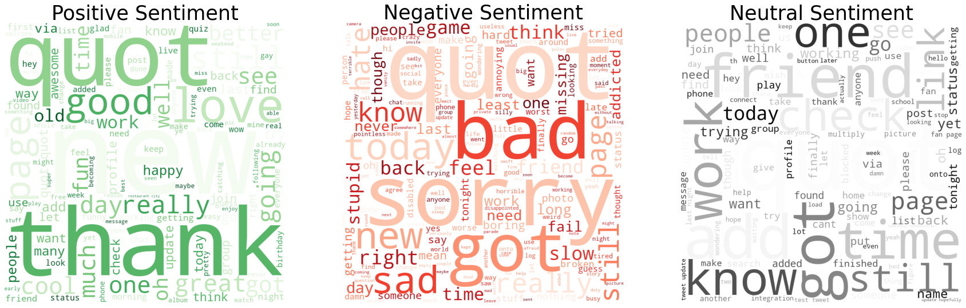
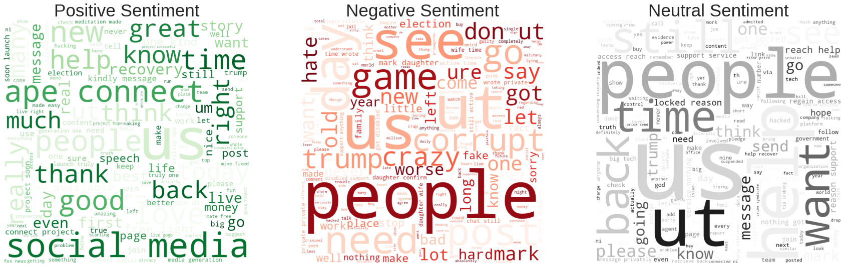
Implementation
| Visualizations & Results
Historical Data
Sentiments Wise Word Count
Current Data

Slide 14
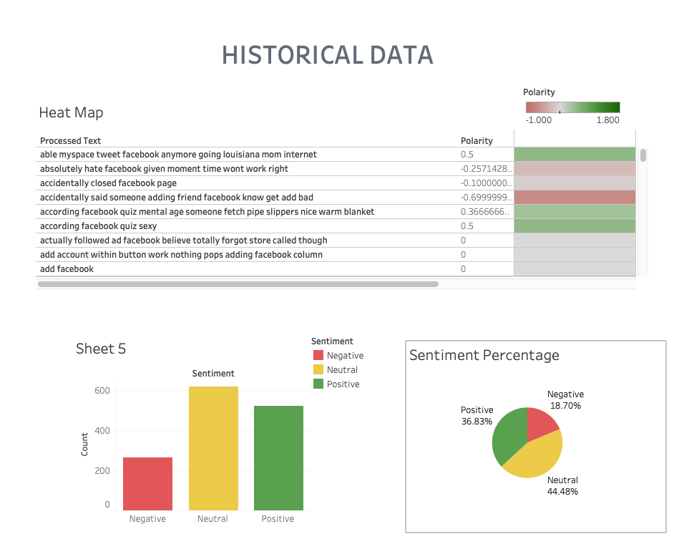
Implementation
| Visualizations & Results
Tableau Visualizations

Slide 15
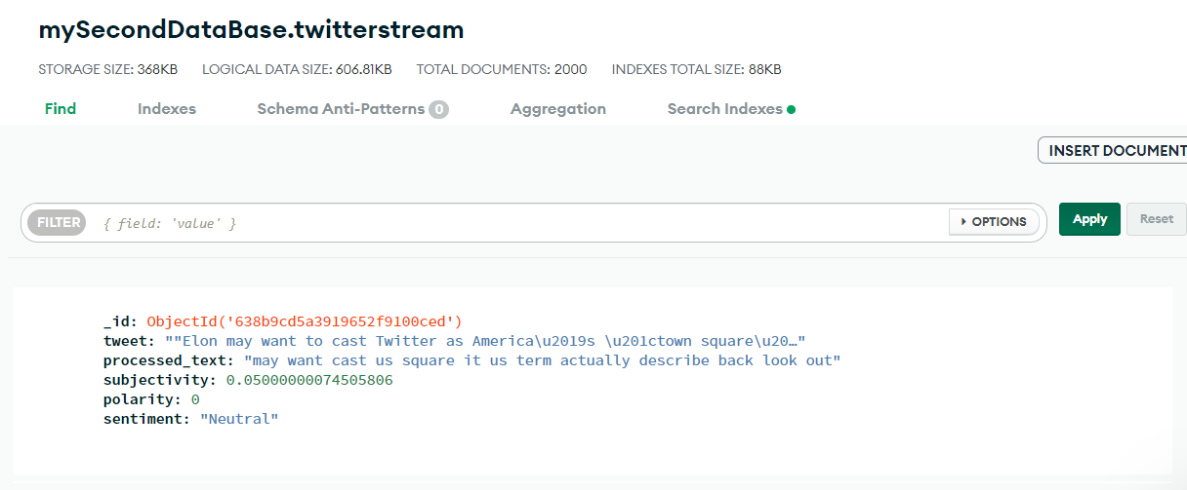
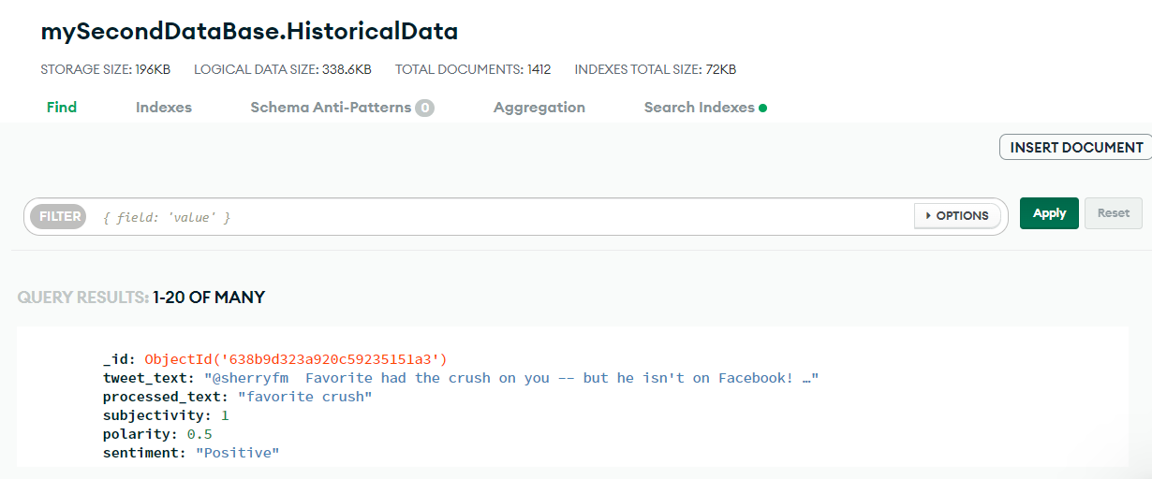
Implementation
| Visualizations & Results
Data in MongoDB

Slide 16



Key Learnings
As per our analysis, we see a rise in positive sentiments towards Facebook in 10 years
There is 27% increase in positive sentiments while negative sentiment have reduced by 22%
Historical Data
Current Data
As far as professional development and learning is concerned, we gained hands-on experience in working with:
Big Data Tools & Technologies
Data Streams
Real-Time Data Processing
Sentiment Analysis Techniques

Slide 17
References
https://medium.com/@lorenagongang/sentiment-analysis-on-streaming-twitter-data-using-kafka-spark-structured-streaming-python-part-b27aecca697a
https://nb.recohut.com/spark/pyspark/kafka/movie/2021/06/25/kafka-spark-streaming-colab.html
https://towardsdatascience.com/connecting-the-dots-python-spark-and-kafka-19e6beba6404
https://sites.google.com/a/ku.th/big-data/pyspart

Slide 18
ANY QUESTIONS?

Slide 19
Thank you.!

