Slide 1


建模与仿真
All models are wrong, but some are useful (George, 1976)
课题7 综合研究
洪流、欧阳敏
华中科技大学人工智能与自动化学院

Slide 2
第一章：建模与仿真概念及内涵---内容概要
0
引子：抛硬币
1
系统、模型、建模与仿真的概念与关系？
2
为什么需要建模？模型的类型？
3
为什么需要仿真？仿真的类型？
4
建模与仿真的发展历史？
5
案例：传染病建模与仿真

Slide 3

0. 引子：抛硬币---Problem Framing & Metrics
Example: Coin Flipping System
Scenario: Flip the coins N times independently, what’s the probability that the tossed coins show the head sides exactly K times?

Slide 4
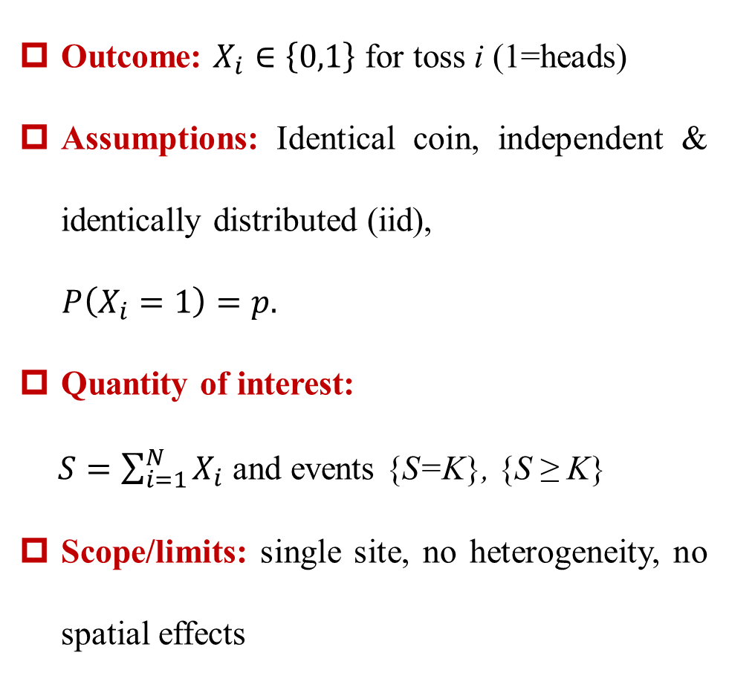
0. 引子：抛硬币---Conceptual Model (iid baseline)
Outcome: $X_{i}∈\left\{0,1\right\}$ for toss i (1=heads)
Assumptions: Identical coin, independent & identically distributed (iid),
$P\left(X_{i}=1\right)=p.$
Quantity of interest:
$S=\sum_{i=1}^{N}{X_{i}}$ and events {S=K}, {S ≥ K}
Scope/limits: single site, no heterogeneity, no spatial effects

Slide 5
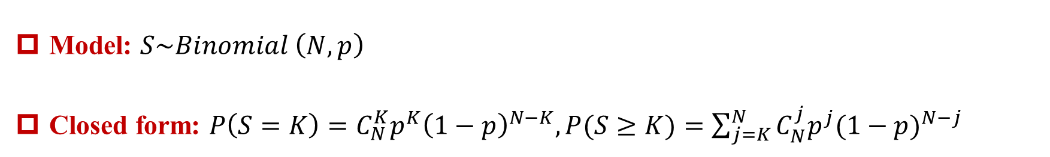
0. 引子：抛硬币---Math Model & Analytical Solution)
Model: $S\sim Binomial \left(N, p\right)$
Closed form: $P\left(S=K\right)=C_{N}^{K}p^{K}{\left(1−p\right)}^{N−K},P(S≥K)=\sum_{j=K}^{N}{C_{N}^{j}p^{j}{(1−p)}^{N−j}}$
Here, simulation is not required; it is useful only to illustrate and verify.

Slide 6
0. 引子：抛硬币---Verification Demo (for the iid case)
N=20; p=1/2
NumSim=100000;
SX=zeros(Numsim,1);
N=20; p=0.5;
for s=1:NumSim
X=zeros(N,1);
for i=1:N
if rand()<p
X(i)=1;
else
X(i)=0;
end
end
SX(s)=sum(X);
end
Takeaway: Analytical solution is correct; proceed to harder variants.

Slide 7
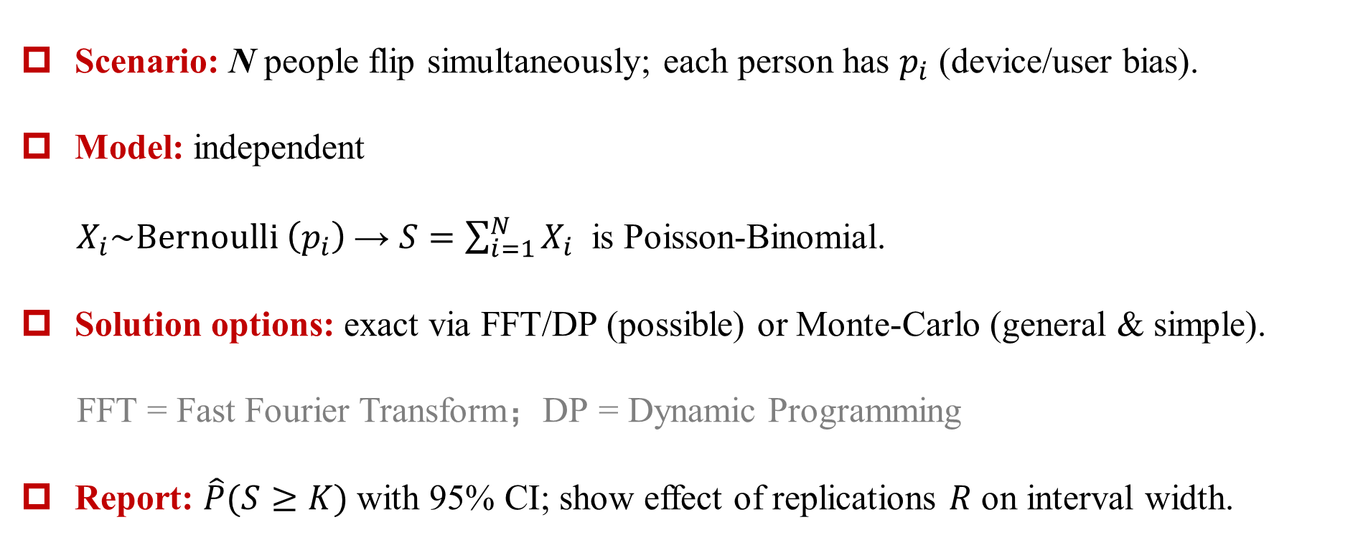
0. 引子：抛硬币---Escalation ①: Heterogeneous but Independent
Scenario: N people flip simultaneously; each person has $p_{i}$​ (device/user bias).
Model: independent
$X_{i}\sim Bernoulli \left(p_{i}\text{​}\right)$→ $S=\sum_{i=1}^{N}{X_{i}}$​ is Poisson-Binomial.
Solution options: exact via FFT/DP (possible) or Monte-Carlo (general & simple).
FFT = Fast Fourier Transform；DP = Dynamic Programming
Report: $\hat{P}(S≥K)$with 95% CI; show effect of replications $R$ on interval width.
Binomial is the special case where $p_{1}$= $p_{2}=…=p_{N}=p$

Slide 8
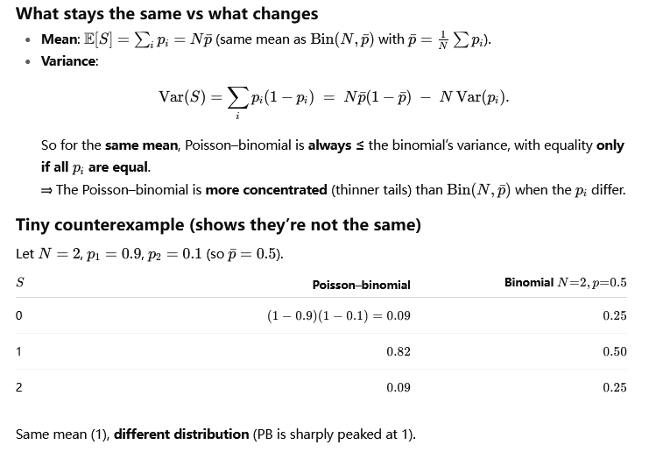
0. 引子：抛硬币---Escalation ①: Heterogeneous but Independent

Slide 9
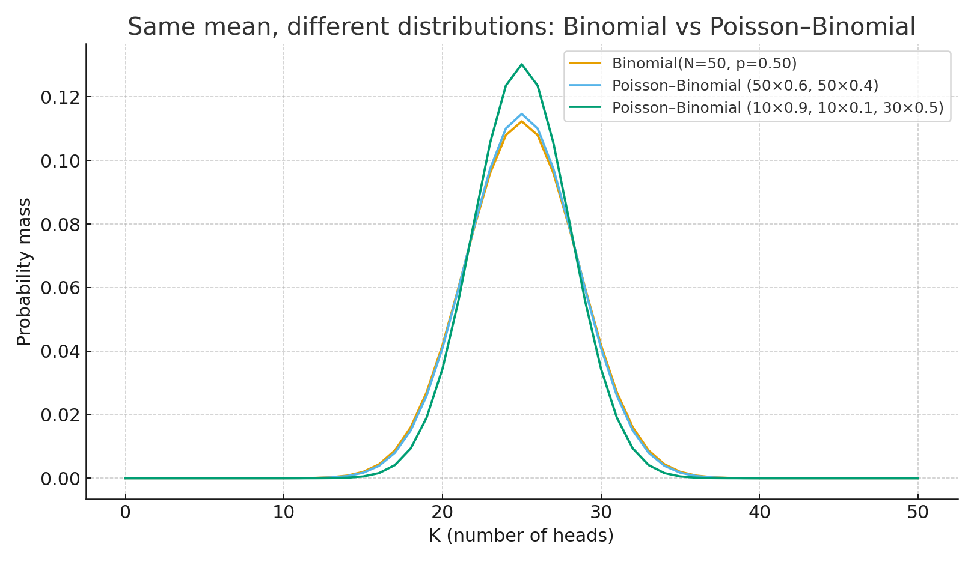
0. 引子：抛硬币---Escalation ①: Heterogeneous but Independent

Slide 10
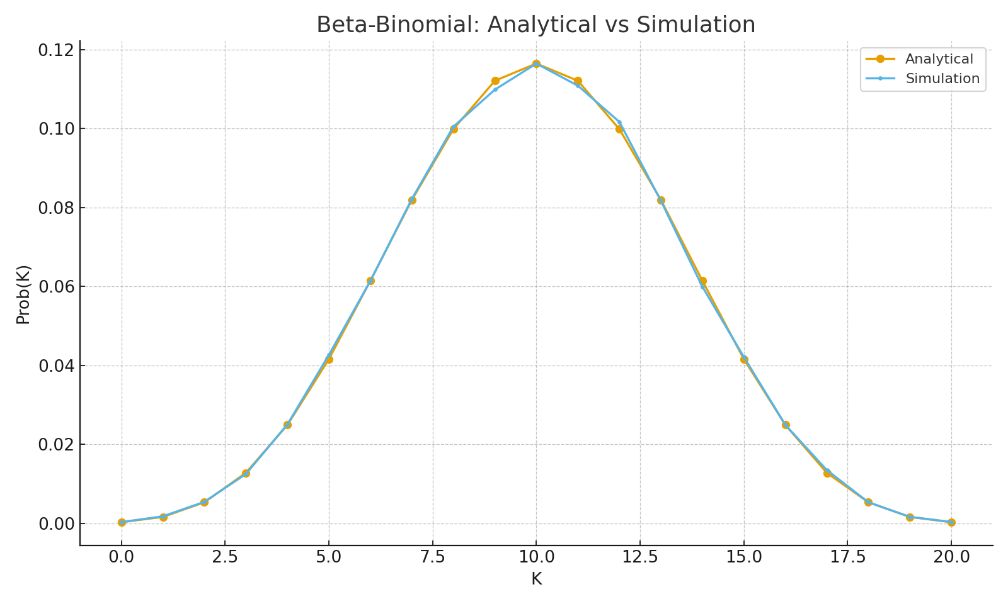
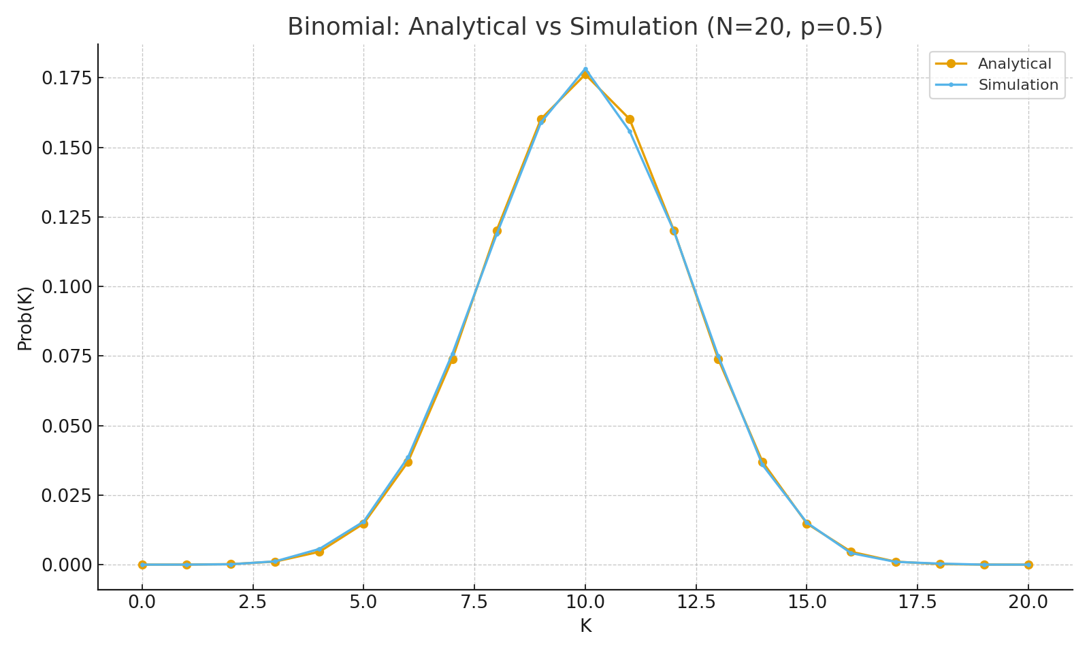
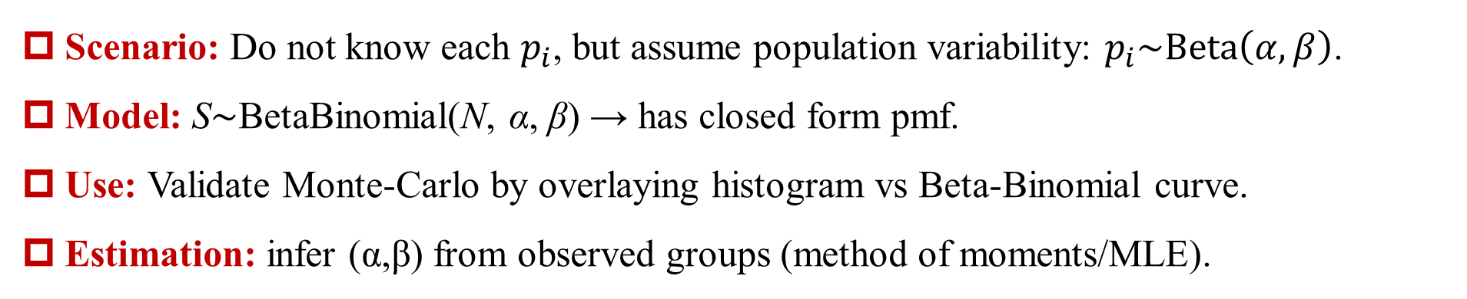
0. 引子：抛硬币---Escalation ②: Hierarchical Crowd
Scenario: Do not know each $p_{i}$​, but assume population variability: $p_{i}\sim Beta\left(α,β\right)$.
Model: S∼BetaBinomial(N, α, β) → has closed form pmf.
Use: Validate Monte-Carlo by overlaying histogram vs Beta-Binomial curve.
Estimation: infer (α,β) from observed groups (method of moments/MLE).
10

Slide 11
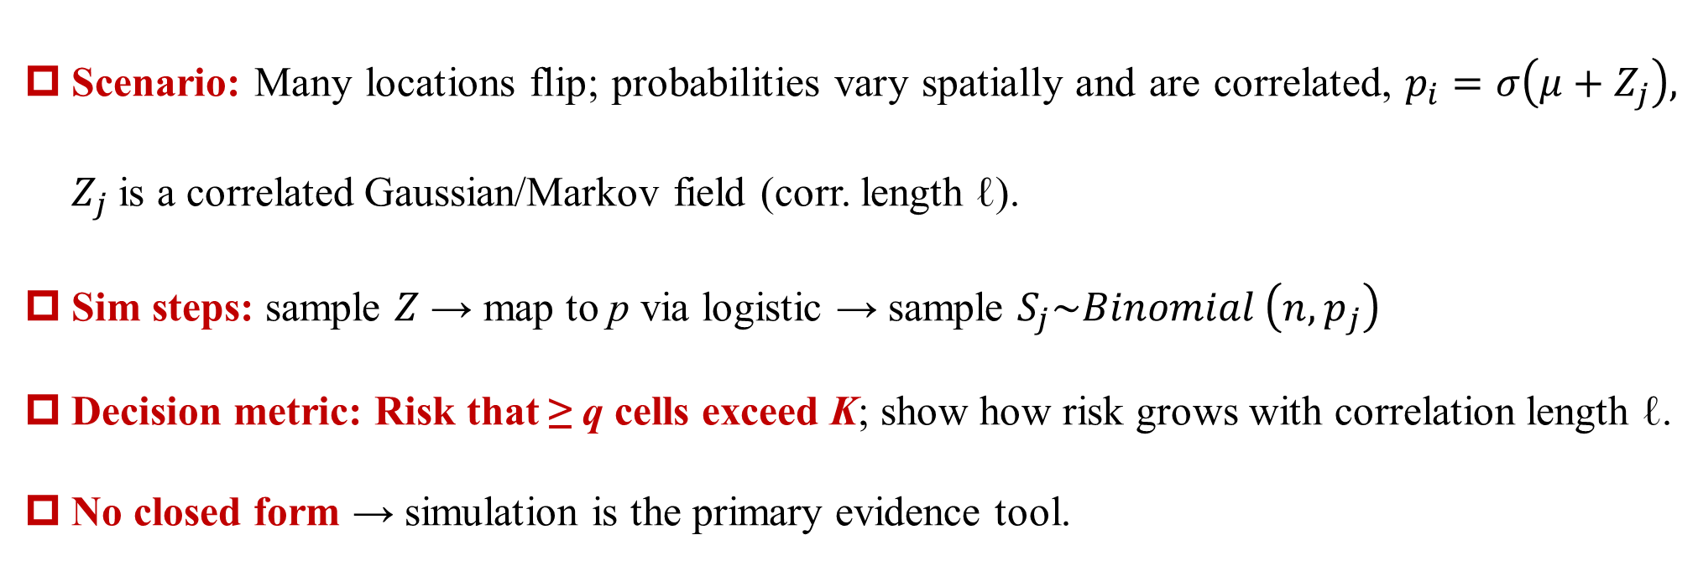
0. 引子：抛硬币--- Escalation ③: Spatial Correlation (simulation becomes essential)
Scenario: Many locations flip; probabilities vary spatially and are correlated, $p_{i}=σ\left(μ+Z_{j}\right),$ $Z_{j}$ is a correlated Gaussian/Markov field (corr. length ℓ).
Sim steps: sample $Z$ → map to p via logistic → sample $S_{j}\sim Binomial \left(n,p_{j}\right)$
Decision metric: Risk that ≥ q cells exceed K; show how risk grows with correlation length ℓ.
No closed form → simulation is the primary evidence tool.

Slide 12
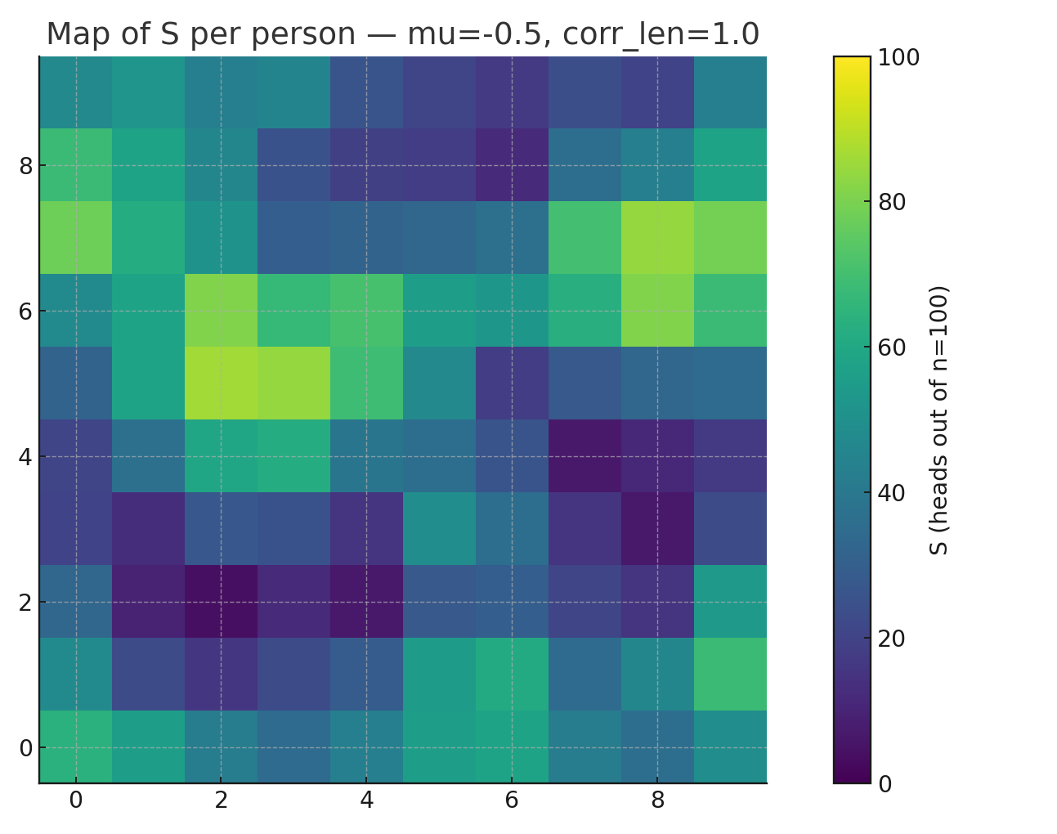
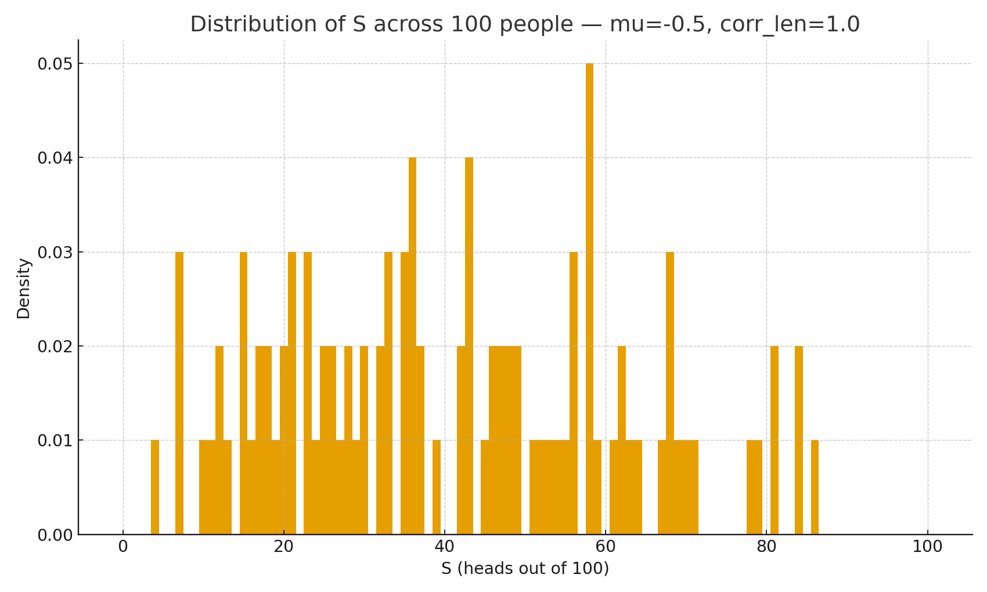
0. 引子：抛硬币--- Escalation ③: Spatial Correlation (simulation becomes essential)
Spatial Correlated Coin Flips — 10×10 crowd, n=100
μ = -0.5, corr_len = 1.0

Slide 13
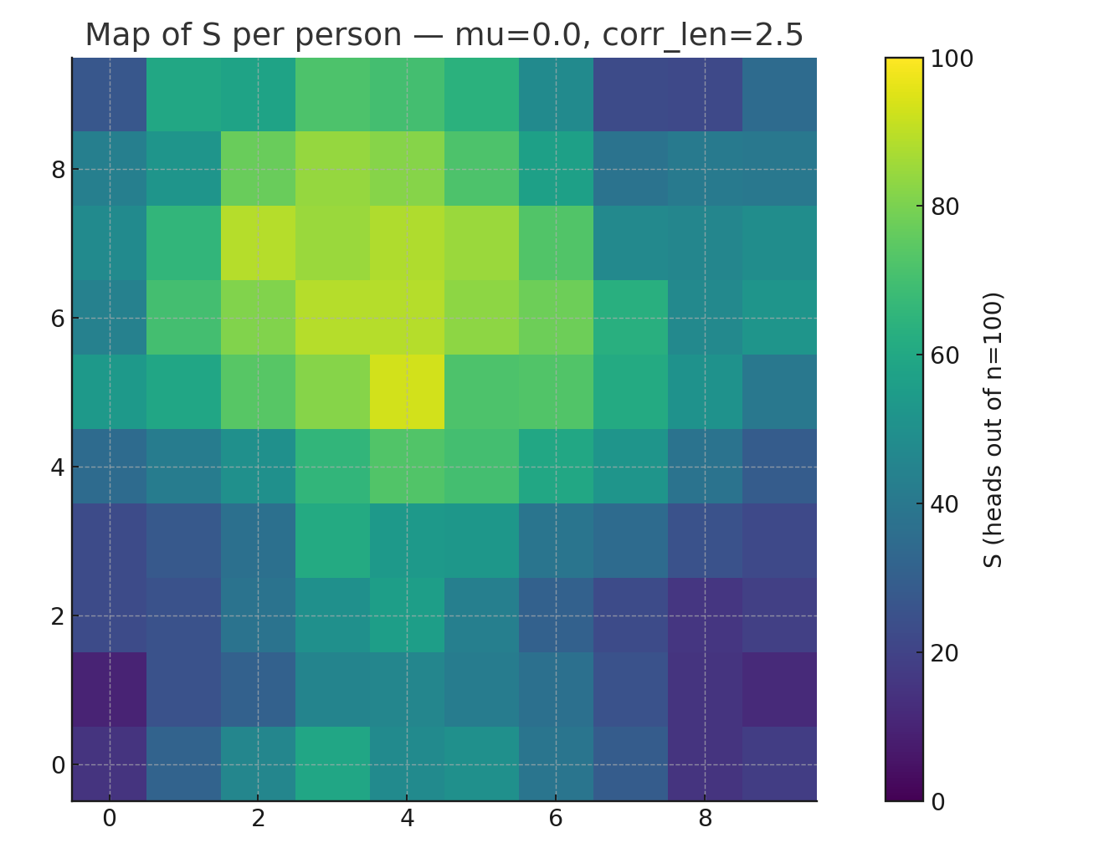
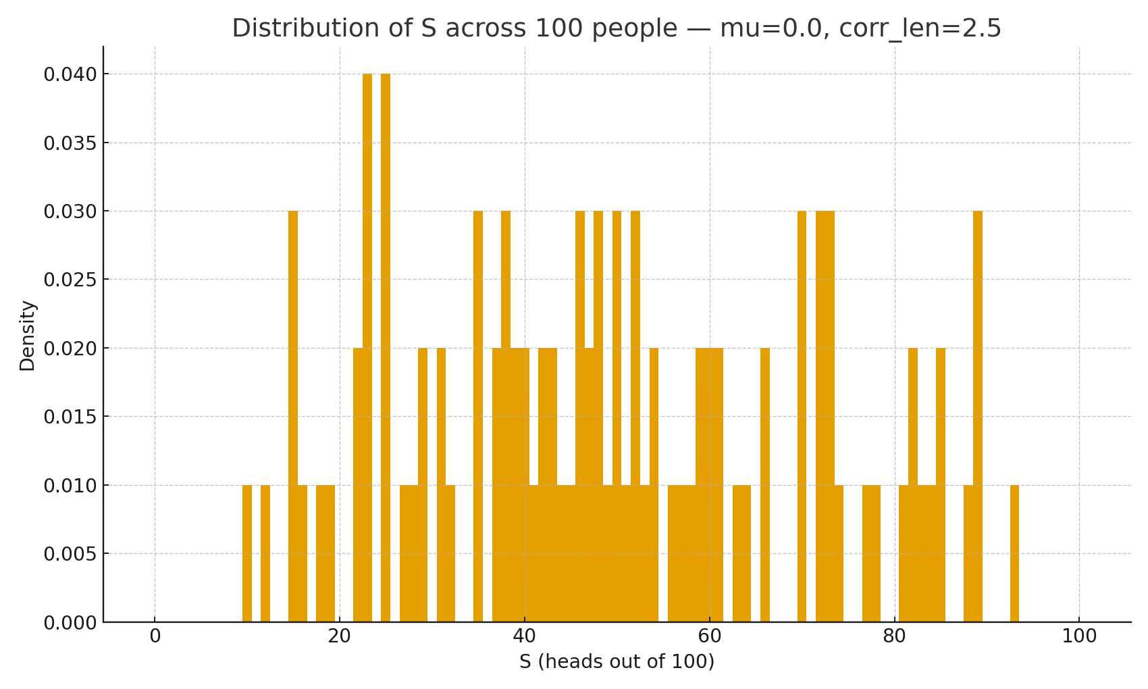
0. 引子：抛硬币--- Escalation ③: Spatial Correlation (simulation becomes essential)
Spatial Correlated Coin Flips — 10×10 crowd, n=100
μ = 0, corr_len = 2.5

Slide 14
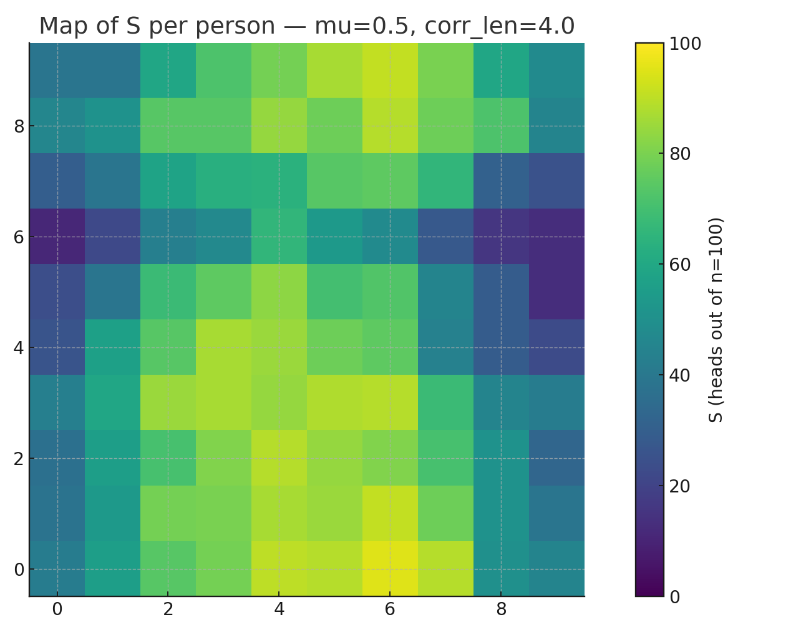
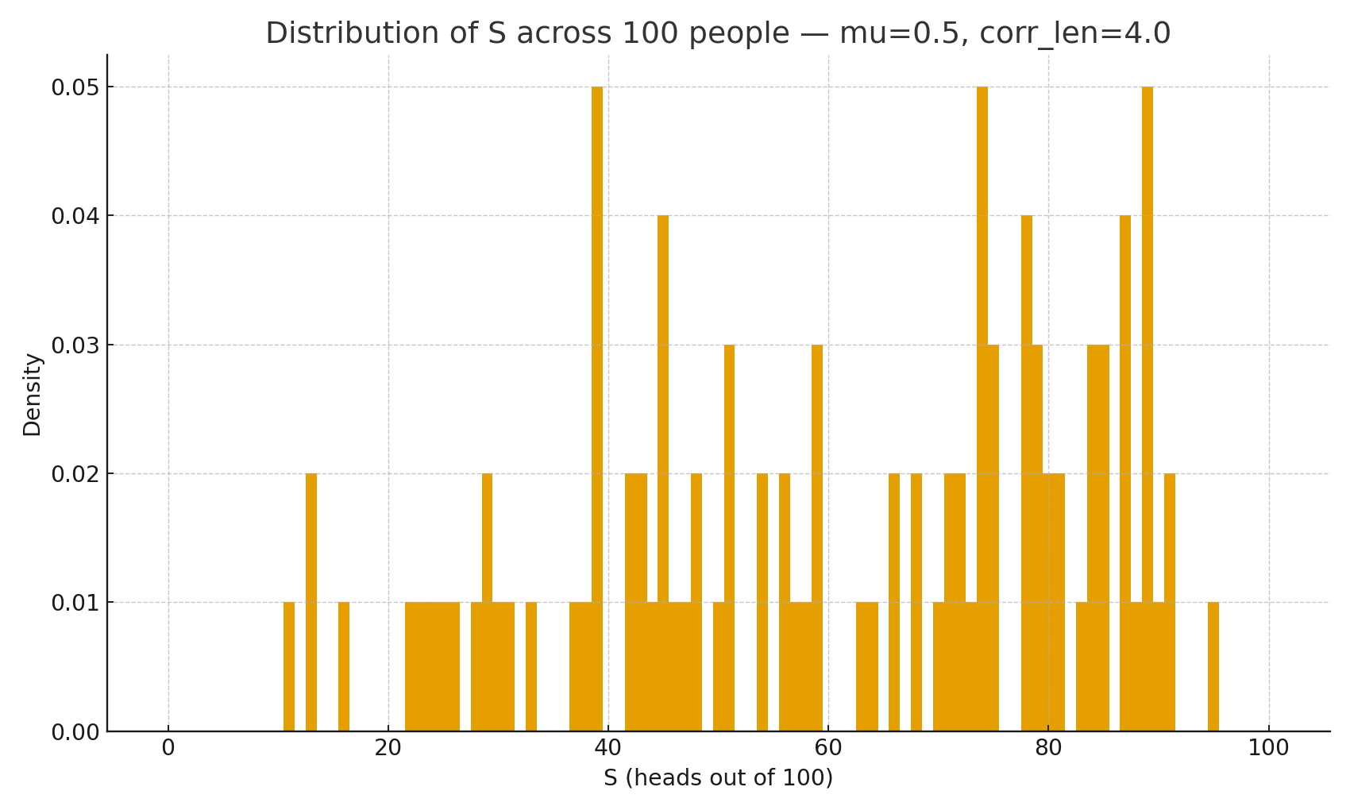
0. 引子：抛硬币--- Escalation ③: Spatial Correlation (simulation becomes essential)
Spatial Correlated Coin Flips — 10×10 crowd, n=100
μ = 0.5, corr_len = 4.0

Slide 15
0. 引子：抛硬币--- Core insights from the coin-flipping escalations
A model is a purposeful simplification. It captures some aspects (e.g., iid Bernoulli) and leaves others out (heterogeneity, dependence).
Assumptions are the model. State them explicitly (iid vs heterogeneous pip_ipi​ vs spatial correlation).
Verification ≠ Validation. (1) Verify we built the model right (code, numerics). (2) Validate we built the right model for purpose (match observations/held-out data or known theory).
Analysis vs simulation is a choice, not a religion. (1) If closed form exists (Binomial), simulation is only for illustration/verification. (2) With heterogeneity (Poisson-binomial) or dependence (spatial/Ising), simulation becomes useful or essential.
Uncertainty matters. Always report intervals/coverage, not just point estimates.
Escalation teaches structure. Adding heterogeneity and dependence changes the distribution family, not just the parameters.
Parsimony first. Start simple; add complexity only when demanded by data/decision needs.
Decisions drive models. Define the metric early (e.g., risk that ≥ q cells exceed K) — the model exists to answer that question.

Slide 16
0. 引子：抛硬币---Four levers that raise complexity (seen in the example)
Heterogeneity (different p_{i}​) → Poisson-binomial (under-dispersion vs Binomial with same mean).
Dependence (spatial/temporal correlation) → clusters/extremes; simulation needed.
Dynamics (parameters change over time) → time-varying models / state-space; often needs sim.
Observability (noise, missingness, bias) → hierarchical/latent models; validation gets harder.
Use these levers as a mental checklist whenever you“upgrade”a model.
16

Slide 17
0. 引子：抛硬币--- When do we simulate?
Do not simulate when a correct, tractable analytical solution exists and meets the decision need.
Simulate to…
handle no closed form (dependence/interaction/constraints),
do what-if/DoE (design of experiments) at scale,
get intervals under complex uncertainty,
stress-test decisions (tail risk, robustness).
Remember: Simulation is evidence conditional on the model. If the model is wrong for purpose, more runs will not help.

Slide 18
0. 引子：抛硬币--- Minimal V&V&UQ checklist (reuse every lab)
V (built-right): fixed seeds, unit/limit checks, convergence diagnostics (MCMC), reproducible scripts.
V (right-for-purpose): compare to theory in simple limits (Binomial/Beta-Binomial), or to held-out data.
UQ: report CIs/coverage; sensitivity to key assumptions (e.g., correlation length ℓ, N,n,K, q).
18

Slide 19
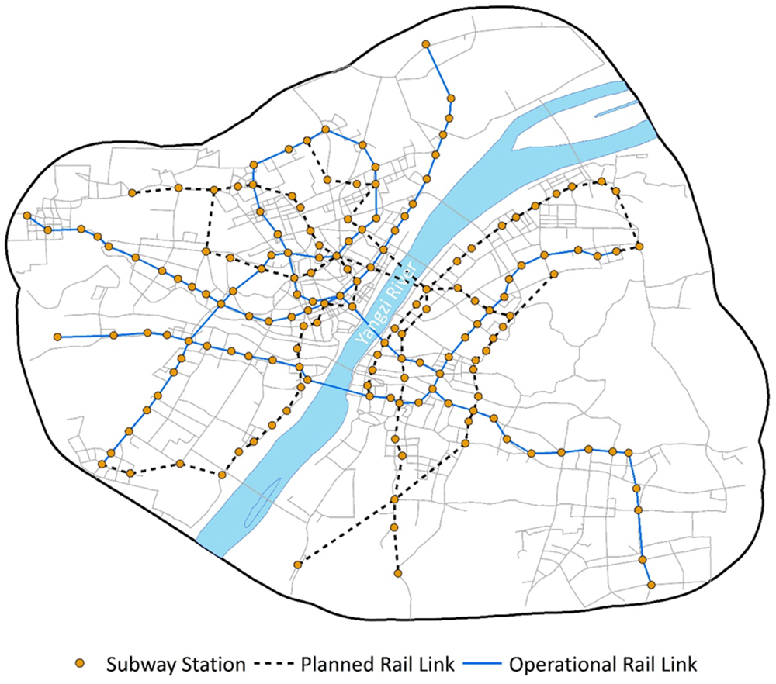
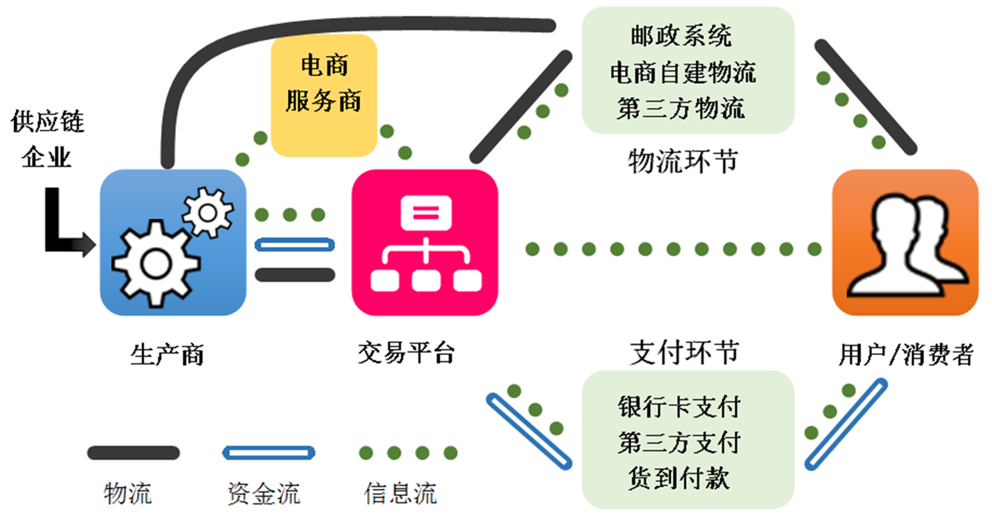

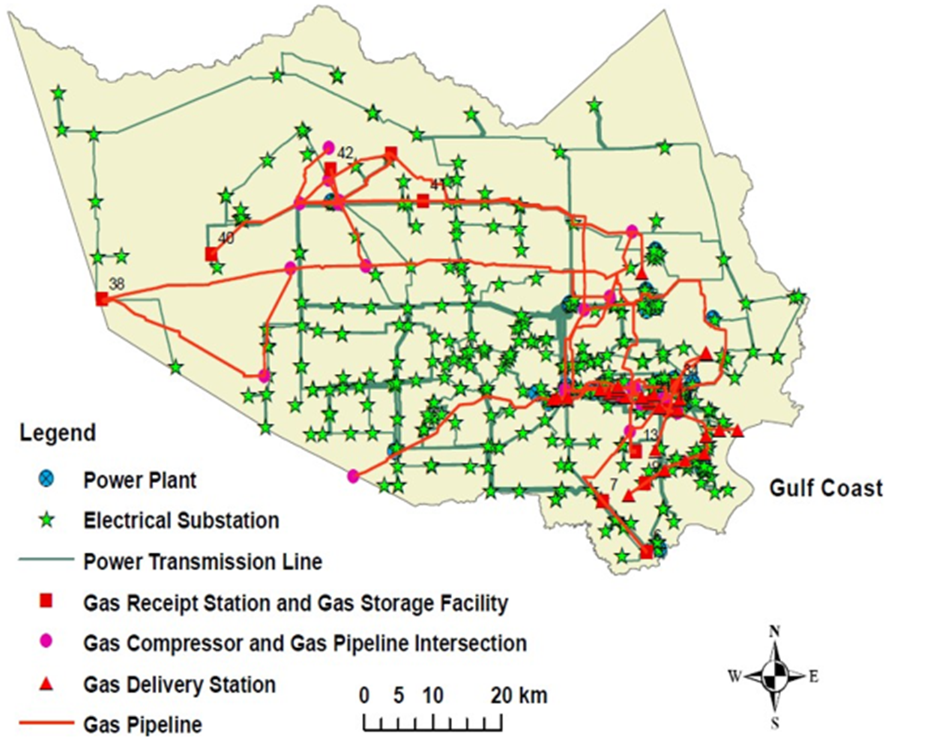
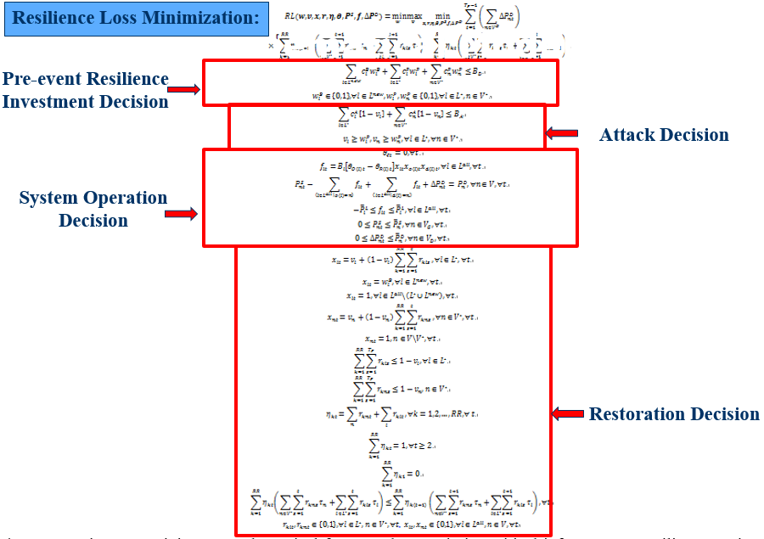
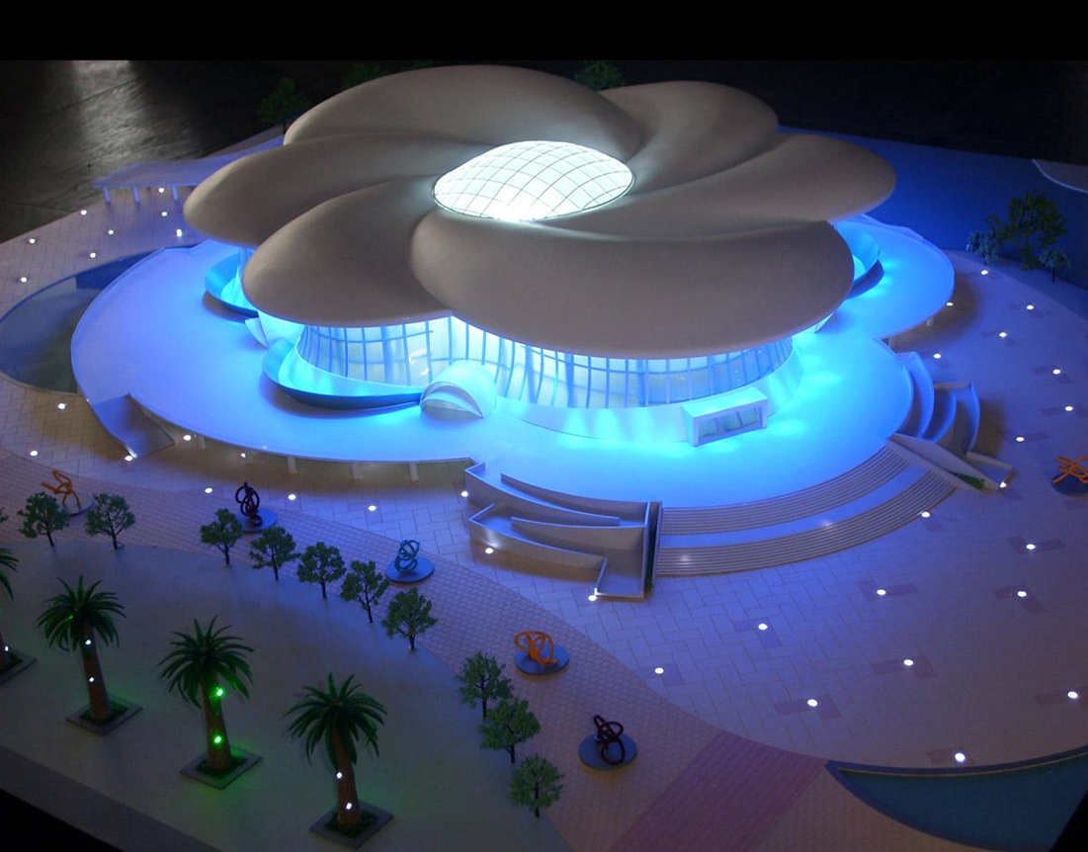
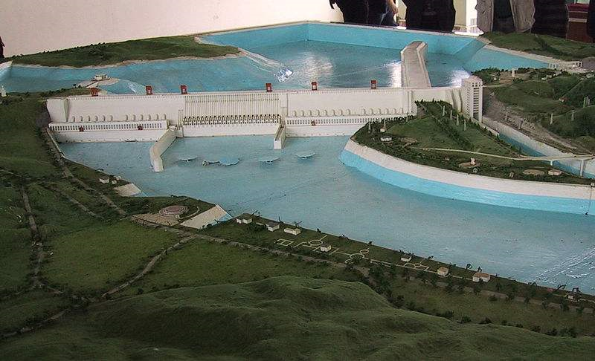
1. 系统、模型、建模与仿真的概念与关系

Slide 20

1. 系统、模型、建模与仿真的概念与关系
钱学森认为: 系统是由相互作用相互依赖的若干组成部分结合而成的，具有特定功能的有机整体，而且这个有机整体又是它从属的更大系统的组成部分。
Bertalanffy (一般系统论和理论生物学创始人): A system is a set of interacting or interdependent components forming an integrated whole.
System: “A combination of elements that function together to produce the capability required to meet a need,” including hardware, software, people, processes, and facilities; the added value comes from how parts are interconnected (NASA_systems_engineering_handbook).
要有两个或两个以上的要素；
要素之间要相互联系、相互作用；
要素之间的联系与作用产生整体功能
构成系统必备条件

Slide 21
1. 系统、模型、建模与仿真的概念与关系
系统的特性
集合性：系统是由许多元素有机地组成的整体。每个元素服从整体，追求全局最优。
相关性：系统的各个组成部分之间是互相联系、互相制约的。
目的性：任何系统都是有目的和目标的。
层次性：一个系统往往由多个部门（或部分）组成。每个部门可看作为一个小的系统，称为子系统，子系统之下又可划分为子子系统。系统具有层次结构。
环境适应性：任何系统都是存在并活动于一个特定的环境之中，与环境不断进行物质、能量和信息的交换。系统必须适应环境。

Slide 22
1. 系统、模型、建模与仿真的概念与关系
系统的分类
(1) 按物质构成分
生物系统:主要由动植物及其群落构成的系统。
社会系统 :以人为基本单元、人在其中起主导作用的系统。
(2)按形成方式:
  自然系统:自然而非人力形成系统－天体、血液循环等。
  人造系统:人为建造系统－生产系统/运输系统
  复合系统:自然和人造相结合系统－农业、水利。

Slide 23
1. 系统、模型、建模与仿真的概念与关系
系统的分类
(3)按与环境联系的方式及密切程度分：封闭系统、开放系统、相对封闭系统
(4)状态与时间：静态系统/动态系统
(5)对环境变化的响应：自适应系统/非自适应系统
(6)研究对象：教育系统/管理系统/军事系统
(7)内部结构：开环系统和闭环系统等。
(8)系统功能划：工业控制系统、经济系统、基础设施系统等。
(9)按照抽象程度将系统分为：概念系统（描述系统的主要特征和大致轮廓）、逻辑系统（脱离实现细节的合理系统）、物理系统（实际存在的系统）

Slide 24
1. 系统、模型、建模与仿真的概念与关系
A physical, mathematical, or otherwise logical representation of a system, entity, phenomenon, or process. (DoD 1998)
A representation of one or more concepts that may be realized in the physical world. (Friedenthal, Moore, Steiner 2009)
A simplified representation of a system at some particular point in time or space intended to promote understanding of the real system. (Bellinger 2004)
An abstraction of a system, aimed at understanding, communicating, explaining, or designing aspects of interest of that system (Dori 2002)
A selective representation of some system whose form and content are chosen based on a specific set of concerns. The model is related to the system by an explicit or implicit mapping. (Object Management Group 2010)
A deliberate, simplified representation of a system for a stated purpose.
Notes:
A model specifies variables, parameters, and assumptions, i.e., a mapping y=M_{θ}(x,s,t). Models may be mathematical, statistical, computational, or physical; deterministic or stochastic; continuous, discrete, or hybrid. Scope, resolution, and fidelity are explicit.

Slide 25
1. 系统、模型、建模与仿真的概念与关系
Modeling: The process that produces a fit-for-purpose, reproducible model.
It includes problem framing and boundary/level-of-detail choices; conceptual → mathematical/algorithmic formulation; parameter estimation/identification; and credibility building via Verification (implemented correctly), Validation (represents reality for the purpose), and Uncertainty Quantification (quantify aleatory/epistemic uncertainty), plus documentation/versioning.

Slide 26
1. 系统、模型、建模与仿真的概念与关系
Simulation: Systematic experimentation with an executable model to study behavior over time and across scenarios/replications.
Simulation covers experiment design (scenarios, initial conditions, random seeds), execution (e.g., ODE/PDE integration, discrete-event logic, agent-based updates, Monte Carlo), and analysis (convergence checks, sensitivity, interval/coverage metrics). A simulation probes consequences conditional on the model—it does not, by itself, prove the model true.

Slide 27
1. 系统、模型、建模与仿真的概念与关系
How they connect in practice
Modeling is the disciplined process → it produces a model (the artifact) → simulation runs designed experiments on that model to inform decisions.

Slide 28
1. 系统、模型、建模与仿真的概念与关系
1) System & problem definition: Purpose, stakeholders, performance measures, boundary (states/inputs/outputs/environment).
2) Conceptual model: Structure, assumptions, level of detail, scope; plan for evidence and data.
3) Mathematical / computational formulation: Equations, rules, state space, parameters θ; discretization choices.
4) Parameter estimation (calibration): Fit θ from data; hold-outs defined in advance.
5) Verification (V) built right?: Units/consistency, numerical convergence, code tests; conservation laws.
6) Validation (V) right for the purpose?: Out-of-sample fidelity, predictive/construct validity against reality for stated use.
7) Uncertainty quantification (UQ): Aleatory & epistemic uncertainty; sensitivity (Morris/Sobol); interval/coverage checks.
8) Experiment design for simulation: Scenarios, policies, initial conditions, random seeds, replications, stopping rules.
9) Simulation analysis: Run experiments, compute metrics, stress/what-if/response surfaces.
10) Decision & deployment: Compare options under uncertainty, trade-offs & constraints; document rationale.
Notes:
Modeling spans Steps 1–9 (and documentation throughout). It is the process that makes a credible, fit-for-purpose model.
The model is the artifact from Steps 4–5: structure + parameters + assumptions (equations/rules/code + θ\thetaθ + model card).
Simulation is Steps 9–10: designed experiments on an executable model (not just “running code”), producing distributions, intervals, and stress-test evidence.

Slide 29
1. 系统、模型、建模与仿真的概念与关系
Common feedback loops (make them explicit)
Validation shortfall → revisit assumptions/structure (Step 2).
High sensitivity to a parameter you can’t observe → redesign measurement or constrain the model.
Simulation reveals policy brittleness → expand scenarios or add robustness constraints.
A simulation does not prove a model true—it provides evidence conditional on the model.

Slide 30
2. 为什么要建模？模型的类型----why build a model?

Slide 31
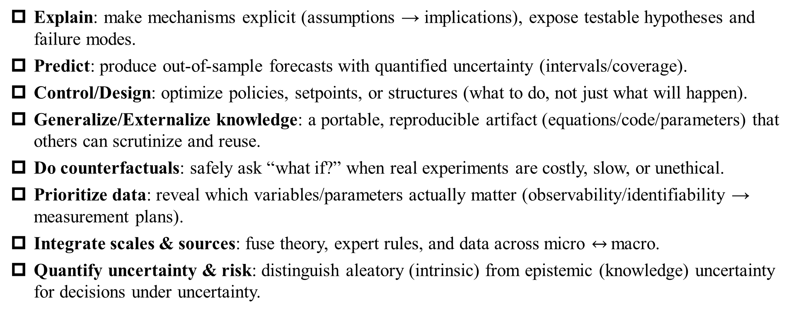
2. 为什么要建模？模型的类型----why build a model?
Explain: make mechanisms explicit (assumptions → implications), expose testable hypotheses and failure modes.
Predict: produce out-of-sample forecasts with quantified uncertainty (intervals/coverage).
Control/Design: optimize policies, setpoints, or structures (what to do, not just what will happen).
Generalize/Externalize knowledge: a portable, reproducible artifact (equations/code/parameters) that others can scrutinize and reuse.
Do counterfactuals: safely ask “what if?” when real experiments are costly, slow, or unethical.
Prioritize data: reveal which variables/parameters actually matter (observability/identifiability → measurement plans).
Integrate scales & sources: fuse theory, expert rules, and data across micro $↔$macro.
Quantify uncertainty & risk: distinguish aleatory (intrinsic) from epistemic (knowledge) uncertainty for decisions under uncertainty.
If a decision, forecast, or explanation must be transparent, testable, and repeatable, you need a model.

Slide 32
2. 为什么要建模？模型的类型---模型的类型
By knowledge source (mechanism vs data)
Mechanistic / white-box: derived from principles (conservation laws, optimization, game/utility).
Evidence: verification (units/stability), validation vs reality, sensitivity/UQ.
Examples: ODE/PDE (SIR/SEIR; heat/diffusion), cell-transmission traffic model, gravity/radiation models, network flow.
Statistical / black-box: learned from data (GLM, ARIMA/VAR, random forests/boosting, GPs, neural nets).
Evidence: out-of-sample performance, calibration/coverage, drift monitoring.
Examples: demand forecasting, short-term load/traffic prediction.
Grey-box / system identification: mechanistic structure + data-estimated parameters (ARX/NARX, state-space ID, SINDy, PINNs, physics-informed ML).
Evidence: identifiability, constrained estimation, sample-external validation.
Examples: RC building thermodynamics; calibrated epidemic/contact rates.
Notes:
How the literature categorizes models
There isn’t a single taxonomy; good practice is to classify across several orthogonal axes. Below are the most used categories (with typical evidence requirements and examples).

Slide 33
2. 为什么要建模？模型的类型---模型的类型
By purpose
Descriptive (fit & summarize)
Explanatory (mechanism/causality)
Predictive (future outcomes)
Prescriptive (optimization/control/MPC)
Normative (policy/design criteria).
Normative model = a formal statement of desired ends (targets, thresholds, utility/value functions, risk tolerances, codes), i.e., what counts as good/acceptable for a system.

Slide 34
2. 为什么要建模？模型的类型
By dynamics & representation
Static vs Dynamic (time-evolving).
Deterministic vs Stochastic (randomness explicit).
Continuous (ODE/PDE) vs Discrete-event (queues, Petri nets) vs Hybrid.
Evidence: numerical convergence (continuous), replication/DOE (discrete-event).

Slide 35
2. 为什么要建模？模型的类型
By level of aggregation
Microscopic / agent-based (ABM): individual rules → macro patterns; heterogeneity & interactions explicit.
Evidence: micro-validity + macro targets; distributional fits.
Mesoscopic: kinetic/fundamental-diagram, compartmental (CTM in traffic; metapopulation in epidemics).
Macroscopic / system dynamics: stocks/flows/feedback loops (SD).
Evidence: structure tests, behavior reproduction under shocks.

Slide 36
2. 为什么要建模？模型的类型
By structure/topology
Network/graph-based: topology matters (percolation, cascades, robustness).
Graphical/probabilistic: Bayesian networks, factor graphs, HMMs.
State-space / control: LTI/LTV models, observers (KF/UKF), MPC.
Queueing/Markov: M/M/c, birth–death, CTMCs.
Evidence: steady-state/transient fits, theoretical baselines (e.g., Erlang-C).

Slide 37
2. 为什么要建模？模型的类型
By parameterization & inference
Parametric vs Nonparametric;
Frequentist vs Bayesian/hierarchical;
Causal (SCM/DAGs, IV/RD) vs Associational.
Evidence: identification assumptions explicit; falsification tests; prior/posterior checks.

Slide 38
2. 为什么要建模？模型的类型
By computational role
Analytical (closed-form)
Numerical (solvers)
Simulation (DES/ABM/Monte Carlo)
Surrogates/emulators (ROMs, polynomial chaos, learned simulators)
Differentiable simulators (end-to-end calibration).

Slide 39
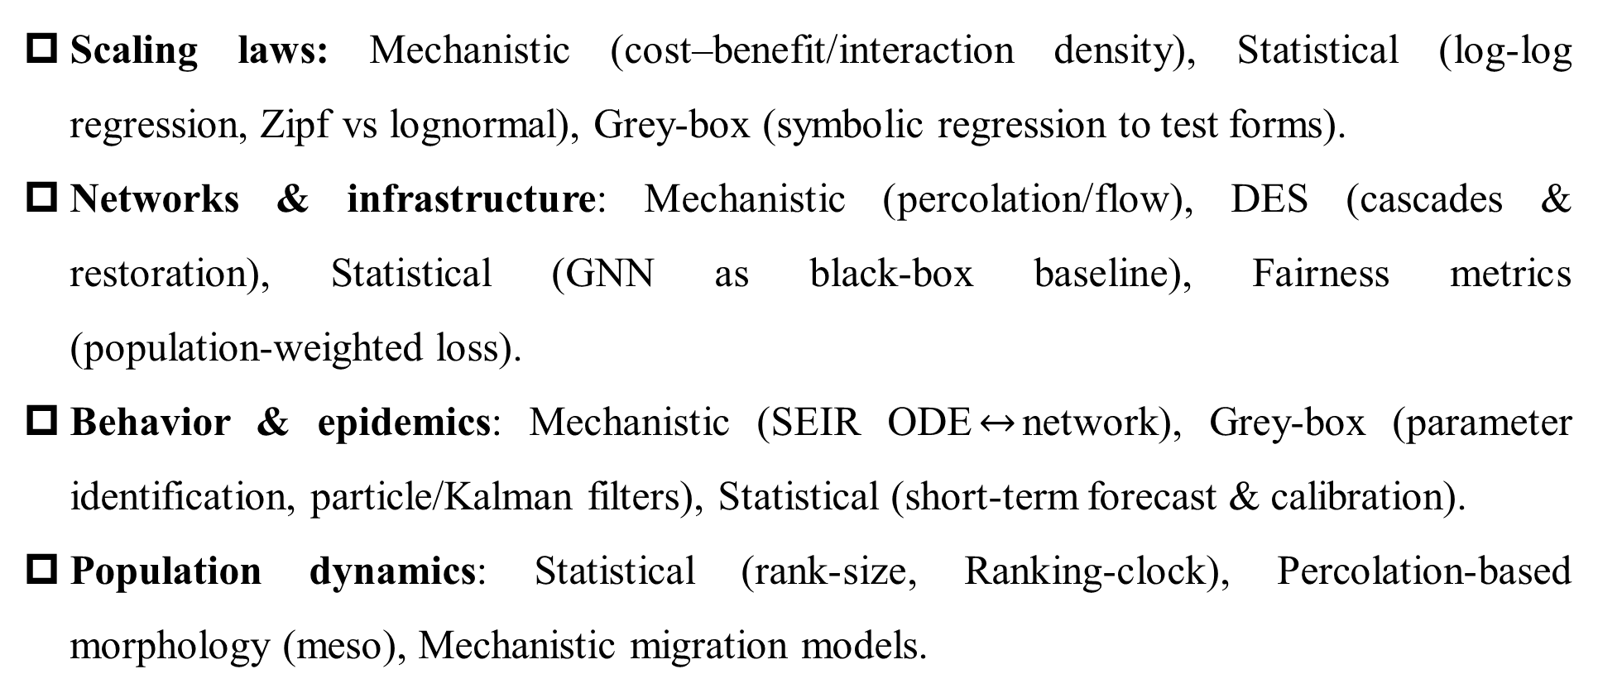
2. 为什么要建模？模型的类型---Course theme mapping
Scaling laws: Mechanistic (cost–benefit/interaction density), Statistical (log‑log regression, Zipf vs lognormal), Grey‑box (symbolic regression to test forms).
Networks & infrastructure: Mechanistic (percolation/flow), DES (cascades & restoration), Statistical (GNN as black‑box baseline), Fairness metrics (population‑weighted loss).
Behavior & epidemics: Mechanistic (SEIR ODE$↔$network), Grey‑box (parameter identification, particle/Kalman filters), Statistical (short‑term forecast & calibration).
Population dynamics: Statistical (rank‑size, Ranking‑clock), Percolation‑based morphology (meso), Mechanistic migration models.

Slide 40
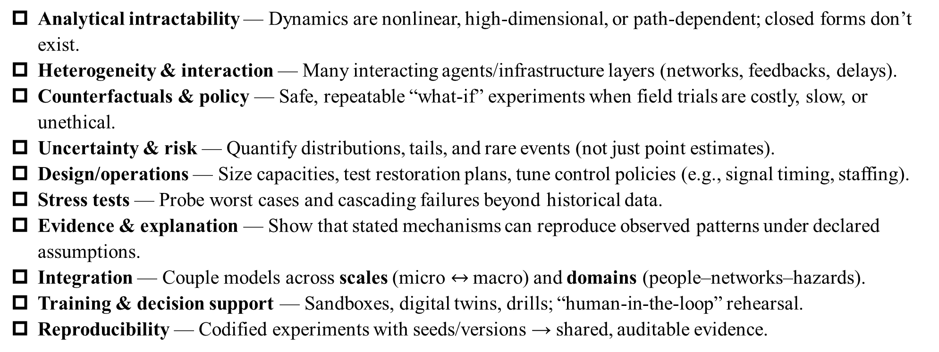
3. 为什么要仿真？仿真的类型: Why do we simulate?
Analytical intractability — Dynamics are nonlinear, high-dimensional, or path-dependent; closed forms don’t exist.
Heterogeneity & interaction — Many interacting agents/infrastructure layers (networks, feedbacks, delays).
Counterfactuals & policy — Safe, repeatable “what-if” experiments when field trials are costly, slow, or unethical.
Uncertainty & risk — Quantify distributions, tails, and rare events (not just point estimates).
Design/operations — Size capacities, test restoration plans, tune control policies (e.g., signal timing, staffing).
Stress tests — Probe worst cases and cascading failures beyond historical data.
Evidence & explanation — Show that stated mechanisms can reproduce observed patterns under declared assumptions.
Integration — Couple models across scales (micro $↔$macro) and domains (people–networks–hazards).
Training & decision support — Sandboxes, digital twins, drills; “human-in-the-loop” rehearsal.
Reproducibility — Codified experiments with seeds/versions → shared, auditable evidence.
Guardrail: A simulation provides evidence conditional on the model; it never proves the model “true”. V&V&UQ still apply.

Slide 41
3. 为什么要仿真？仿真的类型--- Engine/representation
Family (canonical) | What it simulates (time/state) | When to use | Design knobs | Checks you must report | Typical urban example
Continuous-time numerical (ODE/PDE integration) | Trajectories of continuous states; time-stepped solvers (RK, FEM/FVM) | Physics/flow/epidemic dynamics with known equations | Step size, solver, boundary/ICs, coupling | Verification (units, conservation), stability, convergence; validation vs held-out data | Flood routing, traffic CTM/continuum, SEIR ODE
Discrete-Event Simulation (DES) | Event-driven queues/processes; state jumps at arrivals/departures | Flow with contention (services, logistics, turnstiles, ER) | Event logic, warm-up, replications & seeds | Steady-state vs transient, confidence intervals, variance reduction | M/M/c station gates; call-center staffing; evacuation checkpoints
Agent-Based / Microsimulation (ABM) | Heterogeneous agents with local rules; time-stepped or event-driven | Interactions & emergent phenomena matter (behavior, mobility) | Update scheme, interaction radius, scheduling, heterogeneity | Micro-validity + macro targets; sensitivity; distributional fits (not just means) | Pedestrian/crowd, mode choice, disease on contact networks
System Dynamics (SD) | Aggregated stocks–flows, feedback loops | Policy/structure insights at macro scale | Time step, loop structure, delays | Dimensional consistency, behavior reproduction under shocks | Land-use–transport feedback; hospital bed occupancy
Monte Carlo / Stochastic simulation | Random sampling to propagate uncertainty; many replications | Estimate expectations/risks/tails; rare events | RNG/seed, sample size, variance reduction (IS/CV) | Convergence of estimates; coverage of intervals | Cost–risk distributions for retrofit plans; outage probabilities
Network/Percolation/Cascade | Processes on graphs: failures, contagion, diffusion | Topology-dependent robustness & spreading | Graph model, coupling rules, thresholding | Percolation thresholds, cascade size distributions; fairness (pop-weighted loss) | Power/road interdependence; targeted attack vs random failure
Hybrid & Co-simulation (incl. digital twins) | Coupled continuous–discrete/ABM–network; possibly real-time | Multi-scale, cross-domain, or device-in-the-loop | Synchronization, time management, latency | Interface consistency; stability across couplings; drift monitoring | Traffic simulation + signal controller/MPC in the loop

Slide 42
3. 为什么要仿真？仿真的类型: Participation/implementation (LVC)
Mode | Who/what is real? | Primary uses | Evidence you must show | Typical urban examples | Engines you usually pair
Live (L) | People ✅, equipment ✅ | Training, procedures, readiness | DOE (inject schedule), safety/ethics, telemetry & timing, after-action review | Stadium evacuation drill; power-outage field test; traffic police diversion exercise | Often none (real world), but can drive constructive adversaries in parallel
Virtual (V) | People ✅, system ❌ | Operator training, HIL decision support | Usability metrics, task success/latency, scenario coverage, reproducibility (seeds) | Control-room simulator; VR evacuation trainer; adaptive signal HIL lab | DES/ABM for flows; ODE for dynamics; co-sim with controllers
Constructive (C) | People ❌, system ❌ | Design, policy, risk, counterfactuals | V&V&UQ: verification & solver convergence, out-of-sample validation, intervals & sensitivity | Queueing for turnstiles; SEIR on contact networks; network cascade robustness | ODE/PDE, DES, ABM, SD, Network, Monte-Carlo
HIL / Co-sim | Real device ✅ + sim | System integration, controller tests | Real-time sync, interface contracts, stability under latency | Traffic signal controller in the loop; microgrid inverter with EMT sim | Hybrid/co-sim; differentiable sims emerging
Digital Twin | Live asset + model + data | Operations, monitoring, what-ifs | Drift detection, data lineage, versioning; shadow-mode validation | Metro line twin: forecast load, test timetables; water network twin | Constructive or virtual engine + live data

Slide 43
4. 建模与仿真技术的发展历程
时代 | 年份 | 里程碑 | 为什么重要（一句话要点）
早期概率/随机过程 | 1906 | 马尔可夫链（Andrey Markov） | 奠定“状态—转移”随机动力学表述，成为排队、可靠性与贝叶斯滤波的基石。
排队论 | 1909 | 爱尔兰格排队论（A.K. Erlang） | 首次把概率论用于通信/服务系统容量规划，开创排队与离散事件建模应用。
计算物理与数值法 | 1943 → 1960 | 有限元方法：Courant 的变分思想→Clough 正式命名“Finite Element Method” | 让复杂连续体/结构的 PDE 可计算化，现代工程仿真的主力方法。
随机模拟 | 1940s–1949 | 蒙特卡洛法（Ulam、von Neumann；Metropolis 命名） | 以随机采样代替解析求解，成为核工程到金融风控的通用数值实验范式。
状态估计 | 1960–1961 | 卡尔曼滤波（Kalman；Kalman–Bucy 扩展） | 用状态空间与递推最优估计统一“信号+噪声”问题，是导航与轨迹跟踪标配。
系统科学 | 1961 | Forrester《Industrial Dynamics》创立系统动力学 | 把“反馈—库存—信息延迟”形式化，奠定宏观复杂系统的连续仿真框架。
离散事件/模拟语言 | 1961–1967 | GPSS（IBM, 1961）、Simula 67（Nygaard & Dahl） | 标准化离散事件建模（GPSS）并引入面向对象思想服务于仿真（Simula）。
时间序列 | 1970 | Box–Jenkins（ARIMA） | 让统计建模具备可操作的识别-估计-诊断流程，成为“数据—模型”管线模板。
计算生命/离散动力学 | 1970 | Conway“生命游戏”（细胞自动机） | 以极简规则展示复杂涌现，影响后续时空离散仿真与人工生命研究。
化学/生物随机动力学 | 1977 | Gillespie 精确随机模拟算法（SSA） | 为分子/细胞尺度反应网络提供“事件级”金标准模拟方法。
个体为本建模 | 1987/1996 | Reynolds“Boids”群体行为；Epstein & Axtell《Growing Artificial Societies》 | 以规则驱动的主体交互解释群体涌现，奠定 ABM 的方法与社会科学应用。
网络科学 | 1998–1999 | 小世界网络（Watts–Strogatz）；无标度网络（Barabási–Albert） | 揭示真实网络“短径+高聚类/幂律度”的普遍结构，为城市/基础设施网络建模提供范式。
多层/相依网络 | 2010 | 互依网络级联失效（Buldyrev 等，Nature） | 指出网络耦合使系统更脆弱，推动基础设施联动风险与关联渗流研究。
数据驱动建模 | 2016 | SINDy 稀疏识别（Brunton 等，PNAS） | 从数据自动“发现”控制方程，连通可解释机理与机器学习。
物理+深度学习 | 2019 | 物理约束神经网络 PINNs（Raissi 等，JCP） | 把物理约束嵌入网络损失，统一“解方程/估参/补全”三类任务。
可微仿真 | 2020–2021 | DiffTaichi（ICLR’20）、Brax（JAX, 2021） | 让仿真端到端可微并与学习联合优化，显著加速“仿真—学习”闭环。
数字孪生 | 2002/2012 | Grieves 提出概念；NASA AIAA 定义 | “物理—虚拟双向映射+高保真仿真+在轨更新”，成为工程与城市系统新范式。

Slide 44
5. 案例：传染病建模与仿真
Hao, X., Cheng, S., Wu, D. et al. Reconstruction of the full transmission dynamics of COVID-19 in Wuhan. Nature 584, 420–424 (2020). https://doi.org/10.1038/s41586-020-2554-8

Slide 45
5. 案例：传染病建模与仿真

Slide 46
5. 案例：传染病建模与仿真

Slide 47
5. 案例：传染病建模与仿真

Slide 48
第一章：建模与仿真概念及内涵---核心要点
System: a set of interacting or interdependent components forming an integrated whole.
Model: Purposeful representation of a system (structure + parameters + assumptions).
Modeling: The process that creates a credible model.
Simulation: Designed experiments on an executable model (scenarios, seeds, replications) to study behavior and support decisions.
Problem/Decision metric → Conceptual model → Math/Computational model → Data & Estimation → Verification → Validation → UQ/Sensitivity → DoE (scenarios/seeds/replications) → Simulation Runs & Analysis (CIs/coverage) → Decision & Documentation
All models are wrong, but some are useful (George, 1976)

