Slide 1
DINOV3
Thumbnail corpus: embeddings and clustering
8,666 valid video thumbnails · ViT-L/16 · CLS and patch tracks
Olga Lyashevska | Thumbnail study |
Notes:
Open: we already have a year-stratified thumbnail corpus. This talk is how DINOv3 is used on it — not a model lecture. 30–40 seconds.

Slide 2
FROM SAMPLE TO EMBEDDABLE IMAGES
Year-stratified sample, 2,500 videos per year, 2020–2024. Same ≥ 4 KB / 640×360 filter as the VLM path.
12,500
10,957
2,291
8,666
SAMPLED
RETRIEVED
PLACEHOLDERS
EMBEDDABLE
2,500 / year
87.7% HTTP
< 4 KB, dropped
69.3% of sample
Valid thumbnails by year (share of that year’s 2,500)
2020
1,639 65.6%
2021
1,655 66.2%
2022
1,660 66.4%
2023
1,734 69.4%
2024
1,978 79.1%
DINOv3 · thumbnail corpus · 2020–2024
3
Notes:
Placeholders, not HTTP failures, are the main loss in 2020–21 (~24%). 2024 is cleanest (79% valid). DINOv3 and VLM share this filter. ~1 min.

Slide 3
WHOLE THUMBNAIL vs LOCAL PATCH
Same two steps on both tracks: extract embeddings, then cluster. Shared preprocess; the unit of analysis differs.
SHARED
CLS TRACK
PATCH TRACK
Preprocess once
One vector for
the whole image
One vector per
16×16 cell
black pad · masked
UNIT
UNIT
640 × 360
kept, not stretched
Entire thumbnail
Local 16×16 ViT patch
EXTRACT
EXTRACT
1 × 1024-d CLS token
112 patches / image
CLUSTER
CLUSTER
black pad · masked
HDBSCAN + k-means K=40
8,666 vectors
HDBSCAN only (min size 30)
8.666 x 112 = 970,592 vectors
Filter ≥ 4 KB, 640×360
RGB · letterbox to square
resize to 224 px
ASKS
ASKS
What kinds of thumbnails are in the corpus?
Which local parts of the frame recur?
Then the tracks split →
DINOv3 · thumbnail corpus · 2020–2024
4
Notes:
The split is the unit of analysis, not the pipeline. Pads are masked so black bars do not become a fake patch cluster. 8×14 = 14×14 ViT grid minus top/bottom pad rows. ~1 min.

Slide 4
PRODUCTION RUN: VIT-L/16 ON THE FULL CORPUS
facebook/dinov3-vitl16-pretrain-lvd1689m · ~300M params · 1024-d · CUDA
CLS EMBEDDINGS
PATCH EMBEDDINGS
SANITY CHECKS
8,666 × 1024
970,592 tokens
Finite, matched
Run 20260713T131720Z
Load 1.2 s · inference 5 m 1 s
0.035 s / image
Run 20260714T101958Z
112 tokens / image (pad-masked)
0.048 s / image · 6 m 55 s
Shape, ID list, no NaN/Inf
Random cosine similarities
check_cls / check_patch
Paths match the two tracks
data/dinov3_cls_{embeddings,clusters}/ · data/dinov3_patch_{embeddings,clusters}/
Per-image vectors on disk so interrupted HPC runs resume without recomputing finished images.
DINOv3 · thumbnail corpus · 2020–2024
5
Notes:
ViT-B was a laptop pilot and is archived — do not mix B and L embeddings. 2,291 files ≥4 KB still failed as unreadable at inference; the 8,666 are the embeddable set. ~1 min.

Slide 5
CLUSTERING PARAMETERS
Fit on 50-d PCA (Euclidean). UMAP is visualisation only — cosine, 2D, n_neighbors=30, min_dist=0.1, seed=42.
CLS · TIGHT GROUPS
CLS · FULL TAXONOMY
PATCH · LOCAL UNITS
HDBSCAN eom
k-means K=40
HDBSCAN eom
min_cluster_size
3
n_clusters
40
min_cluster_size
30
min_samples
1
n_init
10
min_samples
3
metric
euclidean
init
k-means++
metric
euclidean
selection
eom
random_state
42
selection
eom
539 clusters · 69% noise
40 clusters · 0% noise
1,285 clusters · 84% noise
Shared reduction · PCA 50 (58.9% CLS / 55.2% patch variance) · seed 42 · agglomerative Ward is implemented but not used
DINOv3 · thumbnail corpus · 2020–2024
6
Notes:
Stress: clustering is on PCA, not UMAP. Patch HDBSCAN is stricter (30/3 vs 3/1) because there are ~112× more points. k-means n_init=10. ~1 min.

Slide 6
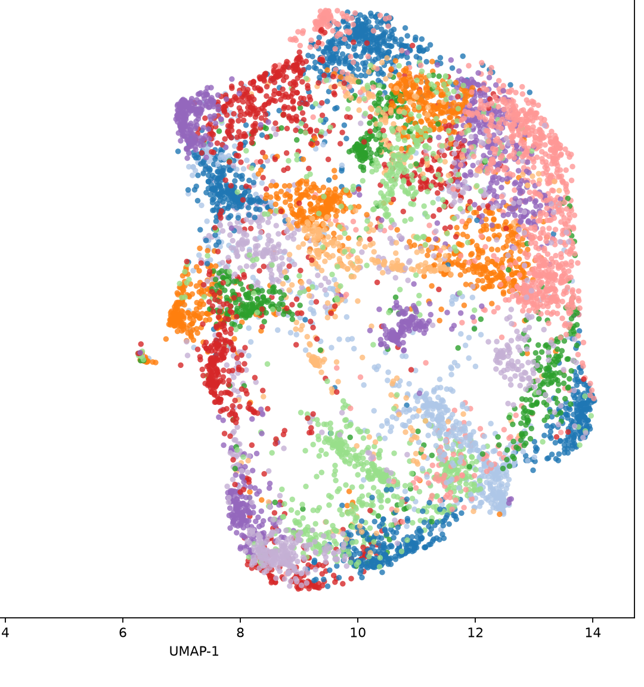
CLS: TWO CLUSTERING ALGORITHMS
Same 8,666 vectors. Shared PCA 50 + UMAP neighbors 30.
TIGHT GROUPS · HDBSCAN eom
539 clusters · 69% noise
2,666 images assigned. Median cluster size 4; largest 56. Most groups are near-duplicates or very tight visual copies. High noise is a finding: many unique compositions.
FULL-CORPUS TAXONOMY · K-MEANS K=40
40 clusters · 0% noise
Every thumbnail gets a type. Sizes 73–404 (median 212). This is the working visual taxonomy for sampling and year-wise mix. Right: UMAP of k-means labels.
K-means K=40 · UMAP of CLS space
DINOv3 · thumbnail corpus · 2020–2024
6
Notes:
Do not treat HDBSCAN noise as failure — it means the corpus is not a handful of templates. Use HDBSCAN for near-dupes; k-means for a complete partition. ~2 min; linger on UMAP.

Slide 7
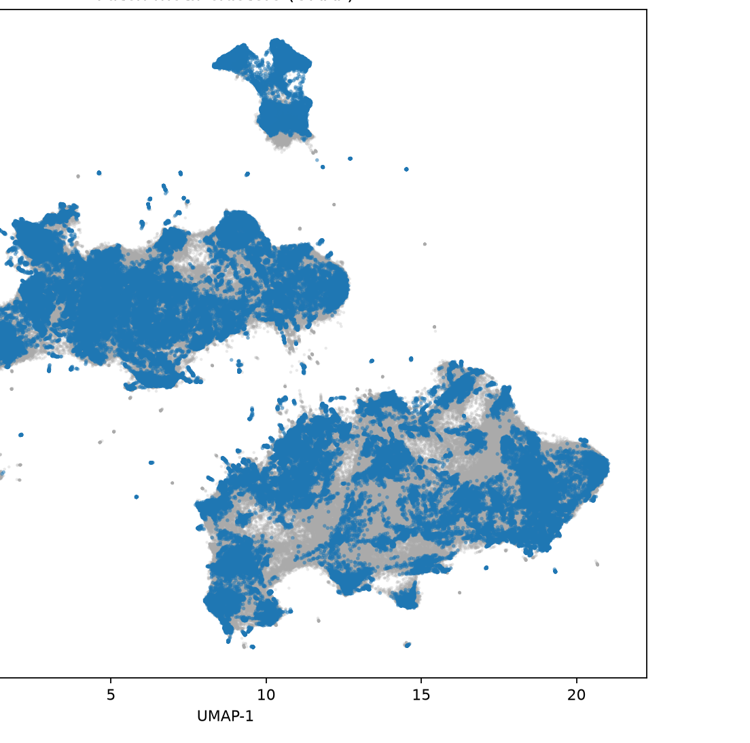
PATCH: LOCAL UNITS, NOT WHOLE THUMBNAILS
HDBSCAN eom · 970,592 tokens · min size 30 · min samples 3
1,285
CLUSTERS
83.7%
NOISE TOKENS
157,946
ASSIGNED TOKENS
Patch-token UMAP · dense local space
DINOv3 · thumbnail corpus · 2020–2024
7
Notes:
High patch noise is expected: most 16×16 windows are unique. Assigned clusters are the recurring local units (text, skin, furniture, graphic overlays). Compare against CLS types — a thumbnail type is a mix of patch clusters. ~1.5 min.

Slide 8
TAKEAWAYS
01
The pipeline is done on the whole corpus
8,666 CLS vectors and 970,592 patch tokens from ViT-L/16; both clusterings written to disk.
02
Two tracks, two CLS clusterings
HDBSCAN = tight / noisy. K-means K=40 = complete taxonomy. Patch HDBSCAN = local units.
03
High noise is a result
69% CLS noise and 84% patch noise mean the corpus is visually diverse, not a small set of templates.
04
Next work is interpretation
Name clusters from sample grids; tabulate cluster × year; overlay VLM codes on a stratified subsample.
DINOv3 · thumbnail corpus · 2020–2024
9
Notes:
Close on interpretation, not more model work. Offer to walk through a sample grid if there is time. ~45 s.

