Slide 1





Ecological time series for the Celtic Sea
Olga Lyashevska

Slide 2
Objectives:
Collate existing data resources for the Celtic Sea;
Tidy, filter and remove duplicates;
Understand relationships between biological data and environment;
Develop models for the detection of regime shifts;

Slide 3
Questions:
Has the occurrence/abundance of unusual events increased over time?
How does it relate to changes in environment (e.g. wind, circulation patterns and temperature)?
Are there similar patterns across species?

Slide 4
Data description
Jellyfish blooms (occurrence, 1890 - 2016);
Loggerhead turtle strandings (abundance, 1990 - 2015)
Cape Clear Bird Observatory:
  Basking sharks sightings (abundance, 1971 - 2008)
  Sunfish sightings (abundance, 1971 - 2008)
  Leatherback turtle sightings (abundance, 1971 – 2008)
Data provided by Thomas Doyle and Aidan Long from NUIG
External variables
Wind data (Cork Airport station, hourly 1962 - 2016)
Sea Surface Temperature (monthly, 1854 – 2017)
Phytoplankton and jellyfish data (Continuous Plankton Recorder)
Zooplankton (Station L4, Plymouth Marine Laboratory)

Slide 5
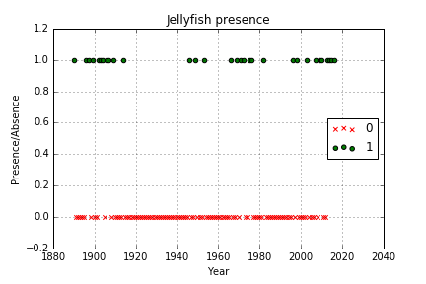
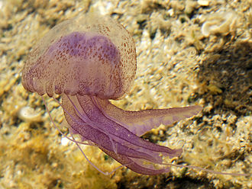
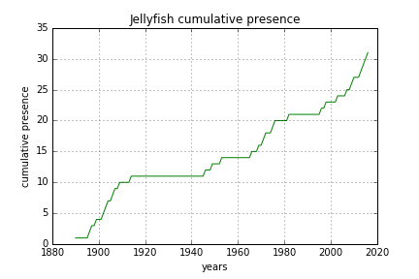

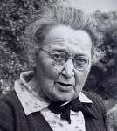
Jellyfish blooms
www.wikipedia.org
Data compiled from soft reports:
Irish Naturalist Journal, Irish Times,
Glaucus, Scottish Naturalist,
Marine Fauna
Effort not quantified and inconsistent
over time
Two comparable periods:
indicates that current swarms similar
to historical evidence
1983-1990
1915-1945
1954-1965

Slide 6
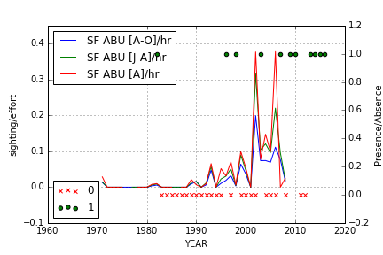
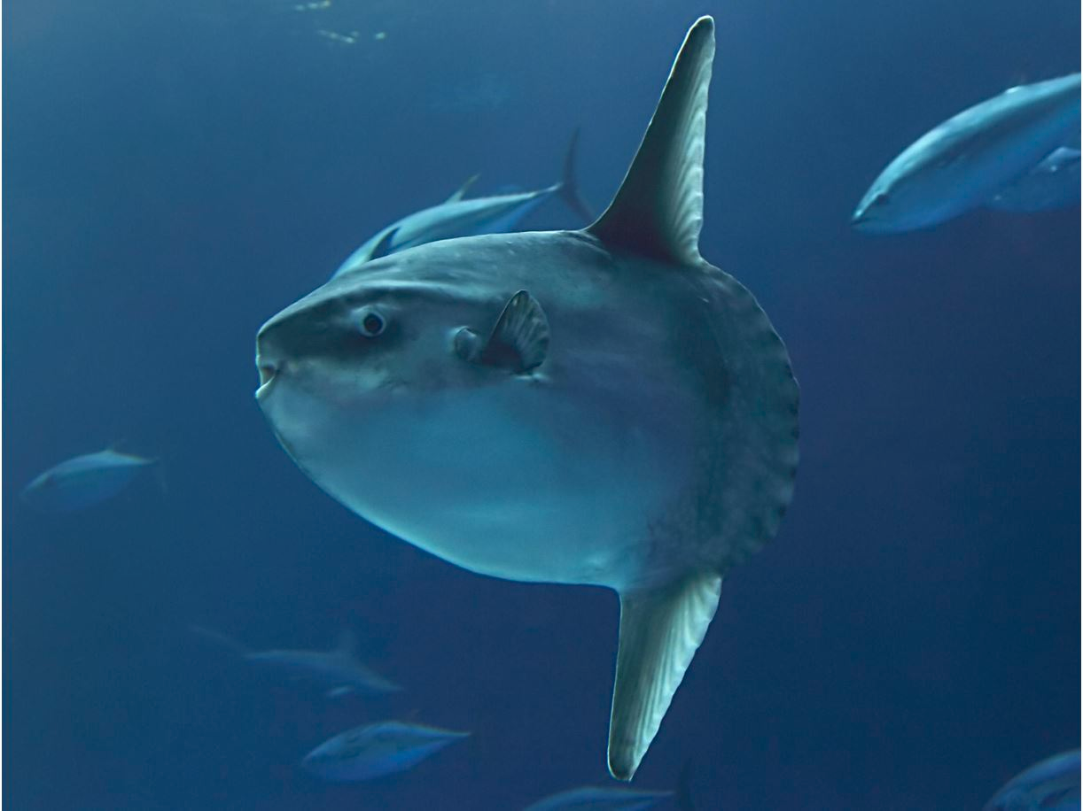
Sunfish sightings
Jellyfish predator – abundance may correlate with jellyfish swarms
Data shows a clear increase in sunfish sightings from 1999 onwards
Source: www.montereybayaquarium.org

Slide 7
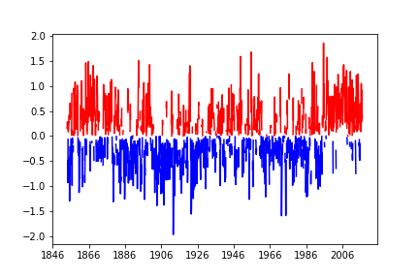
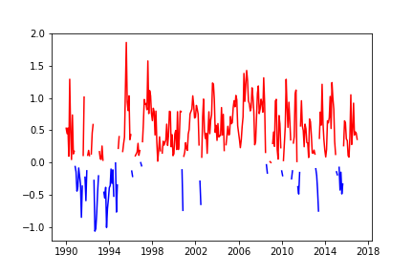
Examining correlations with temperature
Localized sst anomaly
Everage of 163 years

Slide 8
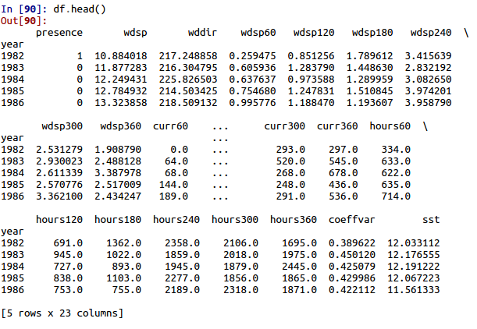
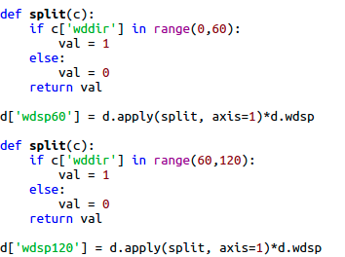
Wind reshape tool
Divide wind data into 6 categories according to direction (60 degrees in each)
Calculate:
- the average speed of the wind from that direction
- the number of hours that the wind blew from that direction
- the total number of current inducing winds from that direction
(winds greater than 5 knots for 20 hours or more).
- coefficient of variation - standard deviation of wind direction relative to the mean

Slide 9
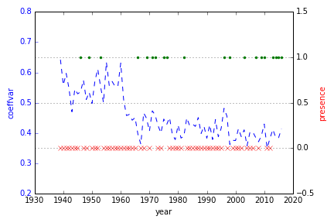
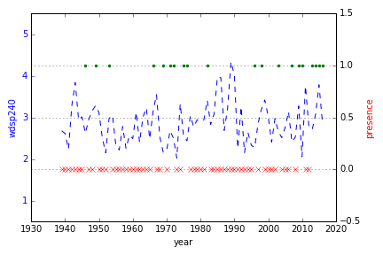
Examining temporal trends in wind patterns
Decreasing coefficient of variation -> wind direction less variable
Direction 180-240 degrees becomes more dominant

Slide 10
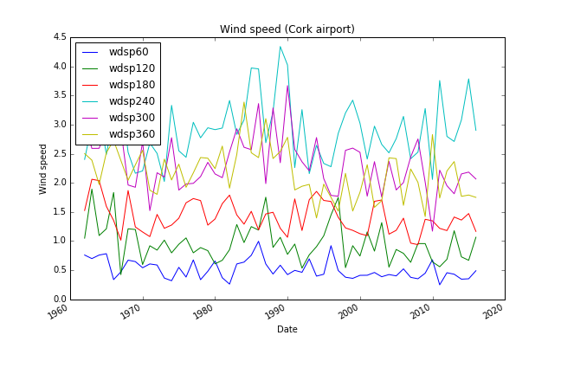
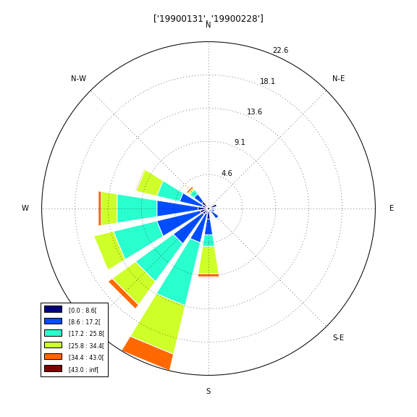
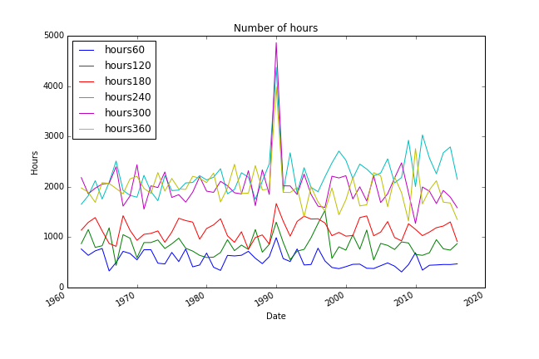
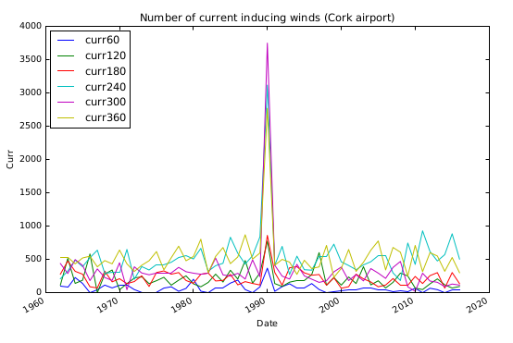
Storm Event: February 1990

Slide 11
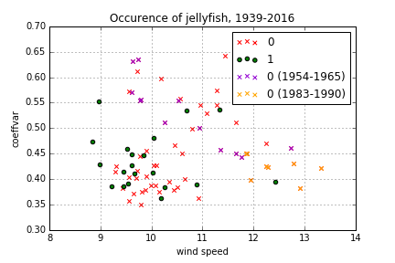
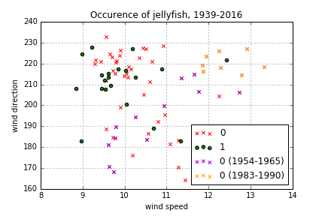
Clusters in years:
1956-1965
1983-1990
False zeros?

Slide 12
False zeros
Non-detection does not imply that event did not take place unless the probability of detection is 1.
Presence-absence with true zeros:
  Consider a subset of jellyfish data where effort was reasonably consistent (i.e. 1890-1915, 1990-2016);
Presence-absence with imperfect detectability:
  Consider all jellyfish data allowing for zeros using pseudo-absences approach (MacKenzie et al 2002);
Presence-only:
  Consider all data treating data as presence only, while discarding information on absences
  Generally not possible to calculate probabilities of presence, only the relative likelihood (Pearce et al 2006).
MacKenzie et al. 2002. Estimating site occupancy rates when detection probabilities are less then one. Ecology, 83(8), 2248—2255
Pearce et al, 2006. Modelling distribution and abundance with presence-only data. Journal of Applied Ecology, 43, 405--412

Slide 13
Statistical models for dealing with false zeros
Generalized Linear Models (GLM)
  in particular Zero Inflated Bernoulli or Poisson
Artificial Neural Networks (ANN)
  Good at non-linear modelling, requires pseudo-absences
Maximum Entropy (Maxent)
  Does not require pseudo-absences

Slide 14
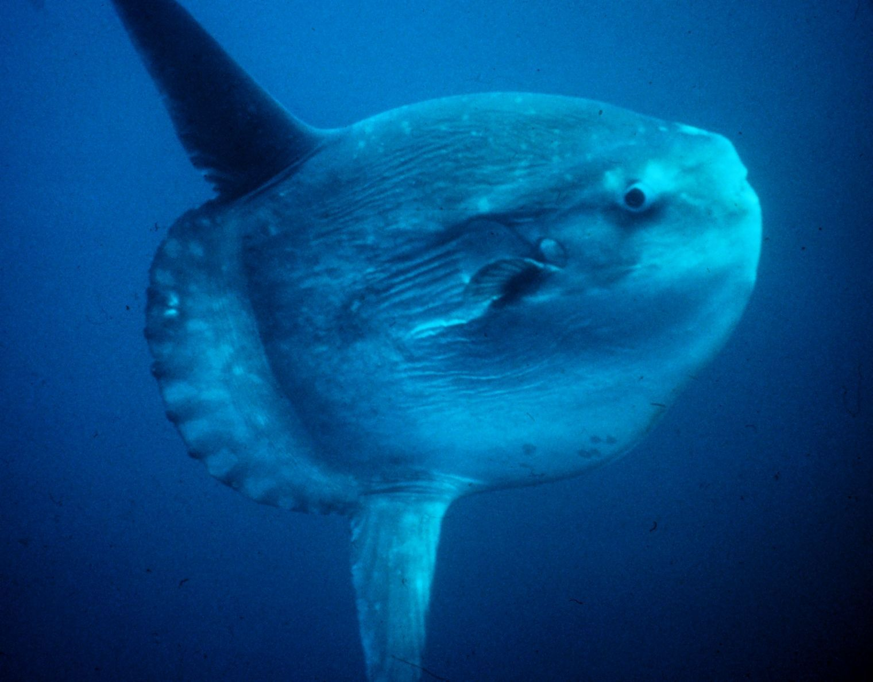
Sunfish Dataset
Time series: 1971 – 2008 (2016)
April – October
Count data, daily observations
Zero-inflated semicontinuos data (95.81% zeros)
Duration of observation, number of observers, sea state
External variables:
zooplankton, sst, jellies, phytoplankton, 13 degrees isoterm
Source: Wikimedia Commons

Slide 15
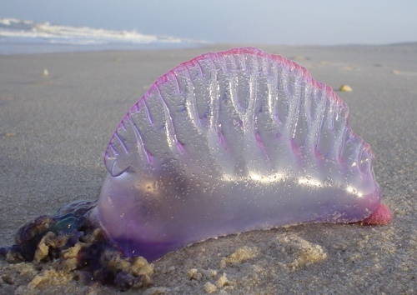
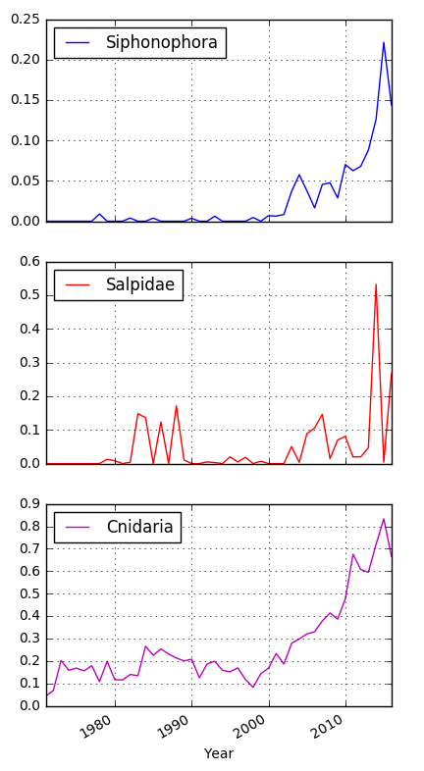
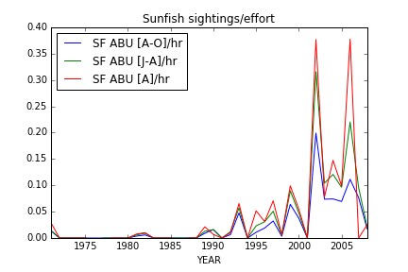
CPR
Source: Wikimedia Commons

Slide 16
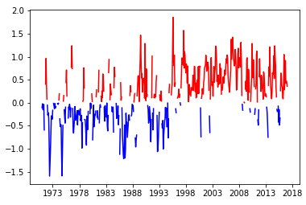
SST anomaly
Meaningful anomaly or
transient event?
Temperatures are higher
than average

Slide 17
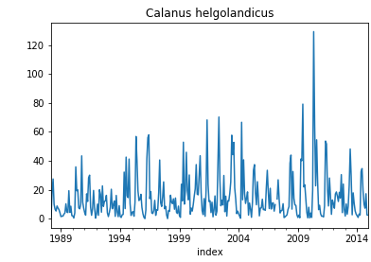
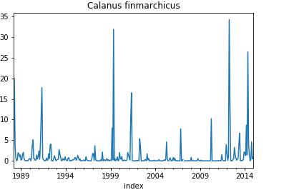
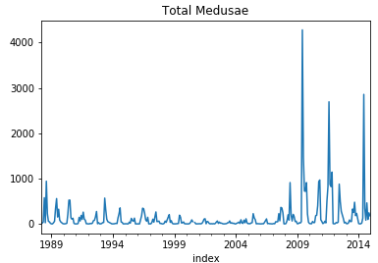
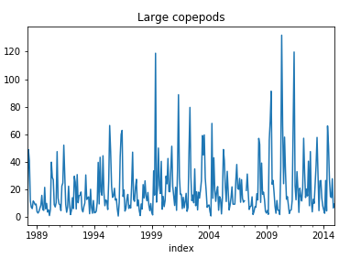
Time series of zooplankton

Slide 18
Methods for dealing with zero-inflated data:
Modelling the zero and non-zero data with one model and then modelling the truncated-at-zero data with another. This is often called a “hurdle model”;
Modelling the response variable as a mixture of a Bernoulli distribution (a point mass at zero) and a Poisson distribution (or any other count distribution supported on non-negative integers)

Slide 19
Hurdle model
Hurdle models treats the zeros and non-zeros as two separate processes;
Allow to model the zeros and non-zeros with different predictors or different roles of the same predictors

Slide 20
Hurdle model results (1):
Intercept only model:
Probability of non-zero value (logit model):
0.0418
Confidence intervals:
2.5 % 97.5 %
0.0355 0.0488
Mean of distribution (log link Gamma model):
0.0118
Confidence intervals:
2.5 % 97.5 %
0.0097 0.0147

Slide 21
Hurdle model results(2):
Full logit model:
Call:
glm(formula = non_zero ~ totzoo + sst + totmedus + xmonth + totsipho +
chel + lcop, family = binomial(link = logit), data = dat)
Coefficients:
Estimate Std. Error z value Pr(>|z|)
(Intercept) -1.372e+01 1.417e+00 -9.677 < 2e-16 ***
totzoo 4.131e-05 1.153e-05 3.582 0.000341 ***
sst 1.017e+00 1.173e-01 8.666 < 2e-16 ***
totmedus -1.833e-03 1.050e-03 -1.745 0.080950 .
xmonth -6.355e-01 1.510e-01 -4.209 2.56e-05 ***
totsipho -8.509e-04 2.969e-04 -2.865 0.004164 **
chel 1.821e-01 4.823e-02 3.774 0.000160 ***
lcop -1.756e-01 4.505e-02 -3.897 9.73e-05 ***
Full Gamma model:
Call:
glm(formula = nsunfishm ~ seastate + xmonth + chel + lcop, family = Gamma(link = log),
data = subset(dat, non_zero == 1))
Coefficients:
Estimate Std. Error t value Pr(>|t|)
(Intercept) -0.11028 1.06714 -0.103 0.9178
seastate -0.09432 0.05447 -1.732 0.0856 .
xmonth -0.56580 0.13659 -4.142 6e-05 ***
chel -0.15060 0.06509 -2.314 0.0222 *
lcop 0.13946 0.06084 2.292 0.0234 *
---

Slide 22
Hurdle model results(3):
Full model:
Probability of non-zero value (logit model):
1.104708e-06
Mean of distribution (log link Gamma model):
0.8956

Slide 23
Progress towards project objectives:
Further analyse sunfish sightings in relation to biological and environmental variables accounting for underlying trends;
Detect annual trends that are over and above seasonal fluctuations that we would expect;
Fit multispecies models to examine trends across species and detect potential step changes using state-space modelling

