Slide 1
Board Games
Giannakopoulos Panagiotis Lymperakis Vasilis

Slide 2
System components
Containers (or Services for Swarm mode)
Website
Authorization Service
Gamemaster
Playmaster
Apache Kafka
Apache Zookeeper
Mongo DB
MySQL DB

Slide 3
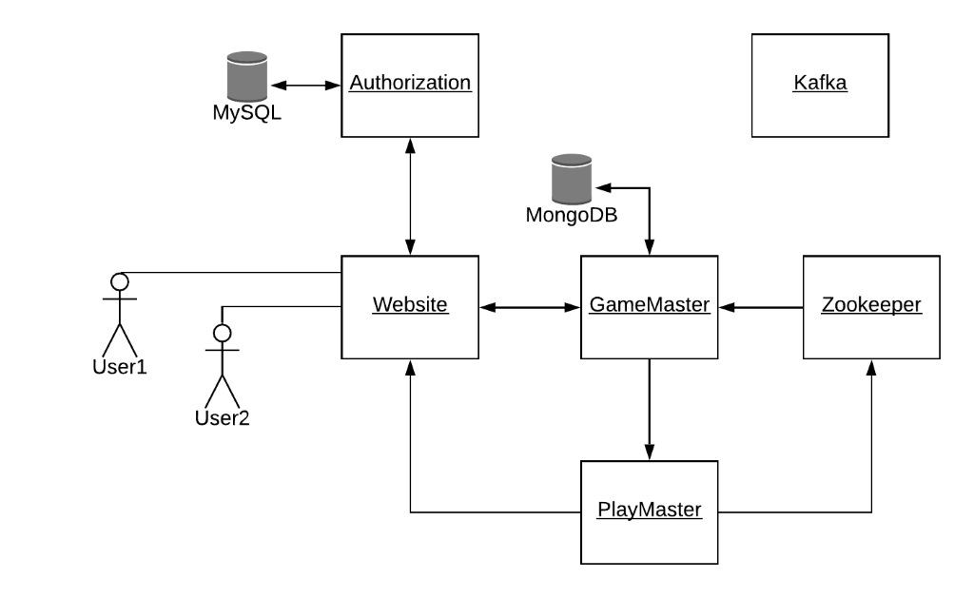
System architecture

Slide 4
Gamemaster Python
Zookeeper Client
Queue Handler
Score Handler
API Handler
Play Recovery

Slide 5
Gamemaster Queue Handler
Read from Kafka requests for plays.
Assign players in practice games.
Organize tournaments; assign pairs on every round.
Store to database games and tournaments in progress, and their players
Send spectator to watch a game upon request.

Slide 6
Gamemaster Score Handler
Read from Kafka game results.
Store practice games.
Store tournament games and check ties for reassignment, new rounds and if tournament is complete.
Store to database all of the above information.

Slide 7
Gamemaster API Handler
Handle users' requests to retrieve data from the database.
Games:
Get: For practice games, return individual plays for the user and the total score of other users. For tournament, returns all individual plays of everyone.
Spectator:
Get: all active games for game type
Tournaments:
Post: tournament creation
Get: all tournaments and players connected in it
Delete: a tournament

Slide 8
Gamemaster - Zookeeper Client
Connect
Connect to Zookeeper
Watch
Add a watch to the path 'games/playmaster'
Save to mongoDB the new list of playmasters.
Save

Slide 9
Gamemaster Play Recovery
Listen to port 9000 for client requests.
Check if the client is valid.
Retrieve the list of available Playmasters.
Re-assign the play.
Return the address of an available Playmaster to the client.

Slide 10
Playmaster Node JS
Zookeeper Client
Play Listener
Game Server

Slide 11
Playmaster Play Listener
Start a listener to port 8080 for POST requests.
Request 's body: {'roundID' : str, 'spectator': bool, 'players': array}
The players are added to an array for pending connections.

Slide 12
Playmaster - Zookeeper Client
Connect
Connect to Zookeeper
Znode
Create an ephemeral Znode under the path 'games/playmaster/hostname', where hostname is the container name.
Heartbeats
Send heartbeats to Zookeeper

Slide 13
Playmaster -Game Server (1/3)
Listen for WebSocket connection to port 90XX.
When everyone is connected, initiate the play.
Serve each play.
When a play is completed, send the score to Kafka topic 'scores'.
Score form: { 'roundID' : str, 'game' : str , 'winner' : str , 'players' : array }

Slide 14
Playmaster -Game Server (2/3)
Characteristics:
The server is stateless.
Arbitrary number of plays can be supported.
Arbitrary number of players can be supported for the game type.
Every game which implement the API is supported.

Slide 15
Playmaster Game Server (3/3)
Server-Side event handlers
Connect
Update
Disconnect
Client-Side event handlers
Wait
Init
Viewer
Board
Disconnect

Slide 16
Game Development React JS
The client gets the arguments from the url: Hostname, Playmaster’s port, Gamemaster’s port, user's token/username.
The play begins when the connection with Playmaster is established for all players → ‘init’ message is received.
When a move is made, the client sends ‘update’ message: { ‘roundID’: str , ‘board’ : array, ‘progress’: 0 (active) | 1 (winner) | 2 (tie) }.
The client receives the ‘board’ message with the updated board contents and other variables optionally.
If the Playmaster fails, the client sends an AJAX call to Gamemaster and then reconnects to a new Playmaster.

Slide 17
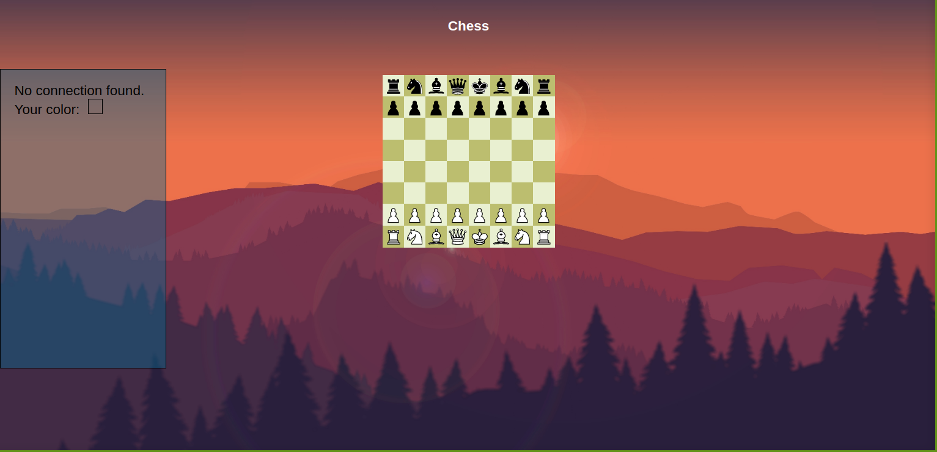
Chess Gameplay

Slide 18
Authorization Python/SQL
Initialization
Requests

Slide 19
Authorization Initialization
Initialize SQL Tables and Events:
Table users:
Contains username(PK), password, email and role
Table tokens:
Contains username(FK), token(PK) and creation date
Event token_expiration:
Checks for tokens more than a week old once a day and deletes them

Slide 20
Authorization Requests
Users:
Post: user creation on sign in; checks for master key and user authorization based on the role of the new user
Get: all user info except passwords; checks for user authorization
Put: update email and role; checks for user authorization
Validation:
Post: token creation on login; checks for master key
Get: check if token exists; checks for user authorization

Slide 21
Website PHP
Apache Server
Plays Receiver

Slide 22
Website Pages
Index: Login/Sign up
Portal: Game selection
Scores: View scores for practice/tournament games
Official’s Panel: Create tournaments
Admin’s Panel: Install games & edit users

Slide 23
Game Implementation
The game is built.
The files of the games are located under public/html/games.
The game characteristics (name & number of players) are saved in Gamemaster.
The steps to install a new game include:
Upload the files (in zip) to Website.
Update the DB of Gamemaster.

Slide 24
Game play workflow
The user selects a game from the list.
An option is selected: Practice/Tournament/Spectate.
The Website produce a record to Kafka topic ‘input’.
The user is redirected to the loading page.
The 'Plays Receiver' process consumes records from the Kafka topic ‘output’ and updates the user session.
The user is redirected to the game board and the play begins.
When the play is over, the game is redirected to portal or to the loading screen if there is a next round.

Slide 25
Demos
Sign up & Login: here
Practice Play: here
Tournament Play: here
Spectator Mode: here
Fault tolerance: here

Slide 26
Thank you

