Slide 1
Convergent Haplotype Association Tagging (CHAT)
Yuan Lin
Post-doc Research Associate
@ Dr. Kirk Wilhelmsen’s Lab
Department of Genetics, School of Medicine
UNC at Chapel Hill

Slide 2
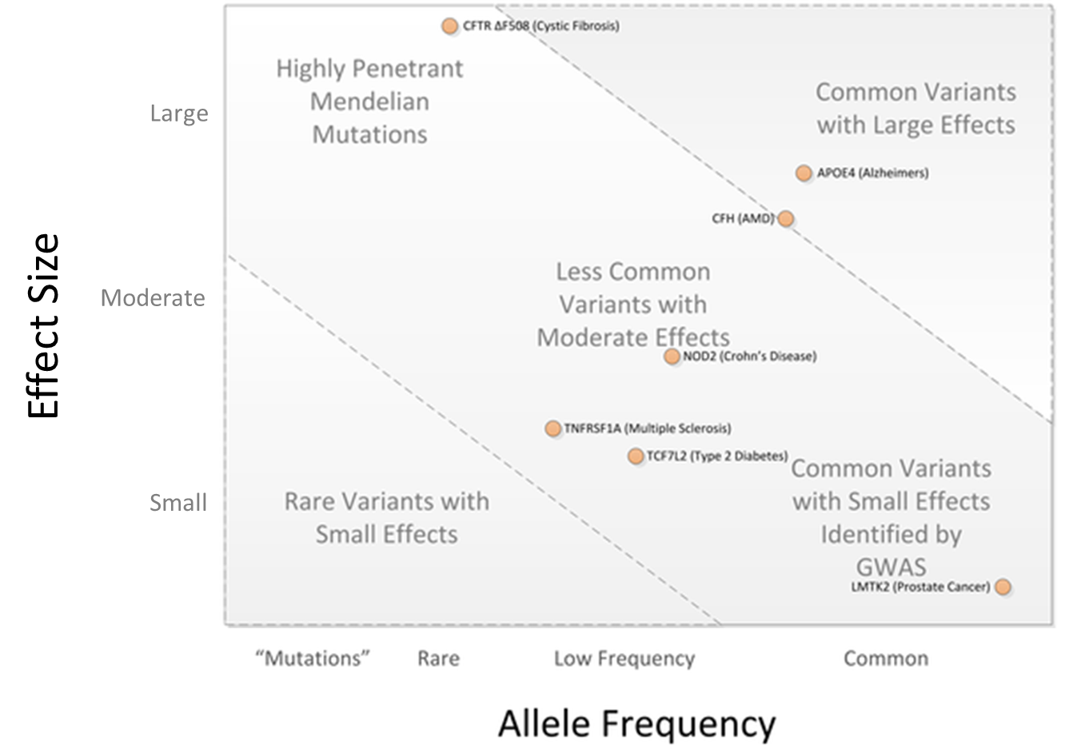

Targets: rare variants with moderate effects
Modified from Figure 1 in Bush WS, Moore JH (2012) Chapter 11: Genome-Wide Association Studies. PLoS Comput Biol 8(12)
Notes:
Let me start by describing the potential target of CHAT. CHAT is designed to capture disease causal variants that are rare and have moderate effect. These variants fall in a blind spot between GWAS and linkage analysis.
As you can see in this figure, most GWAS findings are associations of common SNPs with small effect sizes, like those in the lower right. Linkage analysis has been very successful at detecting variants with a large effect size, which often are rare in the population. They locate at the upper left
Here are the potential targets of CHAT. These variants are not common enough in population to be detected by a standard GWAS procedure. Neither do they do not have sufficient effect to be identified by linkage analysis. A more specific example would be disease causal variants that show allelic or locus heterogeneity. Distinct rare variants (within one or more loci) each explaining most of the risk in just a handful of people.
It has also been proposed that hundreds of rare monogenic subphenotypes may exist for each common disease and that GWAS signals may actually represent ‘synthetic’ associations caused by rare causal mutations segregating on the background of common haplotypes.

Slide 3
Association tagging using IBD segments
IBD segments are chromosomal segments that share identical haplotypes because they are inherited from the same ancestor without disrupted by recombination
We can test the association between a set of individuals’ phenotype similarity and their co-inheritance of certain IBD segments
Each segment tags genetic variants within that segment, including potential disease causal variants
Notes:
A group of methods have been developed to find such variants. To understand how they work, let’s first talk about the idea of tagging disease causal variants with IBD segments in association tests
IBD segments are chromosomal segments that one inherits from ancestors without recombination. If multiple individuals inherit the same IBD segment from a common ancestor, then they inherit all genetic variants within that segment without disruption.
Given a set of subjects, we can test the association between these individuals’ phenotypic similarity and their inheritance of certain IBD segments, with each IBD segment sort of tagging all genetic variants within that segment

Slide 4
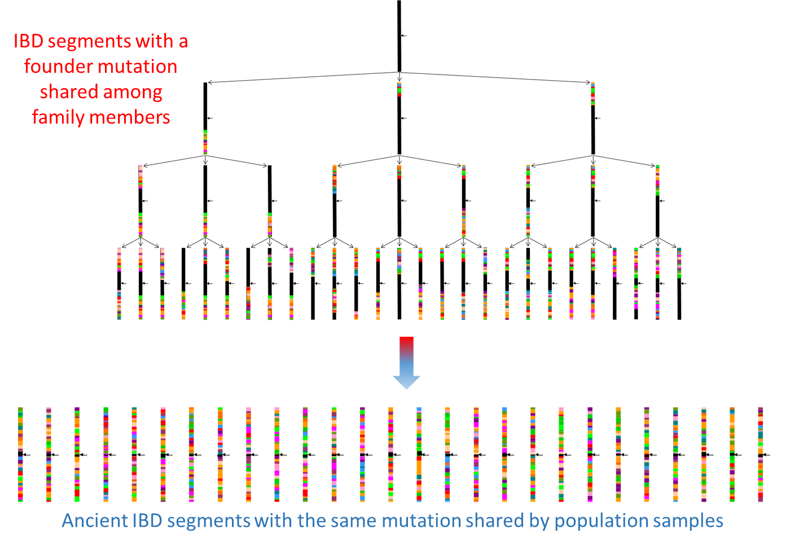
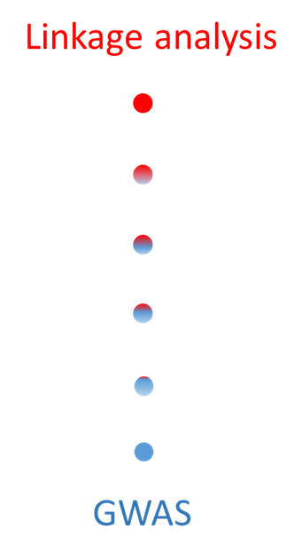
Linkage analysis and GWAS represent two extremes
Notes:
Closely related individuals such as family members share very long IBD segments due to limited numbers of recombination. Then over generations, inherited segments are interrupted by more recombination (and a few mutations) and the intact part gets shorter and shorter. According to population genetics theory all individuals have common ancestry in the distant past, we all have some very short, old IBD segments from this ancestor.
In this regard, GWAS and linkage analysis are two extreme cases of IBD-segment-based association tagging. On the one hand, we have linkage analysis that utilizes long IBD segments inherited by family members to map recent disease causal mutations that are rare in general populations. On the other hand, GWAS relies upon LD structure which reflects ancient IBD to map long-existing common risk variants. (Sort of. Often time only one representative SNP is selected per block in order to reduce the number of multiple tests). If complete genealogy information was available, association analysis could be recast as linkage analysis

Slide 5
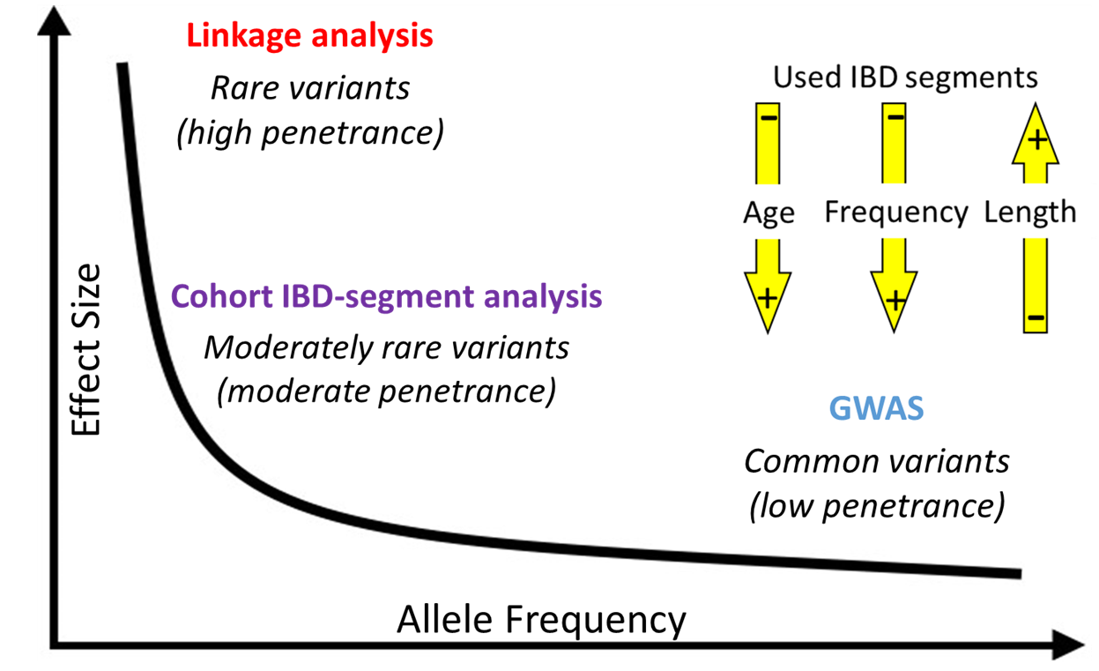
Cohort IBD-segment analysis represents the middle way
Detect IBD sharing in unrelated population samples
Distinguish from IBS sharing – sharing due to pure chance or strong LD in adjacent SNPs
Notes:
Now that makes you wonder, if our target are disease causal variants that are moderate in both frequency and effect size, can we tag them using “moderate” IBD segments, i.e., IBD segments with moderate length, age, and rarity. And another related question is how do we find such IBD segments?
As I mentioned earlier, a group of methods have been developed for this purpose. We refer to them as cohort IBD-segment analysis. The basic idea is to find such segments by detecting IBD sharing in population samples, while distinguishing sharing due to IBD from sharing due to pure chance or strong LD, aka IBS sharing
CHAT is a cohort IBD-segment analysis method.

Slide 6
Promising results yet not many applications
Compared to standard GWAS, cohort IBD-segment analysis
Show more power in mapping genomic regions containing multiple rare disease susceptibility variants (Browning & Thompson, 2012)
Find genome-wide significant regions missed by the former in both isolated and outbred populations (Gusev et al., 2011ab)
Previous applications in mapping causal variants for various diseases
schizophrenia, multiple sclerosis, Parkinson’s disease, Crohn's disease, several types of cancer, and diastolic blood pressure (References omitted due to space limit)
the most recent paper published last year (Liu et al., 2016)
Notes:
This is a brief summary of previous studies that apply cohort IBD-segment analysis on simulated or real datasets. The results show promise but there are not many applications
Browning, S. R.; Thompson, E. A. (2012). "Detecting Rare Variant Associations by Identity-by-Descent Mapping in Case-Control Studies". Genetics. 190 (4): 1521–1531.
Gusev, A.; Shah, M. J.; Kenny, E. E.; Ramachandran, A.; Lowe, J. K.; Salit, J.; Lee, C. C.; Levandowsky, E. C.; Weaver, T. N.; Doan, Q. C.; Peckham, H. E.; McLaughlin, S. F.; Lyons, M. R.; Sheth, V. N.; Stoffel, M.; De La Vega, F. M.; Friedman, J. M.; Breslow, J. L.; Pe'Er, I. (2011). "Low-Pass Genome-Wide Sequencing and Variant Inference Using Identity-by-Descent in an Isolated Human Population". Genetics. 190 (2): 679–689.
Gusev, A.; Kenny, E. E.; Lowe, J. K.; Salit, J.; Saxena, R.; Kathiresan, S.; Altshuler, D. M.; Friedman, J. M.; Breslow, J. L.; Pe'Er, I. (2011). "DASH: A Method for Identical-by-Descent Haplotype Mapping Uncovers Association with Recent Variation". The American Journal of Human Genetics. 88 (6): 706–717.
Houwen, R. H. J.; Baharloo, S.; Blankenship, K.; Raeymaekers, P.; Juyn, J.; Sandkuijl, L. A.; Freimer, N. B. (1994). "Genome screening by searching for shared segments: Mapping a gene for benign recurrent intrahepatic cholestasis". Nature Genetics. 8 (4): 380–386.
Kenny, E. E.; Gusev, A.; Riegel, K.; Lutjohann, D.; Lowe, J. K.; Salit, J.; Maller, J. B.; Stoffel, M.; Daly, M. J.; Altshuler, D. M.; Friedman, J. M.; Breslow, J. L.; Pe'Er, I.; Sehayek, E. (2009). "Systematic haplotype analysis resolves a complex plasma plant sterol locus on the Micronesian Island of Kosrae". Proceedings of the National Academy of Sciences. 106 (33): 13886–13891.
Francks, C.; Tozzi, F.; Farmer, A.; Vincent, J. B.; Rujescu, D.; St Clair, D.; Muglia, P. (2008). "Population-based linkage analysis of schizophrenia and bipolar case–control cohorts identifies a potential susceptibility locus on 19q13". Molecular Psychiatry. 15 (3): 319–325.
Lin, R.; Charlesworth, J.; Stankovich, J.; Perreau, V. M.; Brown, M. A.; Anzgene, B. V.; Taylor, B. V. (2013). Toland, Amanda Ewart, ed. "Identity-by-Descent Mapping to Detect Rare Variants Conferring Susceptibility to Multiple Sclerosis". PLoS ONE. 8 (3): e56379.
Letouzé, E.; Sow, A.; Petel, F.; Rosati, R.; Figueiredo, B. C.; Burnichon, N.; Gimenez-Roqueplo, A. P.; Lalli, E.; De Reyniès, A. L. (2012). Mailund, Thomas, ed. "Identity by Descent Mapping of Founder Mutations in Cancer Using High-Resolution Tumor SNP Data". PLoS ONE. 7 (5): e35897.
Liu, Xiao-Qing, et al. "Identity-by-descent mapping for diastolic blood pressure in unrelated Mexican Americans." BMC proceedings. Vol. 10. No. 7. BioMed Central, 2016.
Zhang, W., et al.,. Extended haplotype association study in Crohn's disease identifies a novel, Ashkenazi Jewish-specific missense mutation in the NF-kappaB pathway gene, HEATR3. Genes Immun 14, 310-316, PMC3785105 (2013).

Slide 7
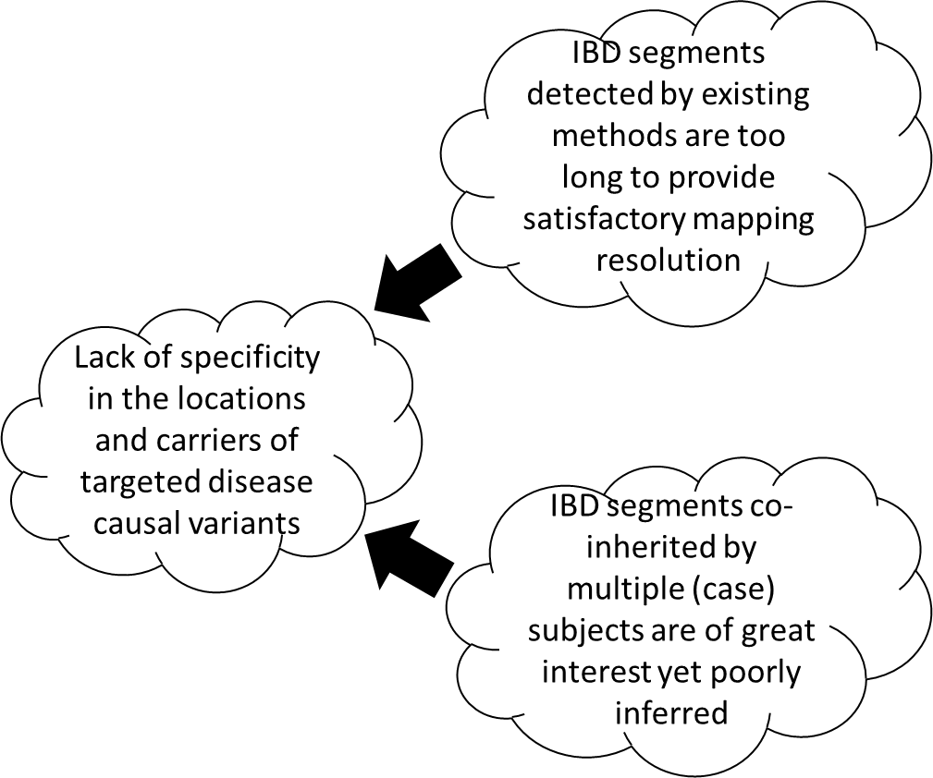
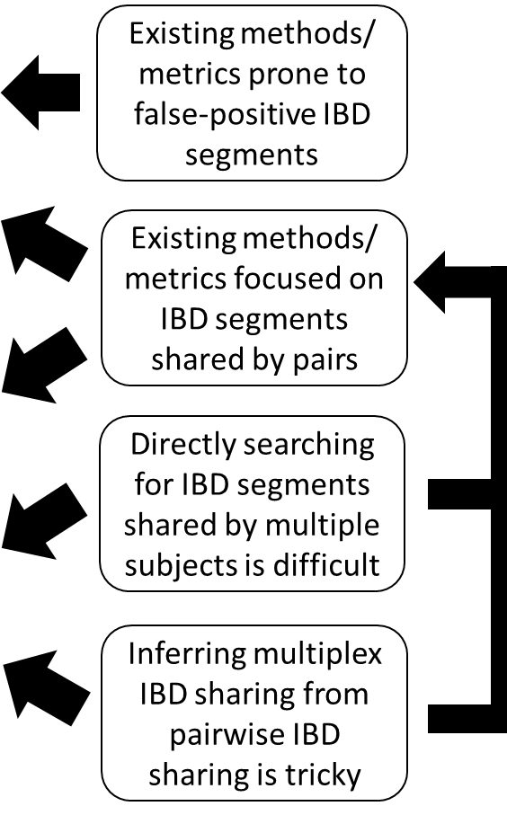
Methodological limitations may have impeded the usage
Notes:
By using cohort IBD segment analysis, our ultimate goal is to localize disease causal variants and identify their carriers. Now we believe the usage of this approach is affected by its existing problems. There are two major ones.
First of all, IBD segments detected using current methods are still quite long. They range from 0.3-2 cM within a 95% confidence interval.
Secondly, IBD segments detected using current methods are mostly about sharing between two subjects. We are more interested in finding IBD segments shared by a group of cases. Dig deeper into these issues. It turns out some limitations in existing methods may have caused these two problems. I will elaborate.

Slide 8
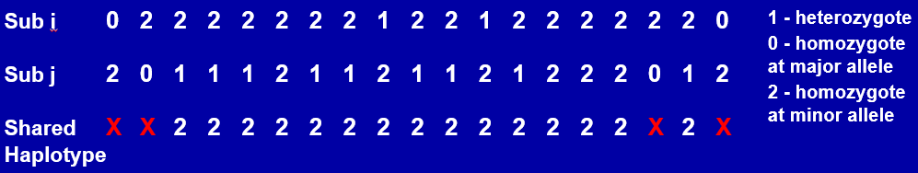
Existing methods prone to false long IBD segments
Use length of (potential) haplotype sharing (or its variants) as the major (if not only) statistic to detect IBD segments
Evaluate potential haplotype sharing via genotype compatibility
Allow for (a small number of) incompatible genotypes
Compatibility based haplotype sharing test claims mismatch only when the genotypes are homozygotes at opposite alleles
Notes:
First of all, it turns out that some long IBD segments detected by existing methods are actually false positives.
Cohort IBD-segment analysis finds IBD segments in population samples by distinguishing IBD sharing from IBS sharing. This is usually done statistically since we don’t have pedigree information for population data. An often used statistic is the length of sharing or its variants. The idea is that IBS sharing tends to be short, at least not beyond an LD block. It is very unlikely that many adjacent SNPs would happen to share the same haplotypes. Therefore, the length of sharing is a sensitive measure. Also, it is easy to check.
When existing methods evaluate the significance of sharing, they mostly do that at the genotype level and following a rule of genotype compatibility, which, as illustrate in this toy example, claims mismatch only when two genotypes are homozygotes at opposite alleles. In addition, existing methods often allow for a small number of mismatches, assuming they are caused by genotyping errors. By doing so, existing methods can handle unphased data and reduce possible false negatives due to phasing or genotyping errors. However, as a side effect, existing methods become prone to false positive errors. An extreme case would be when a subject that is heterozygous for many adjacent markers could appear to share a haplotype with every other subject.

Slide 9

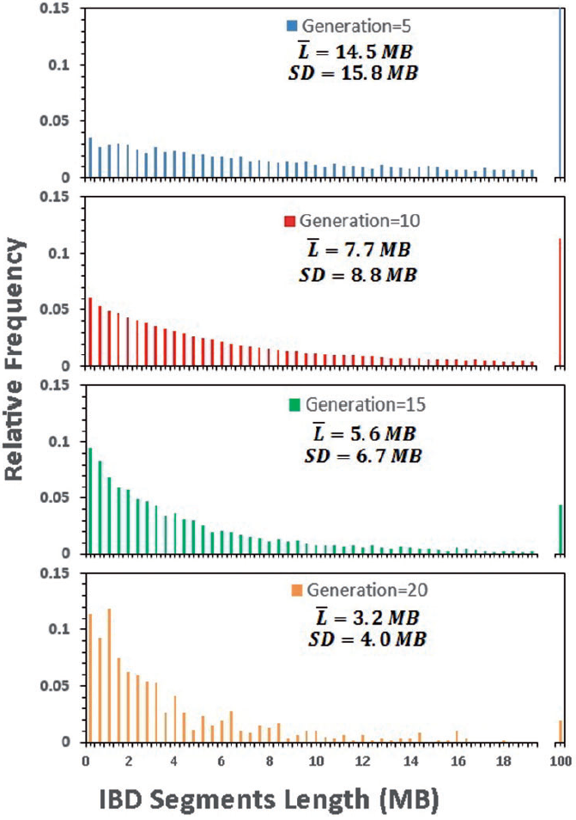
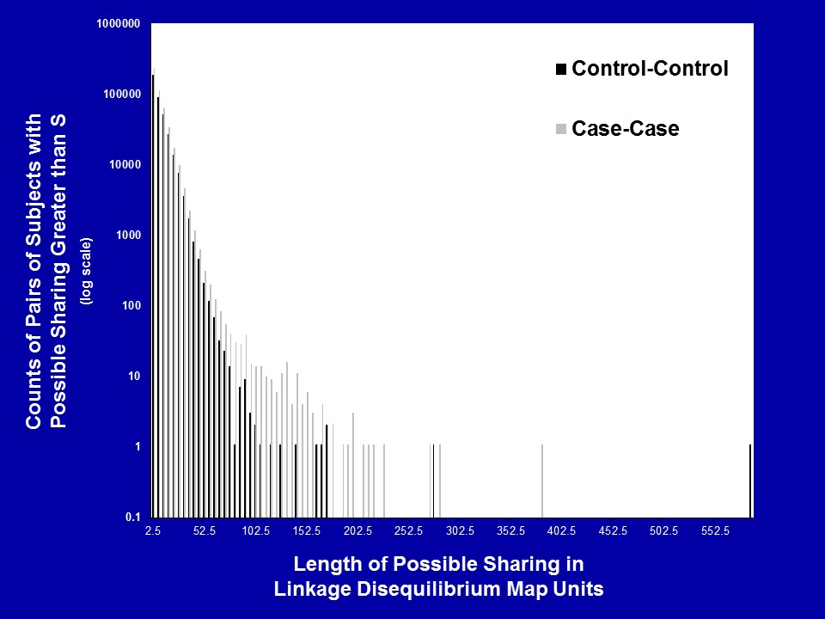
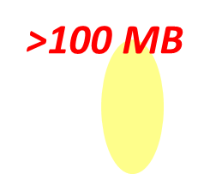

Existing methods focus on pairwise IBD segments which can be relatively long
Notes:
Now when the results are correct. As mentioned, existing methods focuses on detecting IBD segments shared by pairs of subjects. Pairwise IBD segments sometimes can be very long.
Left: copy from a simulation study published in 2016. It shows that individuals from geographically close areas can share very long IBD segments (as long as 100MB) transmitted from their common ancestors as far as 20 generations ago. The rightmost bar in each of these figures indicate such IBD segments. You can see even though their numbers reduce significantly over generations, many of them survived after 20 generations of recombination. (reason: Real human populations have limited sizes and have frequently experienced admixtures)
Right: a similar figure we drew using our own real data, a Parkinson’s Disease Cohort of 600+ AZ Jews samples. You can see on the rightmost side there is a bump indicating the sharing of very long IBD segments.
Left: copied from Figure 3 in Fedorova, Larisa, et al. "Atlas of Cryptic Genetic Relatedness Among 1000 Human Genomes." Genome biology and evolution 8.3 (2016): 777-790.
(animation/show) A recent study (Fedorova et al., 2016) simulated the inheritance of IBD autosomal segments from an initial person (primogenitor) along a chain of his/her descendants in multiple successive generations. They used real distribution of meiotic recombination sites along the human genome. The simulation program was repeated independently 500,000 times. The distribution of average length of simulated IBD segments at 5th, 10th, 15th, and 20th generations is shown in this figure. Number of IBD segments within particular ranges of lengths was calculated for 0.4Mb bins. The last bin represents the number of segments with length >10 Mb.
Right: a figure drawn using our own dataset, a Parkinson’s Disease Cohort of 600+ subjects collected from the AZ Jews community in New York city. The figure shows a histogram of the frequency of potential shared haplotype lengths (in LDU Map units) centered on a point near LRRK2 rare causal G2019S variant, where we know true IBD VLSH exist.

Slide 10
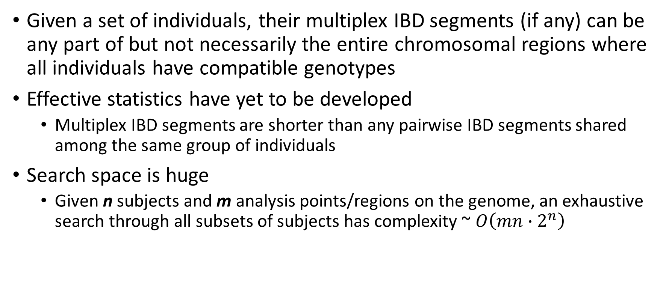
Directly searching for multiplex IBD sharing is challenging
Given a set of individuals, their multiplex IBD segments (if any) can be any part of but not necessarily the entire chromosomal regions where all individuals have compatible genotypes
Effective statistics have yet to be developed
Multiplex IBD segments are shorter than any pairwise IBD segments shared among the same group of individuals
Search space is huge
Given n subjects and m analysis points/regions on the genome, an exhaustive search through all subsets of subjects has complexity ~ $O\left(mn∙2^{n}\right)$
Notes:
For convenience, from now on I will use pairwise and multiplex to respectively describe IBD segments shared by two and more than two individuals.
Any part of it can due to IBS not IBD
Statistics that can effectively distinguish multiplex IBD sharing from IBS sharing based on genotypes have not yet been developed
Notably, multiplex IBD segments are shorter than any pairwise IBD segments shared among the same group of individuals. This is another reason that we are interested in detecting multiplex IBD segments. We expect them to give us a higher mapping resolution than pairwise IBD segments. However, that means multiplex IBD segments would be even harder to find if we keep using the length of sharing as major statistic.
There is another issue.

Slide 11
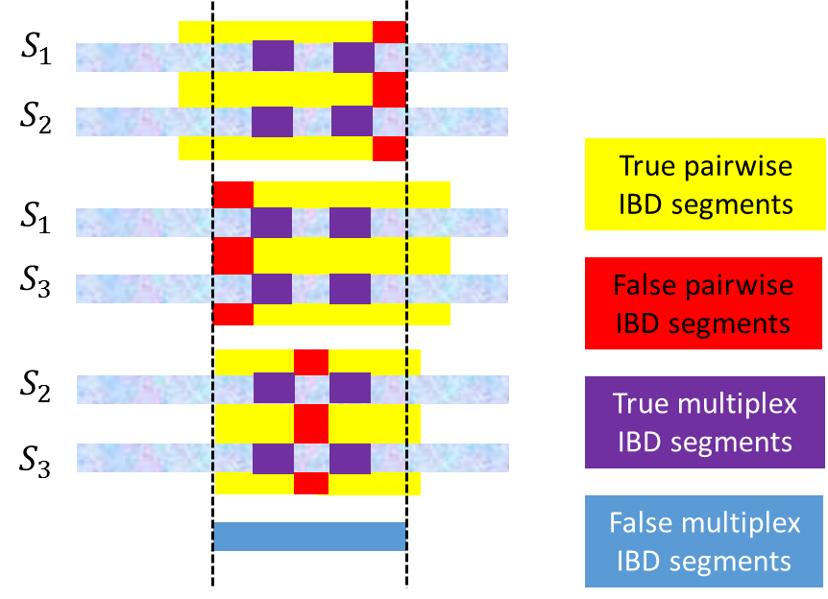
Inferring multiplex IBD sharing from pairwise sharing is tricky
Transitivity of IBD relation: if chromosome segments A and B are true IBD and B and C are true IBD at the same point j then A and C must be IBD at point j too.
IBD transitivity allows us to infer multiplex IBD segments from the overlapping region of (some, not necessarily all) pairwise IBD segments
Notes:
OK. So that does not work. Could we somehow utilize pairwise IBD detection results? That should reduce the search space right?
Yes! That’s actually a very good idea. You see that IBD relation has a very nice property called transitivity, which states that…
However, such an elegant and straightforward inference only happens when all pairwise IBD segments are true.
As mentioned, existing pairwise IBD detection methods are prone to false positive errors and they can lead to mistakes in inferring multiplex IBD segments.
Let me show you an example.
Suppose we have the genotypes of three subjects S1, S2, and S3 and we have detected pairwise IBD segments between any two of them. The yellow color indicates true pairwise IBD, while the red color indicates false pairwise IBD. The reported IBD segments contain both parts. The overlaps of true pairwise IBD segments are colored purple and these are true multiplex IBD segments. The blue color indicates the overlap of reported pairwise IBD segments and it contains false positive sites.

Slide 12
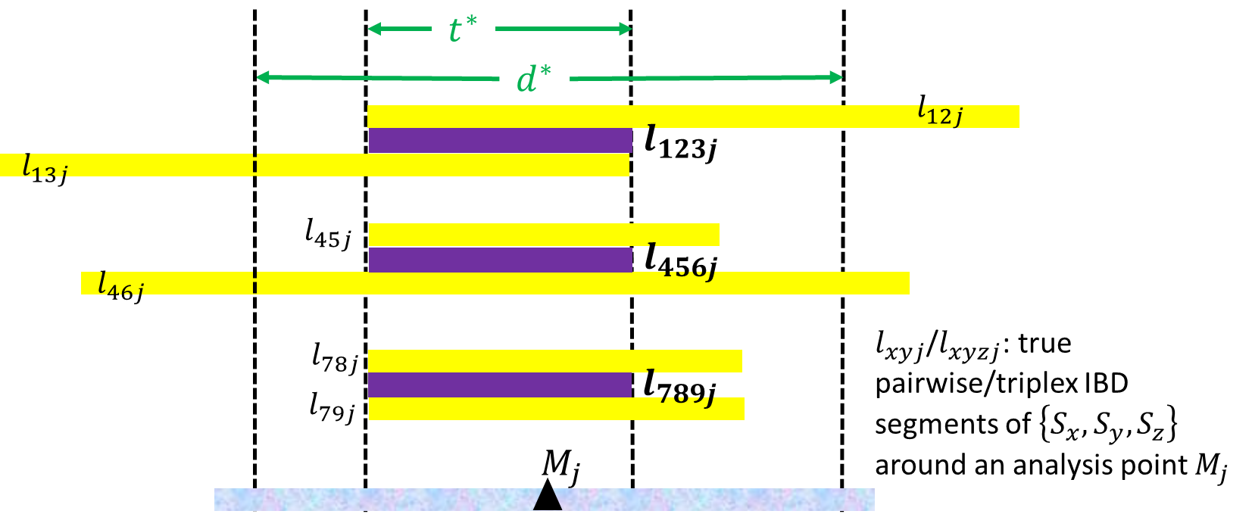

Inferring multiplex IBD sharing from pairwise IBD sharing is tricky
To prevent false-negative errors in triplex IBD detection, we may need to use loose inclusion criteria for pairwise IBD segments
Notes:
Besides false positive errors, there could be false negative errors too, as I’m gonna show you in this example.
Suppose we use the length of sharing to distinguish IBD segments from IBS segments, as many existing methods do. Let’s say the threshold for claiming pairwise and triplex IBD segments are d* and t* respectively around an analysis point j
In addition, we have three groups of subjects {$S_{1},S_{2}$, $S_{3}$}, {$S_{4},S_{5}$, $S_{6}$}, and {$S_{7},S_{8}$, $S_{9}$} and their detected pairwise IBD segments $l_{xyj}$. Suppose these are all true pairwise IBD segments, so their overlaps are true triplex IBD.
Now, using d*, $l_{45j}$ , $l_{78j}$, and $l_{79j}$ would be false negatives in pairwise detection. Then, if we infer triplex IBD segments from the overlap of pairwise IBD segments, only $l_{123j}$ will be found. If we do a complete search using t*, $l_{789j}$ and $l_{456j}$ will also be found.
Note: Raw LSHs are inferred at each marker, so even though they are significantly long locally, they may not be long enough (early version of CHAT will merge raw LSHs shared by the same pair of subjects across the genome to get even longer potential IBD segments in the next step)

Slide 13
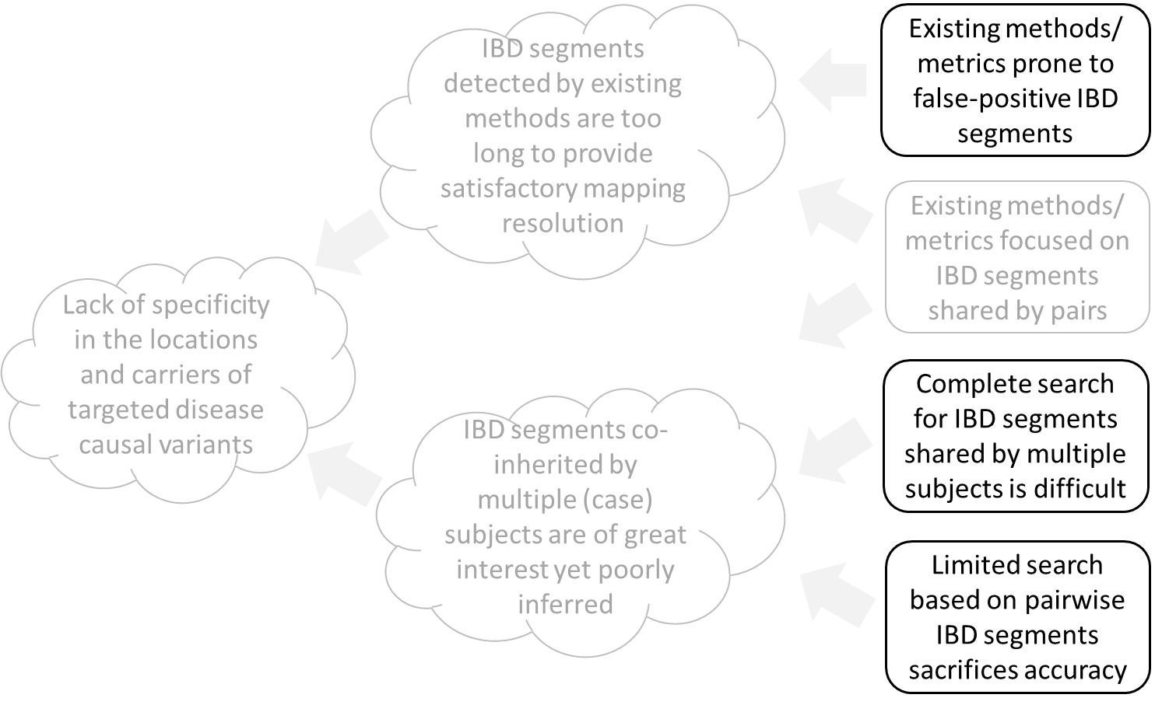
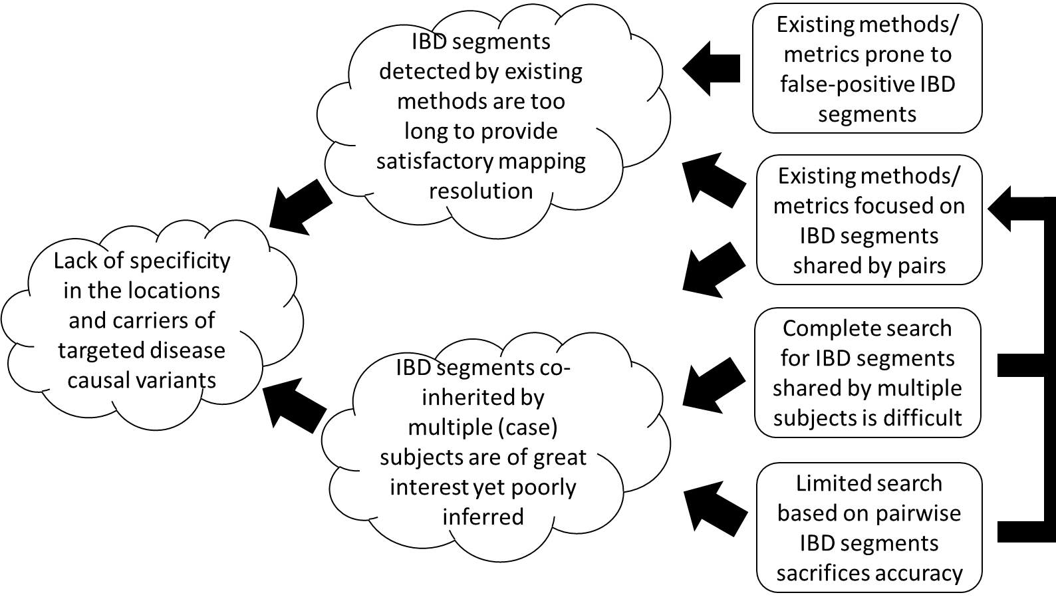
Major problems and our solutions
We need to detect multiplex IBD segments and we need better statistics and better searching strategy for that
Notes:
Since these three are the major problems, we believe the future direction for cohort IBD-segment analysis would be to develop methods that can...In order to be effective and efficient, multiplex detection methods need…
In CHAT, we use a statistic that allows us to evaluate IBD sharing among three subjects based on their genotypes with high specificity. Then we use a graph-theory-based rule to extend significant trios and infer IBD sharing among more subjects (by combining significant trios that have at least two overlapping members).
Now, let’s CHAT

Slide 14
CHAT (Convergent Haplotype Association Tagging )
CHAT targets at rare variants with moderate effects that neither GWAS nor linkage analysis can effectively find
CHAT relies on detecting short IBD segments shared by small (but significant) subsets of population samples to tag these variants
Our statistic detects IBD sharing among three subjects (trios) based on their genotypes with high specificity.
Our strategy for continuously searching subsets of individuals (larger than trios) that are plausibly IBD utilizes graph theory and is relatively efficient
Notes:
Let’s chat
Based on their genotypes (no prephasing or imputation is needed)

Slide 15
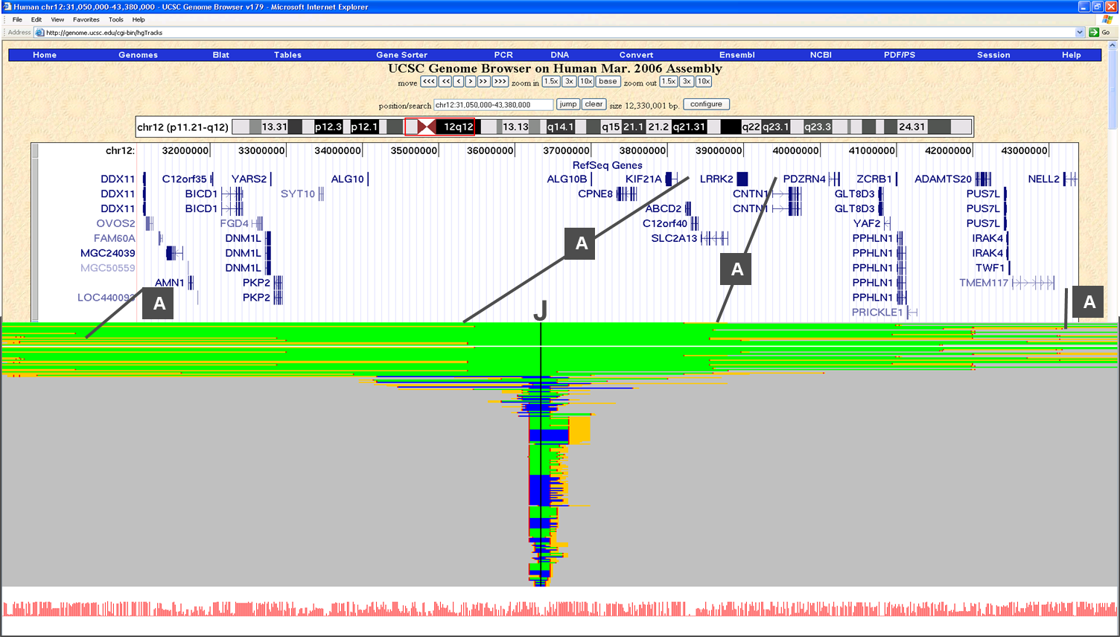
Notes:
Figure 3 shows how the breakdown of haplotype sharing can be used to refine the support interval of a known locus.
This two-part figure show the results of applying an early version of CHAT. The upper part is a screen capture of the UCSC genome browser for the region of LRRK2 mutation around a predefined analysis point J. This region is known to harbor rare causal variants for Parkinson’s disease. Earlier I show you a plot drawn from a GWAS data set of 600+ AZ samples. We ran an early version of CHAT on the same dataset to compare the genotypes of subjects. The results for the lrrk2 region shown in the upper half are presented in the lower half of this figure. Black lines (labeled A) indicate relative positions between the two parts. The lower part contains horizontal lines each representing the genotypes of a subject. Cases and controls are colored green and blue respectively. These two colors are shown wherever the genotypes in that region are compatible with the consensus haplotype. Gold lines indicate the regions where there are significant deviations from the consensus. Grey regions indicate no similarity with the consensus.

Slide 16
CHAT (Convergent Haplotype Association Tagging )
CHAT targets at rare variants with moderate effects that neither GWAS nor linkage analysis can effectively find
CHAT relies on detecting short IBD segments shared by small (but significant) subsets of population samples to tag these variants
Our statistic detects IBD sharing among three subjects (trios) based on their genotypes with high specificity.
Our strategy for continuously searching subsets of individuals (larger than trios) that are plausibly IBD utilizes graph theory and is relatively efficient
Notes:
Based on their genotypes (no prephasing or imputation is needed)

Slide 17
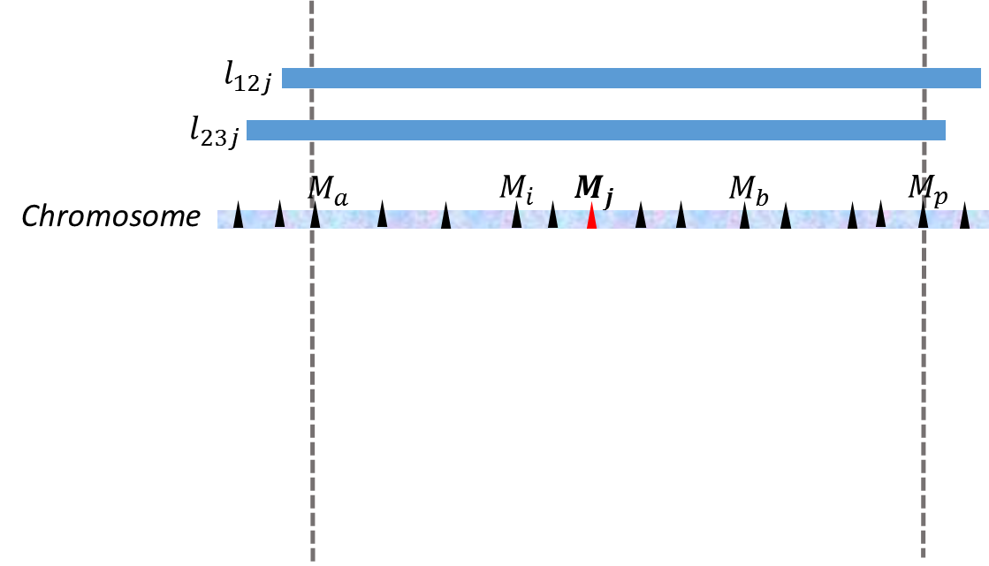
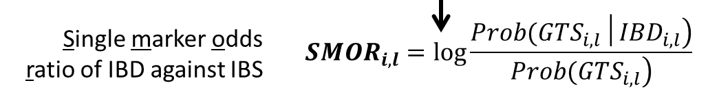
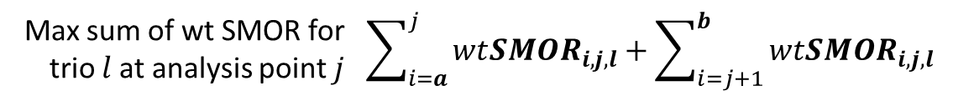
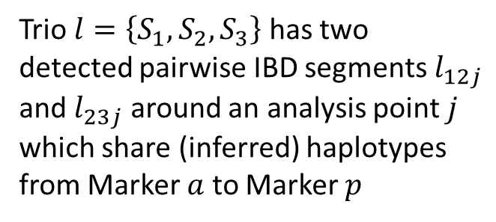

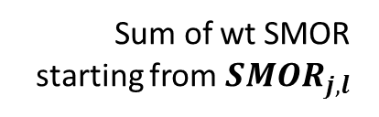
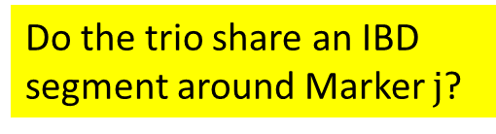

Our statistic for trio IBD sharing: maxSumWtSMOR
Trio $l=\left\{S_{1},S_{2},S_{3}\right\}$ has two detected pairwise IBD segments$l_{12j}$ and $l_{23j}$ around an analysis point $j$ which share (inferred) haplotypes from Marker $a$ to Marker $p$
Sum of wt SMOR starting from ${SMOR}_{j,l}$
LD blocks
Do the trio share an IBD segment around Marker $j$?
Pre-calculated SMOR scores
We first created a database to get all possible actual genotype combinations given three identical observed genotypes, assuming they or IBD or IBS
We then calculated a series of SMOR scores using these combinations and a range of allele frequencies and genotyping error rates
Closet value
Weighted SMOR
$${f(LD\left(i,\left[i−w, i+w\right]\right))∙SMOR}_{i,l}$$
($f≤1$)
Notes:
The first thing I want to show you is our statistic
Suppose a trio $l=\left\{S_{1},S_{2},S_{3}\right\}$ has two detected pairwise IBD segments$l_{12j}$ and $l_{23j}$ around an analysis point $j$. We observe potential haplotype sharing between $l_{12j}$ and $l_{23j}$ from Marker $a$ to Marker $p$. Our goal is to decide whether this sharing indicates an IBD segment shared by all three subjects.
The first component of this statistic is the SMOR, which stands for Single marker odds ratio. It is a log likelihood ratio of IBD against IBS given three subjects’ genotypes at a single marker. In this figure, I show you the SMOR formula for Marker i. For computational efficiency, we pre-calculated SMOR scores for any genotype combinations of 3 subjects, given a vast range of allele frequencies and several estimated genotyping error rates and stored these values in a look-up table. Thus for a specific marker, instead of calculating SMOR on the fly, CHAT will choose the closet value from the look-up table based on the observed genotype and allele frequency of that marker.
The SMOR value will then be weighted based on that marker’s LD with nearby markers. Basically, given a set of adjacent markers in strong LD, we want to weight down each marker’s SMOR score proportionally to reflect their independent contributions. We currently use a very crude strategy. We expect Dr. Li and you guys can give us some advice on how to improve it. So given a data set, CHAT first estimates pairwise LD r2 from genotypes and use the information to calculate the weight for each marker once for all. The weight for a marker is set to be the inverse of the sum of LD r2 between that marker and nearby markers falling in a window. Currently the window size is set to 5.
Then we sum up weighted SMOR in this region starting from the central analysis point j and find out the optimal boundaries on both sides that maximize this sum. In this figure, Markers a and b. This maximum sum is the final score for the region under analysis.

Slide 18
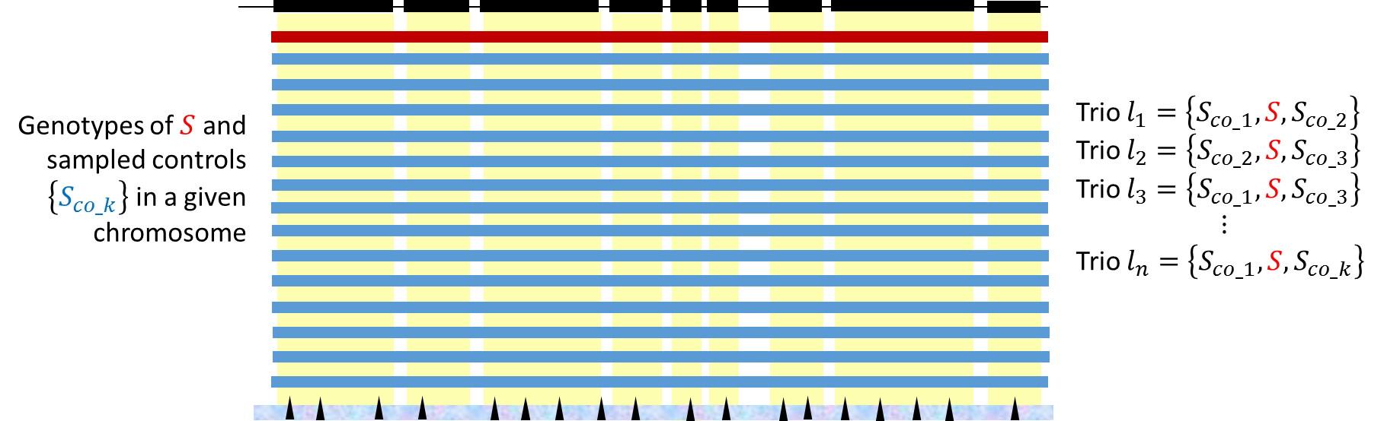
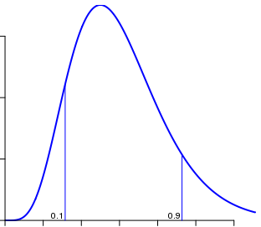
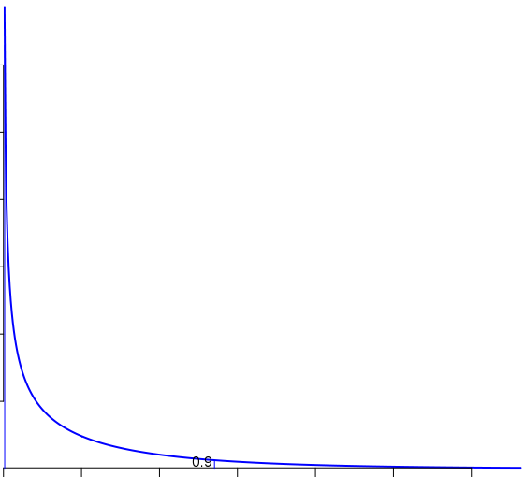
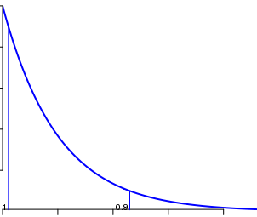
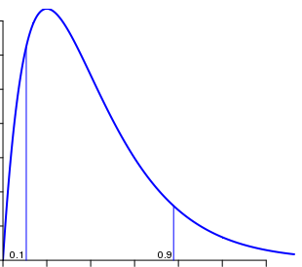
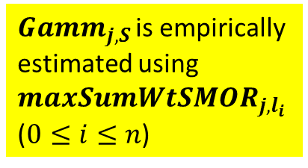
Estimate region and subject-specific null distributions
${Gamm}_{j,S }$is empirically estimated using ${maxSumWtSMOR}_{j,l_{i}}$ ($0≤i≤n$)
Notes:
We estimate the null distributions of our statistic for every subject at every analysis point.
Given a subject S, we first sample a predefined number of controls pairs, i.e., subject pairs from control cohort (with replacement). Each control pair then form a trio with Subject S. So we get a number of trios all involving Subject S, as shown here. Then for each analysis point j, we calculate the maxSumwtSMOR for every trio assuming S shares pairwise IBD segments around that analysis point with both control subjects in the trio. Next, we fit one Gamma distribution per analysis point using all relevant maxSumwtSMOR scores we’ve got.
The data required to fit these distributions are collected in parallel to reduce runtime. We save the parameters for each fitted null distribution for future calculation of thresholds
Admittedly, we are still learning about the distribution of our statistic. We plotted out the data and it looked like a gamma.
The distribution for maxSumWtSMOR_{j,k} for randomly selected controls typically looks like a gamma distribution except there typically is an upward inflection of the frequency of high maxSumWtSMOR_{j,k,l} values when viewed on a semi-log plot (See Fig 5). This observed inflection occurs because the distribution is actually the sum of two distributions, the null distribution and the distribution of sets of k subjects that are all pairwise IBD, which have higher maxSumWtSMOR_{j,k,l} values. We have found that fitting maxSumWtSMOR_{j,k,l} values of the randomly selected sets of k controls to a gamma distribution produces parameters that are essentially unaffected by the small fraction of scores for sets of subjects that are all pairwise IBD.

Slide 19
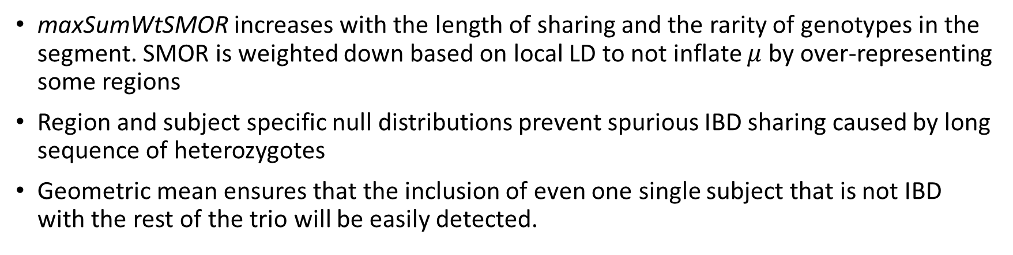
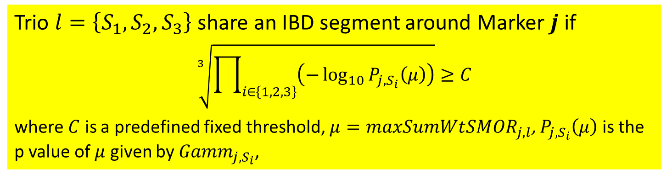
Evaluate the significance of trio IBD sharing
Trio $l=\left\{S_{1},S_{2},S_{3}\right\}$ share an IBD segment around Marker 𝒋 if
$$\sqrt[3]{\prod_{i∈\left\{1,2,3\right\}}{\left(−\log_{10}{P_{j,S_{i}}\left(μ\right)}\right)}}≥C$$
where $C$ is a predefined fixed threshold, $μ=maxSumWt{SMOR}_{j,l}$, $P_{j,S_{i}}\left(μ\right)$ is the p value of $μ$ given by ${Gamm}_{j,S_{i}}$,
maxSumWtSMOR increases with the length of sharing and the rarity of genotypes in the segment. SMOR is weighted down based on local LD to not inflate $μ$ by over-representing some regions
Region and subject specific null distributions prevent spurious IBD sharing caused by long sequence of heterozygotes
Geometric mean ensures that the inclusion of even one single subject that is not IBD with the rest of the trio will be easily detected.
Notes:
Our earlier question:
It is a very important feature of maxSumWtSMORj,k,l that the inclusion of a single subject in a set l that is not IBD dramatically reduces maxSumWtSMORj,k,l for the set even if all the other subjects are IBD.

Slide 20

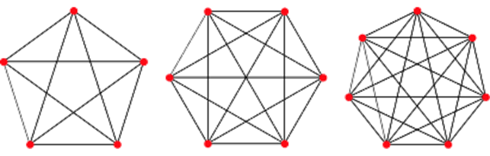
Our searching strategy: graph-based trio extension
IBD transitivity dictates that every IBD subset should form a clique in this graph.
False pairwise IBD detection results lead to missing or wrong edges and eventually subgraphs that violate IBD transitivity.
Triangles are building blocks of cliques (size >=3). Open triads are building blocks of semi cliques.
K-vertex Cliques (K >=3)
Semi-cliques
Open triad
Notes:
In graph theory, clique is a subgraph in which every node is connected with every other node.
Phenotype plays no role in the construction of sets and retaining them for further consideration in this step
Triangles, which represent significant IBD trios, are building blocks of k-vertex clique (k>=3)
Imagine we construct a graph at each analysis point, in which nodes represent subjects and edges represent detected pairwise IBD relations

Slide 21
Our searching strategy: graph-based trio extension
After examining
CHAT searches for IBD subsets with > 3 members by examining open triads and merging triangles with at least one overlapping edge.
Notes:
In graph theory, clique is a subgraph in which every node is connected with every other node.
Phenotype plays no role in the construction of sets and retaining them for further consideration in this step
Triangles, which represent significant IBD trios, are building blocks of k-vertex clique (k>=3)

Slide 22
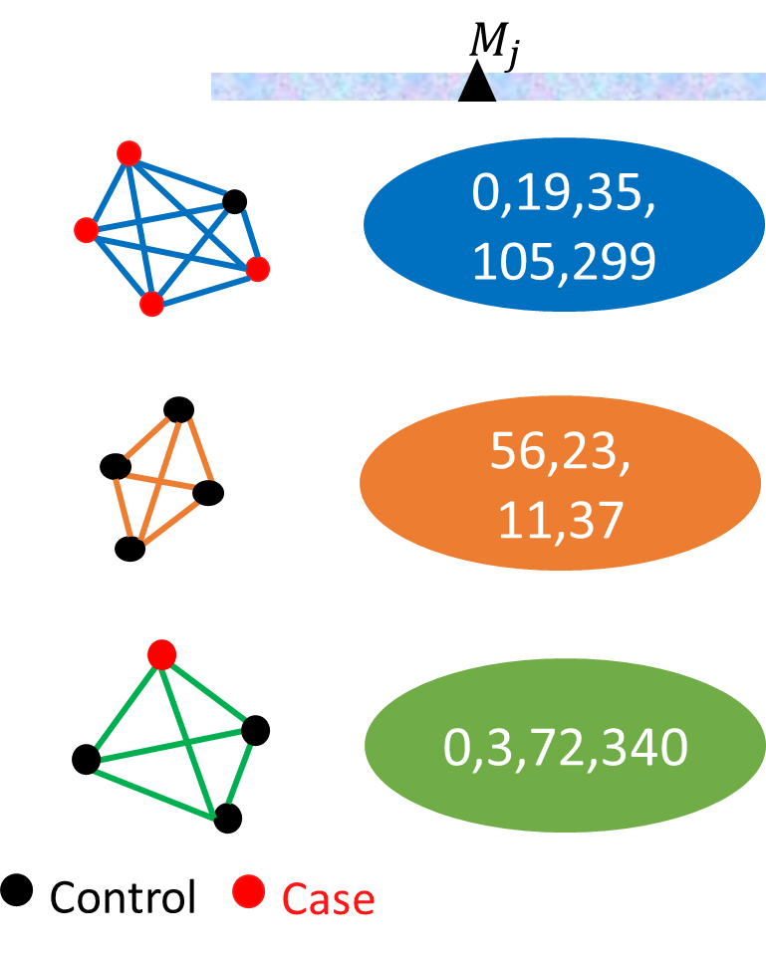
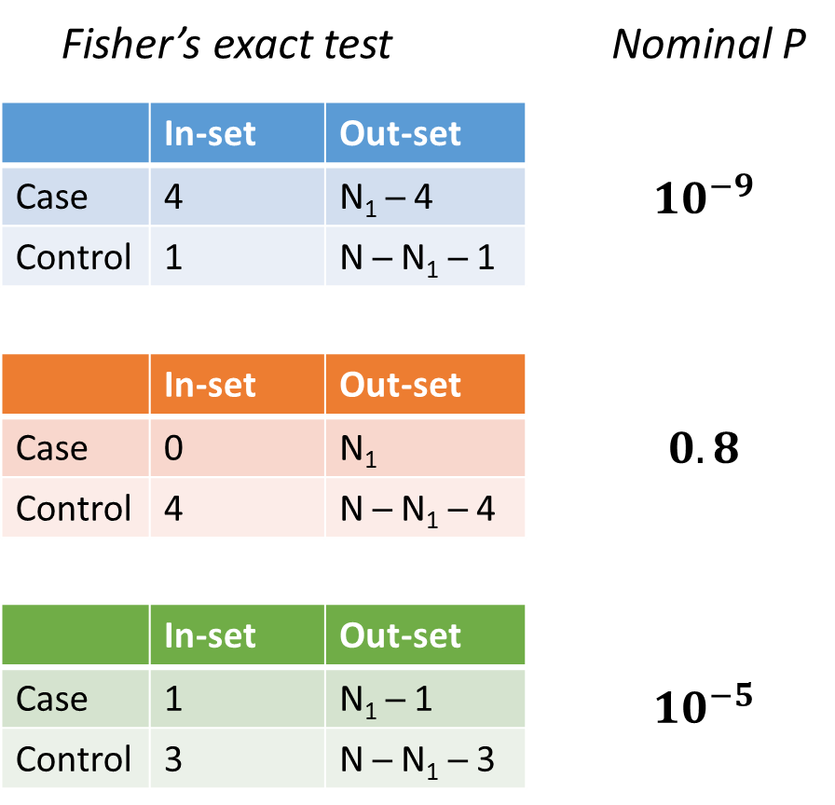
Test the disease association: nominal p
Notes:
CHAT detects an IBD segment along with a small yet significant subsets of individuals who likely share it
Disease association is examined via a Fisher’s exact test on the composition of these subsets
We used a 2*2 Fisher’s exact test to compare the counts of cases and controls in the corresponding subset with those not in the subset.

Slide 23
Test the disease association: adjusted p
CHAT uses a permutation approach as IBD subsets at the same or nearby analysis point/region tend to have similar members and thus are not independent
To reduce computational burden and speed up the procedure, CHAT models the null distribution of most significant P-values with extreme value distributions (EVD)
It chooses among EVD family members and learns distribution parameters from 1000 permutations using maximum likelihood estimation.
The cumulative area under the curve of the fitted EVD density function is used to estimate small adjusted P-values at any significance level.
Notes:
Nominal p values of the above association tests are then adjusted for local and genome-wide multiple comparisons.

Slide 24
Biased urn sampling based permutation tests
Instead of randomly shuffling disease status among subjects to create permutation sets, CHAT applies a biased urn sampling procedure (Epstein et al., 2012)
It preserves the confounding structure in the original data set as well as the numbers of cases and controls in permuted data sets
Allow CHAT to handle more general population (by including PC covariates) and an arbitrary number of categorical and continuous covariates
Notes:
A standard nonparametric permutation test probably needs a huge number of permutations to achieve the demanded p-value resolution and the minimal obtainable p-value, making the procedure computationally expensive and time consuming. To reduce computational burden and speed up the procedure, one approach is to conduct relatively few permutations and fit an extreme value distribution to the test results and then extrapolate to the tail of the fitted distribution^{43,44}

Slide 25
THANK YOU
“If one surely believes that the disease has an underlying genetic basis that is at least partially shared among affected individuals … then, presumably, this means that the cases will be somewhat more closely related to each other, on average, than they are to control individuals.” (Voight & Pritchard, 2005)

