Slide 1
Graph-based IBD clustering and implications for CHAT
Yuan Lin
Post-doc Research Associate
@ Dr. Kirk Wilhelmsen’s Lab
Department of Genetics, School of Medicine
UNC at Chapel Hill

Slide 2
IBD segment detection
Identity-by-descent (IBD) segments are chromosomal regions where two or more individuals inherit identical nucleotide sequences from the same most recent common ancestor (MRCA).
Detected IBD segments have various downstream applications (Browning & Browning, 2012)
For example, IBD mapping, i.e., using detected IBD segments to determine genomic regions likely to harbor rare disease-susceptibility variants
Notes:
IBD mapping in case-control studies: It tests whether the case group has more genomic IBD sharing around a putative causal variant than the control group.

Slide 3
Pairwise vs. multiway IBD detection
Pairwise detection compares the similarity of two haplotypes at a time, while multiway detection compares multiple haplotypes simultaneously.
To the end of IBD mapping, multiway detection may be advantageous over pairwise detection in identifying short IBD regions (< 1cM).
Existing pairwise methods mostly estimate IBD probability based on the length of sharing, so IBD segments must be long enough to be detectable.
Consider haplotypes A, B and C in a region not interrupted by recombination. If A and B are IBD and A and C are IBD, then by definition B and C are also IBD even though their IBD relation is undetectable via pairwise comparison.

Slide 4
Multiway detection: Solving conflicts in multiple IBD relations
Essentially multiway detection needs to solve conflicting pairwise detection results, for example, haplotypes A and B are IBD, A and C are IBD, but B and C are not IBD.
How to solve a conflict is not always straightforward, as IBD relations are estimated.
What would you do, if A and B are IBD with 81.2% probability, A and C are IBD with 49.8% probability, B and C are IBD with 13.2%?
IBD relations are estimated independently.
Shorter regions are subject to more uncertainty.
Notes:
IBD relations are probabilistic due to
The existence of genotyping and phasing errors
The lack of prior information (e.g., pedigree) in population dataset

Slide 5
Multiway detection: Solving conflicts in multiple IBD relations (cont.)
Some multiway methods relies on building a global probabilistic framework and they gain accuracy at the expense of computational efficiency.
MCMC IBD finder (Moltke et al., 2011) detects IBD segments directly from multiple individuals. It needs tens of hours to process even small datasets (e.g., 20-30 individuals with 500 SNPs).
IBD-Groupon (He, 2013) and PIGS (Park et al., 2015) build on pairwise comparison results to improve efficiency, but still, IBD-Groupon cannot handle GWAS-scale datasets (e.g., 4000 haplotypes with 3000 SNPs) and PIGS uses sampling results to approximate exact results in practice.
Notes:
MCMC IBD finder detects IBD segments directly from unphased genotype data, using an HMM model where the states are possible IBD tracts among the given set of individuals. An MCMC approach is developed to infer relevant information about the parameters of the HMM model.
IBD-Groupon uses external tools such as fastIBD to identify pairwise IBD segments in the prerequisite step. However, it adjusts the threshold parameters such that fastIBD outputs more IBD segments, even though some of them can be false-positive. It then constructs a HMM to identify the most likely multiple-IBD clusters (which they called group-wide IBD tracts) so as to eliminate false-positive IBD segments. IBD segments are considered as false-positives and are removed if they do not belong to a multiple-IBD cluster, or they are too short and thus have a low likelihood. The depth-first search algorithm and shortest path algorithm are applied to determine the possible number of hidden states, which corresponds to the number of multiple-IBD clusters.
PIGS takes as input the IBD probabilities output by pairwise approaches. Then, to update the probability that a pair of haplotypes are IBD, it computes the probability of IBD conditional on the IBD probabilities of all other haplotypes pairs at the locus.

Slide 6
Multiway detection: Solving conflicts in multiple IBD relations (cont.)
Some methods utilize graph-based techniques.
IBD is not only about sequence similarity but also about the genealogical relationships among individuals.
Graph provides a global view of (pairwise) relational data.
A graph is a set of linked nodes. The links (edges) can have weights.
Given a set of N haplotypes at a locus, a typical IBD graph contains N nodes each representing a haplotype. Two nodes are linked if their corresponding haplotypes are IBD at the locus.

Slide 7
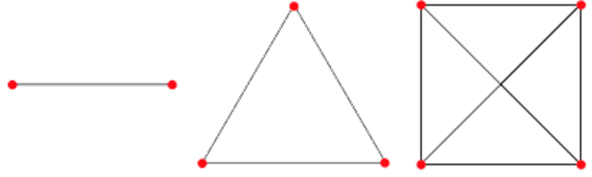
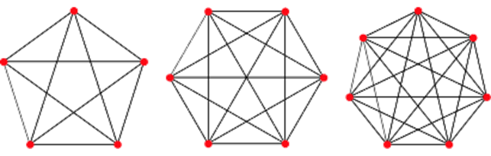
A graph model of IBD
A key concept is the transitivity of IBD relations at a locus: If A B and A C, then B C. It means in the corresponding (undirected) graph, if Edge AB and AC exist, BC should also exist.
Given that all and only true IBD relations were identified, every connected component of the corresponding IBD graph should be a clique.
Notes:
A clique is – a subgraph in which each node is connected with every other node. Here are some cliques of different sizes

Slide 8
A graph model of IBD (cont.)
Nested cliques
1
5
2
1
Each clique represents a cluster of IBD haplotypes at a locus that have the same MRCA.
If there are multiple such IBD clusters at the locus, the IBD graph will contain multiple disjoint cliques.
Finding all IBD haplotype clusters is equivalent to finding all maximal cliques in an IBD graph.
3
5
2
1
5
2
4
3
Disjoint maximal cliques
Notes:
A maximal clique is a clique that is not included in a larger clique.
Cliques are naturally nested.

Slide 9
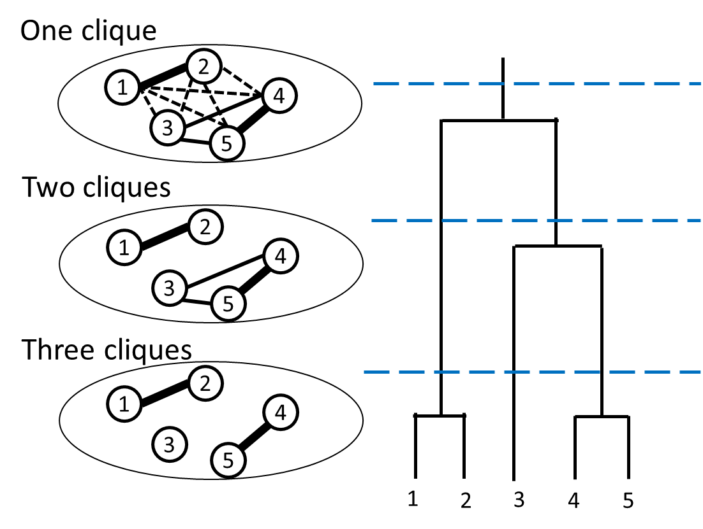
A graph model of IBD (cont.)
The nested nature of cliques provides a way to model the hierarchical relations of IBD clusters.
Depending on the generation of interest, the IBD graph of a genomic site contains either one clique or multiple disjoint cliques (assuming error-free IBD detection).
Notes:
This nature provides a way to…
While all leave nodes of a coalescent tree belong the same IBD cluster, the leave nodes of any sub-tree also forms an IBD cluster.

Slide 10
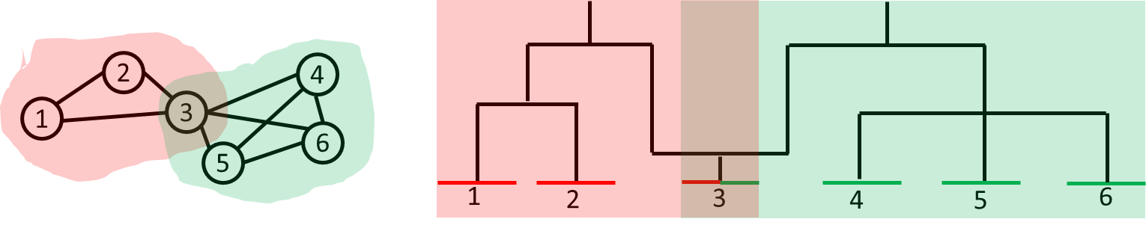
A graph model of IBD (cont.)
While the genealogy at a genomic site corresponds to a coalescent tree, the genealogy of a genomic region with possible recombination may contain multiple trees.
Thus, there can be overlapping cliques in the IBD graph of such a genomic region.

Slide 11
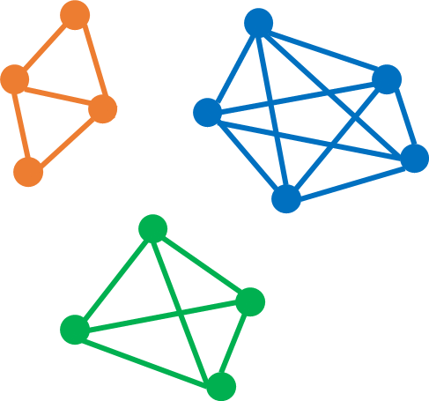
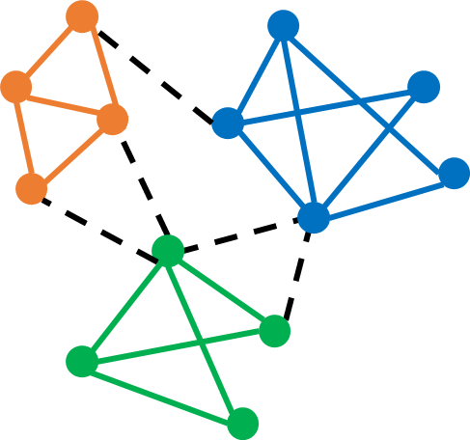
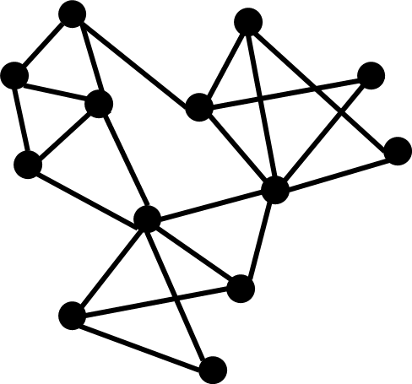
A graph model of IBD (cont.)
Inaccurate or ambiguous pairwise detection results are missing or misplaced edges that lead to incomplete subgraphs in an IBD graph.
Identifying true IBD clusters thus involves reconstructing clique(s) or dense enough subgraph(s), by removing/adding links that presumably represent false-positive/false-negative IBD relations.
The problem is we don’t know the right answer.
Notes:
What we have discussed so far are based on an assumption that pairwise detection results are error-free and perfect. However, the reality is a specific pairwise detection method makes mistakes and have limits, which means it may miss something.
By “without knowing the right answer”, I mean a population dataset usually does not provide information (e.g., pedigree or the extent of relatedness) that can tell us what level of IBD we are looking for with regard to the genealogy.

Slide 12
A graph model of IBD (cont.)
However, if the errors are not pervasive, intra-clique areas should still be denser than inter-clique areas.
Moreover, if we define the probability of an IBD relation (or some correlated measures) as the weight of the corresponding link, intra-clique links should be stronger than inter-clique links.
Thus, structural properties of the IBD graph such as density and tie strength hint true cliques, even if the graph is “noisy” and “fuzzy”.
Notes:
BTW, a major difference between graph clustering and traditional relational data clustering is that, graph clustering utilizes the structural similarity (e.g., the number of common neighbors) of nodes, while traditional relational data clustering mainly relies on the attribute similarity (e.g., Euclidian distance between two attribute vectors) of nodes. In addition, traditional clustering algorithms generally work very well on dense data, while state-of-the-art graph clustering algorithms are designed for large sparse matrices (each graph has a matrix representation called the adjacency matrix)

Slide 13
Graph-based multiway IBD detection
Partition a graph based on its structural properties is an active research area known as community detection or graph clustering (Fortunato, 2010).
Existing graph-based multiway IBD detection methods more or less borrow ideas/techniques from this area.
DASH (Gusev et al., 2011) and EMI (Qian et al., 2014) are the only two methods that can handle genome-wide data of thousands of individuals. They are both graph-based methods.
IBD-Groupon and PIGS also leverage graph representations of IBD.

Slide 14
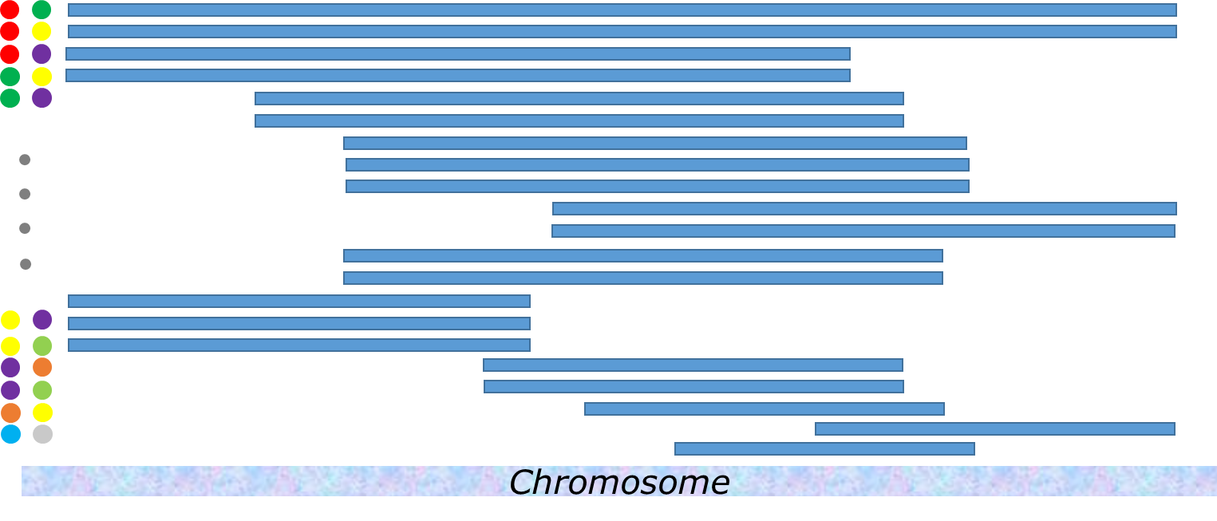
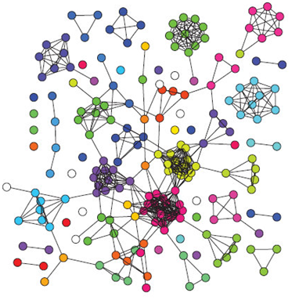
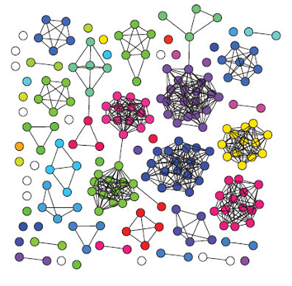
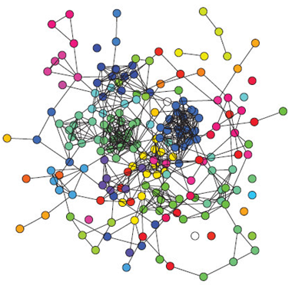
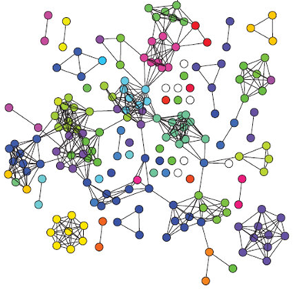
DASH &
EMI: similar workflow
Win k - 2
Win k - 1
Win k
Win k + 1
Notes:
Common features of DASH and EMI:
They start with a previously identified collection of pairwise IBD haplotypes, which DASH obtains using GERMLINE (Gusev et al., 2009) while EMI using Refined IBD (Browning & Browning, 2013).
They scan the genome using a sliding window and split pairwise IBD haplotypes into windows.
They model the IBD patterns inside each window using an undirected weighted graph. DASH defines weight as the length of pairwise IBD segments (in cM). EMI provides three types of weight – the length of pairwise IBD segments in base pair or in cM or the LOD score provided by Refined IBD for pairwise segments, which is the log 10 of the likelihood ratio between IBD and IBS.
They build the IBD graph at each window independently based on the pairwise IBD segments falling in each window.
Except for at the first window, the IBD clustering at a window is not conducted from the scratch but by adjusting the clustering results derived from the preceding window (i.e., only examine changes and thus actions are only taken when there is a change). This strategy not only save computational efforts by avoiding redundancy but also provides a way to track the evolution of IBD clusters across multiple regions of the genome (but neither of them developed on this idea).

Slide 15
DASH vs. EMI: different clustering strategies
As mentioned, IBD graphs have an intrinsic hierarchical structure.
DASH works downwards the hierarchy. It starts from the largest connected component and divides the component into smaller and denser subgraphs, by removing putative false-positive edges.
In contrast, EMI works upwards the hierarchy. It starts from two seed nodes and repeatedly adds qualified adjacent nodes to expand a dense subgraph.
Notes:
IBD graphs have a hierarchical structure – small clusters are included within large clusters, which are in turn included in larger clusters, and so on.

Slide 16
HCS (Highly Connected Subgraphs) Clustering
Hartuv & Shamir (2000)
Work on similarity graphs
Start from the global graph and identify minimum cut recursively
Stop dividing a subgraph when its density reaches a predefined upper bound or when it has no links to cut.
This algorithm is efficient when the graph is highly connected.
Notes:
DASH uses a modified HCS clustering algorithm
In a similarity graph, nodes represent elements and the presence/weight of a link between two nodes indicates how similar the two elements are (actually we can treat the presence/absence of a link as if the link has a dichotomous weight of 0 or 1). Thus, the more links exist for a given number of nodes and/or the stronger these links are, the more similar such a set of nodes to one another.
Suppose we try to disconnect a similarity graph (or any of its subgraphs) by removing links and we would like to keep large clusters. Intuitively we should start from the most sparse area. HCS clusters the nodes of a similarity graph by recursively identifying a minimum set of links whose removal divides the graph into two disjoint subgraphs. Meanwhile, the remaining connected components of the graph (i.e., identified clusters) are getting smaller and denser. We can stop applying this algorithm on a subgraph when its density reaches a desired threshold or when the subgraph contains no links to cut. DASH uses a modified version of HCS so that each time the identified set of links is minimal in total weight rather than size.
This algorithm is efficient when the graph is highly connected (i.e., with few loosely connected outliers)

Slide 17
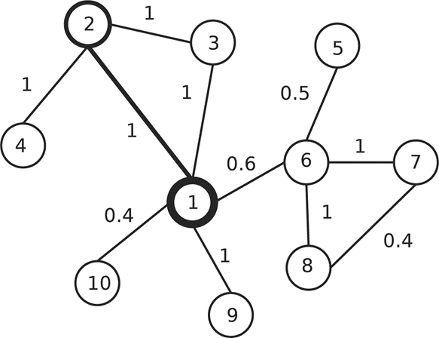
SPICi (Speed and Performance In Clustering)
Jiang & Singh (2010)
Expand a subgraph from seed nodes and by adding qualified adjacent nodes
Stop when the density of the subgraph reaches a lower bound
Output the subgraph and remove its links to the rest of the graph
Search for another subgraph in the remaining graph until all non-isolated nodes are clustered.
Apply computationally efficient data structures
Notes:
SPICi builds clusters greedily, starting from local seeds that have high weighted degree, and adding nodes that maintain the density of the clusters and are adjacent to a suitable fraction of nodes within them.
Output the subgraph and remove its links to the rest of the graph (like DASH, EMI assumes the cliques that represent multiple IBD clusters are disjoint)
This example network has 10 vertices, and every edge has weight 1 except (1,6), (1,10), (5,6) and (7,8). The highest weighted degree vertex, vertex 1 with weighted degree 4, is taken as the first seed node. The highest non-empty bin (0.8,1] for vertex 1 is composed of neighboring vertices 2, 3 and 9. Of these, vertex 2 has weighted degree 3, the largest of this bin, and it is taken as the second seed vertex. In the first step of the density-based search, vertex 3 has the highest support, 2, from the current cluster {1,2}. We add vertex 3 to the cluster and this cluster now has density 1. Suppose the support threshold is Ts=0.5. All the remaining vertices have support less than density×cluster_size×Ts=1.5. Thus we stop expanding the cluster and output {1,2,3} as the first cluster. After this, the next search will start from vertex 6 and output {6,7,8} as the next cluster. Vertices 4, 5, 9 and 10 are left as singleton clusters.
Start from the node with highest weighted degree and the node with the strongest link to the first node as initial seeds of a cluster. Keep adding nodes strongly connected with current members as a whole. Adding single nodes one at a time will bring down the density of the current subgraph. Thus, the process will stop when the density of the subgraph is lower than a threshold

Slide 18

DASH & EMI: different clustering strategies (cont.)
False negative
False positive
Chromosome
DASH
EMI
Notes:
A generalized representation of the DASH/EMI clustering algorithm across three windows (vertical lines) of a single chromosome.
The upper half: pairs of haploid individuals (left, colored circles) and their respective identical-by-descent segments, if any. True segments are represented
by a thick blue bar spanning at least one window; false positive and negative regions are labeled and represented by orange bars.
The lower half: The corresponding haplotype graph for each respective window; the haploid individuals are represented as nodes (circles) (the color
is consistent with that in the upper half) and identical-by-descent sharing at the locus represented as edges (lines). Gray fill shows the multiple-IBD-haplotype-cluster detected by DASH or EMI.

Slide 19
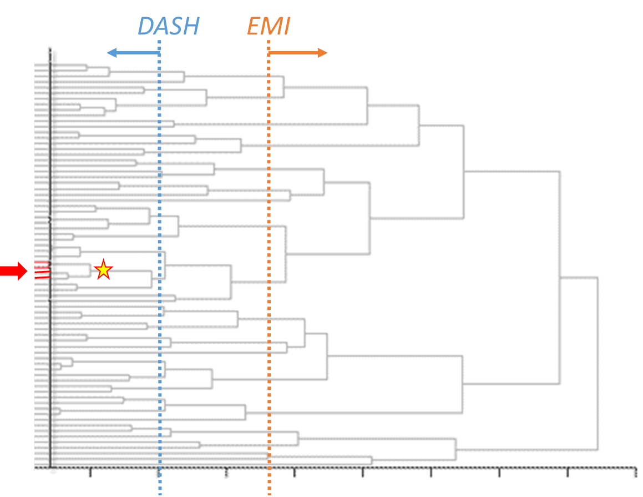
DASH vs. EMI: different starting points (possible)
DASH aims to find the largest IBD clusters, but it starts from relatively long IBD haplotypes (GERMLINE outputs).
EMI can cover small IBD clusters, but it starts from relatively short IBD haplotypes (Refined IBD outputs)
Thus, their abilities to identify small clusters of long IBD haplotypes (the target of CHAT) are still unclear to me.
Notes:
DASH works downwards, but it may start low.
EMI works upwards, but it may start high.
Thus, their abilities to identify clusters near the bottom of the genealogical hierarchy is unclear.

Slide 20
The graph elements in IBD-Groupon
IBD-Groupon constructs an HMM across the genome to identify the most likely IBD clusters. It splits pairwise IBD haplotypes into maximum IBD chunks and creates an HMM state for each chunk.
To figure out the values of an HMM state, IBD-Groupon builds an IBD graph for each chunk and identifies all maximal cliques in that graph.
IBD graphs are built on the results of an external pairwise IBD detection algorithm called fastIBD (Browning & Browning, 2011).
IBD-Groupon only eliminates putative false-positive links. It does not add links to the IBD graph.
Notes:
A maximum IBD chunk is defined as the maximum chromosomal region in which the estimated IBD status between all pairs of haplotypes remains the same.
It assumes that a maximal clique includes the largest number of haplotypes that are IBD with one another.

Slide 21
The graph elements in PIGS
PIGS (probabilistic IBD graph sampling) imports (independent) IBD probabilities obtained by pairwise methods and updates each of them conditional on all others.
The global probabilistic framework is modeled as a fully connected weighted graph G, whose nodes represent haplotypes and edge weight represents the IBD probabilities between corresponding haplotypes.
A set of unweighted transitive graphs gi are induced from G, each representing a valid scenario of IBD clustering on haplotypes in G. PIGS calculates a conditional probability P(gi|G) for each graph.
The IBD probability for Haplotypes A and B is updated as ∑P(gk|G) / ∑P(gi|G), where gk is a transitive graph in which A and B are connected.
A new set of gi are recreated based on the updated edge weight in G.
For efficiency, gi is sampled rather than enumerated.
Notes:
G itself is a big clique.
Transitive graphs: each connected component is a clique; containing one or more disjoint cliques
The whole process iterates until each estimated pairwise probability converges or a time limit has been reached.
The outputs of PIGS can be inputs of other multiway detection methods.

Slide 22
Hierarchical graph clustering
Identify multiple levels of clusters by iteratively grouping nodes with high similarity or removing links between nodes with low similarity.
Need to define the similarity between one node/cluster and the other.
No prior knowledge on the number and size of the clusters is required.
Reveal the hierarchical structure in the data with multiple levels of resolution
Results are sensitive to the similarity measure.
Cannot choose a globally optimal level of clusters. The decision is often arbitrary.
Nodes with only one neighbors are often mistaken as isolated clusters.
Agglomerative clustering does not scale well.
Cannot discover partially overlapped clusters.
Notes:
From the perspective of graph clustering, the multiway IBD detection strategies DASH and EMI apply on a single IBD graph belong to so-called hierarchical graph clustering algorithms.
The results of the method depend on the specific similarity measure adopted.
In single linkage clustering, the similarity between two groups is the minimum element xij , with i in one group and j in the other. On the contrary, the maximum element xij for vertices of different groups is used in the procedure of complete linkage clustering. In average linkage clustering one has to compute the average of the xij .
Picking the level of resolution (via predefined thresholds of related parameters): in DASH and EMI, the related parameters are window size and the density threshold of subgraphs representing IBD clusters.

Slide 23
Implications for CHAT
CHAT divides the genome into segments of a fixed length (0.5 LDU). We will refer to these segments as bins. They are equivalent to the windows in DASH and EMI.
A major step in CHATv1.0 is to look for so called “CHATSets” in each bin. This step is equivalent to finding IBD clusters based on an IBD graph. A CHATSet represents an IBD cluster.

Slide 24
A: Bin i, i+1, …, i+k
CHATSet building process
LSH_AB
LSH_A#
Explore merging
LSH_AC
Randomly pick two to phase
ASB
{Subject A, B}
ANSB
ASC
ANSC
LSH_AB
BNSA
CSA
CNSA
BSA
Merged successfully?
ASB
(ASC)
ANSB
(ANSC)
BNSA
CNSA
BSA
CSA
OR
ASB
(ANSC)
ANSB
(ASC)
Pairwise detection results as LSHs
CSA
BSA
BNSA
CNSA
Notes:
In CHAT, what is equivalent to the sliding window in DASH and EIM is a chromosome segment with a length of 0.5 ldu distance. A segment is referred to as a bin. The program looks for so called CHATSets in each bin, which is equivalent to a cluster of IBD haplotypes within a window.

Slide 25
CHATSet building process (cont.)
B: Bin i+j, …, i+m
A: Bin l+p, …, l+n
LSH_AB
LSH_A#
LSH_B#
LSH_BD
Phasing
Phasing
BNSA
{A, B, C}
BSD
BNSD
Explore merging
BSA
DSB
DNSB
Merged successfully?
Merging
BNSA
{A, B, C, D}
{A, B, C, D}
BSD
DSB
Explore merging with updated consensus haplotype
Explore merging
BSA
BNSD
OR
BSD
BNSA
BNSD
BSA
DSB
Notes:
Each cluster keeps an updated consensus haplotype (calculated based on all member haplotypes and used to make merging decisions).
According to the code, after CHAT examines all subjects in the original subjectToMerge set (i.e., A and B), if any new subject (e.g., C or D) was added into the set, CHAT will reexamine everyone in the current subjectToMerge set, including old members and new members (this is Kirk’s intendsion), following a natural order of subject IDs. The process (of examining this group of subjects) will continue until the “lookForMerge” variable, which is initialized as false at the beginning of each iterative “exploreMerge” step, does not turn to true (for this variable to become true, there needs to be at least one successful merging in the immediately previous iteration of “exploreMerge”).
Then, the program will move on to the next LSH in the collection and repeat this whole process all over again, until all LSHs falling in the analysis window has been processed.

Slide 26
CHATSet building process (cont.)
P: Bin #, …
Q: Bin #, …
Phasing
Phasing
{Subject P, Q}
{P, Q, …}
LSH_PQ
Merging
Merging
Pairwise detection results as LSHs

Slide 27
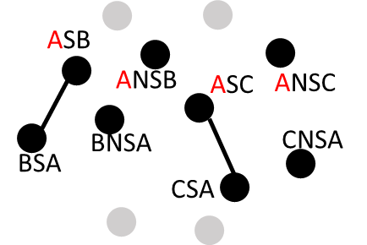
CHATSet building process
CHAT iterates through ordered pairwise detection results and updates the IBD graphs in all involved windows by adding the strongest edges.
Meanwhile it keeps checking whether in some windows there are >= 2 pairwise IBD segments involving the same individual, i.e., an IBD graph like

Slide 28
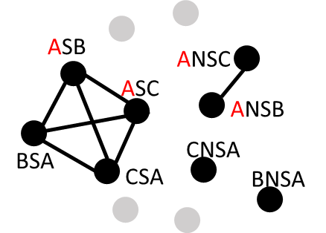
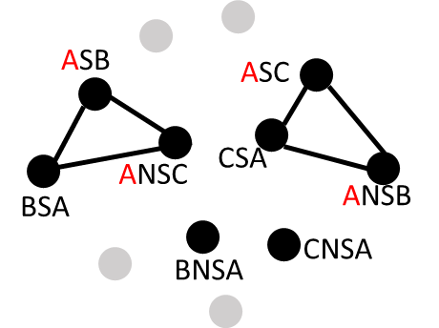
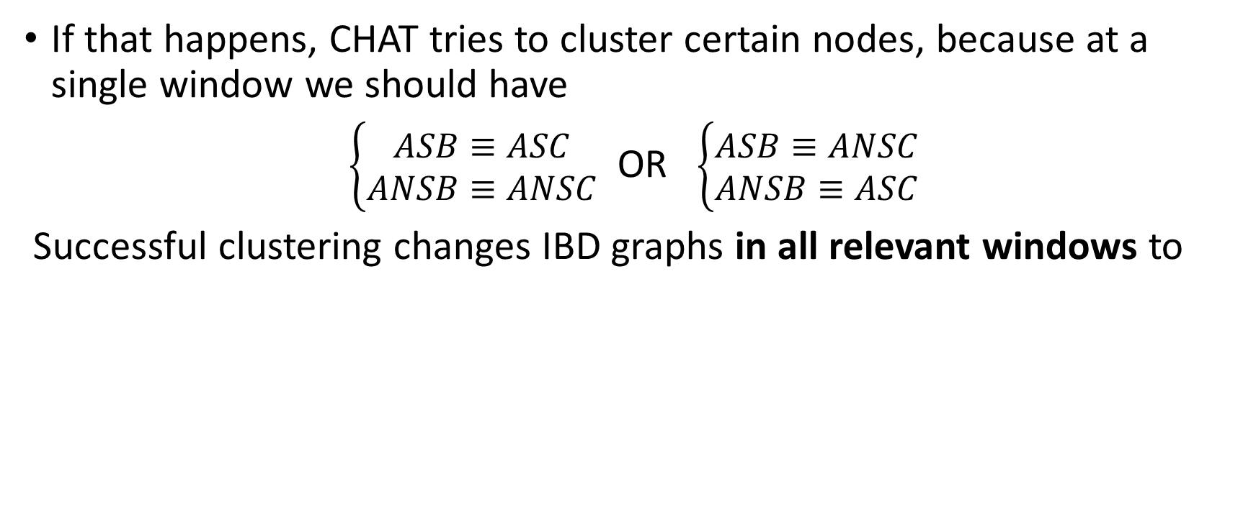
CHATSet building process (cont.)
If that happens, CHAT tries to cluster certain nodes, because at a single window we should have
$\left\{\begin{matrix}ASB≡ASC \\ ANSB≡ANSC\end{matrix}\right.$ OR $\left\{\begin{matrix}ASB≡ANSC \\ ANSB≡ASC\end{matrix}\right.$
Successful clustering changes IBD graphs in all relevant windows to
OR

Slide 29
CHATSet building process (cont.)
Given successful clustering, CHAT checks every other subject also involved (i.e., B and C) to see whether they can, as the first subject, bring in more haplotypes to further expand existing clusters.
This process ends when no more new subject were added. Then CHAT goes back to add strong edges base on pairwise results, until all results are processed.
Notably, the examination of each subject may lead to updates of IBD graphs at multiple windows, but only at overlapping windows will the expansion happen.

Slide 30
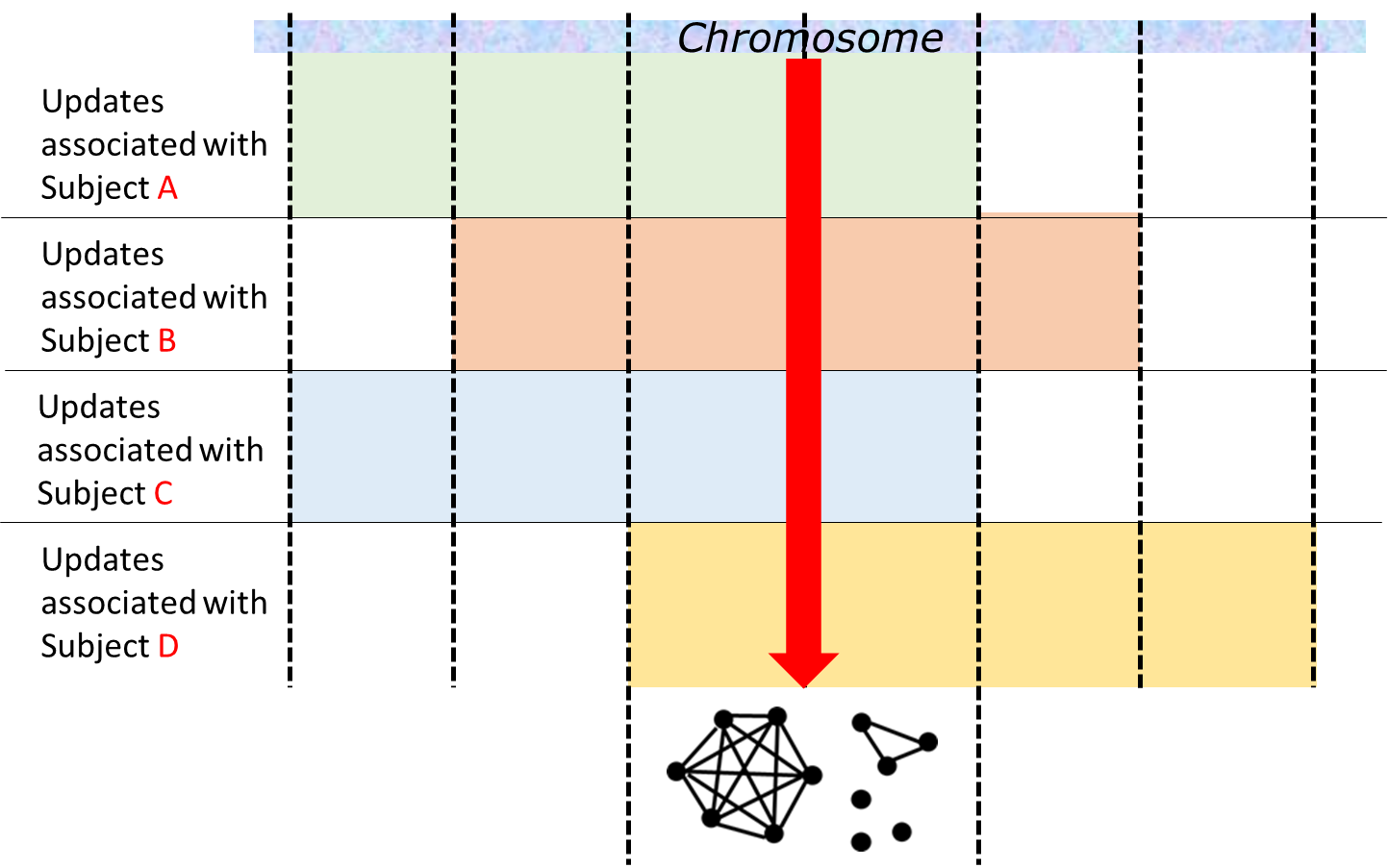
Continuous expansion at overlapping bins

Slide 31
Difference from EMI
Is CHAT more vulnerable to errors due to 2 and 3?
Seed selection
EMI selects one node with the highest strength, i.e., (the haplotype of) one subject that is in strong IBD with many other subjects. CHAT selects a few nodes that may indicate one long IBD haplotype. Thus, CHAT probably has fewer false positives (good for its purpose).
Density of the forming clusters
CHAT assumes every cluster is a clique. Thus, once a node is added, a k-clique will automatically become a (k+1)-clique
Expansion of clusters
EMI considers one candidate’s IBD relations with ALL current members, while CHAT consider it’s relation with only one current member

Slide 32
References
Browning, B. L., and S. R. Browning, (2011) A fast, powerful method for detecting identity by descent. Am. J. Hum. Genet. 88: 173–182.
Browning, S. R., and B. L. Browning. (2012) Identity by descent between distant relatives: detection and applications. Annu. Rev. Genet. 46: 617–633.
Browning, B. L., and S. R. Browning. (2013) Improving the accuracy and efficiency of identity-by-descent detection in population data. Genetics 194.2: 459-471.
Fortunato, Santo. "Community detection in graphs." Physics reports 486.3 (2010): 75-174.
Gusev, A., J. K. Lowe, M. Stoffel, M. J. Daly, D. Altshuler et al., 2009 Whole population, genome-wide mapping of hidden relatedness. Genome Res. 19: 318–326.
Gusev, A. et al. (2011) DASH: a method for identical-by-descent haplotype mapping uncovers association with recent variation. Am. J. Hum. Genet., 88, 706–717.
ences[edit]
Hartuv, E.; Shamir, R. (2000), A clustering algorithm based on graph connectivity, Information Processing Letters 76 (4-6): 175–181
He, D. (2013) IBD-Groupon: an efficient method for detecting group-wise identity-by-descent regions simultaneously in multiple individuals based on pairwise IBD relationships. Bioinformatics, 29, i162–i170.
Hochreiter S (2013). HapFABIA: identification of very short segments of identity by descent characterized by rare variants in large sequencing data. Nucleic acids research, 41(22):202.
Jiang,P. and Singh,M. (2010) SPICi: a fast clustering algorithm for large biological networks. Bioinformatics, 26, 1105–1111.
Moltke,I. et al. (2011) A method for detecting IBD regions simultaneously in multiple individuals–with applications to disease genetics. Genome Res., 21, 1168–1180.
Park et al. (2015) PIGS: improved estimates of identity-by-descent probabilities by probabilistic IBD graph sampling. Bioinformatics, 16(Suppl 5):S9.
Qian Y et al., (2014). Efficient clustering of identity-by-descent between multiple individuals. Bioinformatics, 30(7):734-922.

