Slide 1
CHAT: some experiment results
Yuan Lin
Post-doc Research Associate
@ Dr. Kirk Wilhelmsen’s Lab
Department of Genetics, School of Medicine
UNC at Chapel Hill

Slide 2
Background
CHAT is designed to find a group of cases that share one or more IBD segments that are likely to harbor rare disease-associated genetic variants.
I will refer to a group of individuals who have a common IBD segment as an IBD cluster and a cluster of k individuals a k-order cluster.
CHAT detects IBD clusters around each marker. Each cluster tags an IBD segment shared by all the members.
CHAT aims for higher-order clusters, because they tend to tag shorter segments and thus provide higher mapping resolution.
Notes:
tag IBD segments: we can infer the IBD haplotypes with certain ambiguity, but this is not necessary in CHAT.

Slide 3
Background (cont.)
However, high-order IBD clusters are increasingly difficult to detect.
CHAT determines whether a shared segment is IBD or IBS (i.e., shared by chance) by evaluating genotype/haplotype similarity in that segment statistically.
A major task of CHAT is to accurately and efficiently detect high-order IBD clusters.
Then CHAT uses Fisher’s exact test to evaluate the association of each IBD cluster with the disease. The segment tagged by a disease-associated cluster is likely to harbor causal variant(s).
Notes:
This is also today’s topic

Slide 4
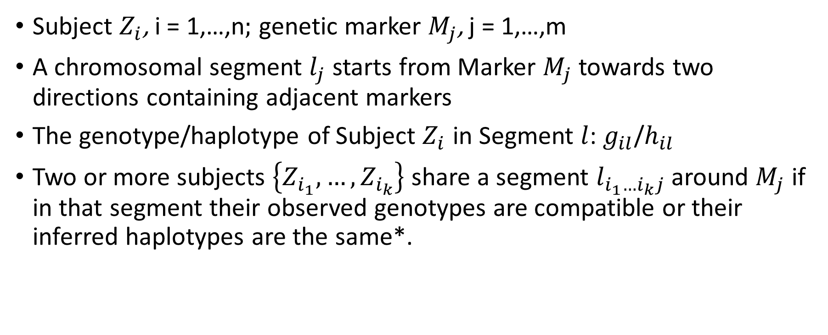
Nomenclature
Subject $Z_{i}$, i = 1,…,n; genetic marker $M_{j}$, j = 1,…,m
A chromosomal segment $l_{j}$ starts from Marker $M_{j}$ towards two directions containing adjacent markers
The genotype/haplotype of Subject $Z_{i}$ in Segment $l$: $g_{il}$/$h_{il}$
Two or more subjects $\left\{Z_{i_{1}},…,Z_{i_{k}}\right\}$ share a segment $l_{i_{1}…i_{k}j}$ around $M_{j}$ if in that segment their observed genotypes are compatible or their inferred haplotypes are the same*.
Notes:
CHAT allows for certain number of inconsistencies, which it assumes are genotyping errors.

Slide 5
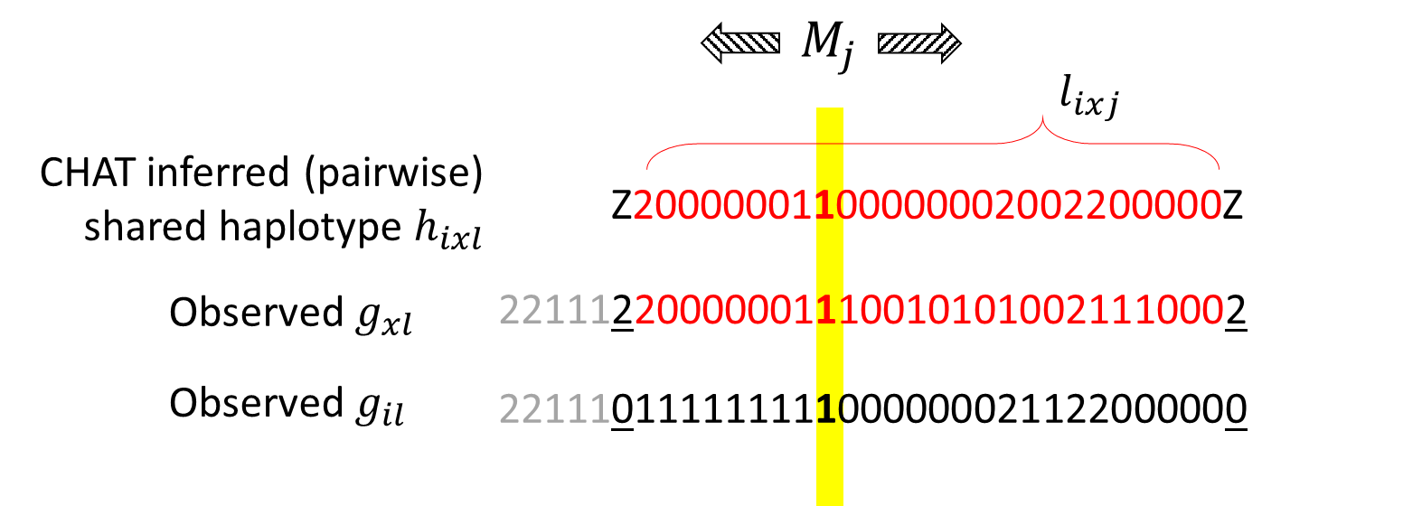
CHAT progressively infers haplotypes shared by multiple individuals
1 - heterozygote
0 - homozygote at major allele
2 - homozygote at minor allele
*Suppose we do not tolerate any mismatch, i.e., we assume no genotyping error
Notes:
Early versions of CHAT also infers each subject’s the other haplotype, but in the latest version, we only focus on shared haplotypes.

Slide 6
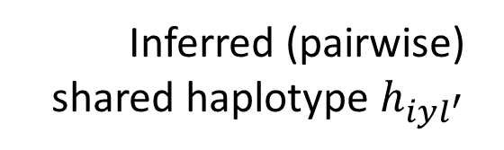


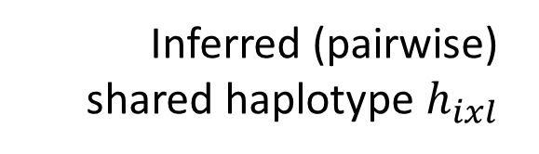
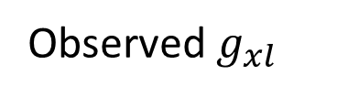

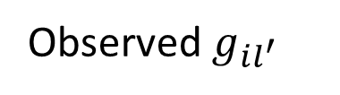
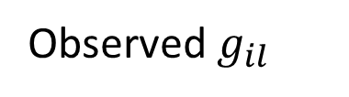
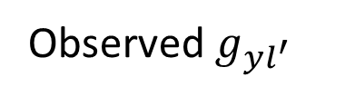
$$M_{j}$$
$$l_{ixj}$$
Inferred (pairwise) shared haplotype $h_{ixl}$
Z20000001100000002002200000Z
Observed $g_{xl}$
221112200000011100101010021110002
Observed $g_{il}$
221110111111111011000021122000000
221110111111111000000022122000000
Observed $g_{il^{′}}$
022220000000000000020022122000000
Observed${ g}_{yl^{′}}$
Z222200000000000000Z
Inferred (pairwise) shared haplotype $h_{iyl^{′}}$
$$l_{iyj}^{′}$$

Slide 7



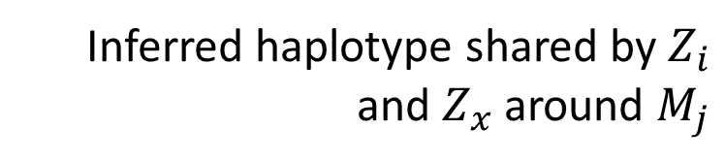

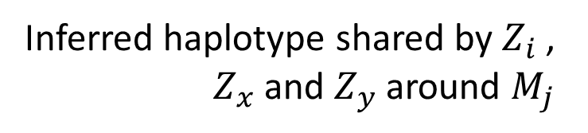
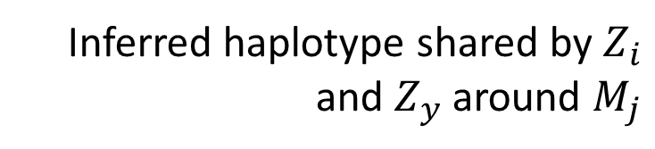
$$M_{j}$$
$$l_{ixj}$$
Inferred haplotype shared by $Z_{i}$ and $Z_{x}$ around $M_{j}$
22111Z20000001110010101002111000Z
$$l_{ixyj}^{′′}$$
Inferred haplotype shared by $Z_{i}$ , $Z_{x}$ and $Z_{y}$ around $M_{j}$
Z000000000000
Inferred haplotype shared by $Z_{i}$ and $Z_{y}$ around $M_{j}$
Z222200000000000000Z0022122000000
$$l_{iyj}^{′}$$
Notes:
One way to test the significance of triple sharing is to go through every possible trios, similar to what we did for test pairwise sharing
“Z” defines valid boundaries of inferred shared haplotypes. Only the sequence within boundaries in the overlapping region will be further compared to infer an IBD haplotype potentially shared by three subjects

Slide 8
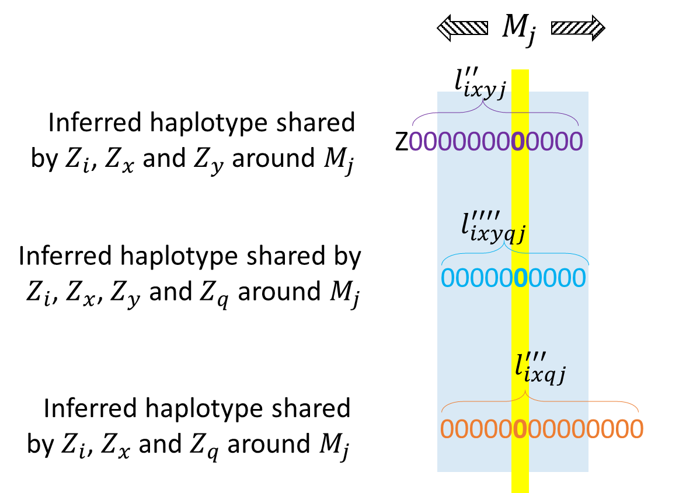
We could go on and on…
Are these shared segments IBD or IBS?
Notes:
We could go on and on... But now there is the more interesting and important question

Slide 9
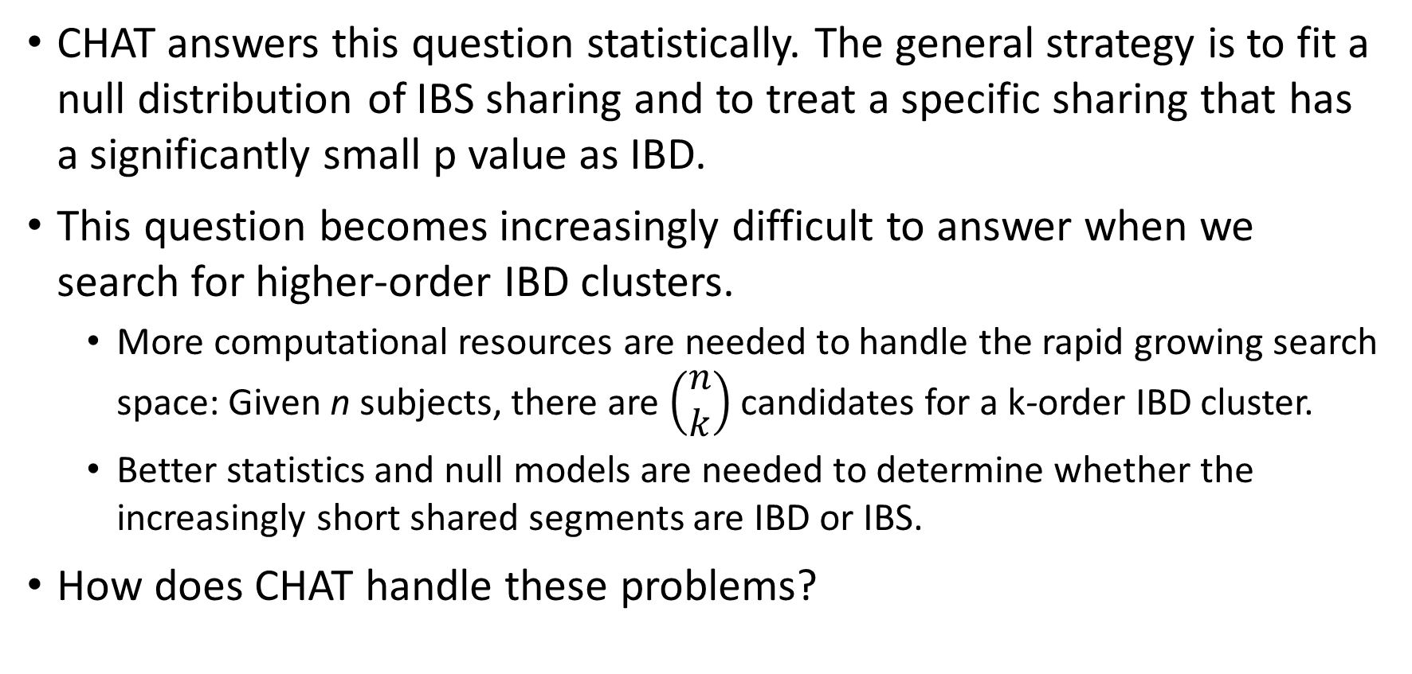
CHAT answers this question statistically. The general strategy is to fit a null distribution of IBS sharing and to treat a specific sharing that has a significantly small p value as IBD.
This question becomes increasingly difficult to answer when we search for higher-order IBD clusters.
More computational resources are needed to handle the rapid growing search space: Given n subjects, there are $\left(\begin{matrix}n \\ k\end{matrix}\right)$ candidates for a k-order IBD cluster.
Better statistics and null models are needed to determine whether the increasingly short shared segments are IBD or IBS.
How does CHAT handle these problems?
Notes:
As we can see from the toy example I showed you in the earlier slides, the more subjects being compared, the shorter the commonly shared haplotype.
But this is actually a good thing for mapping. Shorter IBD segments have finer mapping resolution. It’s just that deciding whether a shared segment is IBD becomes difficult when it is short.
Then we would like to know whether a shared segment is IBS or IBD. Better statistics and null models are needed to distinguish actual IBD sharing from random sharing (null hypothesis).

Slide 10
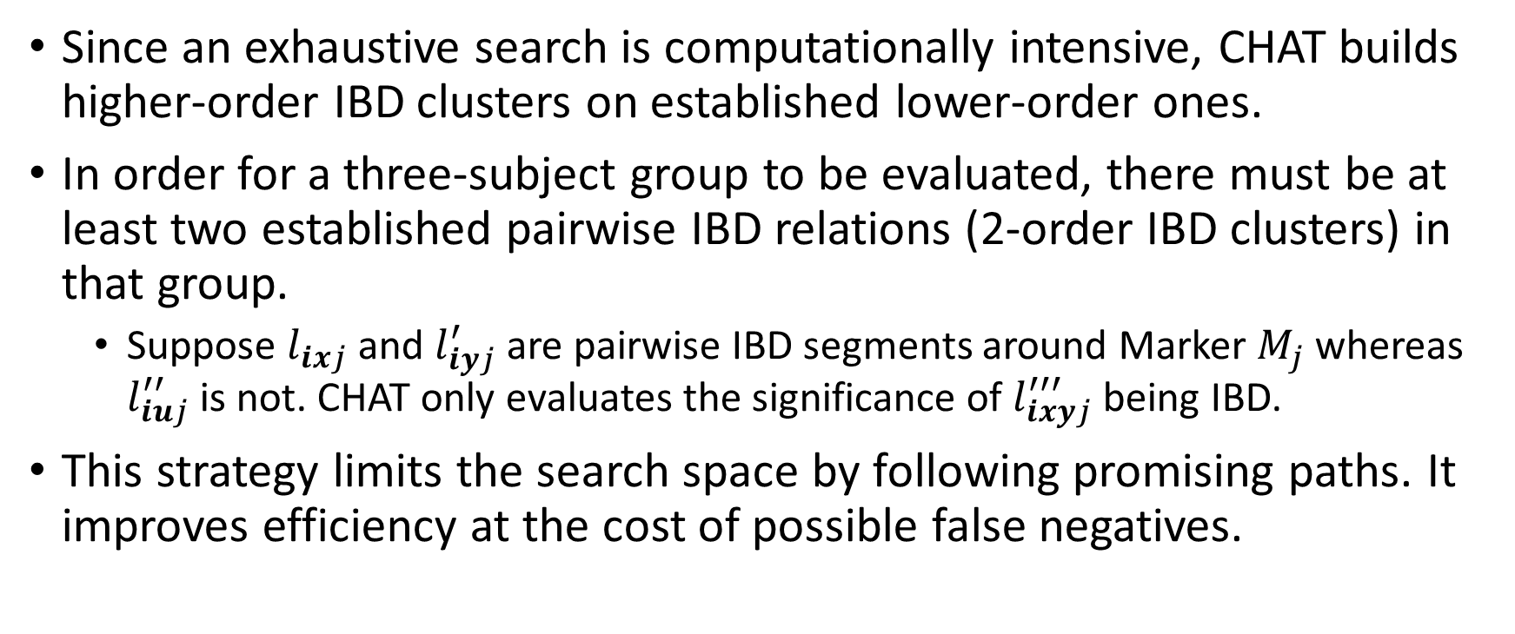
Incremental search of high-order IBD clusters
Since an exhaustive search is computationally intensive, CHAT builds higher-order IBD clusters on established lower-order ones.
In order for a three-subject group to be evaluated, there must be at least two established pairwise IBD relations (2-order IBD clusters) in that group.
Suppose $l_{ixj}$ and $l_{iyj}^{′}$ are pairwise IBD segments around Marker $M_{j}$ whereas $l_{iuj}^{′′}$ is not. CHAT only evaluates the significance of $l_{ixyj}^{′′′}$ being IBD.
This strategy limits the search space by following promising paths. It improves efficiency at the cost of possible false negatives.

Slide 11
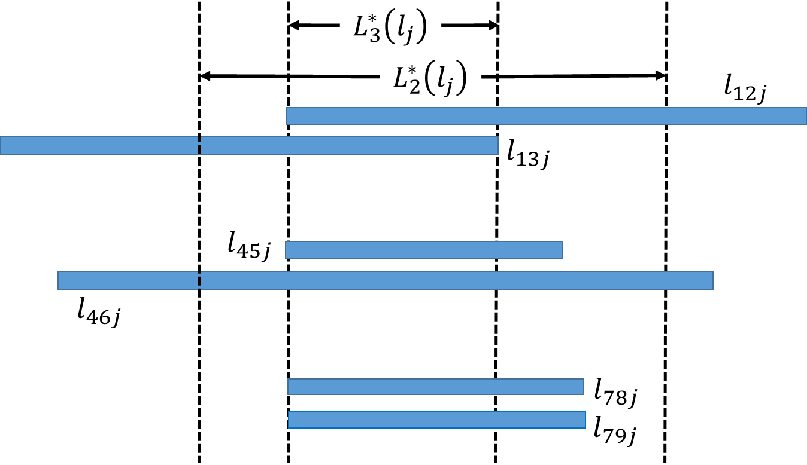
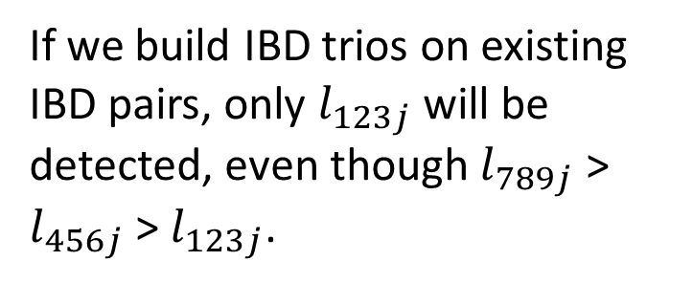
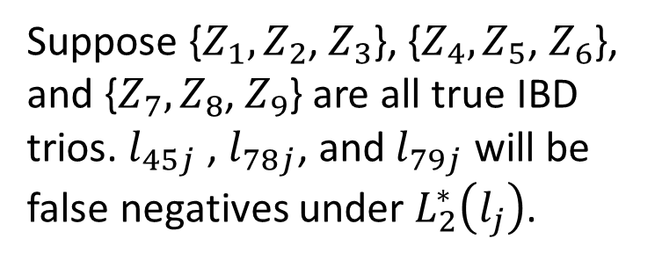
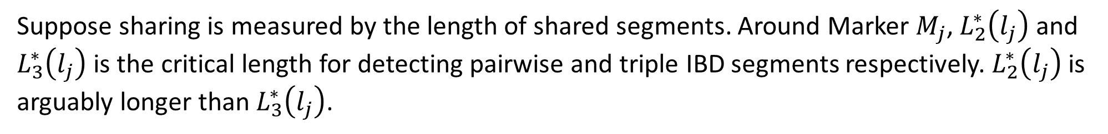
Suppose sharing is measured by the length of shared segments. Around Marker $M_{j}$, $L_{2}^{∗}\left(l_{j}\right)$ and $L_{3}^{∗}\left(l_{j}\right)$ is the critical length for detecting pairwise and triple IBD segments respectively. $L_{2}^{∗}\left(l_{j}\right)$ is arguably longer than $L_{3}^{∗}\left(l_{j}\right)$.
Suppose {$Z_{1},Z_{2}$, $Z_{3}$}, {$Z_{4},Z_{5}$, $Z_{6}$}, and {$Z_{7},Z_{8}$, $Z_{9}$} are all true IBD trios. $l_{45j}$ , $l_{78j}$, and $l_{79j}$ will be false negatives under $L_{2}^{∗}\left(l_{j}\right)$.
If we build IBD trios on existing IBD pairs, only $l_{123j}$ will be detected, even though $l_{789j}$ > $l_{456j}$ > $l_{123j}$.
MISSED
MISSED
A solution is to reduce the significance threshold for selecting lower-order IBD clusters.
Notes:
We could imagine that this problem becomes particularly severe when the critical length of IBD segments decreases quickly with the order of IBD clusters (?). This is especially a problem for isolated populations (e.g., AJ) in which there are a lot of long shared pairwise IBD haplotypes, they sort of raise the bar of IBD sharing significance, so that short IBD haplotypes become more difficult to identify.
Raw LSHs are inferred at each marker, so even though they are significantly long locally, they may not be long enough (early version of CHAT will merge raw LSHs shared by the same pair of subjects across the genome to get even longer potential IBD segments in the next step)

Slide 12
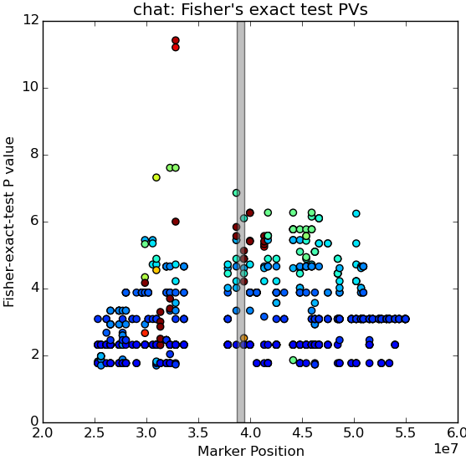
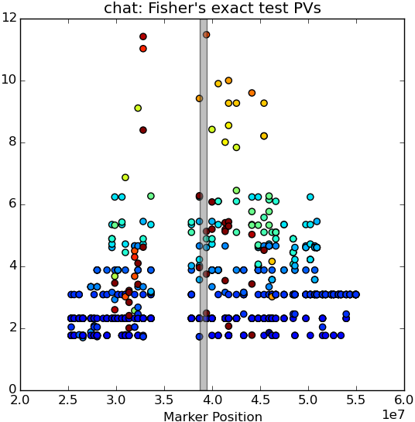
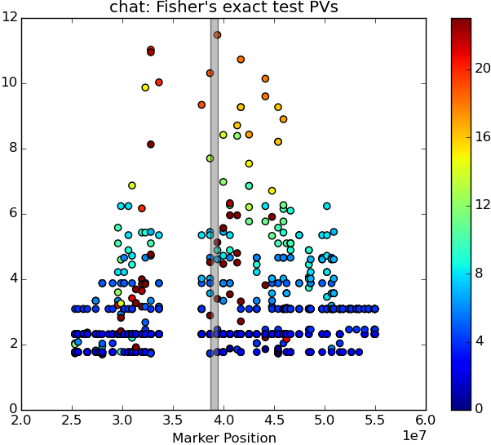
Strategy 1: IBD pairs identified using “Raw LSHs”
11.48
11.48
Search IBD trios using subject pairs with IBD probability = 0.9
Search IBD trios using subject pairs with IBD probability = 0.5
Search IBD trios using subject pairs with IBD probability = 0.1
Notes:
Figure: X: marker positions
Highlighted area: location of Lrrk2 mutation
Y: -log10 of Fisher’s exact test P value
Color: number of cases in the cluster
Then CHAT uses Fisher’s exact test to evaluate the association of each IBD cluster with the disease. The segment tagged by a disease-associated cluster is likely to harbor one or more disease-associated genetic variants.
rawPV0.9: pv=11.42, at 2886, completely off; 22 cases, 8 controls (328,160,330,309,329,303,320,326,134,325,130,163,133,324,285,143,166,138,335,149,306,304,1039,662,650,402,1053,738,823,1121)
rawPV0.5: pv=11.48, at 3969; 19 cases (? known lrrk2 mutation carriers), 4 controls (163,330,160,309,328,329,320,166,130,324,285,138,306,335,143,149,158,326,134,1039,1053,738,402); next significant cluster (close) pv=11.03; at 2886; 20 cases and 6 controls (309,160,329,330,303,328,320,326,130,324,285,143,166,331,138,335,325,134,163,149,662,1039,402,1053,738,1121), this signal is difficult to filter out (raw LSH 0.9 picks it up instead of the real one).
rawPV0.1: pv=11.48, at 3969, 19 cases (? known lrrk2 mutation carriers), 4 controls (163,160,330,309,329,328,320,306,130,324,285,138,335,143,166,149,158,326,134,1039,1053,738,402)

Slide 13
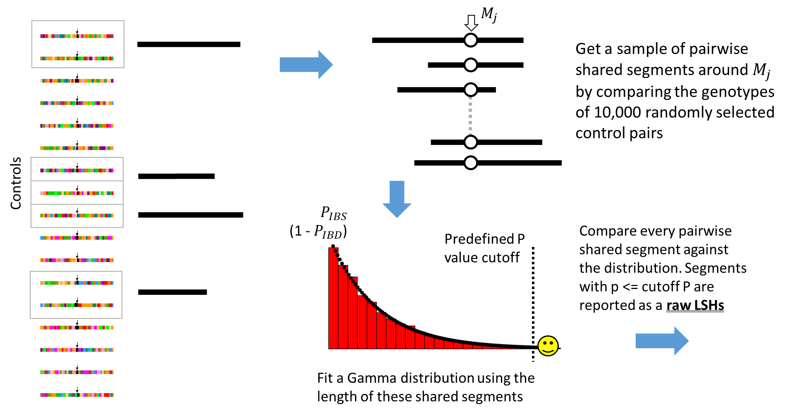
Notes:
About loosen the selection threshold, at least Experiments on CHAT with pairwise IBD screening using the Lrrk2 dataset prove this point.
I want to show you some results. I tried different strategies on selecting IBD pairs to form IBD trios. You know CHAT has several versions. The first strategy is to use the results of the first step in CHATv1.0, which is often referred to as Raw LSHs. Here is how we get them.

Slide 14
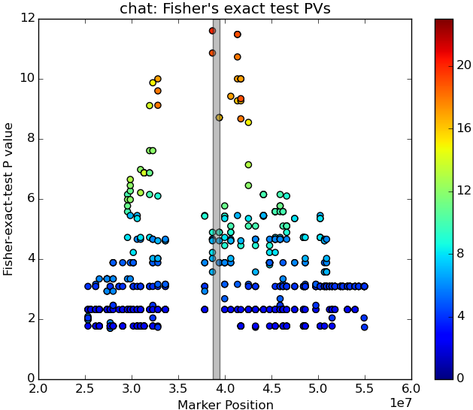
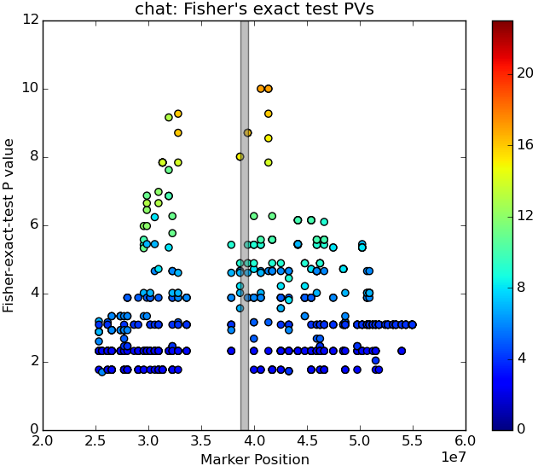
Strategy 2: IBD pairs identified using subject-specific distributions of genotype sharing
11.6
Search IBD trios in IBD pairs determined with threshold = 3
Search IBD trios in IBD pairs determined with threshold = 5 (fewer pairs)
Notes:
Left: pv=11.6, at 3703, closer to actual lrrk2 mutation position; 20 cases (? known lrrk2 mutation carriers), 5 controls (320,160,330,309,329,328,138,130,285,324,149,335,166,143,306,158,134,163,326,325,1039,738,1053,402,823)

Slide 15
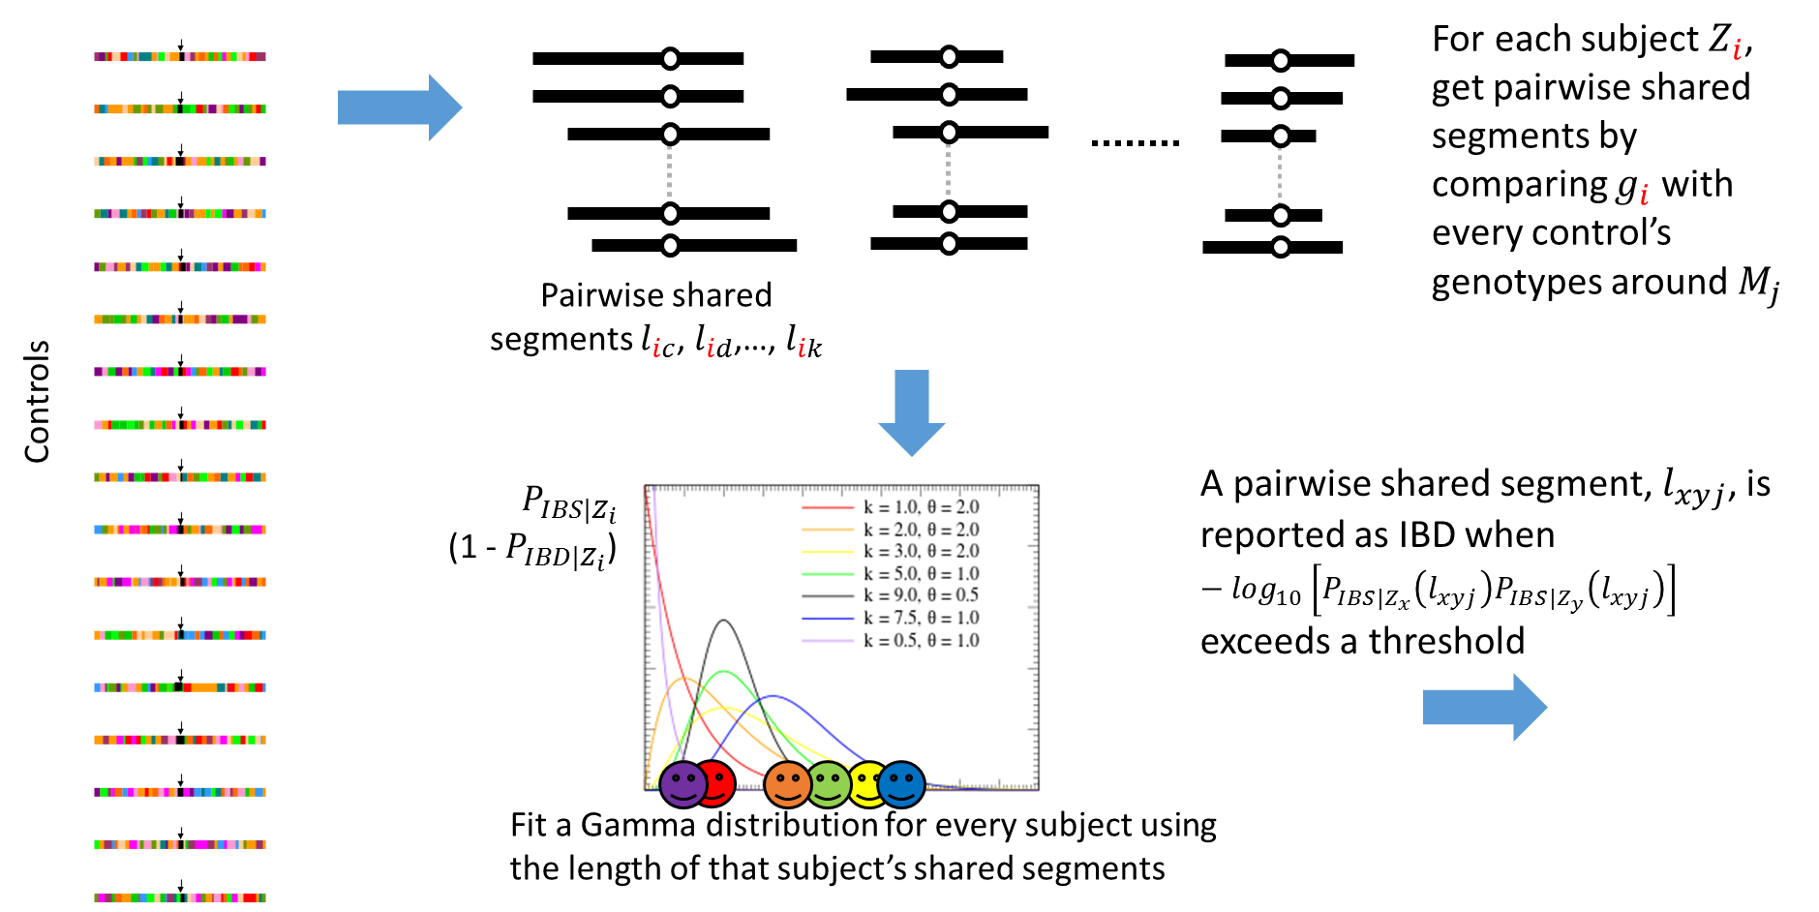

Slide 16
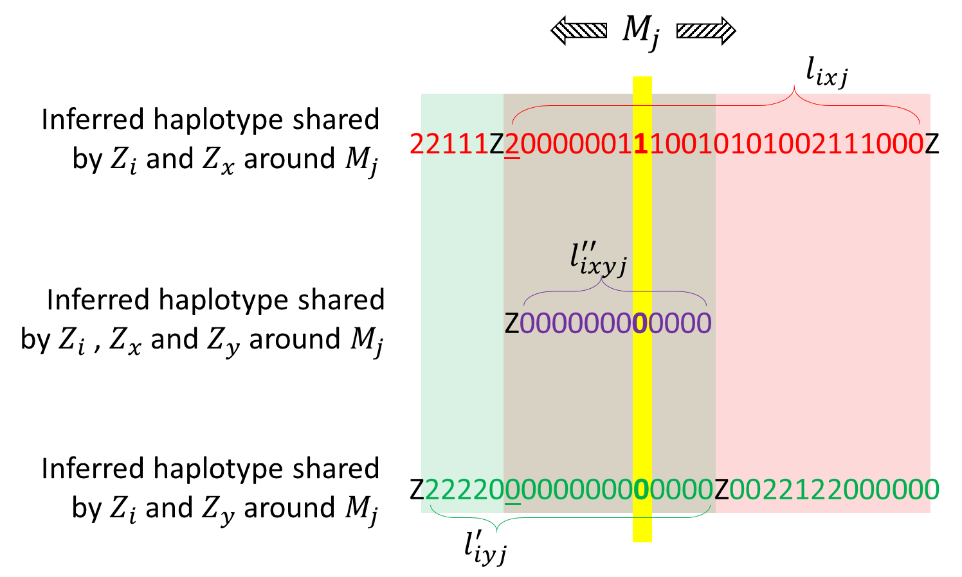
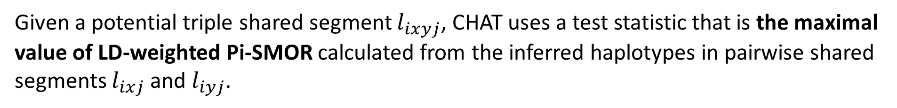
Besides short shared segments, CHAT has to detect high-order IBD clusters based on inferred haplotypes.
Given a potential triple shared segment $l_{ixyj}$, CHAT uses a test statistic that is the maximal value of LD-weighted Pi-SMOR calculated from the inferred haplotypes in pairwise shared segments $l_{ixj}$ and $l_{iyj}$.
Notes:
It seems subject-specific distributions of genotype sharing works well in detecting IBD pairs.
Subject-specific distributions of sharing is also applied in another major step, which we will talk about later.
Why subject-specific distributions work? This is a long story, but let’s start.

Slide 17
Advanced statistics and null models
Pi-SMOR is sum of the odds ratio of IBD against IBS at every single marker within the segment. It increases with not only the length a shared segment but also the number of rare variants in that segment, which is also a strong indicator of IBD sharing.
The contribution of each marker (i.e., single marker odds ratio or SMOR) is adjusted with local LD to avoid over-representing certain regions.
Notes:
Allele frequency matters because the sharing of a rare variant is a strong indicator of IBD than the sharing of a common variant.
To prevent SNP markers in close LD from being overrepresented and thus inflating Pi-SMOR (sum of SMOR), we need to weight the SMOR value of each SNP markers with their LD.

Slide 18
Advanced statistics and null models (cont.)
Pi-SMOR can be “fooled” by long range of heterozygous sites, which provides some interesting information (the presence of minor alleles) at the cost of high phase uncertainty.
To avoid overestimating long range of heterozygotes, CHAT evaluates triple shared segment against subject-specific distributions of maximal LD-weighted Pi-SMOR.

Slide 19
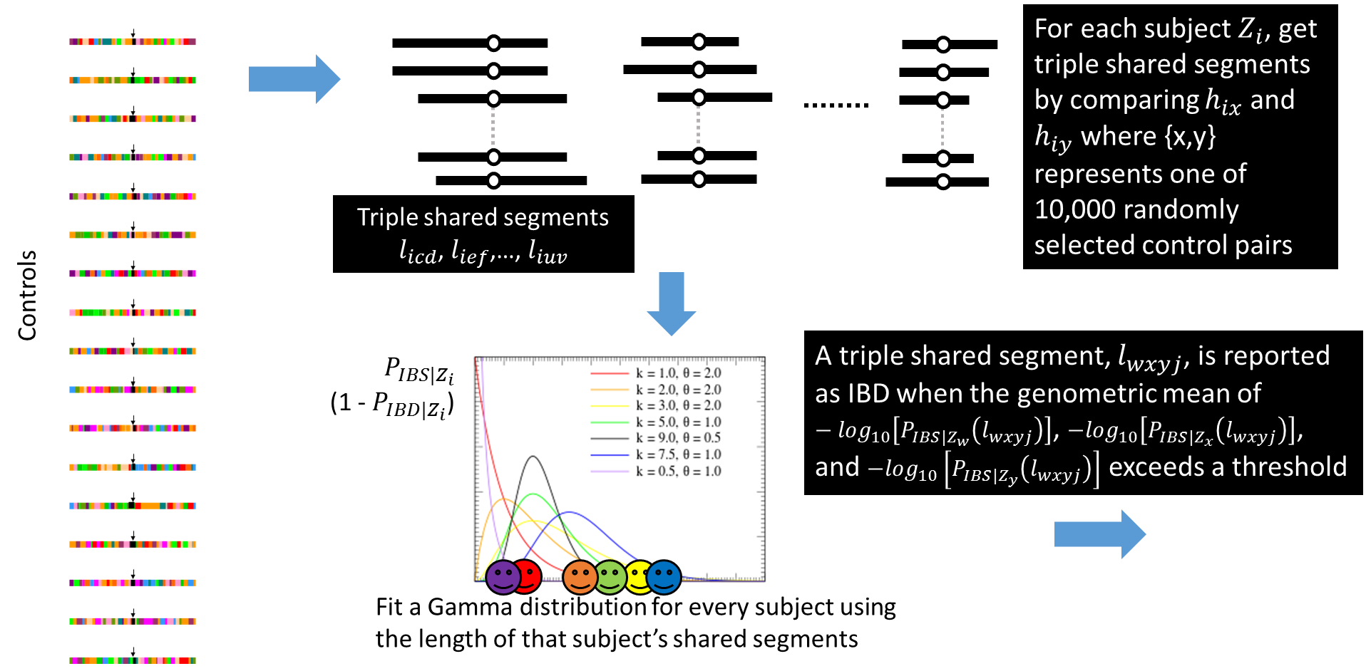
Notes:
The subject-specific distribution I talked about several slides ago is about pairwise sharing based on genotypes. Here we are talking about fitting and using subject-specific distributions of sharing based on inferred haplotypes.
The process is similar though. I highlighted some major difference.

Slide 20
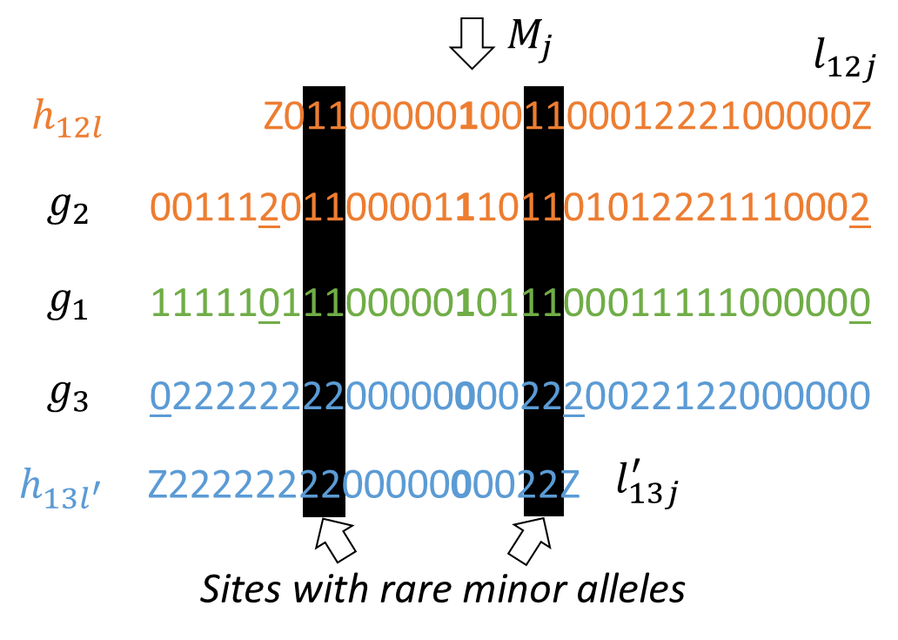
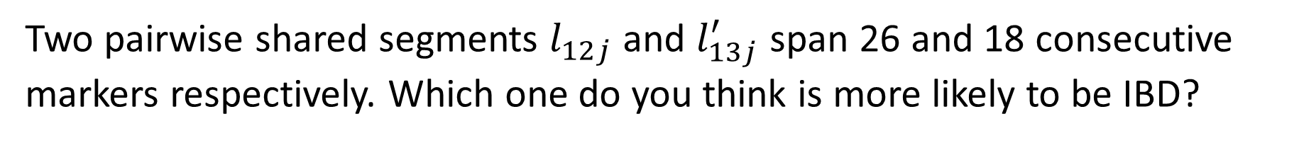
Two pairwise shared segments $l_{12j}$ and $l_{13j}^{′}$ span 26 and 18 consecutive markers respectively. Which one do you think is more likely to be IBD?
Notes:
What is the difference between using a distribution fitted with subject-specific data and using a distribution fitted with data collected from all subjects. Let me show you a toy example.
Suppose we have these pairwise sharing results. As we’ve seen earlier, the “Z” symbol indicates inconsistency and is used to show the boundaries of either pairwise segment. The shared segment between Subject 1 and 2 around marker Mj, $l_{12j}$ spans 26 markers while $l_{13j}^{′}$ spans 18 markers. The four highlighted sites have very rare minor alleles; other sites are all common SNPs. $h_{12l}$ and $h_{13l′}$ are two haplotypes CHAT inferred for the pairwise shared segment.

Slide 21
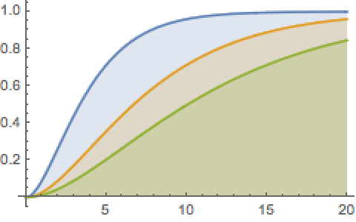
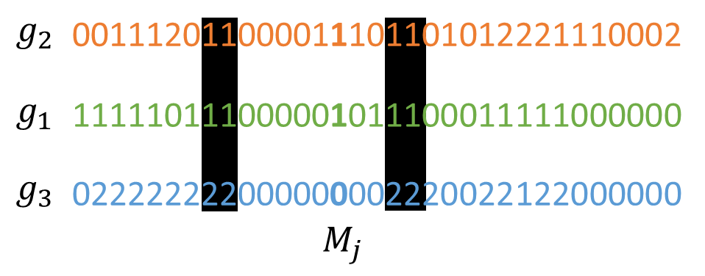
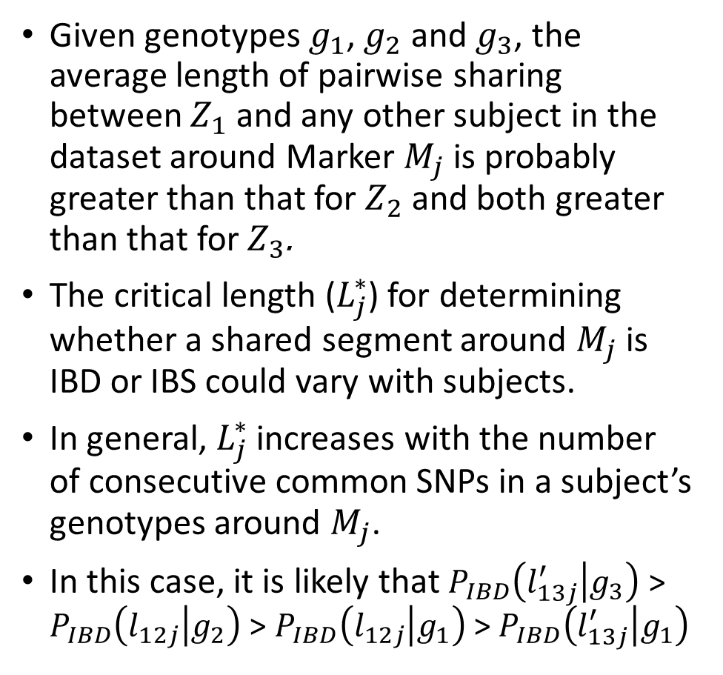



Given genotypes $g_{1}$, $g_{2}$ and $g_{3}$, the average length of pairwise sharing between $Z_{1}$ and any other subject in the dataset around Marker $M_{j}$ is probably greater than that for $Z_{2}$ and both greater than that for$Z_{3}$.
The critical length ($L_{j}^{∗}$) for determining whether a shared segment around $M_{j}$ is IBD or IBS could vary with subjects.
In general, $L_{j}^{∗}$ increases with the number of consecutive common SNPs in a subject’s genotypes around $M_{j}$.
In this case, it is likely that $P_{IBD}\left(l_{13j}^{′} | g_{3}\right)$ > $P_{IBD}\left(l_{12j} | g_{2}\right)$ > $P_{IBD}\left(l_{12j} | g_{1}\right)$ > $P_{IBD}\left(l_{13j}^{′} | g_{1}\right)$
Probability of IBD
0.5
$L_{j}^{∗}$($Z_{3}$)
$L_{j}^{∗}$($Z_{2}$)
$L_{j}^{∗}$($Z_{1}$)
Notes:
The same length or even the same candidate segment may have different probabilities of IBD if we compare them against
It is likely that $P_{IBD|Z_{3}}\left(Z_{1},Z_{3} | l_{13j}^{′}\right)$ > $P_{IBD|Z_{2}}\left(Z_{1},Z_{2} | l_{12j}\right)$ > $P_{IBD|Z_{1}}\left(Z_{1},Z_{2} | l_{12j}\right)$

Slide 22
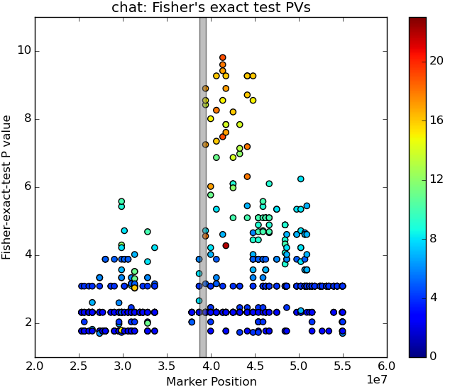
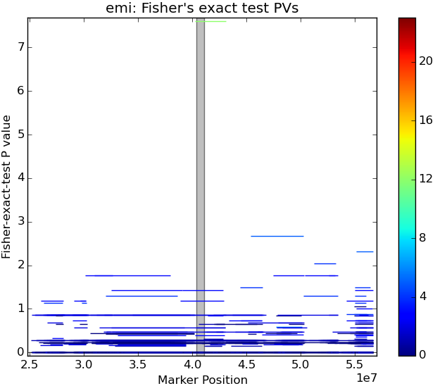
CHAT Vs EMI: using IBD pairs detected by Refined IBD
9.81
7.61
Notes:
So it is expected that using subject-specific distributions of sharing could improve the accuracy. And it does. Here are some evidence. Using the same IBD pairs, CHAT get more accurate, higher resolution results than DASH and EMI
CHAT: pv=9.81, 19 cases (18 known lrrk2 mutation carriers), 7 controls (143,149,738,580,402,1053,823,688,1035): 320,329,328,163,324,330,160,309,326,306,143,130,285,166,138,149,331,158,335,738,580,402,1053,823,688,1035
EMI: pv = 7.61, 12 cases, 2 controls, 12 out of 23 Lrrk2 mutation carriers
I collect the subject pair for each reported IBD segment, providing that the IBD segment go across the marker being analyzed. I admit that I forgot there is a build difference between emi or dash reported positions with the marker positions used in CHAT. So the function I used to check whether the IBD segment covers a specific marker needs to be modified. So I suspect the top result in CHAT+EMI is at the right spot. The reason why the deviation is not show in DASH+CHAT (next slide) is probably because that the top IBD segment identified by Germline is much longer than that identified by RefinedIBD (as shown in the plots), so that DASH result covers the build difference

Slide 23
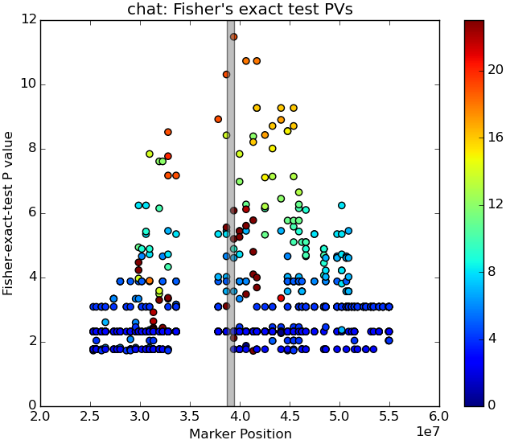
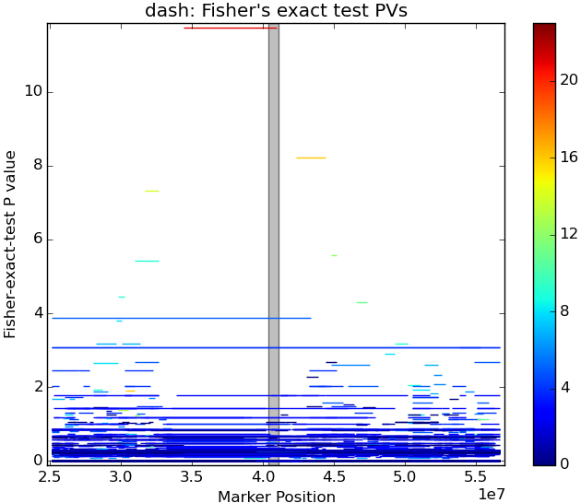
CHAT Vs DASH: using IBD pairs detected by Germline
11.48
11.75
Notes:
CHAT: pv =11.48, 19 cases (17 known Lrrk2 mutation carriers), 4 controls, not known Lrrk2 carriers: 149,143,1039,1053,738,402; (160,328,309,329,330,320,163,166,138,149,130,324,285,306,335,143,158,326,134,1039,1053,738,402)
DASH: pv = 11.75, 21 cases (19 out of 23 known Lrrk2 mutation carriers), 6 controls:
Germline tends to find extremely long haplotypes and allows for false positives. It divides a chromosome into non-overlapping slices of equal width and search for (nearly) identical segments at each slice. It allow for a small number of mismatches in each slice to accommodate genotype error and missing data (it chooses an error rate that ensures the expected number of matching slices > 1) After identifying some nearly identical segments, this algorithm then extends these segments to form longer shared haplotypes and the algorithm will only reports segments whose length exceeds a minimum-length threshold.
Germline allows for genotype error, whereas no mismatch is allowed in Refined IBD, as Refined IBD does not allow for genotyping error.

Slide 24
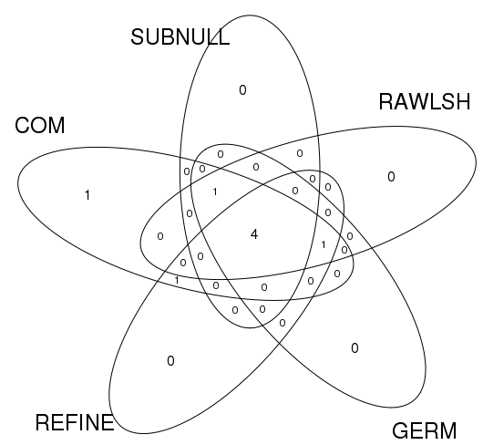
Lrrk2 mutation carriers that tend to be excluded from the finally detected IBD cluster
Fewest false negatives
331
325
Most false negatives
326
COM: Exhaustive search
SUBNULL: IBD pairs identified via subject-specific null distributions
RAWLSH: IBD pairs identified from Raw LSHs
GERM: IBD pairs identified by GERMLINE
REFINE: IBD pairs identified by Refined IBD
{396,455,316,319}
134

Slide 25
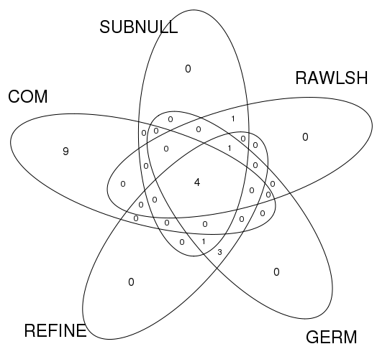
Subjects that are not known Lrrk2 mutation carriers yet tend to be included in the finally detected IBD cluster
Fewest false positives
Most false positives
738
1039
{131,152,119,605,929,397,736,731,622}
823
{143,149,402,1053}
COM: Exhaustive search
SUBNULL: IBD pairs identified via subject-specific null distributions
RAWLSH: IBD pairs identified from Raw LSHs
GERM: IBD pairs identified by GERMLINE
REFINE: IBD pairs identified by Refined IBD
{1035,580,688}

Slide 26
Efficiency
Using raw LSHs as the sources of IBD pairs seems most efficient regarding CHAT’s workload and the final result.
CHAT’s workload in building IBD trios on IBD pairs from different sources (measured by the number of comparison jobs CHAT needs to do)
Raw LSH p=0.1 | Raw LSH p=0.3 | Raw LSH p=0.9 | Subject GT thresh=0.3 | Subject GT thresh=0.5 | Germline | Refined IBD
5219 | 5206 | 5200 | 5414 | 5399 | 5543 | 5305

Slide 27
Efficiency (cont.)
Fitting subject-specific distributions of sharing is time demanding.
When the maximal LD-weighted Pi-SMOR is the test statistic, fitting subject-specific distributions does not provide useful null models for genotype sharing as it does for haplotype sharing.
Notes:
I did not actually compare different strategies. I did not put exhaustive search into this framework, so cannot really compare that.

Slide 28
Thank you!
Questions?

Slide 29
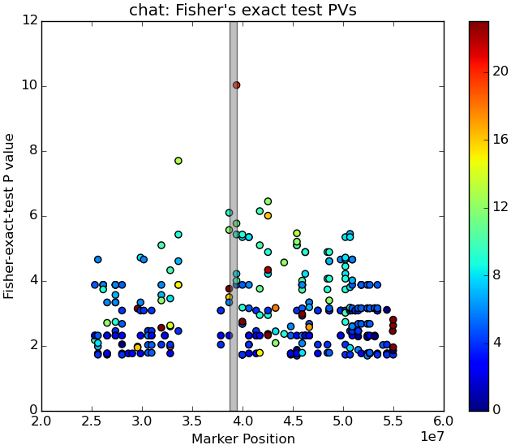
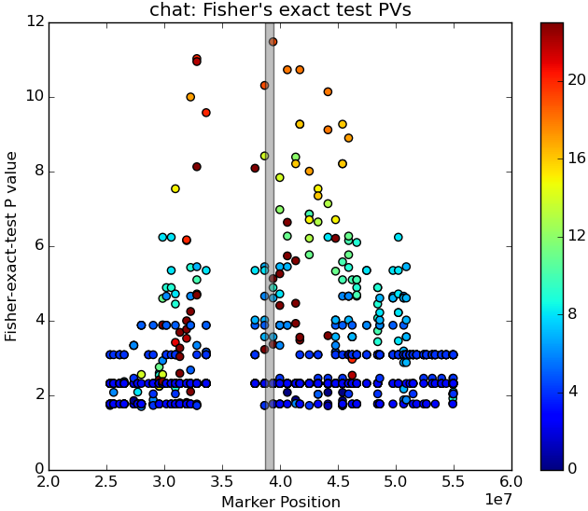
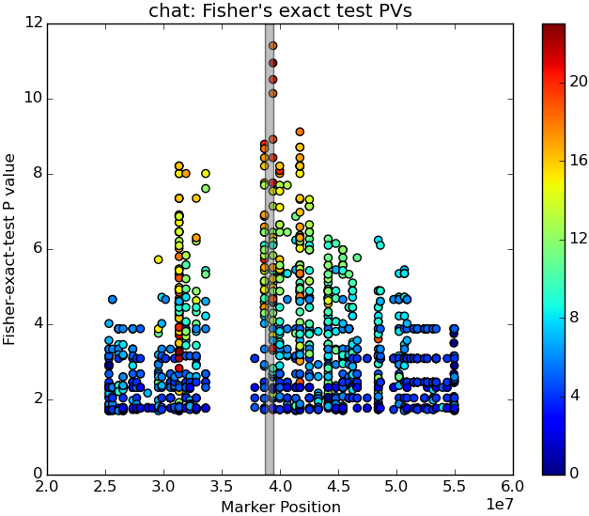
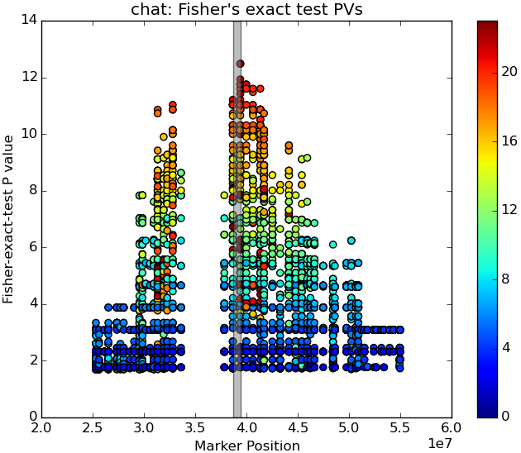
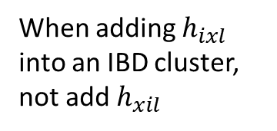
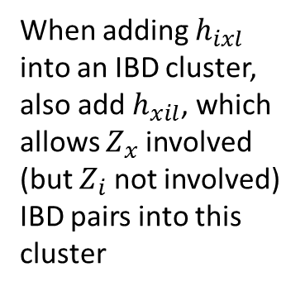
10.03
When adding $h_{ixl}$ into an IBD cluster, also add $h_{xil}$, which allows $Z_{x}$ involved (but $Z_{i}$ not involved) IBD pairs into this cluster
When adding $h_{ixl}$ into an IBD cluster, not add $h_{xil}$
Notes:
Search every possible triplet for IBD trios
Left: first run: pv=10.03, at 3969, 20 cases, 8 controls; 138,324,131,130,306,335,143,166,149,285,152,160,330,158,309,320,329,163,119,328,605,929,1053,397,736,402,731,622
Right: rerun (fix a bug, null distribution of share-share haps rebuilt); data lost
I observed similar differences in these two strategies, i.e., adding flipped haplotypes or not. Basically, adding flipped haplotypes get you a clearer view, i.e., with much background noise filtered out. However, the Fisher’s exact test top result (cluster with the smallest pv) is more significant when not adding flipped haplotypes.

