Slide 1
Sequence structure
R1
R2
mRNA
Barcode (8bp)
R1 Primer (+ TSO)
UMI (8bp)
R2 Primer
R2:
Barcode (8BP)
+
UMI (8bp)
+
PolyA + （mRNA）
R1:
( TSO + )
mRNA
( + PolyA )

Slide 2
New pipeline
1
UMItools: Barcode+UMI extraction
2
QC
3
STAR: mapping
4
Subread featurecounts: quantification
5
UMItools: expression matrix organizaion
Libraries based (including multiple cells)

Slide 3
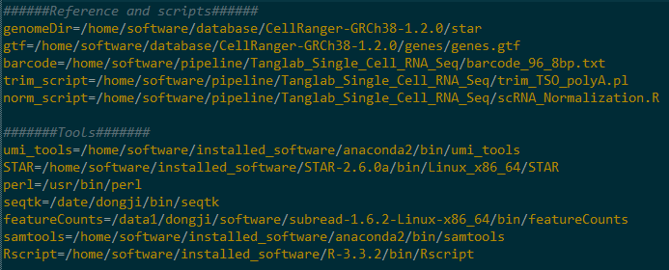
New pipeline preparation based on your own paths
scRNA_all_in_one_hg38/mm10.sh
1. STAR index (I used the Ensemble GRCh38), not provided
2.Barcode, provided
3. Trim script, provided
4. Normalize the expression, provided
5. Needed softwares

Slide 4
Based on your own paths

Slide 5
New pipeline summary
######Step1 Extract Barcode and UMI######
~12h,1g,1cpu
######Step2 Trim TSO and PolyA######
######Step3 Mapping With STAR######
~2h,28g,4cpu
######Step4 Add feature using featureCounts of subread#######
#######Step5 sort and index bam file######
~4h,1g,1cpu
######Step6 get umi count table######
<1min,1g,1cpu
#######Step7 Normalization umi count table######

Slide 6
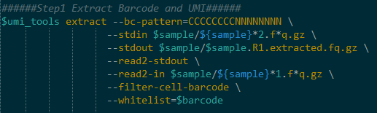
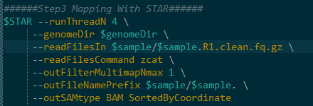

New pipeline

Slide 7
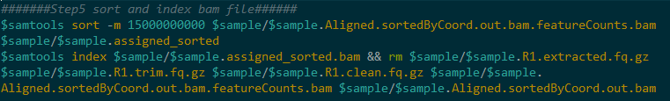

New pipeline

Slide 8
Run new pipeline
Include 1-96 cells
nohup sh scRNA_all_in_one_hg38.sh F_10_embryo1 &

Slide 9
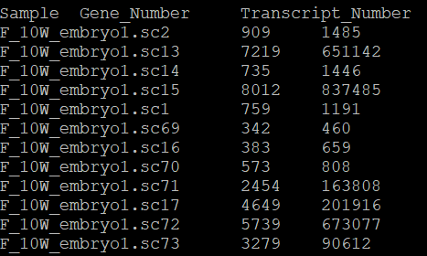

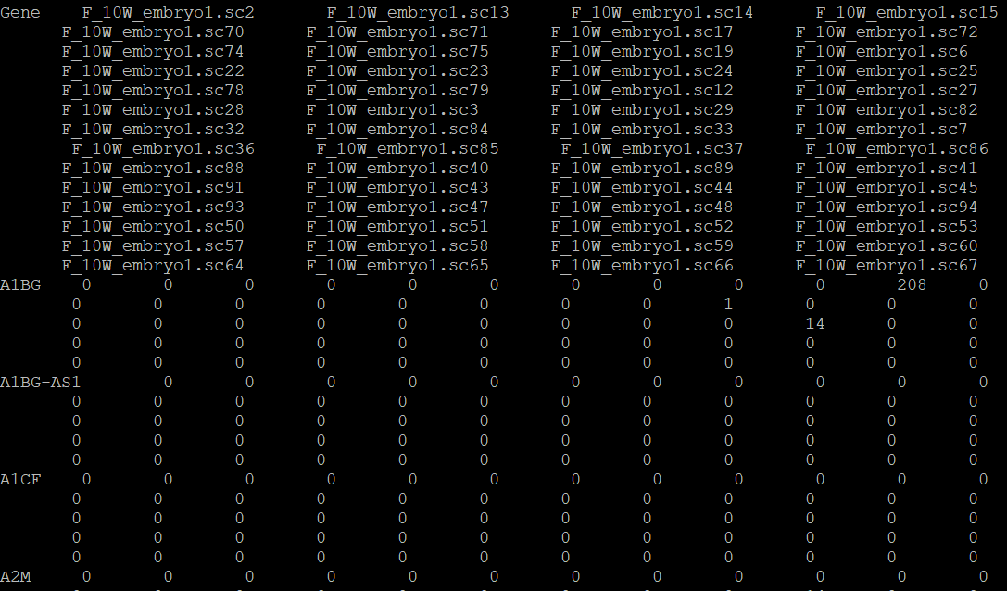
New pipeline results
Summary of genes and UMIs
UMI counts matrix

