Slide 1
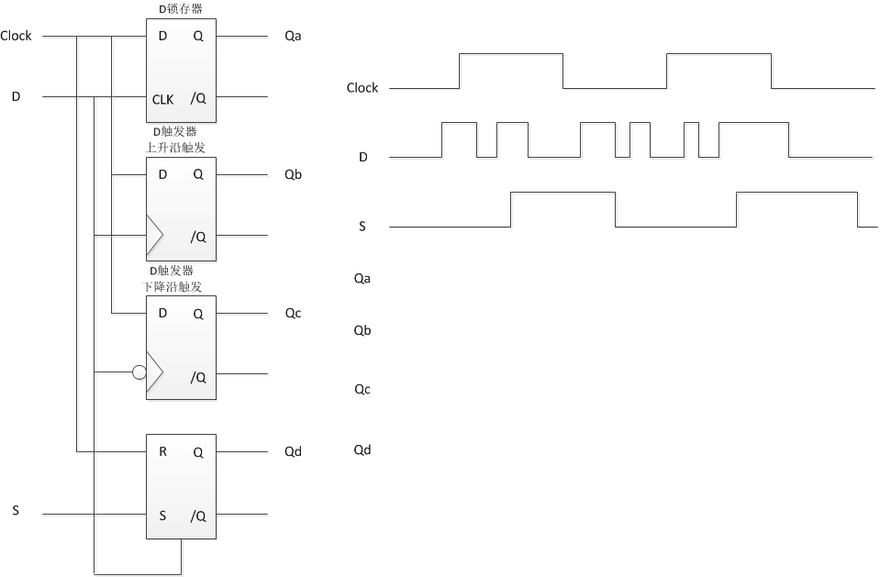
实验4_5
lab4: 1-1、2-1、3-2仿真代码及仿真截图——6分
lab5: 2-2对RS锁存器、D锁存器、D触发器（上升沿触发及下降沿触发两种）进行仿真，检查仿真代码及仿真截图——4分
本次实验结束后一周内提交一份实验报告

Slide 2
代码示例——Task
module EXAMPLE (A, B, CIN, S, COUT); input [3:0] A, B; input CIN; output [3:0] S; output COUT; reg [3:0] S; reg COUT; reg [1:0] S0, S1, S2, S3; always @(A or B or CIN) begin ADD (A[0], B[0], CIN, S0); ADD (A[1], B[1], S0[1], S1); ADD (A[2], B[2], S1[1], S2); ADD (A[3], B[3], S2[1], S3); S = {S3[0], S2[0], S1[0], S0[0]}; COUT = S3[1]; end
task ADD; input A, B, CIN; output [1:0] C; reg [1:0] C; reg S, COUT; begin
S = A ^ B ^ CIN; COUT = (A&B) | (A&CIN) | (B&CIN); C = {COUT, S}; end endtask endmodule

Slide 3
代码示例——Function
module EXAMPLE (A, B, CIN, S, COUT); input [3:0] A, B; input CIN; output [3:0] S; output COUT; reg [3:0] S; reg COUT; reg [1:0] S0, S1, S2, S3; assign S0 = ADD (A[0], B[0], CIN),
assign S1 = ADD (A[1], B[1], S0[1]),
assign S2 = ADD (A[2], B[2], S1[1]),
assign S3 = ADD (A[3], B[3], S2[1]),
assign S = {S3[0], S2[0], S1[0], S0[0]},
assign COUT = S3[1];
function signed [1:0] ADD;
input A, B, CIN;
reg S, COUT;
begin
S = A ^ B ^ CIN;
COUT = (A&B) | (A&CIN) | (B&CIN);
ADD = {COUT, S};
end
endfunction
endmodule

Slide 4
代码示例-D锁存器
module D_latch_behavior (input D, input Enable, output Q, output Qbar);
always @ (D or Enable)
if(Enable)
begin
Q <= D;
Qbar <= ~D;
end
endmodule

Slide 5
代码示例-D触发器
module D_ff_behavior (
input D,
input Clk,
output reg Q
);
always @ (posedge Clk)
//posedge表示上升沿，下降沿用negedge
if(Clk)
begin
Q <= D;
end
endmodule

